Slide 1
«Програмування та підтримка веб-застосувань»
Львівський національний університет імені Івана Франка
факультет прикладної математики та інформатики
кафедра Інформаційних систем
Static Web Site
Вовк Олександр Володимирович
vovk@windowslive.com
2019

Slide 2
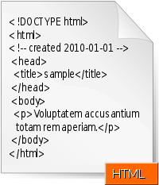
Hypertext Markup Language (HTML) is the standard markup language for creating web pages and web applications
HTML documents are delivered as "documents". These are then parsed into the Document Object Model (DOM) internal representation, within the web browser.
Presentation by the web browser, such as screen rendering or access by JavaScript, is then performed on this internal model, not the original document.
"Elements" and "tags" are terms that are widely confused. HTML documents contain tags, but do not contain the elements. The elements are only generated after the parsing step, from these tags.
As HTML is based on SGML. The Standard Generalized Markup Language (SGML) is a standard for defining generalized markup languages for documents. https://en.wikipedia.org/wiki/Standard_Generalized_Markup_Language
HTML5 abandons any attempt to define HTML as an SGML application, explicitly defining its own parsing rules, which more closely match existing implementations and documents. https://www.w3.org/TR/html5/syntax.html (W3C).
The World Wide Web Consortium (W3C) is the main international standards organization for the World Wide Web (abbreviated WWW or W3). Founded and currently led by Tim Berners-Lee, the consortium is made up of member organizations which maintain full-time staff for the purpose of working together in the development of standards for the World Wide Web. As of 26 July 2017, the World Wide Web Consortium (W3C) has 476 members
Notes:
http://handbook.imarc.com/strategy

Slide 3
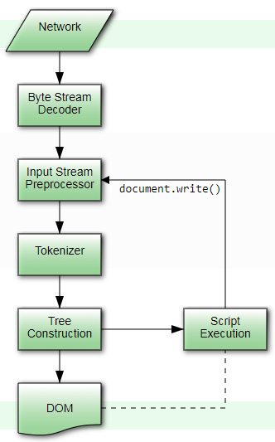
Overview of the HTML parsing model
https://www.w3.org/TR/html5/syntax.html
User agents must use the parsing rules to generate the DOM trees from text/html resources.
Together, these rules define what is referred to as the HTML parser.
The input to the HTML parsing process consists of a stream of Unicode code points, which is passed through a tokenization stage followed by a tree construction stage.
The output is a Document object.
In the common case, the data handled by the tokenization stage comes from the network, but it can also come from script running in the user agent, e.g. using the document.write() API.

Slide 4
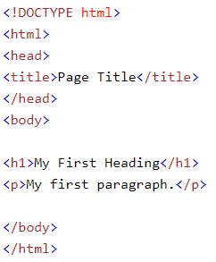
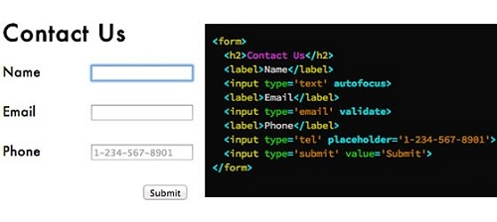
HTML examples
Tutorials: https://www.w3schools.com/html
The <!DOCTYPE html> declaration defines this document to be HTML5
The <html> element is the root element of an HTML page
The <head> element contains meta information about the document
The <title> element specifies a title for the document
The <body> element contains the visible page content
The <h1> element defines a large heading
The <p> element defines a paragraph

Slide 5
HTML5 vs HTML4: General Differences
1. Simplified and Clear Syntax
The syntax in HTML5 is simple as compared to HTML4. One example of this is the DOCTYPE element. In HTML4 the DOCTYPE declaration was too messy and lengthy and used to refer an external source.
2. Multimedia Elements
HTML5 supports integrated multimedia files into web page via video and audio tags. Previously, in HTML4, the multimedia content was integrated in web pages via third party plugins such as Silverlight and flash.
3. Accessing User Geographical location
Previously in HTML4, it was an difficult task to get the geographical locations of the visitors. It was even difficult when the website was accessed through mobile devices. On the other hand, in HTML5 is easy to get the user location (HTML5’s JS GeoLocation)
4. Client Side storage
In HTML4, in order to store important data on client side, limited browser’s cache was used. In HTML5, this issue has been addressed via application cache that can be access via HTML5’s JavaScript interface.
5. Client Server Communication
In HTML4 the communication between the client and server was done through streaming and long polling, since there are no web sockets available in HTML4. On the contrary, HTML5 contains web sockets that allow full duplex communication between clients and servers.
6. JavaScript Threading Mechanism
In HTML4, JavaScript and the browser interface with which user interacts, run in the same thread. HTML5 contains JS Web Worker API which allows JavaScript and Browser interface to run in separate threads.
7. Browser Compatibility
HTML4 is an established standard for developing browser applications and has been in use for more than 10 years. On the other hand, HTML5 is still in the process of evolution and the currently available tags are being modified and also new tags are being added. Therefore, HTML5 lags behind HTML4 in terms of compatibility with the browsers.
Notes:
https://www.webcodegeeks.com/html5/top-10-major-advantages-html5/

Slide 6
Tag Differences in HTML4 and HTML5
https://www.webcodegeeks.com/html5/top-10-major-advantages-html5
1. <Applet> removed and <Object> Added in HTML5
HTML4 contained an <applet> tag that was used for displaying applets in a web browser. However, in HTML5, this applet tag has been removed (for applet items, a new tag has been introduced in HTML5)
2. <Acronym> removed and <Abbr> Added in HTML5
HTML4 contained an <acronym> tag that was used for displaying abbreviation’s in a web browser. However, in HTML5, this tag has been replaced by the new tag.
3. Difference in usage of <hr> tag
The <hr> tag was used to draw a line in HTML4 however in HTML5, the functionality of this tag has been changed and it is used for defining a thematic break in the web page.
4. Difference in usage of <a> tag
In HTML4 and previous versions, the <a> tag was used as anchor as well as for referring to a link. In the HTML5, the <a> tag is used only as a hyperlink. But if the href tag is removed from the <a> tag, the <a> tag can be used as a place holder for other hyperlinks.
5. Schema attribute removed from <meta> tag in HTML5
The tag is defined in the header section of the HTML document and contains information about the data. In the previous versions of HTML, including the HTML4, this tag used to contain an attribute called schema that defined the schema of the document. However, in HTML5, this tag has been removed.
Notes:
https://www.webcodegeeks.com/html5/top-10-major-advantages-html5/

Slide 7
What is CSS
https://www.tutorialrepublic.com/css-tutorial/css-introduction.php
CSS is the key presentational technology that is used in website design.
Prior to CSS, nearly all of the presentational attributes of HTML documents were contained within the HTML markup; all font colors, background styles, element alignments, borders and sizes had to be explicitly described, within the HTML.
As a result of, development of large web sites, where fonts and color information were repeatedly added to every single page, became a long and expensive process.
CSS solve these problems, by allowing web designers to move much of that formatting information to a separate style sheet resulting in considerably simpler HTML markup. CSS has much wider presentation capabilities than HTML.
CSS enable multiple pages to share formatting, and reduce complexity and repetition in the structural content. It significantly reduces the file transfer size, which results in a faster page loading.
Multiple Device Compatibility — CSS can also allow the HTML document to be optimized for more than one type of device or media. Using CSS the same HTML document can be presented in different viewing styles for different rendering devices such as computer screen, cell phones, printer, etc.
Notes:
https://www.tutorialrepublic.com/css-tutorial/css-syntax.php

Slide 8
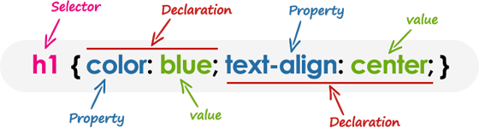
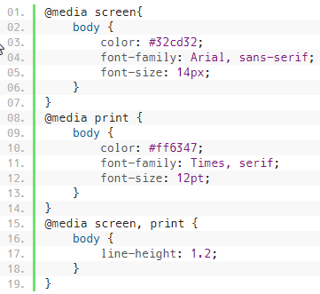
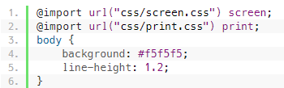

Introduction to Media Types
https://www.tutorialrepublic.com/css-tutorial/css-media-types.php
One of the most important features of style sheets is that, you can specify separate style sheets for different media types
Method 1: The @media rule is used to define different style rules for different media types in a single style sheet
Method 2: Using the @import At-rules:
Method 3: Using the <link> element:
Notes:
https://www.tutorialrepublic.com/css-tutorial/css-media-types.php

Slide 9
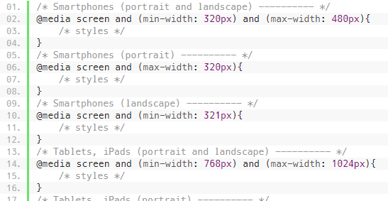
Media Types | Description
all | Used for all media type devices.
aural | Used for speech and sound synthesizers.
braille | Used for braille tactile feedback devices.
embossed | Used for paged braille printers.
handheld | Used for small or handheld devices (mobile phones or PDAs).
print | Used for printers.
projection | Used for projected presentations, for example projectors.
screen | Used primarily for color computer screens.
tty | Used for media using a fixed-pitch character grid (teletypes, terminals).
tv | Used for television-type devices — low resolution, color, limited-scrollability screens.
CSS3 media queries enable you to format your documents to be presented correctly on different size of output devices.
Notes:
http://handbook.imarc.com/strategy

Slide 10
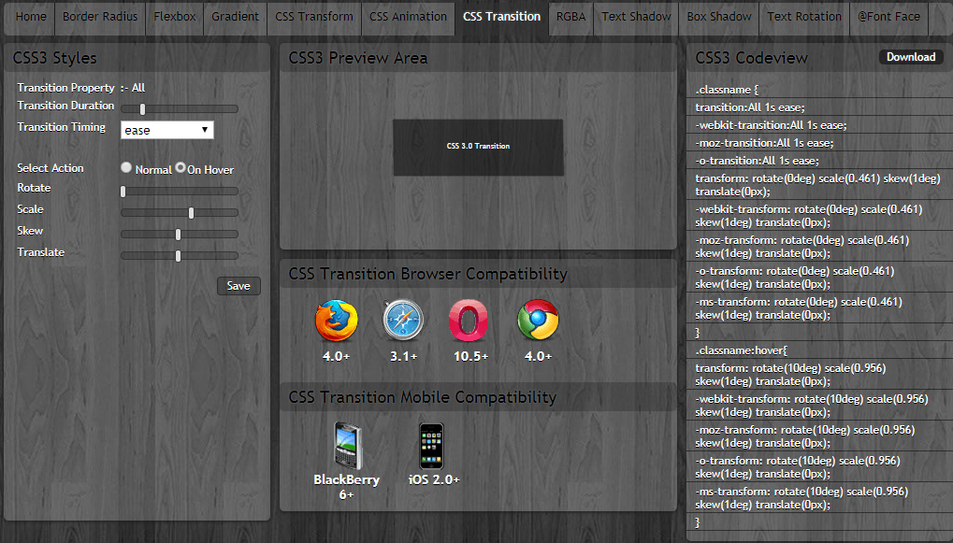
CSS3 Test Example
http://www.css3maker.com
Notes:
http://handbook.imarc.com/strategy

Slide 11
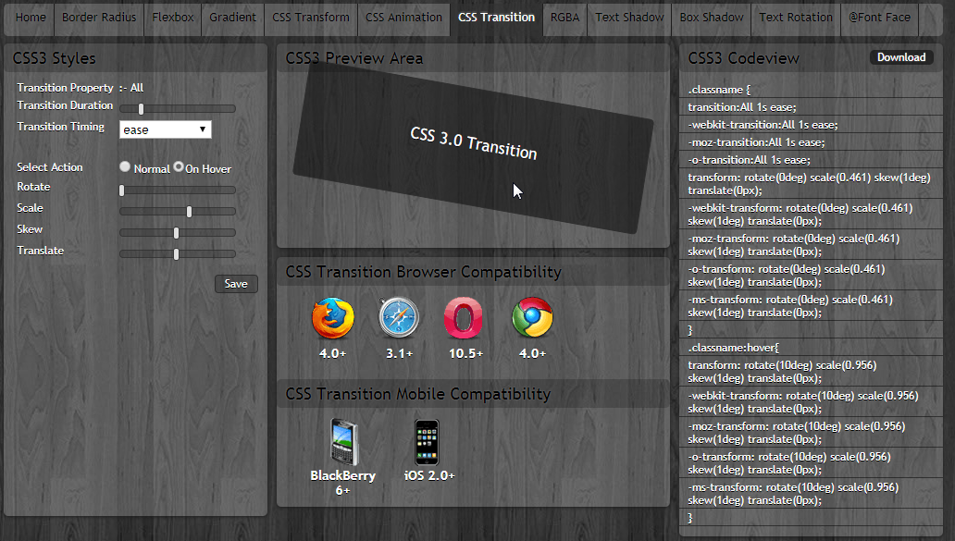
CSS3 Test Example
http://www.css3maker.com
Notes:
http://handbook.imarc.com/strategy

Slide 12

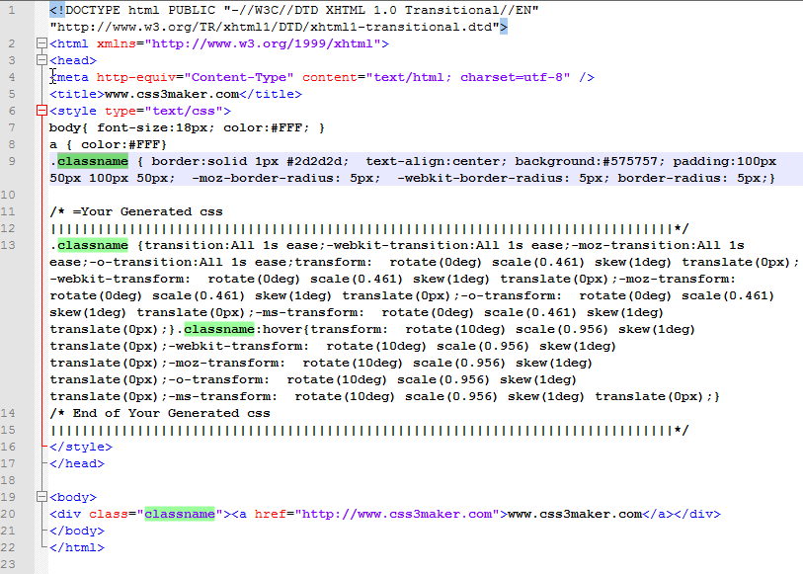
Edit css3maker.html
Preview
Notes:
http://handbook.imarc.com/strategy

Slide 13
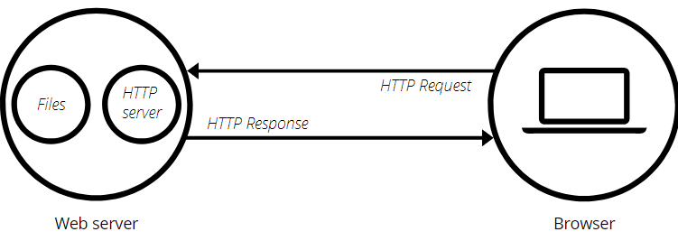
Web server
A web server is a computer system that processes requests via HTTP, the basic network protocol used to distribute information on the World Wide Web.
On the hardware side, a web server is a computer that stores a website's component files (e.g. HTML documents, images, CSS stylesheets, and JavaScript files) and delivers them to the end-user's device. It is connected to the Internet and can be accessed through a domain name like mozilla.org.
On the software side, a web server includes several parts that control how web users access hosted files, at minimum an HTTP server. An HTTP server is a piece of software that understands URLs (web addresses) and HTTP (the protocol your browser uses to view webpages).
The primary function of a web server is to store, process and deliver web pages to clients. The communication between client and server takes place using the Hypertext Transfer Protocol (HTTP).
Notes:
https://developer.mozilla.org/en-US/docs/Learn/Common_questions/What_is_a_web_server

Slide 14
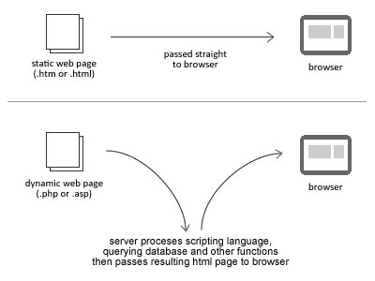
Web server
A static web server, or stack, consists of a computer (hardware) with an HTTP server (software). We call it "static" because the server sends its hosted files "as-is" to your browser.
A dynamic web server consists of a static web server plus extra software, most commonly an application server and a database. We call it "dynamic" because the application server updates the hosted files before sending them to your browser via the HTTP server.
For example, to produce the final webpages you see in the browser, the application server might fill an HTML template with contents from a database. Sites like MDN or Wikipedia have many thousands of webpages, but they aren't real HTML documents, only a few HTML templates and a giant database. This setup makes it easier and quicker to maintain and deliver the content.

Slide 15
To fetch a webpage, browser sends a request to the web server, which proceeds to search for the requested file in its own storage space.
On finding the file, the server reads it, processes it as needed, and sends it to the browser.
Hosting files
A web server first has to store the website's files, namely all HTML documents and their related assets, including images, CSS stylesheets, JavaScript files, fonts, and videos.
Technically, you could host all those files on your own computer, but it's far more convenient to store them all on a dedicated web server that
is always up and running and connected to the Internet
has the same IP address all the time (not all ISPs provide a fixed IP for home lines)
is maintained by a third-party provider
Communicating through HTTP
Second, a web server provides support for HTTP which is:
Textual. All commands are plain-text and human-readable.
Stateless. Neither the server nor the client remember previous communications. For example, relying on HTTP alone, a server cannot remember a password you typed or what step you're on in a transaction. You need an application server for tasks like that
Only clients can make HTTP requests, and then only to servers. Servers can only respond.
When requesting a file via HTTP, clients must provide the file's URL.
The web server must answer every HTTP request, at least with an error message.
Static websites are the easiest to set up, so we start from a static site.
Notes:
https://developer.mozilla.org/en-US/docs/Learn/Common_questions/What_is_a_web_server

Slide 16
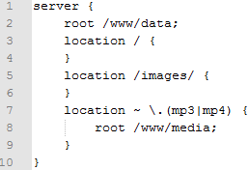

Nginx web server for serving static content
The root directive specifies the root directory that will be used to search for a file.
NGINX searches for a URI that starts with /images/ in the /www/data/images/ directory on the file system.
But if the URI ends with the .mp3 or .mp4 extension, NGINX instead searches for the file in the /www/media/ directory because it is defined in the matching location block.
Optimizing NGINX Speed for Serving Content
Enabling sendfile. By default, NGINX handles file transmission itself and copies the file into the buffer before sending it. Enabling the sendfile directive will eliminate the step of copying the data into the buffer and enables direct copying data from one file descriptor to another.
Alternatively, to prevent one fast connection to entirely occupy the worker process, you can limit the amount of data transferred in a single sendfile() call by defining the sendfile_max_chunk directive.
Notes:
https://www.nginx.com/resources/admin-guide/serving-static-content/

Slide 17
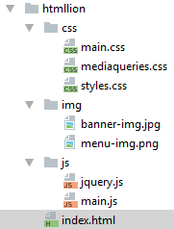
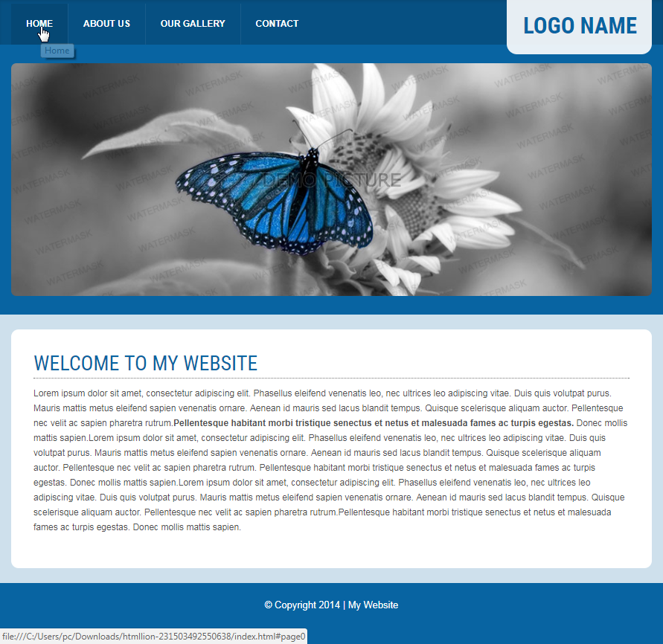

Lets look at the simple example of web site
Open root

Slide 18
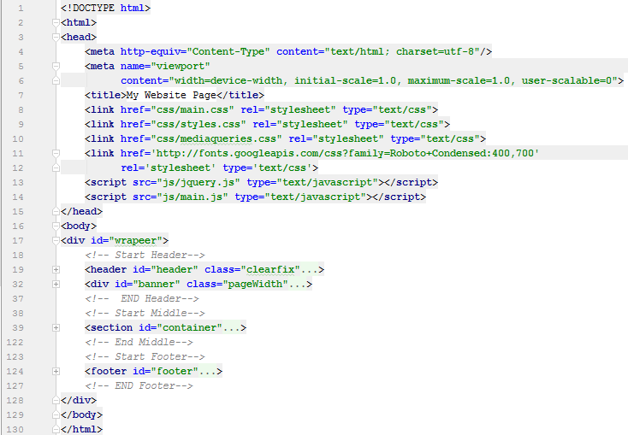
Edit index.html

Slide 19
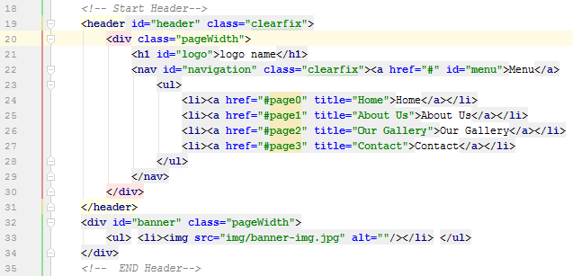
Edit index.html

Slide 20
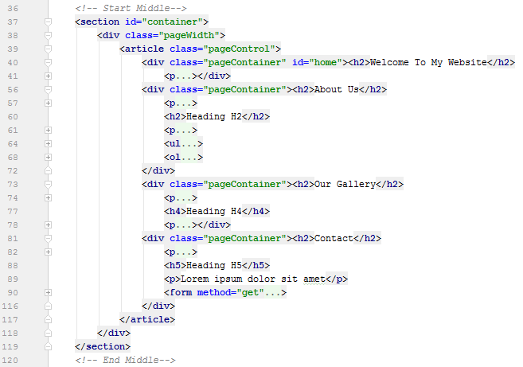
Edit index.html

Slide 21
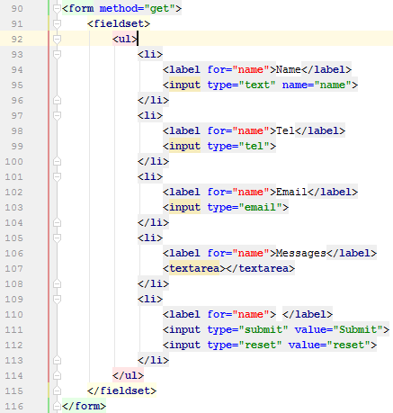

Edit index.html

Slide 22
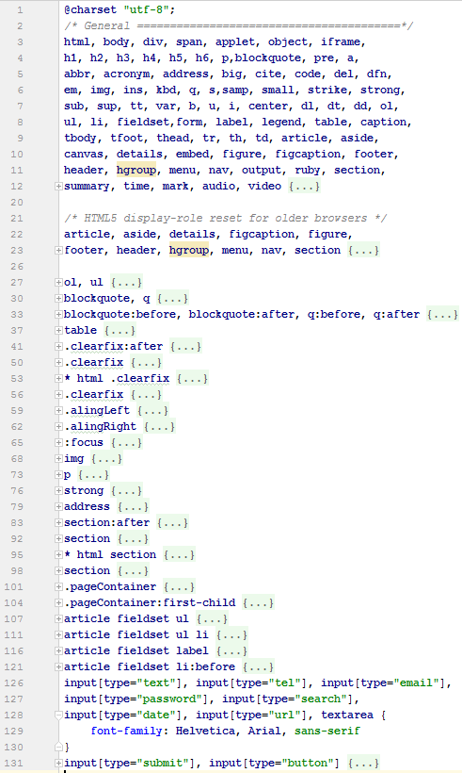
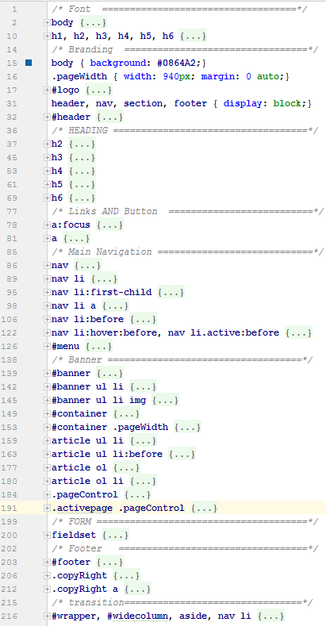
Edit
main.css
Edit
styles.css
Notes:
The HTTP protocol provides several ways to perform a request; HTML form data can be transmitted via a number of different ones, the most common of which are the GET method and the POST method.
To understand the difference between those two methods, let's step back and examine how HTTP works. Each time you want to reach a resource on the Web, the browser sends a request to a URL. An HTTP request consists of two parts: a header that contains a set of global metadata about the browser's capabilities, and a body that can contain information necessary for the server to process the specific request.

Slide 23
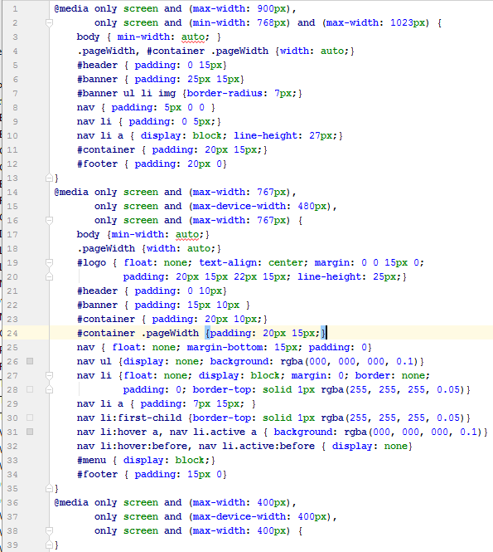
Edit css/mediaqueries.css
Notes:
The HTTP protocol provides several ways to perform a request; HTML form data can be transmitted via a number of different ones, the most common of which are the GET method and the POST method.
To understand the difference between those two methods, let's step back and examine how HTTP works. Each time you want to reach a resource on the Web, the browser sends a request to a URL. An HTTP request consists of two parts: a header that contains a set of global metadata about the browser's capabilities, and a body that can contain information necessary for the server to process the specific request.

Slide 24
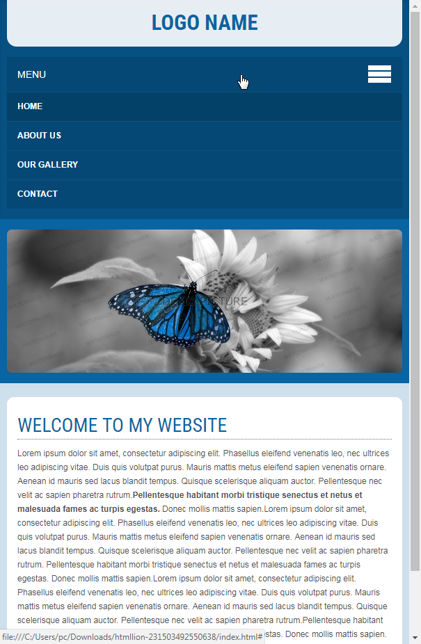
mediaqueries.css
Style depends on window width
Notes:
The HTTP protocol provides several ways to perform a request; HTML form data can be transmitted via a number of different ones, the most common of which are the GET method and the POST method.
To understand the difference between those two methods, let's step back and examine how HTTP works. Each time you want to reach a resource on the Web, the browser sends a request to a URL. An HTTP request consists of two parts: a header that contains a set of global metadata about the browser's capabilities, and a body that can contain information necessary for the server to process the specific request.

Slide 25
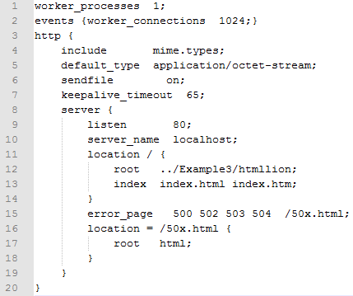

Deploy web site on nginx server
Edit nginx.conf
Run Nginx Web Server for test
Open http://localhost:80
Notes:
The HTTP protocol provides several ways to perform a request; HTML form data can be transmitted via a number of different ones, the most common of which are the GET method and the POST method.
To understand the difference between those two methods, let's step back and examine how HTTP works. Each time you want to reach a resource on the Web, the browser sends a request to a URL. An HTTP request consists of two parts: a header that contains a set of global metadata about the browser's capabilities, and a body that can contain information necessary for the server to process the specific request.

Slide 26
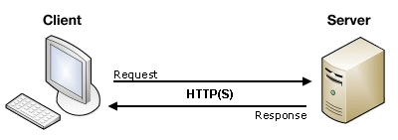
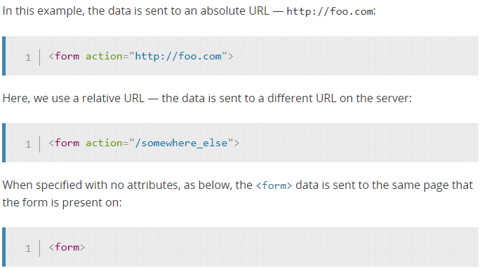
What happens when a user submits a data?
https://developer.mozilla.org/en-US/docs/Learn/HTML/Forms/Sending_and_retrieving_form_data
The <form> element defines how the data will be sent.
The action attribute defines where the data gets sent. Its value must be a valid URL. If this attribute isn't provided, the data will be sent to the URL of the page containing the form.
The method attribute defines how data is sent.
Notes:
https://developer.mozilla.org/en-US/docs/Learn/HTML/Forms/Sending_and_retrieving_form_data

Slide 27
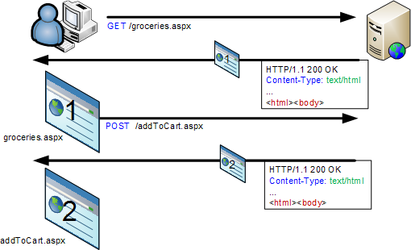
Each time a user enters some data and submits a form, the browser makes a call to the server so that it can perform some operation or calculation.
The results of that call are rendered in HTML and displayed as a new page:

Slide 28
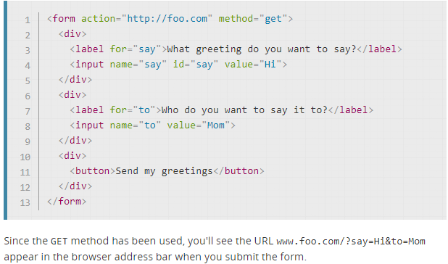
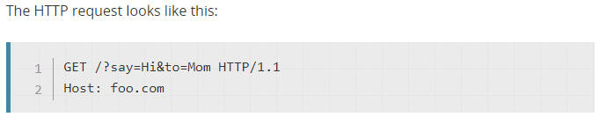
The GET method is the method used by the browser to ask the server to send back a given resource: "Hey server, I want to get this resource." In this case, the browser sends an empty body. Because the body is empty, if a form is sent using this method the data sent to the server is appended to the URL.
Edit html
Open html
Edit tcp
server
Start tcp
server
Notes:
The HTTP protocol provides several ways to perform a request; HTML form data can be transmitted via a number of different ones, the most common of which are the GET method and the POST method.
To understand the difference between those two methods, let's step back and examine how HTTP works. Each time you want to reach a resource on the Web, the browser sends a request to a URL. An HTTP request consists of two parts: a header that contains a set of global metadata about the browser's capabilities, and a body that can contain information necessary for the server to process the specific request.

Slide 29
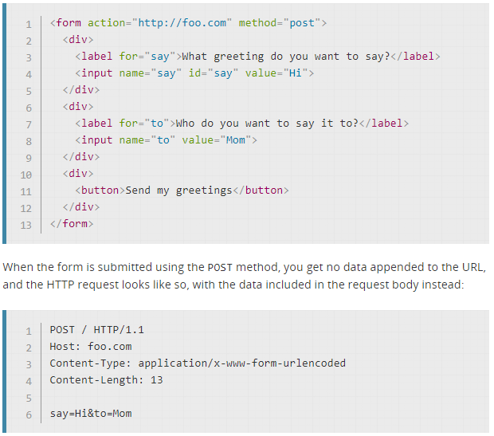
The POST method is a little different. It's the method the browser uses to talk to the server when asking for a response that takes into account the data provided in the body of the HTTP request: "Hey server, take a look at this data and send me back an appropriate result." If a form is sent using this method, the data is appended to the body of the HTTP request.
Edit html
Open html
Edit tcp
server
Start tcp
server
Notes:
The HTTP protocol provides several ways to perform a request; HTML form data can be transmitted via a number of different ones, the most common of which are the GET method and the POST method.
To understand the difference between those two methods, let's step back and examine how HTTP works. Each time you want to reach a resource on the Web, the browser sends a request to a URL. An HTTP request consists of two parts: a header that contains a set of global metadata about the browser's capabilities, and a body that can contain information necessary for the server to process the specific request.

Slide 30
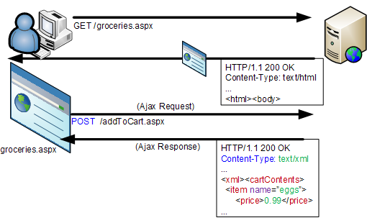
The use of AJAX allows JavaScript on a web page to issue HTTP requests to a server without ever leaving the page.
Interactive web applications can use this technique to update the web page without causing the distracting flicker that is seen when the browser loads a new page.

Slide 31
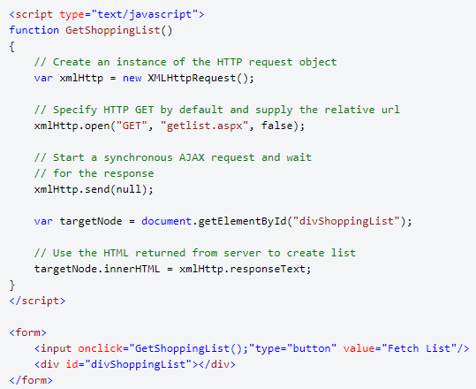
The core functionality of AJAX is implemented in the XmlHttpRequest object that is now incorporated in most modern browsers.
The sample code, shown below, makes a call to the web server to obtain the data to display in a list box.
The response data is in HTML format for the sake of simplicity because it allows the text returned from the server to be applied directly to the <div> tag.

Slide 32
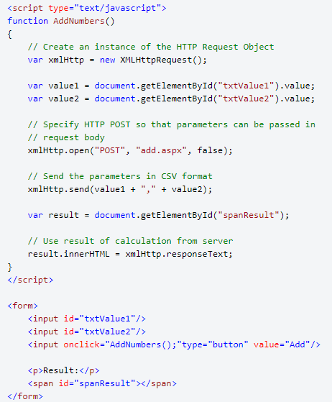
Sending Parameters with AJAX
AJAX is often styled as an RPC mechanism in which some kind of parameter list is constructed for a server-side call and the results are returned in a convenient format such as XML, CSV or JSON.
The code below shows how two numeric parameters can be passed to a server using a simple comma delimited format. The encoded parameters are supplied as a string parameter to the send method and become the payload of the resulting HTTP POST request message:

Slide 33
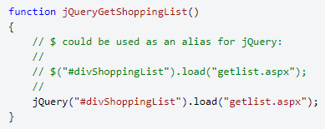
Sending Parameters with AJAX
Many developers use a library to handle the cross-browser issues and simplify what is essentially 'boilerplate' code. One of the most widely used is jQuery which provides AJAX support as well as many other features.
Almost any HTML element can be the target recipient of an AJAX request in jQuery. If our server returns HTML we can simply bind our <div> output tag directly as shown below:
For details see:
https://www.httpwatch.com/httpgallery/ajax/

Slide 34
Самостійне опрацювання:
Література та ресурси:

