Slide 1
«Програмування та підтримка веб-застосувань»
Львівський національний університет імені Івана Франка
факультет прикладної математики та інформатики
кафедра Інформаційних систем
Web Socket and Secure Web Socket.
Вовк Олександр Володимирович
vovk@windowslive.com
2021

Slide 2

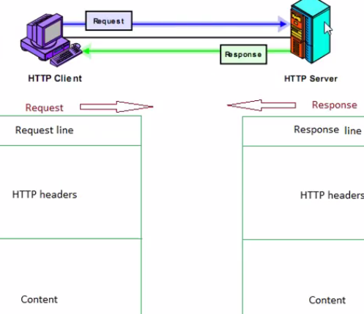
An Introduction to WebSockets
http://blog.teamtreehouse.com/an-introduction-to-websockets
https://uk.wikipedia.org/wiki/WebSocket
The introduction of AJAX around 2005 many people started to explore the possibilities of making connections between a client and server bidirectional.
Problem: HTTP request includes a bunch of headers and cookie data are transferred to the server. It increases latency.
www.youtube.com/watch?v=1eVj6nZoTcw

Slide 3
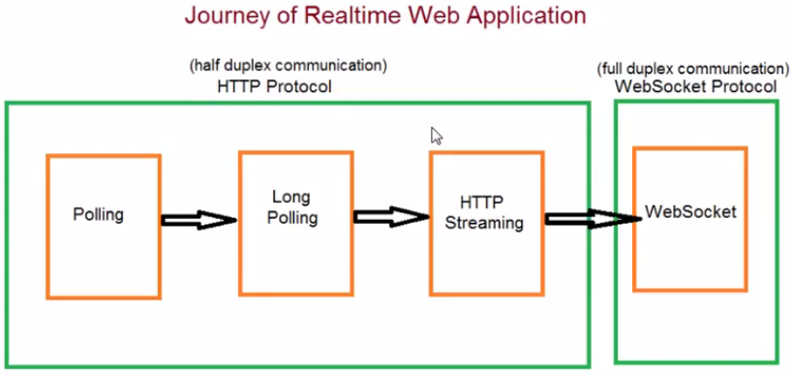
Common problem: client have to create new connection to inform server while current connection wait data from server
www.youtube.com/watch?v=1eVj6nZoTcw

Slide 4
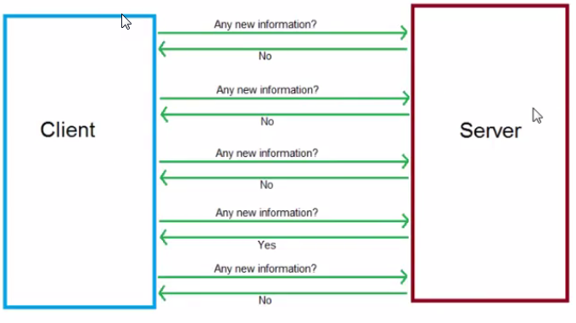
Polling
www.youtube.com/watch?v=1eVj6nZoTcw

Slide 5
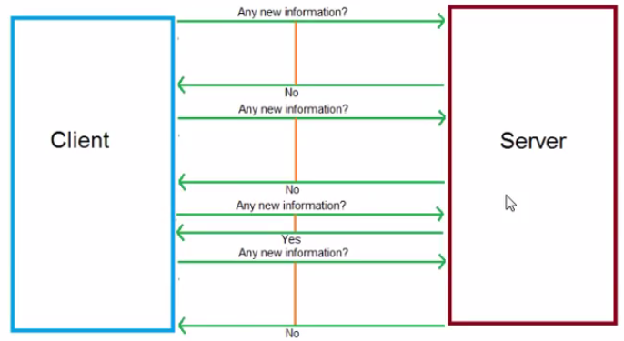
Long polling
This involves keeping an HTTP connection open until the server has some data to push down to the client.
www.youtube.com/watch?v=1eVj6nZoTcw

Slide 6
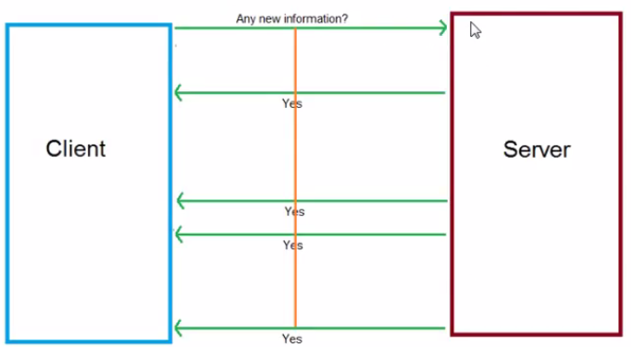
HTTP Streaming
www.youtube.com/watch?v=1eVj6nZoTcw

Slide 7
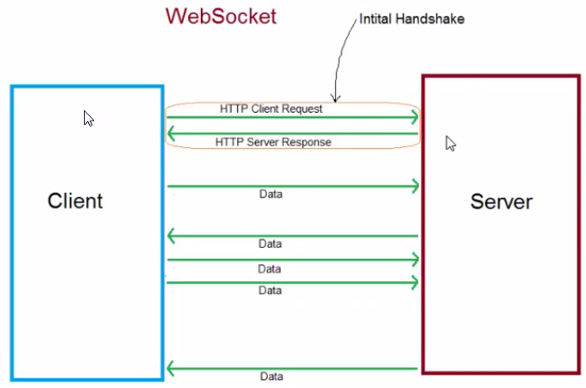
WebSocket is a computer communications protocol, providing full-duplex communication channels over a single TCP connection.
The WebSocket Protocol is an independent TCP-based protocol. Its only relationship to HTTP is that its handshake is interpreted by HTTP servers as an Upgrade request.
WebSocket is designed to be implemented in web browsers and web servers, but it can be used by any client or server application (e.g. desktop application)

Slide 8
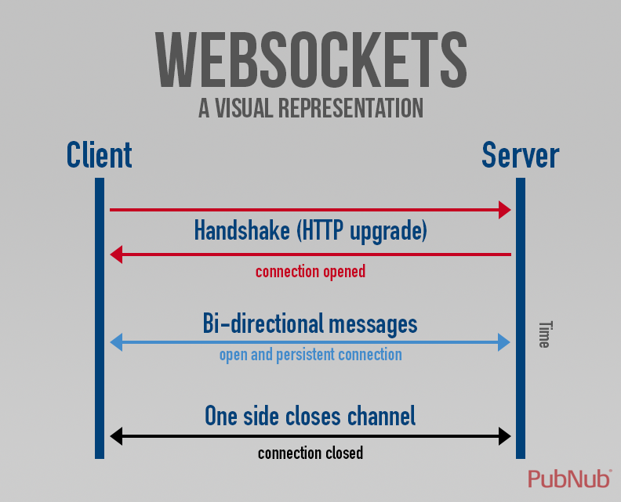
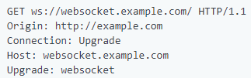

The WebSocket Protocol
RFC 6455:
tools.ietf.org/html/rfc6455
The client establishes a WebSocket connection through a process known as the WebSocket handshake. This process starts with the client sending a regular HTTP request to the server. An Upgrade header is included in this request that informs the server that the client wishes to establish a WebSocket connection.
If the server supports the WebSocket protocol, it agrees to the upgrade and communicates this through an Upgrade header in the response.

Slide 9
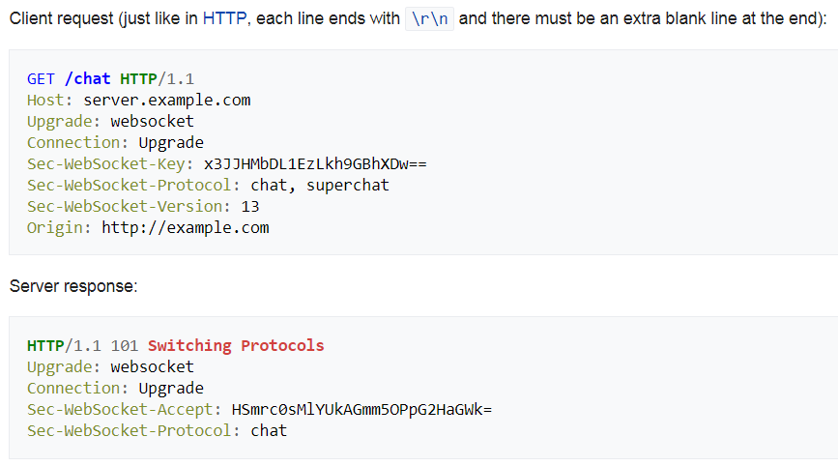
Handshake in details
Notes:
Front-end:
beletsky.net/2015/04/npm-for-everything.html
Browserify lets you require('modules') in the browser by bundling up all of your dependencies.
http://browserify.org/

Slide 10
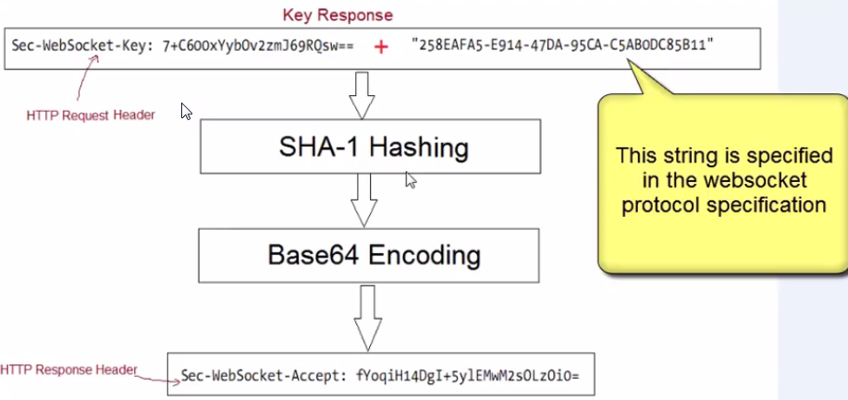
Handshake in details
Notes:
Front-end:
beletsky.net/2015/04/npm-for-everything.html
Browserify lets you require('modules') in the browser by bundling up all of your dependencies.
http://browserify.org/

Slide 11
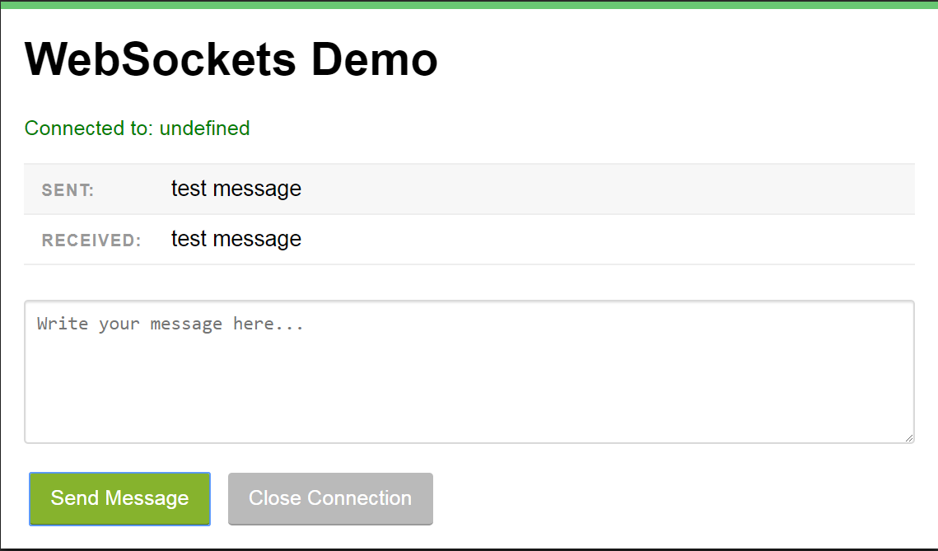
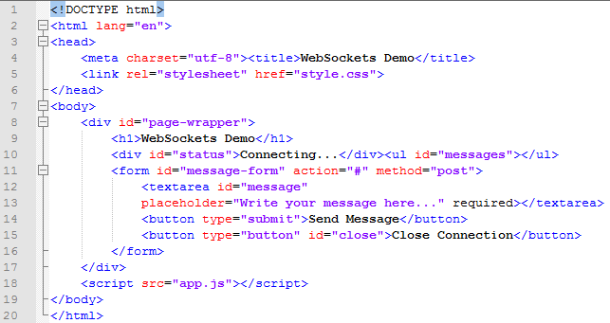


Test Web Socket Example
blog.teamtreehouse.com/an-introduction-to-websockets
Test: codepen.io/matt-west/full/tHlBb
Download: cl.ly/2m303J2H0P0g
Preview
Edit index.html
Open root

Slide 12
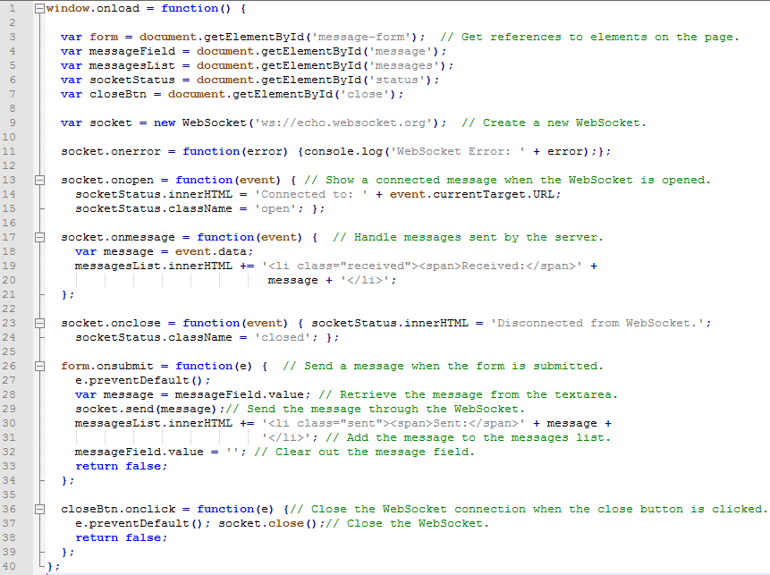
Edit app.js

Slide 13
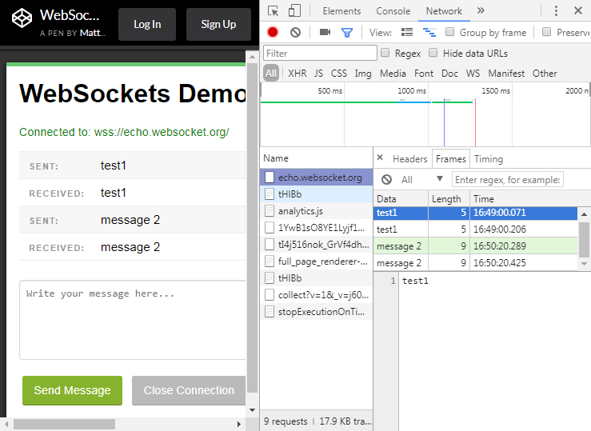
Preview

Slide 14
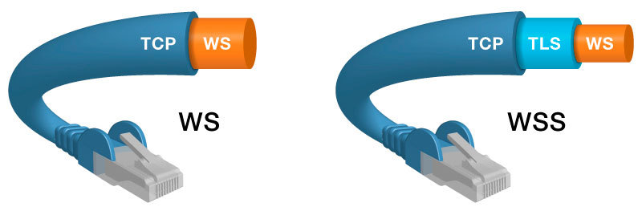
When the page is accessed through HTTP, you can use WS or WSS (WebSocket secure: WS over TLS) . However, when your page is loaded through HTTPS, you can only use WSS - browsers don't allow to "downgrade" security.
A secure version of the WebSocket protocol is implemented in Firefox 6, Safari 6, Google Chrome 14, Opera 12.10 and Internet Explorer 10
Notes:
Front-end:
beletsky.net/2015/04/npm-for-everything.html
Browserify lets you require('modules') in the browser by bundling up all of your dependencies.
http://browserify.org/

Slide 15
Web service echo.websocket.org can also support secure web socket
Edit app.js
wss://echo.websocket.org

Slide 16
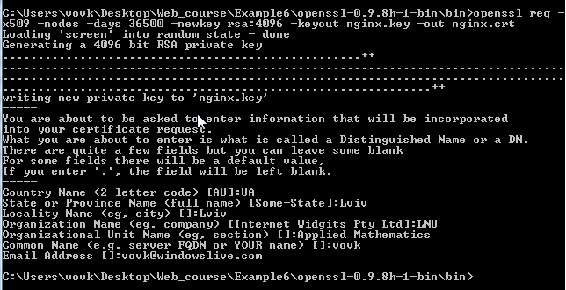
Generate ssl certificates:
https://www.htpcguides.com/generate-openssl-certificates-nginx-win-linux-mac/
Install: Win32 OpenSSL (for windows)
http://gnuwin32.sourceforge.net/packages/openssl.htm
Run command:
$ openssl req -x509 -nodes -days 36500 -newkey rsa:4096 -keyout nginx.key -out nginx.crt

Slide 17
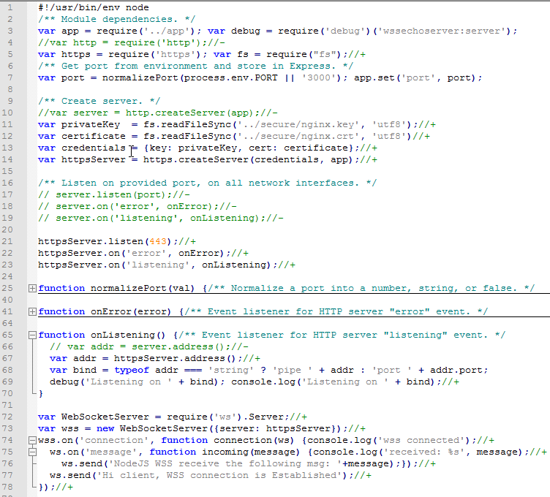

Edit WSSEchoServer/bin/www
Generate application template
$ express WSSEchoServer
$ npm install -d
Install Node.js WebSocket library
$ npm install --save ws

Slide 18
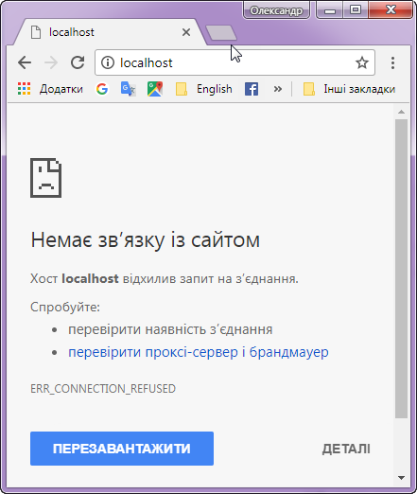
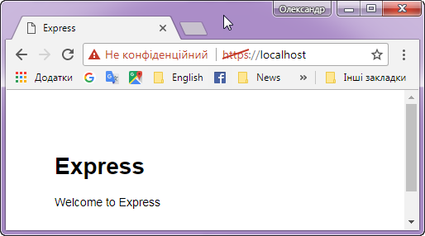

Test HTTP/HTTPS
Run Server
$ node www
Server Console Log:

Slide 19

Test Web Secure Socket
Run Server
We use previous wss client:
$ node www
Modify
Edit app.js
wss://localhost

Slide 20
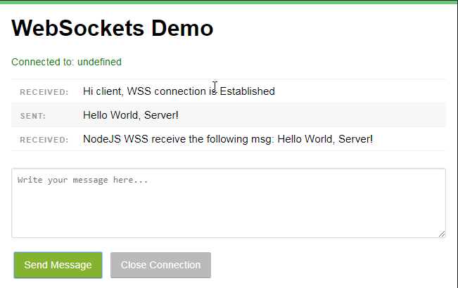

Preview
Server Console Log:

