Slide 1

«Програмування та підтримка веб-застосувань»
Львівський національний університет імені Івана Франка
факультет прикладної математики та інформатики
кафедра Інформаційних систем
JavaScript Classes and Modules
Client JavaScript
David Flanagan.
JavaScript. The Definitive Guide.
O'Reilly Media, 2011
2017

Slide 2
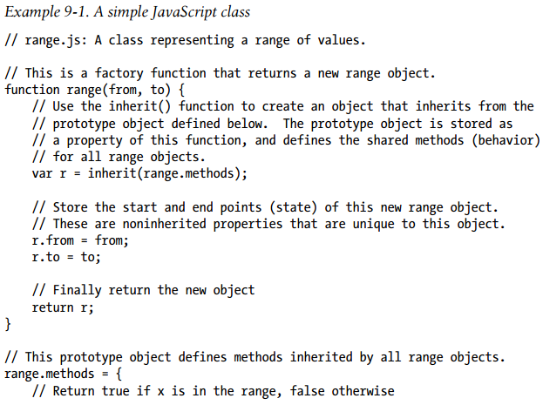
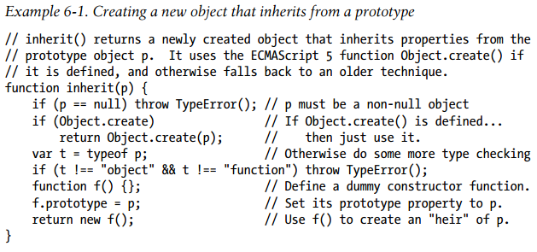
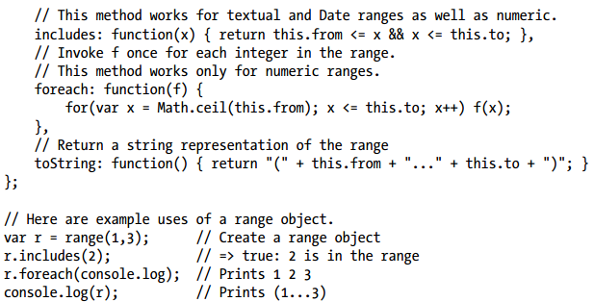
Classes and Prototypes
JavaScript class is a set of objects that inherit properties from the same prototype object

Slide 3
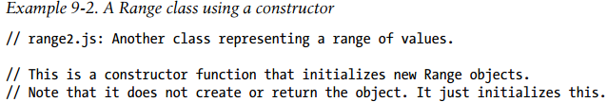
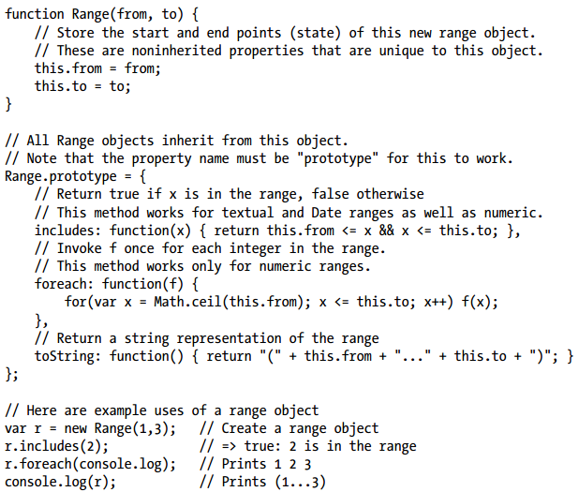
Classes and Constructors
Noting the differences between these two techniques for defining classes
Two objects are instances of the same class if and only if they inherit from the same prototype object. The constructor function that initializes the state of a new object is not fundamental: two constructor functions may have prototype properties that point to the same prototype object. Then both constructors can be used to create instances of the same class.

Slide 4

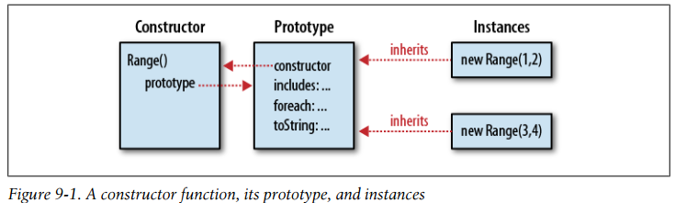
The constructor Property
Any JavaScript function can be used as a constructor, and constructor invocations need a prototype property. Therefore, every JavaScript function (except functions returned by the ECMAScript 5 Function.bind() method) automatically has a prototype property.
The value of this property is an object that has a single nonenumerable constructor property
Augmenting Classes
JavaScript’s prototype-based inheritance mechanism is dynamic: an object inherits properties from its prototype, even if the prototype changes after the object is created. This means that we can augment JavaScript classes simply by adding new methods to their prototype objects.

Slide 5
Classes and Types
Recall, JavaScript defines a small set of types: null, undefined, boolean, number, string, function, and object.
None of the techniques described above for determining the class of an object are problem-free, at least in client-side JavaScript.
An alternative is to sidestep the issue: instead of asking “what is the class of this object?” we ask instead, “what can this object do?”
This approach to programming is common in languages like Python and Ruby and is called duck-typing after this expression (often attributed to poet James Whitcomb Riley):
“When I see a bird that walks like a duck and swims like a duck and quacks like a duck, I call that bird a duck.”
Standard Conversion Methods
toString(), toLocaleString(), valueOf(), JSON.stringify(), JSON.parse()
If an object has a toJSON() method, JSON.stringify() does not serialize the object but instead calls toJSON() and serializes the value (either primitive or object) that it returns.
Comparison Methods
JavaScript equality operators compare objects by reference, not by value. If you define a class and want to be able to compare instances of that class, you should define appropriate methods to perform those comparisons
To enable instances of your class to be tested for equality, define an instance method named equals(). It should take a single argument and return true if that argument is equal to the object it is invoked on.
The compareTo() method should accept a single argument and compare it to the object on which the method is invoked. If the this object is less than the argument, compareTo() should return a value less than zero.

Slide 6
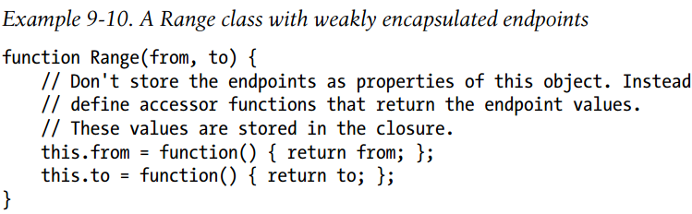
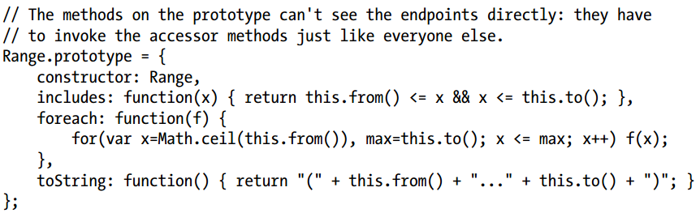
Borrowing Methods
A single function can even be used as a method of more than one class.
Most of the built-in methods of the Array class, for example, are defined generically, and if you define a class whose instances are array-like objects, you can copy functions from Array.prototype to the prototype object of your class.
If you view JavaScript through the lens of classical object-oriented languages, the use of methods of one class as methods of another class can be thought of as a form of multiple inheritance.
JavaScript is not a classical object-oriented language, however, and to describe this kind of method reuse we can use the informal term borrowing.
Private State
In classical object-oriented programming, it is often a goal to encapsulate or hide the state of an object within the object, allowing access to that state only through the methods of the object, and now allowing the important state variables to be read or written directly.
We can approximate private instance fields using variables (or arguments) captured in the closure of the constructor invocation that creates an instance. To do this, we define functions inside the constructor (so they have access to the constructor’s arguments and variables) and assign those functions to properties of the newly created object.
This new Range class defines methods for querying the endpoints of a range, but no methods or properties for setting those endpoints. This gives instances of this class a kind of immutability
But we can replace the methods from() and to()!

Slide 7
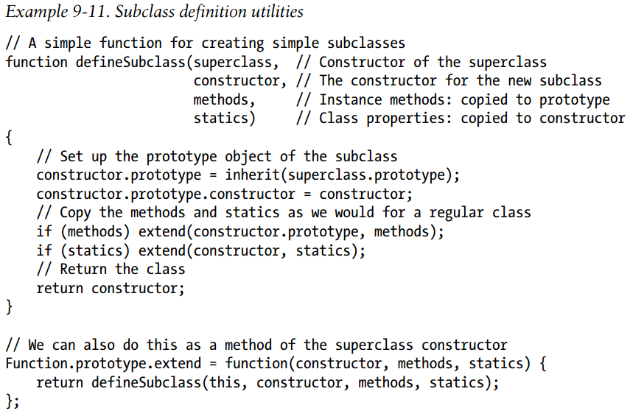
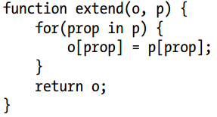
Subclasses
The key to creating subclasses in JavaScript is proper initialization of the prototype object. If class B extends A, then B.prototype must be an heir of A.prototype.

Slide 8
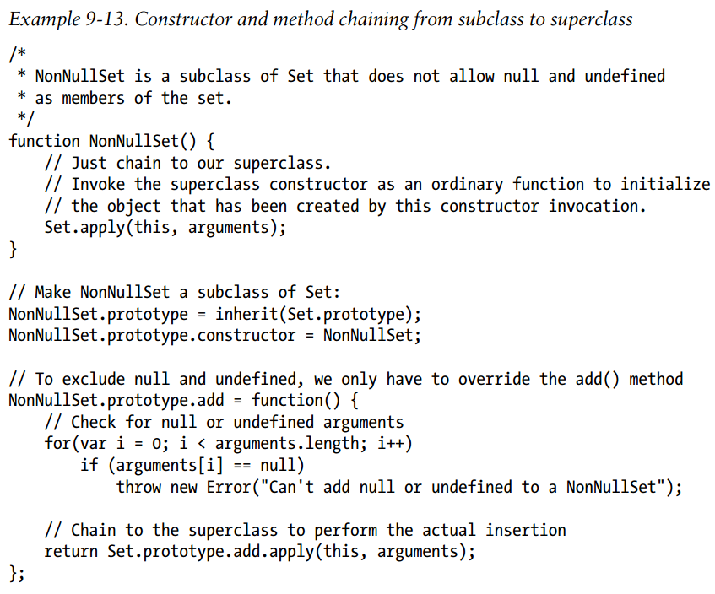
Constructor and Method Chaining
the constructor and methods of the subclass call or chain to the superclass constructor and the superclass methods

Slide 9
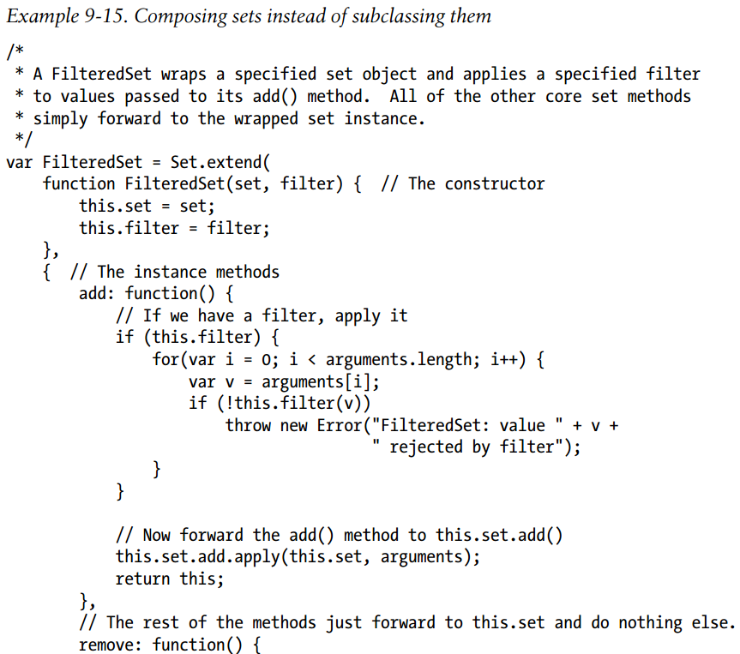
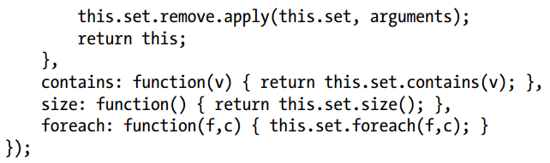
Composition Versus Subclassing
A well-known principle in objectoriented design is “favor composition over inheritance.”

Slide 10
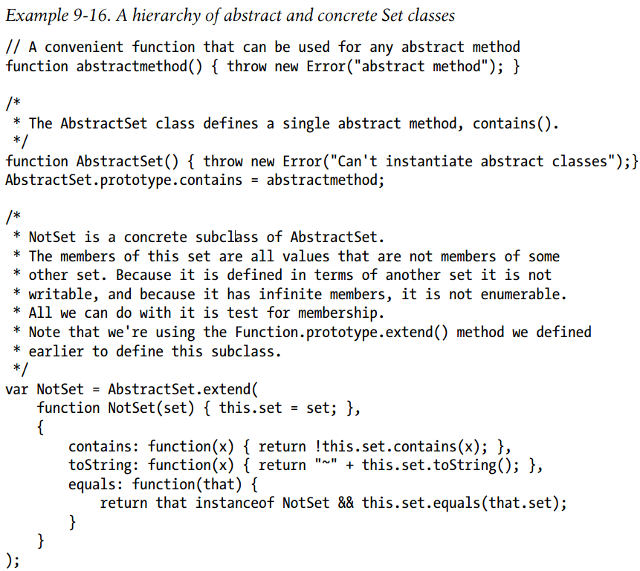
Abstract class

Slide 11
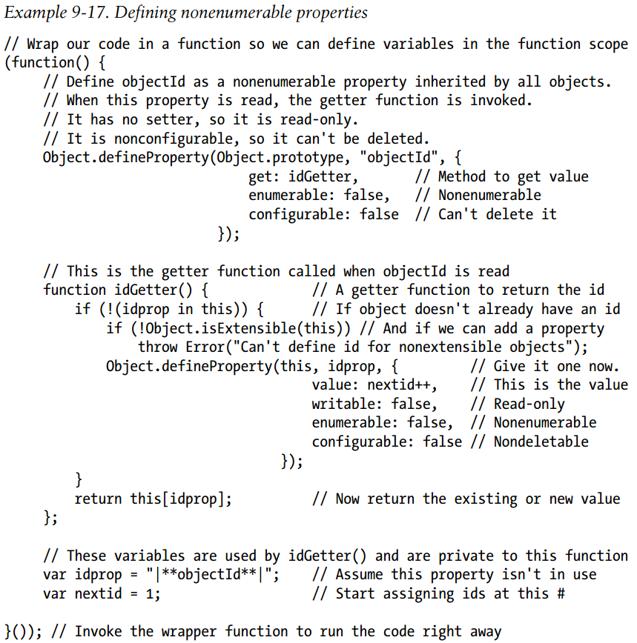
Classes in ECMAScript 5
ECMAScript 5 adds methods for specifying property attributes (getters, setters, enumerability, writability, and configurability) and for restricting the extensibility of objects.

Slide 12
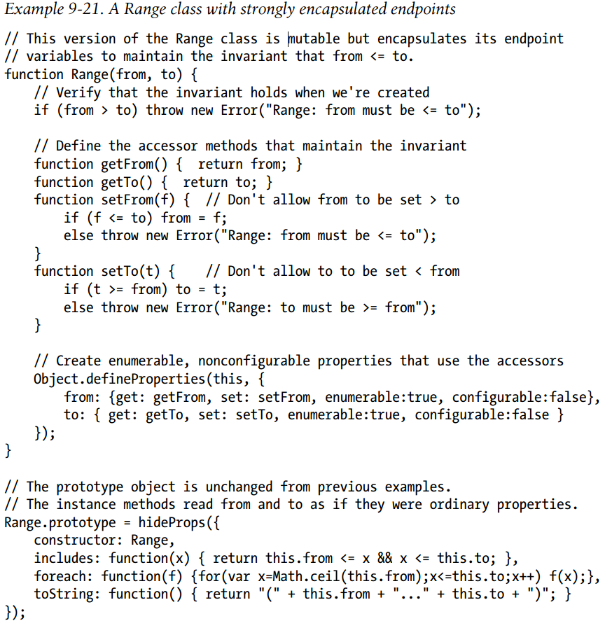
Encapsulating Object State
The shortcoming of this technique is that in ECMAScript 3, the accessor methods that provide access to that state can be replaced. ECMAScript 5 allows us to encapsulate our state variables more robustly by defining property getter and setter methods that cannot be deleted.

Slide 13
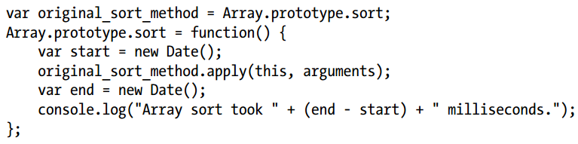
Preventing Class Extensions
It is usually considered a feature of JavaScript that classes can be dynamically extended by adding new methods to the prototype object.
ECMAScript 5 allows you to prevent this, if you want to. Object.preventExtensions() makes an object nonextensible, which means that no new properties can be added to it.
Object.seal() takes this a step further: it prevents the addition of new properties and also makes all current properties nonconfigurable, so that they cannot be deleted.
Another dynamic feature of JavaScript is the ability to replace (or “monkey-patch”) methods of an object:
You can prevent this kind of alteration by making your instance methods read-only. Object.freeze() does everything that Object.seal() does, but also makes all properties read-only and nonconfigurable.
If you want to override an inherited read-only property, you have to use Object.defineProperty() or Object.defineProperties() or Object.create() to create the new property

Slide 14
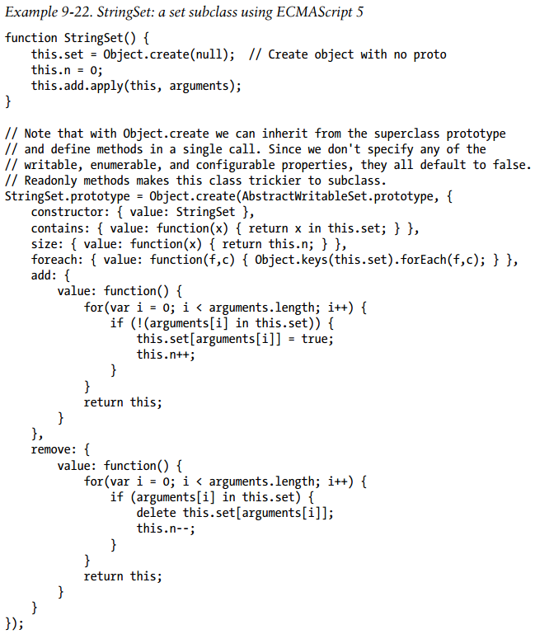
Subclasses and ECMAScript 5
Interesting point about this example is that it passes null to Object.create() to create an object that inherits nothing. This object is used to store the members of the set, and the fact that it has no prototype allows us to use the in operator with it instead of the hasOwnProperty() method

Slide 15

Modules
Typically, a module is a single file of JavaScript code. Any chunk of JavaScript code can be a module, as long as it is written in a modular way.
JavaScript does not define any language constructs for working with modules (it does reserve the keywords imports and exports), which means that writing modular JavaScript is largely a matter of following certain coding conventions.
Many JavaScript libraries and client-side programming frameworks include some kind of module system (for example provide() and require() functions for declaring and loading modules).
The goal of modules is to allow large programs to be assembled using code from disparate sources
One way for a module to avoid the creation of global variables is to use an object as its namespace.
This sets object is the namespace for the module, and we define each of the set classes as a property of this object:
When we want to use a class defined like this, we simply include the namespace when we refer to the constructor:
A programmer who was going to make frequent use of the Set class from the sets namespace might import the class like this:

Slide 16
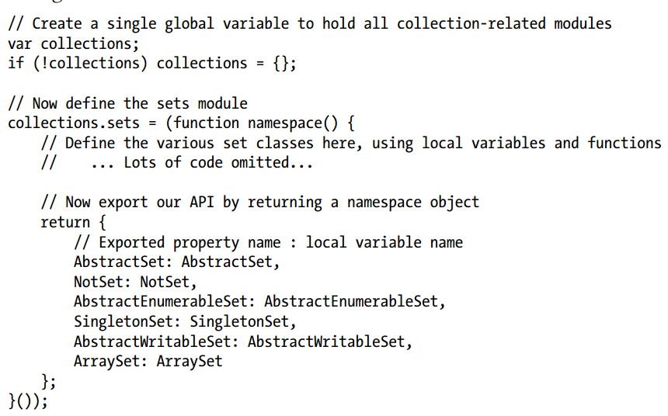
Modules
Modules have a public API that they export: these are the functions, classes, properties, and methods that are intended to be used by other programmers. Often, however, module implementations require additional functions or methods that are not intended for use outside of the module.
We can do that by defining our module inside a function. Variables and functions defined within another function are local to that function and not visible outside of it. In effect, we can use the scope of a function (sometimes called a “module function”) as a private namespace for our module.
Modules that have more than one item in their API can return a namespace object.
As an alternative, if a global namespace object has already been defined, the module function can simply set properties of that object directly, and not bother returning anything at all.

Slide 17
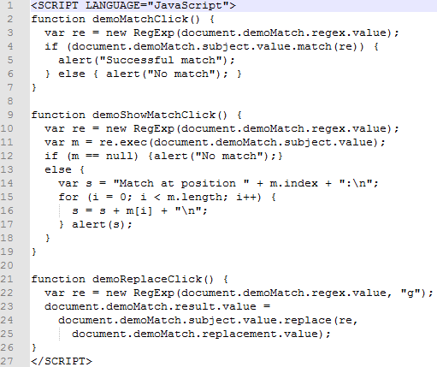
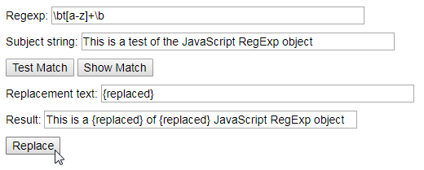
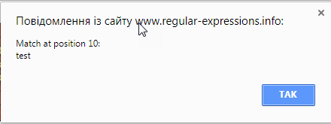
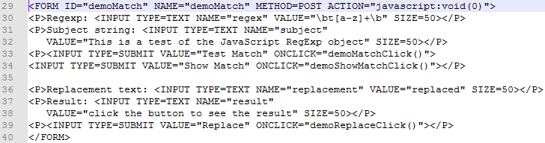
Regular Expressions
A regular expression is an object that describes a pattern of characters.
Test regular expressions:
https://www.regular-expressions.info/javascriptexample.html

Slide 18


JavaScript Subsets
Douglas Crockford’s short book JavaScript: The Good Parts (O’Reilly) describes a JavaScript subset that consists of the parts of the language that he thinks are worth using.
The goal of this subset is to simplify the language, hide quirks and imperfections, and ultimately, make programming easier and programs better.
Crockford explains his motivation: “Most programming languages contain good parts and bad parts. I discovered that I could be a better programmer by using only the good parts and avoiding the bad parts”.
Stoyan Stefanov. Javascript Patterns.
JavaScript is the programming language of the Web, and most JavaScript code is written for web browsers. But JavaScript is a fast and capable general-purpose language, and there is no reason that JavaScript cannot be used for other programming tasks.
Node is a fast C++-based JavaScript interpreter. Except for some specially named synchronous methods, Node’s bindings are all asynchronous, and by default Node programs never block, which means that they typically scale well and handle high loads effectively. Because the APIs are asynchronous, Node relies on event handlers, which are often implemented using nested functions and closures.

Slide 19
Client Javascript
Some web pages present static information and can be called documents. (The presentation of that static information may be fairly dynamic—because of JavaScript—but the information itself is static.)
Other web pages feel more like applications than documents. These pages might dynamically load new information as needed, they might be graphical rather than textual, and they might operate offline and save data locally so they can restore your state when you visit them again.
Still other web pages sit somewhere in the middle of the spectrum and combine features of both documents and applications.
The Window object is the main entry point to all client-side JavaScript features and APIs. It represents a web browser window or frame, and you can refer to it with the identifier window. The Window object defines properties like location, which refers to a Location object that specifies the URL currently displayed in the window and allows a script to load a new URL into the window:
The Window object also defines methods like alert(), which displays a message in a dialog box, and setTimeout().
Notice that the code above does not explicitly use the window property. In client-side JavaScript, the Window object is also the global object. This means that the Window object is at the top of the scope chain.

Slide 20

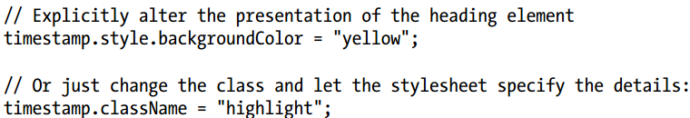
Window object
One of the most important properties of the Window object is document: it refers to a Document object that represents the content displayed in the window. The Document object has important methods such as getElementById().
Each Element object has style and className properties that allow scripts to specify CSS styles for a document element or to alter the CSS class names that apply to the element.
Another set of important properties on Window, Document, and Element objects are the event handler properties. Event handlers allow JavaScript code to alter the behavior of windows, of documents, and of the elements that make up those documents.
One of the most important event handlers is the onload handler of the Window object. It is triggered when the content of the document displayed in the window is stable and ready to be manipulated. JavaScript code is commonly wrapped within an onload event handler.

Slide 21
JavaScript in Web Documents
A JavaScript program can manipulate document content through the Document object and the Element objects it contains. It can alter the presentation of that content by scripting CSS styles and classes.
And it can define the behavior of document elements by registering appropriate event handlers.
The combination of scriptable content, presentation, and behavior is called Dynamic HTML or DHTML
JavaScript in Web Applications
With this notion of web browser as simplified OS in mind, we can define web applications as web pages that use JavaScript to access the more advanced services (such as networking, graphics, and data storage) offered by browsers.
The best known of these advanced services is the XMLHttpRequest object, which enables networking through scripted HTTP requests. Web pages with Ajax applications form the backbone of what is known as “Web 2.0.”
The HTML5 specification are defining the data storage graphics, geolocation, history management, and background threads APIs.
A well-designed web document will continue to work with JavaScript disabled. Web applications are, by definition, JavaScript programs that use the OS-type services provided by the web browser, and they would not be expected to work with JavaScript disabled.
Embedding JavaScript in HTML
Client-side JavaScript code is embedded within HTML documents in four ways:
Inline, between a pair of <script> and </script> tags
From an external file specified by the src attribute of a <script> tag
In an HTML event handler attribute, such as onclick or onmouseover
In a URL that uses the special javascript: protocol.

Slide 22
Execution of JavaScript Programs
We can say that a JavaScript program consists of all the JavaScript code in a web page (inline scripts, HTML event handlers, and javascript: URLs) along with external JavaScript code referenced with the src attribute of a <script> tag.
All of these separate bits of code share a single global Window object. That means that they all see the same Document object, and they share the same set of global functions and variables
If a web page includes an embedded frame (using the <iframe> element), the JavaScript code in the embedded document has a different global object than the code in the embedding document, and it can be considered a separate JavaScript program.
If the container document and the contained document are from the same server, the code in one document can interact with the code in the other, and you can treat them as two interacting parts of a single program, if you wish.
Scripts generally run in the order in which they appear in the document.
Once the document is loaded and all scripts have run, JavaScript execution enters its second phase. This phase is asynchronous and event-driven. During this event-driven phase, the web browser invokes event handler in response to events that occur asynchronously
When the HTML parser encounters a <script> element, it must, by default, run the script before it can resume parsing and rendering the document (if the script source code is in an external file specified with a src attribute, this means that the portions of the document that follow the script will not appear in the browser until the script has been downloaded and executed).

Slide 23
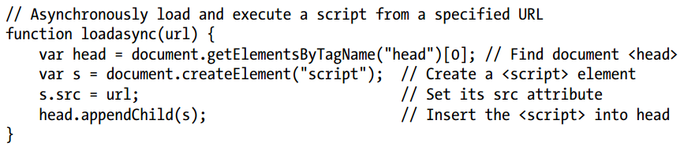
Execution of JavaScript Programs
the defer and async attributes are ways of telling the browser that the linked script does not use document.write() and won’t be generating document content, and that therefore the browser can continue to parse and render the document while downloading the script.
The defer attribute causes the browser to defer execution of the script until after the document has been loaded and parsed and is ready to be manipulated.
The async attribute causes the browser to run the script as soon as possible but not to block document parsing while the script is being downloaded.
If a <script> tag has both attributes, a browser that supports both will honor the async attribute and ignore the defer attribute.
Note that deferred scripts run in the order in which they appear in the document. Async scripts run as they load, which means that they may execute out of order.
You can load and execute scripts asynchronously, even in browsers that do not support the async attribute, by dynamically creating a <script> element and inserting it into the document.

Slide 24
Event-Driven JavaScript
The event handler functions. These functions are then invoked asynchronously when the events for which they were registered occur.
Events whose targets are elements in a document often propagate up the document tree in a process known as “bubbling.” If the user clicks the mouse on a <button> element a click event is fired on the button. If that event is not handled (and its propagation stopped) by a function registered on the button, the event bubbles up to whatever element the button is nested within, and any click event handler registered on that container element will be invoked.
If you want to write a module of code that can safely register event handlers even if another module has already registered a handler for the same event on the same target, you have to use a method named addEventListener(), which allows the registration of multiple listeners
The functions passed to setTimeout() are registered differently than true event handlers, and they are usually called “callbacks” instead of “handlers”, but they are asynchronous just as event handlers are.
Client-Side JavaScript Threading Model
Single-threaded execution makes for much simpler scripting: you can write code with the assurance that two event handlers will never run at the same time.
You can manipulate document content knowing that no other thread is attempting to modify it at the same time, and you never need to worry about locks, deadlock, or race conditions.
Single-threaded execution means that web browsers must stop responding to user input while scripts and event handlers are executing. So event handlers must not run for too long.
If it is possible to break your durable computation down into discrete subtasks, you can use method such as setTimeout() to run the subtasks in the background while updating a progress indicator for the user.
HTML5 defines a “web worker” which is a background thread for performing computationally intensive tasks without freezing the user interface. The code that runs in a web worker thread does not have access to document content, does not share any state with the main thread or with other workers, and can only communicate with the main thread and other workers through asynchronous events.

Slide 25
Client-Side JavaScript Timeline in detail (idealized timeline and not all browsers support it)
The web browser creates a Document object and begins parsing the web page, adding Element objects to the document as it parses HTML elements and their textual content. The document.readyState property has the value “loading” at this stage.
When the parser encounters a <script> elements without async and defer attributes it adds those elements to the document and then executes the inline or external script. These synchronous scripts can see their own <script> element and document content that comes before it.
When the parser encounters a <script> element that has the async attribute set, it begins downloading the script text and continues parsing the document. Asynchronous scripts must not use the JavaScriptdocument.write() method. They can see their own <script> element and all document elements that come before it, and may or may not have access to additional document content.
When the document is completely parsed, the document.readyState property changes to “interactive”.
Any scripts that had the defer attribute set are executed, in the order in which they appeared in the document. (Async scripts may also be executed at this time). Deferred scripts have access to the complete document tree and must not use the document.write() method.
The browser fires a DOMContentLoaded event on the Document object. This marks the transition from synchronous script execution phase to the asynchronous event-driven phase of program execution. (Note, however, that there may still be async scripts that have not yet executed at this point).
The document is completely parsed at this point, but the browser may still be waiting for additional content, such as images, to load. When all such content finishes loading, and when all async scripts have loaded and executed, the document.readyState property changes to “complete” and the web browser fires a load event on the Window object.
From this point on, event handlers are invoked asynchronously in response to user input events, network events, timer expirations, and so on.
!!! For very long documents or very slow network connections, it is theoretically possible that a web browser will render part of a document and allow the user to start interacting with it before all the scripts have executed

Slide 26
Security
Client-side JavaScript does not provide any way to write or delete arbitrary files or list arbitrary directories on the client computer. But JavaScript can read user-selected files and obtain a secure private filesystem within which it can read and write files.
General-purpose internet clients and servers cannot be written in client-side JavaScript.
A JavaScript program can open new browser windows, but, to prevent pop-up abuse by advertisers, most browsers restrict this feature so that it can happen only in response to a user-initiated event, such as a mouse click.
A JavaScript program can close browser windows that it opened itself, but it is not allowed to close other windows without user confirmation.
The value property of HTML FileUpload elements cannot be set.
A script cannot read the content of documents loaded from different servers than the document that contains the script. (same-origin policy)
The origin of a document is defined as the protocol, host, and port of the URL from which the document was loaded. Documents loaded from different web servers have different origins. Documents loaded through different ports of the same host have different origins. And a document loaded with the http: protocol has a different origin than one loaded with the https: protocol, even if they come from the same web server.
The same-origin policy also applies to scripted HTTP requests made with the XMLHttpRequest object. This object allows client-side JavaScript code to make arbitrary HTTP requests to the web server from which the containing document was loaded, but it does not allow scripts to communicate with other web servers.

Slide 27

Relaxing the same-origin policy
To support multidomain websites of this sort, you can use the domain property of the Document object. By default, the domain property contains the hostname of the server from which the document was loaded. You can set this property, but only to a string that is a valid domain suffix of itself.
If two windows (or frames) contain scripts that set domain to the same value, the same origin policy is relaxed for these two windows, and each window can interact with the other.
The second technique for relaxing the same-origin policy is being standardized under the name Cross-Origin Resource Sharing (see http://www.w3.org/TR/cors/). This draft standard extends HTTP with a new Origin: request header and a new Access-Control:Allow-Origin response header. It allows servers to use a header to explicitly list origins that may request a file or to use a wildcard and allow a file to be requested by any site.
Another technique (cross-document messaging) allows a script from one document to pass textual messages to a script in another document, regardless of the script origins. Calling the postMessage() method on a Window object results in the asynchronous delivery of a message event (you can handle it with an onmessage event handler function) to the document in that window.
Cross-Site Scripting
Cross-site scripting, or XSS, is a term for a category of security issues in which an attacker injects HTML tags or scripts into a target website.
A web page is vulnerable to cross-site scripting if it dynamically generates document content and bases that content on user-submitted data without first “sanitizing” that data by removing any embedded HTML tags from it.
Attack:

Slide 28

The Window Object
setTimeout() returns a value that can be passed to clearTimeout() to cancel the execution
setInterval() is like setTimeout() except that the specified function is invoked repeatedly
The location property of a window is a reference to a Location object with properties href, protocol, host, hostname, port, pathname, search, and hash.
The search property returns the portion of the URL that starts with a question mark: often some sort of query string.
The assign() method of the Location object makes the window load and display the document at the URL you specify. The replace() method is similar, but it removes the current document from the browsing history before loading the new document.
When a script unconditionally loads a new document, the replace() method is often a better choice than assign(). Otherwise, the Back button would take the browser back to the original document, and the same script would again load the new document.
The reload() method makes the browser reload the document
The URL decomposition properties of the Location object are writable, and setting them changes the location URL and also causes the browser to load a new document (or, in the case of the hash property, to navigate within the current document)

Slide 29
Browsing History
The History object models the browsing history of a window as a list of documents and document states. The length property of the History object specifies the number of elements in the browsing history list, but for security reasons scripts are not allowed to access the stored URLs
The History object has back() and forward() methods that behave like the browser’s Back and Forward buttons do. And there is go() method:
If a window contains child windows (such as <iframe> elements), the browsing histories of the child windows are chronologically interleaved with the history of the main window.
History management before HTML5 is a more complex problem. An application that manages its own history must be able to create a new entry in the window browsing history, associate its state information with that history entry, determine when the user has used the Back button to move to a different history entry, get the state information associated with that entry, and re-create the previous state of the application.
One approach uses a hidden <iframe> to save state information and create entries in the browser’s history. In order to create a new history entry, you dynamically write a new document into this hidden frame using the open() and write() methods of the Document object.
The document content should include whatever state information is required to re-create the application state. When the user clicks the Back button, the content of the hidden frame will change. Before HTML5, no events are generated to notify you of this change, however, so in order to detect that the user has clicked Back you might use setInterval() to check the hidden frame two or three times a second to see if it has changed.

Slide 30
The Navigator and Screen Objects
The navigator property of a Window object refers to a Navigator object that contains browser vendor and version number information. But today, feature testing is preferred.
The screen property of a Window object refers to a Screen object that provides information about the size (width, height) of the user’s display and the number of colors available on it.
Error Handling
The onerror property of a Window object is an event handler that is invoked when an uncaught exception propagates all the way up the call stack.
The first argument to window.onerror is a message describing the error. The second argument is a string that contains the URL of the JavaScript code that caused the error. The third argument is the line number within the document where the error occurred
Dialog Boxes: alert(), confirm(), and prompt(), showModalDialog() (block main thread)
If you name an element in your HTML document using the id attribute, and if the Window object does not already have a property by that name, the Window object is given a nonenumerable property whose name is the value of the id attribute and whose value is the HTMLElement object that represents that document element.
This doesn’t happen if the Window object already has a property by that name. So use getElementById() method.
The following HTML elements also behave this way when given a name attribute: <a> <applet> <area> <embed> <form> <frame> <frameset> <iframe> <img> <object>
The id element is required to be unique within a document: two elements cannot have the same id. This is not true for the name attribute, however. If more than one of the elements above has the same name attribute (or if one element has a name attribute, and another element has an id with the same value), the implicit global variable with that name will refer to an array-like object that holds each of the named elements.

Slide 31
Multiple Windows and Frames
A single web browser window on your desktop may contain several tabs. Each tab is an independent browsing context. Each has its own Window object, and each is isolated from all the others.
But windows are not always isolated from one another. A script in one window or tab can open new windows or tabs, and when a script does this, the windows can interact with one another and with one another’s documents (same-origin policy).
Window.open() loads a specified URL into a new or existing window and returns the Window object that represents that window.
Browsers allow you to automatically close those windows that your own JavaScript code has created.
A Window object continues to exist after the window it represents has been closed. A window that has been closed will have a closed property of true, document = null, and its methods will no longer work.
The open() method of a Window object returns a new Window object that has an opener property that refers back to the original window. In this way, the two windows can refer to each other, and each can read properties and invoke methods of the other.
A similar thing is possible with frames. A frame can refer to the Window object of the window or frame that contains it using the parent property
A Window object that represents a top-level window or tab has no container, and its parent property simply refers to the window itself:
No matter how deeply a frame is nested, its top property refers to the top-level containing window. For frames that are direct children of a top-level window, the top property is the same as parent property.
The <iframe> elements have a contentWindow property that refers to the Window object of the frame:
Every Window object has a frames property that refers to the child frames contained within the window or frame.

Slide 32
JavaScript in Interacting Windows
Each frame has own window object – global object
Each window has an independent copy of the constructor and an independent copy of the prototype object. For example, copy of the String() constructor and the String.prototype object. So if you write a new method for manipulating JavaScript strings it is not accessible to strings created in other windows.
The fact that each Window has its own prototype objects means that the instanceof operator does not work across windows. instanceof will evaluate to false!
Each time a web browser loads new content into a window or a frame, it must start with a fresh JavaScript execution context, including a newly created global object. But when multiple windows or frames are in use, it is critical that the Window object that refers to a frame or window continue to be a valid reference even if that frame or window loads a new document.
So client-side JavaScript has two important objects. The client-side global object is the top of the scope chain and is where global variables and functions are defined. This global object is, in fact, replaced whenever the window or frame loads new content.
The object we have been calling the Window object is not actually the global object, but a proxy for it. Whenever you query or set a property of the Window object, that object queries or sets the same property on the current global object of the window or frame. The HTML5 specification calls this proxy object WindowProxy

Slide 33
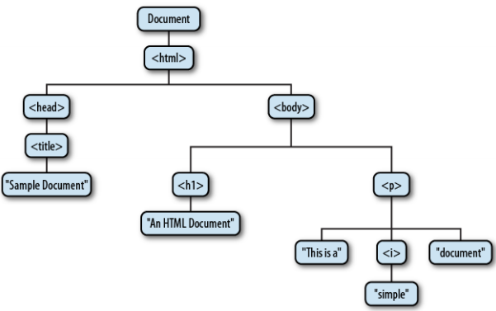
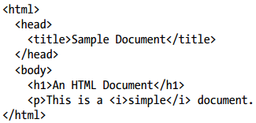
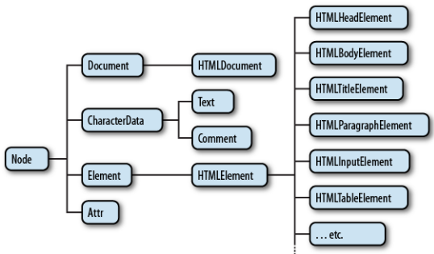
Execution of JavaScript Programs
Window object has a document property that refers to a Document object. The Document object represents the content of the window
There is Document Object Model (DOM) for representing and manipulating document
There are three different types of nodes: Document, Element, and Text that are subclasses of Node

Slide 34

Selecting Document Elements
The DOM defines a number of ways to select elements:
with a specified id attribute; document.getElementById(id)
with a specified name attribute; document.getElementsByName(“name") (returns a NodeList object that behaves like a read-only array of Element objects)
with the specified tag name (by type); document.getElementsByTagName("span");
with the specified CSS class or classes; document.getElementsByClassName("warning")
matching the specified CSS selector (css files); querySelectorAll() takes a single string argument containing a CSS selector and returns a NodeList that represents all elements in the document that match the selector.
The images, forms, and links properties refer to objects that behave like read-only arrays of <img>, <form>, and <a> elements (but only <a> tags that have an href attribute). These properties refer to HTMLCollection objects, which are much like NodeList objects, but they can additionally be indexed by element ID or name.
So getElementsByName() and getElementsByTagName() return NodeList objects, and properties like document.images and document.forms are HTMLCollection objects.
One of the most important and surprising features of NodeList and HTMLCollection is that they are not static snapshots of a historical document state but are generally live and the list of elements they contain can vary as the document changes.

Slide 35

Attributes
The Element defines getAttribute(), setAttribute() (even for nonstandard attributes), and hasAttribute(), removeAttribute() methods
For Element objects, attributes is a read-only array-like object that represents all the attributes of the element
Element Content
The innerHTML property of an Element returns the content of that element as a string of markup.
The outerHTML is defined only for Element nodes, returns the markup with the opening and closing tags

Slide 36
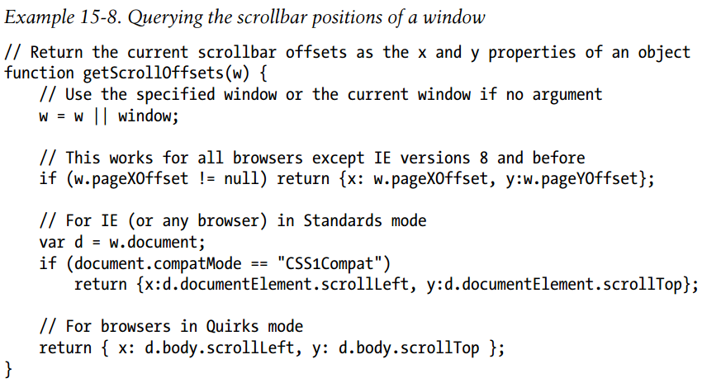
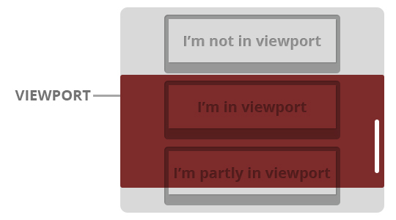
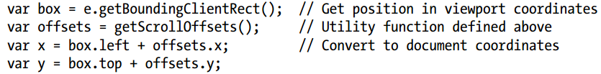
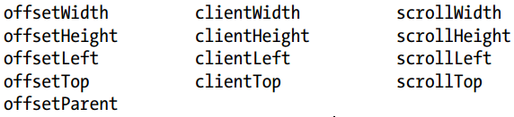
Document and Element Geometry and Scrolling
the X and Y coordinates of an element can be relative to the top-left corner of the document or relative to the top-left corner of the viewport in which the document is displayed
Every HTML element has all of the following properties:

Slide 37
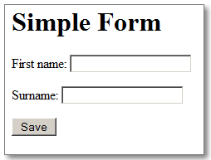
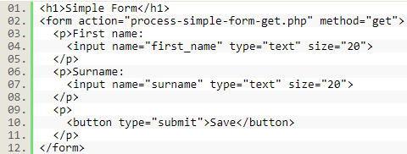
HTML Forms
HTML forms are the mechanism behind the first generation of web applications, which required no JavaScript at all.
User input is gathered in form elements; form submission sends that input to the server; the server processes the input and generates a new HTML page for display by the client.
Invoking the submit() method of a Form submits the form, and invoking reset() resets the form elements

Slide 38
CSS Scripting
The most common and important technique: altering the styles of document elements.
Style rules can come from a “cascade” of different sources:
The web browser’s default stylesheet
The document’s stylesheets
The style attribute of individual HTML elements
An element may match more than one selector within a stylesheet, in which case the style properties associated with all of those selectors are applied to them element.
If different selectors define different values for the same style property, the value associated with the most specific selector overrides the value associated with less specific selectors
The result of style computation is the actual set of style properties that are used to display the element. This set of values is known as the computed style of the element.
Shortcut Properties:
Nonstandard CSS properties are implemented with prefixes: Firefox: moz-, Chrome: -webkit-, and IE: -ms-
The new feature of CSS is web fonts: the ability to download and use custom fonts with a CSS @font-face rule. (See http://code.google.com/ webfonts for a selection of fonts free).
CSS Transitions automatically turn any scripted change to a CSS style into a smoothly animated transition.
CSS Animations uses CSS Transitions as a starting point for defining more complex animation sequences
CSS Transforms, which allows arbitrary 2D affine transforms (expressed by a matrix)

Slide 39
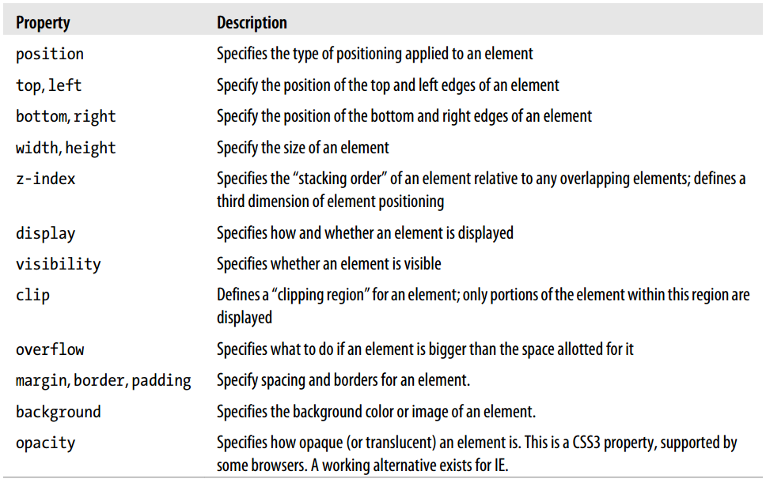
Important CSS Properties

Slide 40
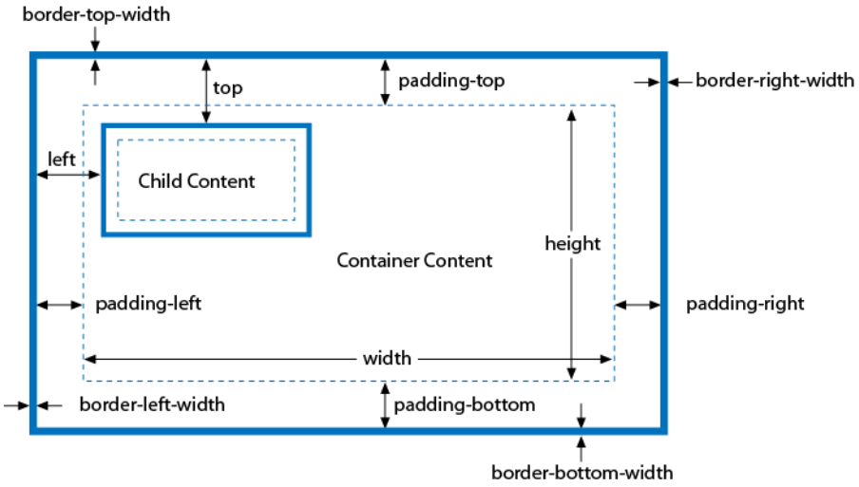
Positioning Elements
Positioning Elements with CSS: static (default), absolute, fixed, relative
The z-index property allows you to specify the stacking order of elements and indicate which of two or more overlapping elements is drawn on top of the others.
If overlapping elements have the same z-index, they are drawn in the order in which they appear in the document.
If two elements that are not siblings overlap, setting their individual z-index properties does not allow you to specify which one is on top. Instead, you must specify the z-index property for the two sibling containers of the two overlapping elements.

Slide 41
Element Visibility
The difference between the visibility and display style properties has to do with their effect on elements that use static or relative positioning. For an element that appears in the normal layout flow, setting visibility to hidden makes the element invisible but reserves space for it in the document layout. If an element’s display property is set to none, no space is allocated for it in the document layout.
The display property is useful when creating expanding and collapsing outlines.
The overflow and clip properties allow you to display only part of an element.
The overflow property specifies what happens when the content of an element exceeds the size specified
the clip property allows you to specify exactly which portion of an element should be displayed, whether or not the element overflows

Slide 42
Computed Styles
The computed style is the set of properties actually used to display the element.
The computed styles are represented with a CSSStyleDeclaration object and can be obtained by getComputedStyle() method. Computed style properties are read-only!
Computed style properties are absolute (relative units like percentages and points are converted to absolute values).
The cssText property of the computed style is undefined.
Scripting Stylesheets
The document.styleSheets property is a read-only array-like object containing CSSStyleSheet objects that represent the stylesheets associated with the document.
<style> elements, <link> elements, and CSSStyleSheet objects all define a disabled property
It is possible to create entirely new stylesheets and add them to your document. In most browsers, this is done with standard DOM techniques: just create a new <style> element and insert it into the document head

Slide 43
Handling Events
The event type is a string (event name) that specifies what kind of event occurred
The event target is the object on which the event occurred or with which the event is associated
An event handler or event listener is a function that handles or responds to an event.
An event object is an object that is associated with a particular event and contains event details.
All event have properties: type, target
Event propagation (“bubble” up) is the process by which the browser decides which objects to trigger event handlers on. For events that are specific to a single object (such as the load event on the Window object), no propagation is required. An event handler can stop the propagation of an event.
It is sometimes more convenient to register a single event handler on a Document or other container element than to register handlers on each individual element you’re interested in.
Another form of event propagation, known as event capturing, handlers specially registered on container elements have the opportunity to intercept (or “capture”) events before they are delivered to their actual target.
Some events have default actions associated with them. Event handlers can prevent this default action by returning an appropriate value, invoking a method of the event object, or by setting a property of the event object. This is sometimes called “canceling” the event.

Slide 44
Event Categories
Device-dependent input events. They are directly tied to a specific input device, such as the mouse or keyboard (“mousedown”, “keyup”, “touchmove”, “gesturechange”).
Device-independent input events. They are not directly tied to a specific input device. (The textinput event is a device-independent alternative to the keypress event and supports keyboard input as well as alternatives such as cut-and-paste and handwriting recognition)
User interface events. They are higher-level events, often on HTML form elements that define a user interface for a web application. They include the focus event (when a text input field gains keyboard focus), the change event when the user changes the value displayed by a form element, and the submit event when the user clicks a Submit button in a form.
State-change events. They are not triggered directly by user, but by network or browser activity, and indicate some kind of lifecycle or state-related change. (The load event, fired on the Window object)
API-specific events. A number of web APIs defined by HTML5 and related specifications include their own event types. (The drag-and-drop API defines events such as “dragstart”, “dragenter”, and “drop”)
Timers and error handlers. Timers and error handlers are similar to events.
Registering Event Handlers
Two basic ways to register event handlers:
Set a property on the object that is the event target:
Pass the handler to a method of the object or element (you can call addEventListener() multiple times to register more than one handler function for the same event type on the same object)

Slide 45
Event Handles
Context. The event handlers are invoked as methods of the object on which they are defined. That is, within the body of an event handler, the this keyword refers to the event target.
Scope. Like all JavaScript functions, event handlers are lexically scoped. They are executed in the scope in which they are defined, not the scope from which they are invoked
Return Value. In general, a return value of false tells the browser that it should not perform the default action associated with the event.
The return value of the onbeforeunload handler of the Window object is triggered when the browser is about to navigate to a new page. If this event handler returns a string, it will be displayed in a modal dialog box that asks the user to confirm the leaving of the page.
Invocation Order:
Handlers registered by setting an object property, if any, are always invoked first
Handlers registered with addEventListener() are invoked in the order in which they were registered.
Handlers registered with attachEvent() (IE 8 or less) may be invoked in any order and your code should not depend on sequential invocation.
More about events, see in Chapter 17 of JS: The Definitive Guide

Slide 46
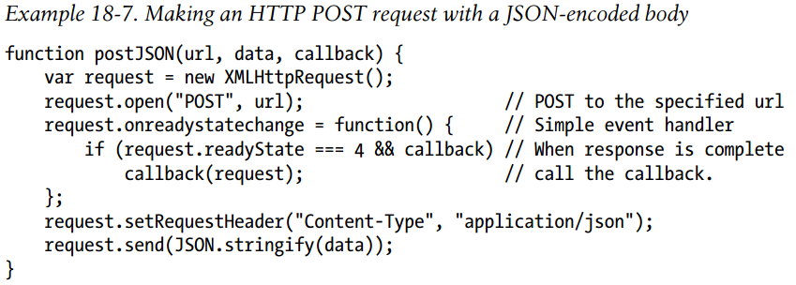
Scripted HTTP
The key feature of an Ajax application is that it uses scripted HTTP to initiate data exchange with a web server without causing pages to reload
Comet is the reverse of Ajax: in Comet, it is the web server that initiates the communication, asynchronously sending messages to the client. (HTML5 Server-Sent Events draft)
Although Ajax techniques can be implemented on top of an <iframe> or <script> (dynamically change the src attibute) transport, there is usually an easier way to do it: all browsers have supported an XMLHttpRequest object that defines an API for scripted HTTP.
The XMLHttpRequest API includes the ability to make POST requests, in addition to regular GET requests, and can return the server’s response as text or as a Document object.
Transport mechanisms for Comet require the client to establish (and re-establish as necessary) a connection to the server, and require the server to keep that connection open so that it can send asynchronous messages over it.
The server to keep this connection open until it needs to push a message. Each time the server sends a message, it closes the connection, which helps to ensure that the message is properly received by the client. After processing the message, the client then immediately establishes a new connection for future messages.

Slide 47
HTTP Requests
As part of the same-origin security policy, the XMLHttpRequest object can normally issue HTTP requests only to the server from which the document that uses it was downloaded.
Note that the <script> element can download and execute any script, regardless of origin. This freedom to make cross-origin requests makes the <script> element an attractive Ajax transport alternative to XMLHttpRequest.
XMLHttpRequest2 (HTML5) allows cross-origin requests to websites that opt-in by sending appropriate CORS (Cross-Origin Resource Sharing) headers in their HTTP responses. CORS is supported in: Chrome 3+, Firefox 3.5+, Opera 12+, Safari 4+, Internet Explorer 8+.
For details about CORS, see www.html5rocks.com/en/tutorials/cors/
The technique of using a <script> element as an Ajax transport has come to be knownas JSONP: it works when the response body of the HTTP request is JSON-encoded.
Instead of just sending JSON data like this: [1, 2, {"buckle": "my shoe"}] It sends a padded-JSON response like this: handleResponse([1, 2, {"buckle": "my shoe"}])
In practice, services that support JSONP do not dictate a function name like “handleResponse” that all clients must implement.
Instead, they use the value of a query parameter to allow the client to specify a function name, and then use that function name as the padding in the response. The following Example uses a query parameter named “jsonp” to specify the name of the callback function.

Slide 48
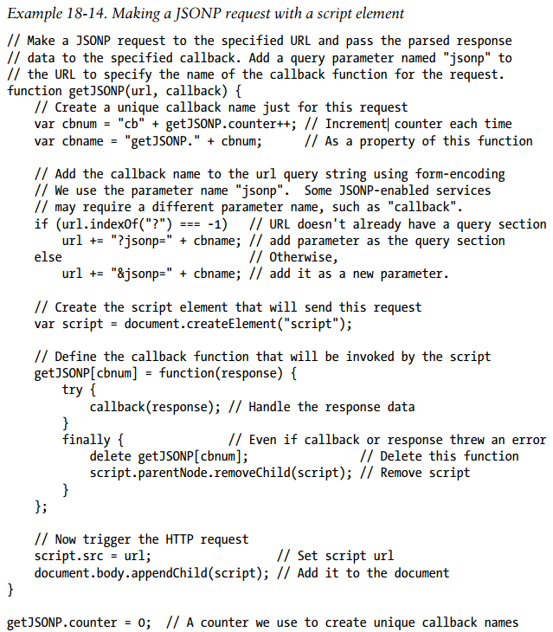

Slide 49
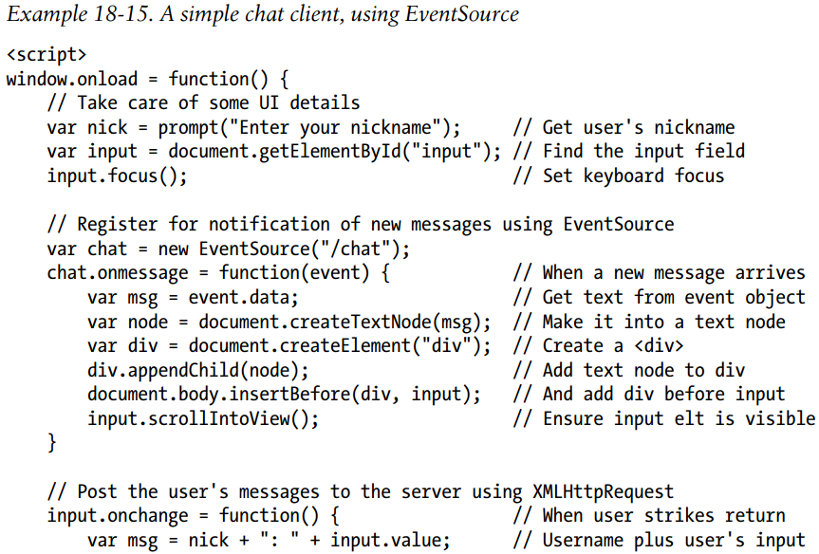
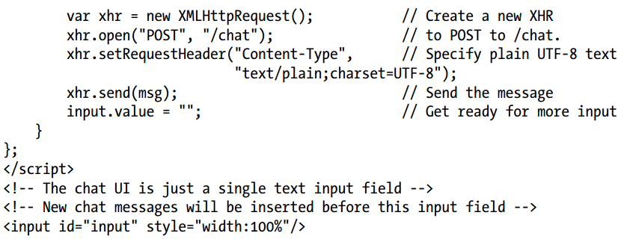
Comet with Server-Sent Events
The Server-Sent Events draft standard defines an EventSource object that makes Comet applications trivial to write. Simply pass a URL to the EventSource() constructor and then listen for message events on the returned object.
In browsers (like Firefox) whose XMLHttpRequest implementation fires a readystatechange event it is easy to emulate EventSource with XMLHttpRequest

Slide 50
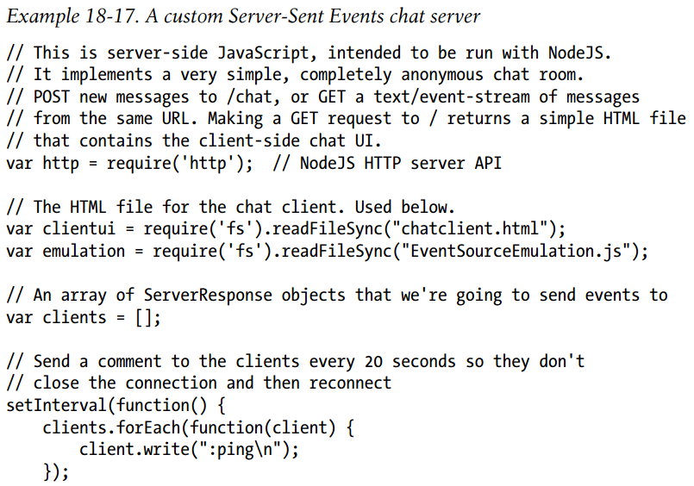
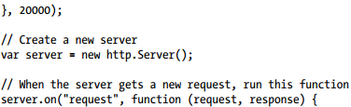
Example of a custom HTTP server written in server-side JavaScript for the Node
server-side environment.
When a client requests the root URL “/”, it sends the chat client code shown in previous Example and the emulation code (when we emulate EventSource with XMLHttpRequest).
When a client makes a GET request for the URL “/chat”, it saves the response stream in an array and keeps that connection open.
And when a client makes a POST request to “/chat”, it uses the body of the request as a chat message and writes it, prefixed with the Server-Sent Events “data:” prefix, to each of the open response streams.
If you install Node, you can run this server example locally. It listens on port 8000, so after starting the server, you’d point your browser to localhost:8000 to connect and begin chatting with yourself.

Slide 51
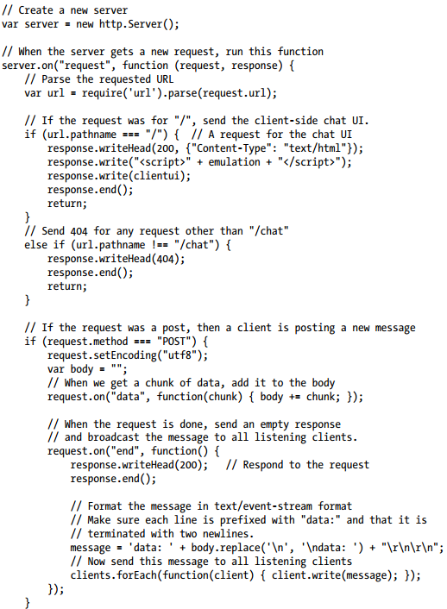
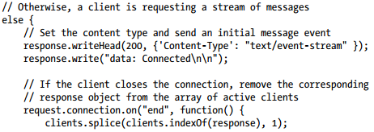
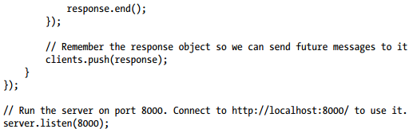

Slide 52
Client-Side Storage
Client-side storage is segregated by origin, so pages from one site can’t read the data stored by pages from another site. But two pages from the same site can share storage and can use it as a communication mechanism
Web applications can choose the lifetime of the data they store.
There are a number of forms of client-side storage:
Web Storage (HTML5). This API consists of the localStorage and sessionStorage objects, which are essentially persistent associative arrays that map string keys to string values.
Cookies are an old client-side storage mechanism that was designed for use by server-side scripts. An awkward JavaScript API makes cookies scriptable on the client-side, but they are hard to use and are suitable only for storing small amounts of textual data. Also, any data stored as cookies is always transmitted to the server with every HTTP request, even if the data is only of interest to the client.
Offline Web Applications. HTML5 defines an “Offline Web Applications” API that allows the caching of web pages and their associated resources (scripts, CSS files, images, and so on). This is client-side storage for web applications themselves rather than just their data, and it allows web apps to install themselves so that they are available even when there is no connection to the Internet.
Web Databases. Developers who need to work with really huge amounts of data like to use databases, and the most recent browsers have started to integrate client-side database functionality into their browsers.
Filesystem API. The modern browsers support a File object that allows user-selected files to be uploaded through an XMLHttpRequest. Related draft standards define an API for obtaining a private local filesystem and for reading and writing files from and to that filesystem.

