Slide 1
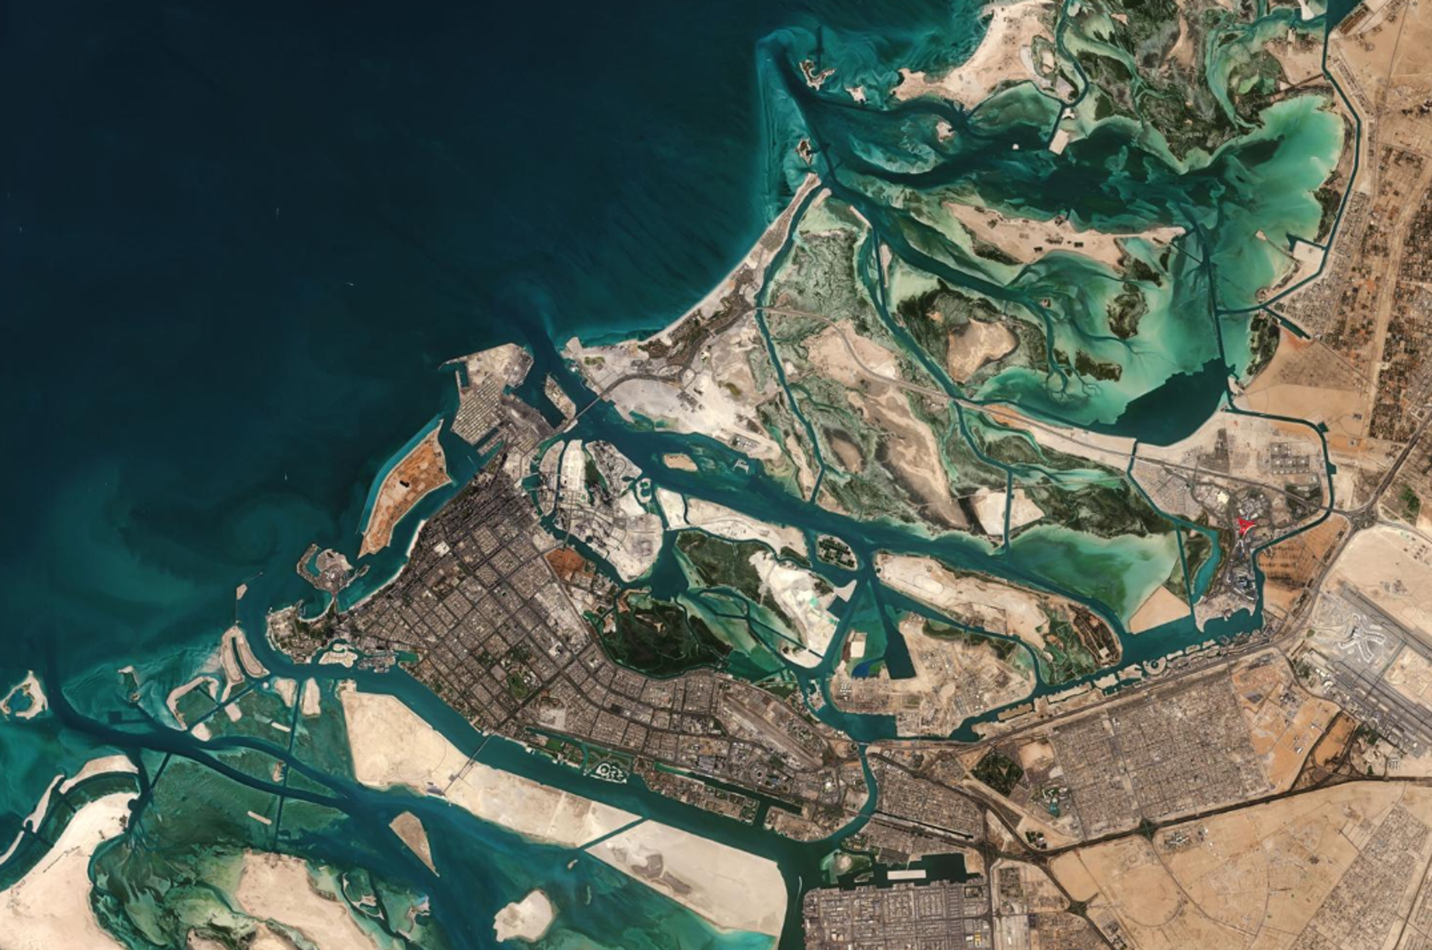
ARAB YOUTH SPACE HACKATHON 2026 • CHALLENGE 813
AquaSpectra
Turning satellite signals into
coastal monitoring priorities
AL RAHA BAY / AL MUNEERA · ABU DHABI
Team AquaSpectra | October 2026
Notes:
PRESENTER NOTES (approx. 55 sec)
Open with a simple question: How can we know which coastal locations need closer inspection when a satellite observes a much larger area? Introduce AquaSpectra as a proof of concept, not a verified algal bloom detector.

Slide 2
01 • FOUNDATION
Why does coastal monitoring matter?
Large coastal areas
Limited field capacity
Changing conditions
Too much coastline to inspect everywhere.
Sampling takes time, people and resources.
Water appearance can change for many reasons.
The real challenge is not collecting more images — it is knowing where to investigate.
AQUASPECTRA • ARAB YOUTH SPACE HACKATHON 2026
02
Notes:
PRESENTER NOTES (approx. 60 sec)
Coastal waters support ecosystems and human activities. Satellites can cover large areas, but field inspections cannot be everywhere. The challenge is deciding where to look first.

Slide 3
02 • CORE CHALLENGE
From satellite data to a useful decision
OBSERVE
INTERPRET
PRIORITIZE
→
→
Satellite pixels
Spectral change
Places to inspect
Not every unusual pixel is pollution or a harmful algal bloom.
AQUASPECTRA • ARAB YOUTH SPACE HACKATHON 2026
03
Notes:
PRESENTER NOTES (approx. 55 sec)
A satellite gives us observations, but observations are not automatically decisions. AquaSpectra focuses on a narrow question: can spectral changes point to locations worth checking?

Slide 4
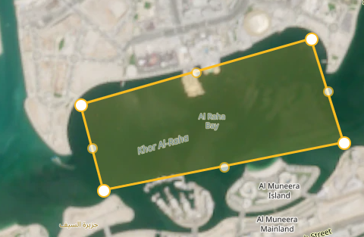
03 • STUDY AREA
Where did we look?
Study area
Al Raha Bay vicinity
Data
Sentinel-2 Level-2A
Four dates
29 Mar · 03 Apr · 06 Apr · 28 Apr 2023
AQUASPECTRA • ARAB YOUTH SPACE HACKATHON 2026
04
Notes:
PRESENTER NOTES (approx. 65 sec)
We focused on a small coastal area near Al Raha Bay and Al Muneera in Abu Dhabi. We downloaded four Sentinel-2 Level-2A scenes from Copernicus Browser: 29 March, 3 April, 6 April and 28 April 2023. Sentinel-2 is multispectral, not hyperspectral.

Slide 5
04 • OUR METHOD
How does AquaSpectra work?
1
2
3
4
5
SELECT
MEASURE
SMOOTH
COMPARE
GROUP
Candidate-water pixels
NDCI spectral index
5 × 5 spatial window
29 Mar → 03 Apr
Nearby high-change pixels
A transparent, reproducible screening workflow — not a trained AI prediction model.
AQUASPECTRA • ARAB YOUTH SPACE HACKATHON 2026
05
Notes:
PRESENTER NOTES (approx. 85 sec)
First we select preliminary water-candidate pixels. Then we calculate NDCI, a chlorophyll-sensitive spectral index, using red and red-edge bands. We smooth the map using a 5 by 5 spatial moving window, compare March 29 to April 3, and group high-change neighboring pixels. The mask is preliminary and the smoothing is spatial, not an AI transformer.

Slide 6
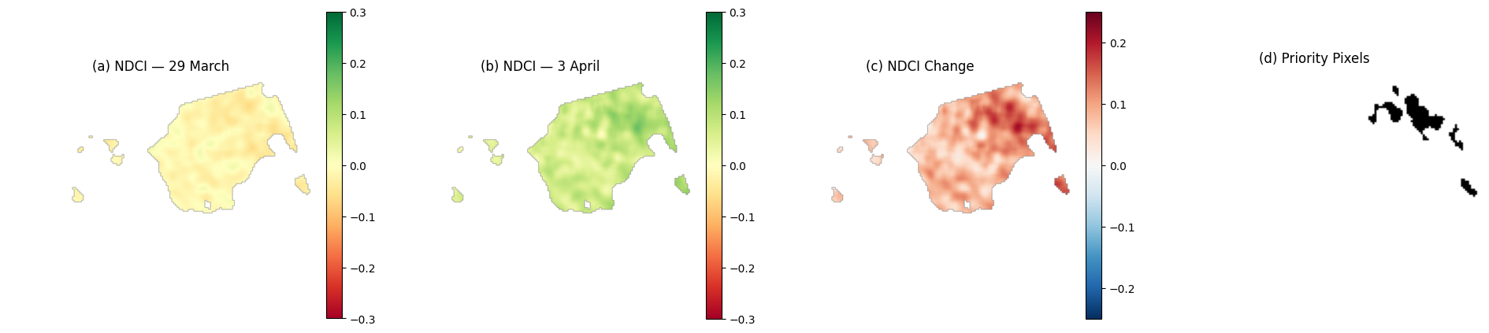
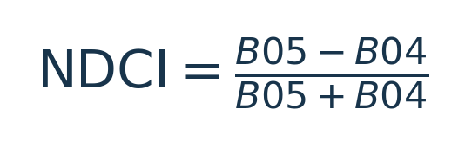
05 • WHAT CHANGED?
Finding the strongest spectral changes
3,435
Valid comparison pixels
344
Priority pixels
Top 10% of valid change values
AQUASPECTRA • ARAB YOUTH SPACE HACKATHON 2026
06
Notes:
PRESENTER NOTES (approx. 70 sec)
We compared the smoothed NDCI on March 29 and April 3. Out of 3,435 valid comparisons, the highest 10 percent gave 344 priority pixels. The threshold was a screening choice, not a medical or biological alarm.

Slide 7
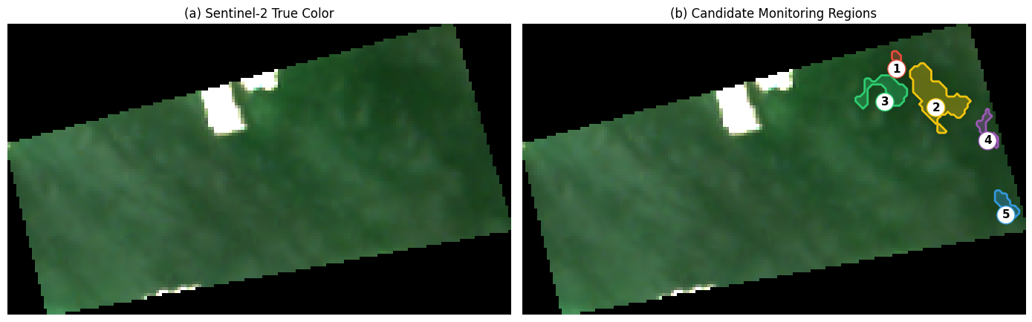
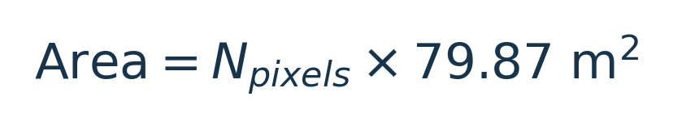
06 • FROM SIGNAL TO ACTION
Five areas worth investigating
5 regions
Candidate monitoring areas
Region 2
Largest: 189 pixels
≈ 15,095 m²
AQUASPECTRA • ARAB YOUTH SPACE HACKATHON 2026
07
Notes:
PRESENTER NOTES (approx. 80 sec)
We grouped adjacent priority pixels and kept regions with at least five pixels. Five candidate regions remained. Region 2 was largest: 189 pixels, around 15,095 square meters. These are candidates for further checks, not confirmed harmful blooms.

Slide 8
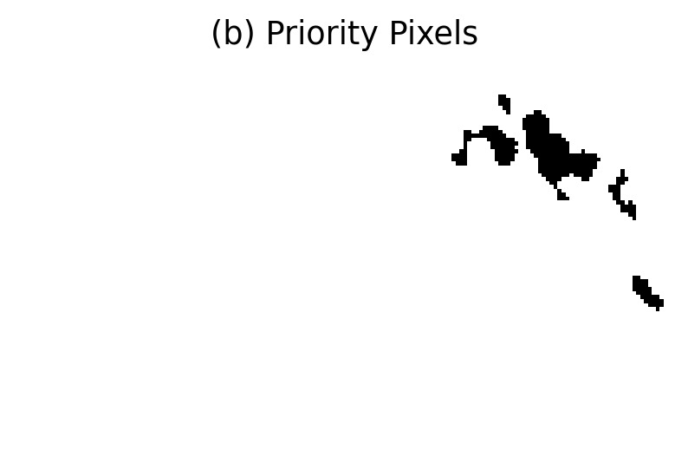
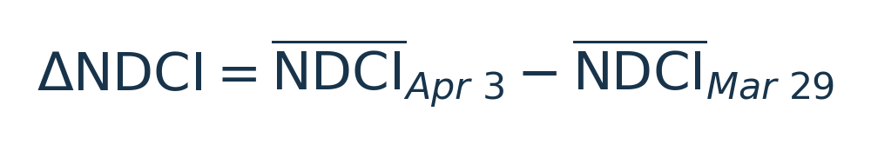

07 • DEMONSTRATION
A map an analyst can explore
SELECT
Choose a monitoring region
EXPLORE
See location and summary
DECIDE
Plan follow-up inspection
08
AQUASPECTRA • ARAB YOUTH SPACE HACKATHON 2026
Notes:
PRESENTER NOTES (approx. 85 sec)
Now show the working Colab dashboard live, or use this slide as backup. Choose All Regions and then Region 2. Explain that the interface displays the map and region information. The outlines come from the March 29 to April 3 comparison, even when another image date is selected.

Slide 9
08 • IMPACT
From observation to action
TODAY
NEXT
FUTURE
Transparent spatial prioritization
Field validation + stronger quality checks
Operational decision support
AquaSpectra helps turn observations into better questions — and more focused action.
AQUASPECTRA • ARAB YOUTH SPACE HACKATHON 2026
09
Notes:
PRESENTER NOTES (approx. 65 sec)
The value is a clearer starting point for environmental teams: where should we investigate first? Next we would validate water masks, compare with field samples, expand the time series, and only then consider AI models. Close with: AquaSpectra does not replace scientists; it helps them focus.

Slide 10
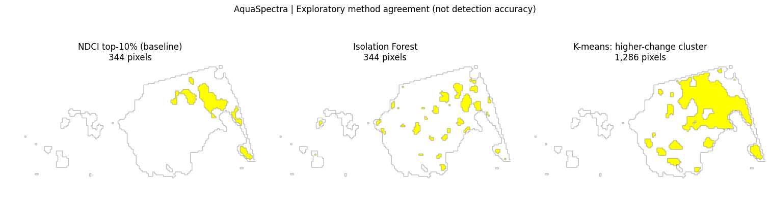
09 • EXPLORATORY MACHINE LEARNING
Three methods, one coastal dataset
NDCI: 344 pixels | Isolation Forest: 344 (155 overlap) | K-means: 1,286 (344 overlap)
Agreement is not detection accuracy — field validation remains necessary.

Slide 11
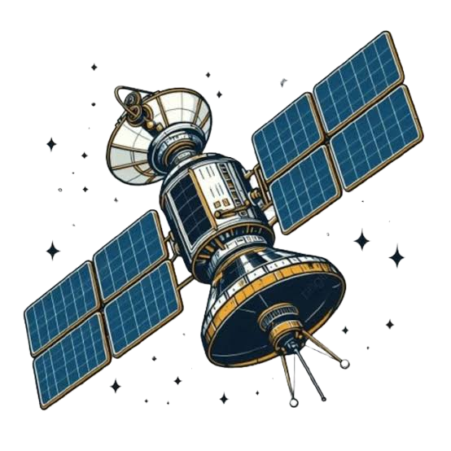
AQUASPECTRA • ARAB YOUTH SPACE HACKATHON 2026
Thank You
Any questions?
TEAM AQUASPECTRA • CHALLENGE 813

