Slide 1



HR ANALYTICS CO.
Smart
Recruitment
Assistant
Predicting Candidate Job-Change Likelihood with XGBoost

Slide 2





Team
01
02
03
Jana Medhat Mostafa Ahmed
Menna Nabil Mohamed Nazmy
Aya Yasser Mohammed Fekry
04
05
06
Habiba Ahmed Mohamed Mokhtar
Razan Amjad Abu Shady
Mai Adel Abdel Hakam Ebrahim

Slide 3

The
Problem
01
Application overload
Modern organizations receive far more applications than recruiters can screen.
Recruiters face an impossible volume. AI-assisted screening helps identify the right candidates faster.
02
AI-assisted screening
HR departments rely on data-driven systems to identify suitable candidates.
03
Our objective
Predict whether a candidate is looking to change jobs, so recruiters can prioritize outreach.

Slide 4


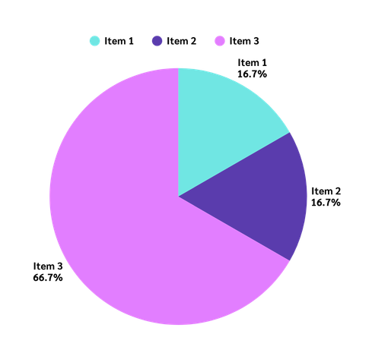

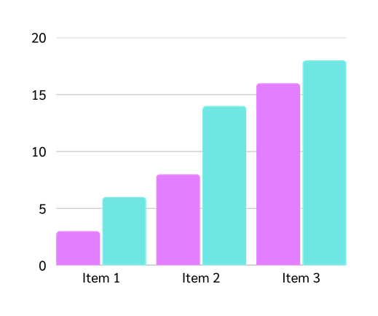
The Dataset
19,158
2,129
75% / 25%
Training rows
Unlabeled test rows
No change vs. will change

Slide 5






Cleaning & Feature Eng.
Group-aware imputation
Ordinal vs. sentinel handling
Missing values filled using group-based modes instead of one global guess.
"Unknown" for nominal gaps; a -1 sentinel preserves company_size's numeric order.
4 engineered features
High-cardinality city dropped
job_stability, low/high_experience, recent_job_change.
123 unique cities dropped for a simpler, more generalizable model.

Slide 6



Modeling & Tuning
Split & select
Compare 5 models
Tune for imbalance
Retrain & score
80/20 stratified split. Feature selection tested k=5-30; k=15 chosen.
LR, Random Forest, Gradient Boosting, XGBoost.
GridSearchCV tuning for class imbalance.
Best model retrained on all rows, scores the 2,129-row test set.

Slide 7

Results — Model Comparison
Validation ROC-AUC across five candidate models
79.1%
0.815
0.815
0.812
Validation Accuracy
(tuned XGBoost)
0.778
0.779
0.812
ROC-AUC
55.6%
Recall on job-changers
Logistic Regression
Random Forest
Gradient Boosting
XGBoost (default)
XGBoost (tuned)

Slide 8
Precision, Recall & Key Predictors
Tuned XGBoost — Classification Report
Pred: No change
Pred: Will change
86%
Actual: No change (2,877)
precision 0.86
recall 0.87
Precision identifying candidates NOT looking to change jobs
Actual: Will change (955)
recall 0.56
precision 0.59
56%
Top predictive features (mutual information)
city_development_index
Recall catching real job-changers on the validation set
company_size
company_type_Unknown
0.812
high_experience
job_stability
ROC-AUC on the held-out validation set

Slide 9

Business
Impact
Recruiters see who’s most likely to say yes — no more working through applications in random order.
Catches over half of real job-seekers, more than double a simple baseline model.
Clear reasons behind every score — location and job status, not a black box.
Next: pilot with real recruiters before full rollout.

Slide 10

Thank you!
Smart Recruitment Assistant
Questions & Discussion

