Slide 1

PRACTICAL DATA SCIENCE PROJECT
-Neeraj (s3711712) and Ayaz(s3751555)

Slide 2
GOALS:
To showcase the thorough understanding of Data Modelling.
HYPOTHESIS:
“The social and economic background of a person helps in identifying if he is going to be defaulter for credit card payment”
DATA:
One binary target feature and 23 descriptive features.
30,000 observations.
Taken from UCI.
DATA PREPARATION & EXPLORATION:
Checked for inconsistencies.
Gained insight through visualization.
Practical Data Science Presentation - Neeraj (s3711712) and Ayaz (s3751555)

Slide 3
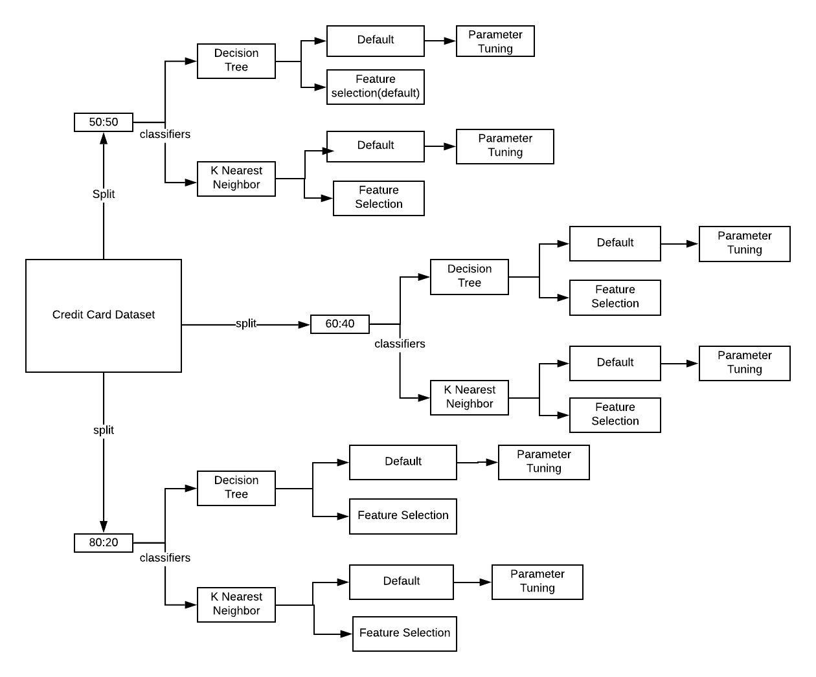
METHODOLOGY:
---CLASSIFICATION TECHNIQUE---
PERFORMANCE BASED ON :
Accuracy
Precision
Recall
F1 score
Practical Data Science Presentation - Neeraj (s3711712) and Ayaz (s3751555)

Slide 4
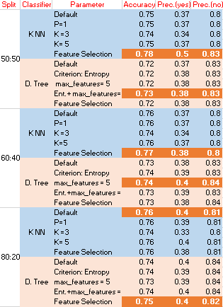
RESULTS:
CONCLUSION:
K-NN is better than Decision Tree
Feature Selection with 6 Descriptive Features at 50:50 split.
Accuracy:0.78
Precision: 0.5, 0.8
RECOMMENDATION:
Uneven proportion of target class
An equal proportion of target class can improve the performance and accuracy of the model
Practical Data Science Presentation - Neeraj (s3711712) and Ayaz (s3751555)

