Slide 1
Reliability Block Diagram and Fault Tree Analysis

Slide 2
Review
Degradation related failures
Exponential distribution
Random Variable: Time between failure events
Reliability computation
Memoryless property
Estimating mean time to failure.
Poisson Distribution
Number of failure events
Poisson is a special case of binomial distribution

Slide 3



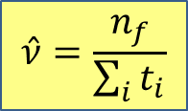
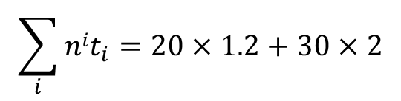
Review- Right censuring testing
Example:
50 components are tested for two weeks. 20 of them fail in this time, with an average failure time of 1.2 weeks.
What is the mean time till failure assuming a constant failure rate?
Answer:
$$\hat{ν}=\frac{n_{f}}{\sum_{i}{t_{i}}}$$
$n=50$, $n_{f}=20$
$$\sum_{i}{nit_{i}}=20×1.2+30×2$$
$=84$ weeks
$$⇒\hat{ν}=\frac{n_{f}}{\sum_{i}{t_{i}}}=\frac{20}{84}=0.238/week$$
$⇒$ mean time till failure is estimated to be $\frac{1}{\hat{ν}}=\frac{1}{0.238}=4.2 weeks$

Slide 4
System Dependability Models
Reliability Graph
Fault Trees
Probabilistic fault trees
Reliability Block Diagrams
Timed Failure Propagation Graphs (covered later in the class)

Slide 5
System Reliability
A system usually consists of components
Each component consists of sub-components
Components may have
Different reliability
Different dependencies between them
System reliability is a function of the reliabilities of the (sub-) components and of the relationships between the components

Slide 6
Problem
For a system consisting of n components
Every component can be in one of the two conditions: working or failed
How many possible combinations of the status of these n components?
How do you calculate the reliability of the system given the probability of each component being working (or failed)?

Slide 7
RBD – reliability block diagram
Reliability Block Diagram (RBD) is a graphical representation of how the components of a system are connected from reliability point of view.
RBD is used to model the various series-parallel and complex block combinations (paths) that result in system success.
Reliability of the system is derived in terms of reliabilities of its individual components.
The most common configurations of an RBD are the series and parallel configurations.
A system is usually composed of combinations of serial and parallel configurations.
RBD analysis is essential for determining reliability, availability and down time of the system.

Slide 8
RBD
Reliability Block Diagram helps reliability analysis using a functional diagram to portray and analyze the reliability relationship of components in a system.
Each element of a system is represented by a block that is in some way interconnected with or through the other blocks of the system at a desired level of assembly. The basic relationship between components are depicted as lines that may be:
Serial: if a single failure results in entire assembly or system failure
Parallel: if all redundant units failure causes system failure
Or a combination of these two

Slide 9
RBD
In a serial system configuration, the elements must all work for the system to work and the system fails if one of the components fails. The overall reliability of a serial system is lower than the reliability of its individual components.
In parallel configuration, the components are considered to be redundant and the system will still cease to work if all the parallel components fail. The overall reliability of a parallel system is higher than the reliability of its individual components.

Slide 10
RBD - Steps
Define boundary of the system for analysis
Break system into functional components
Determine serial-parallel combinations
Represent each components as a separate block in the diagram
Draw lines connecting the blocks in a logical order for mission success

Slide 11

Example (serial RBD)
No redundancy
ALL component of the system are needed to make the system function properly
If any one of the components fails, the system fails
Example
System block diagram
Power Unit
Processor
Monitor

Slide 12
Example (Series RBD)
Reliability Block Diagram
System is composed of n independent serially connected components.
Failure of any component has a cross system effect, i.e., results in failure of the whole system.
...
R₁/λ₁ R₂ /λ₂
Example
Power Unit
R /λ
Processor
R /λ
Monitor
R /λ
Power Unit
R1 /λ1
Processor
R2 /λ2
Monitor
R3 /λ3
1 1
2 2
3 3

Slide 13

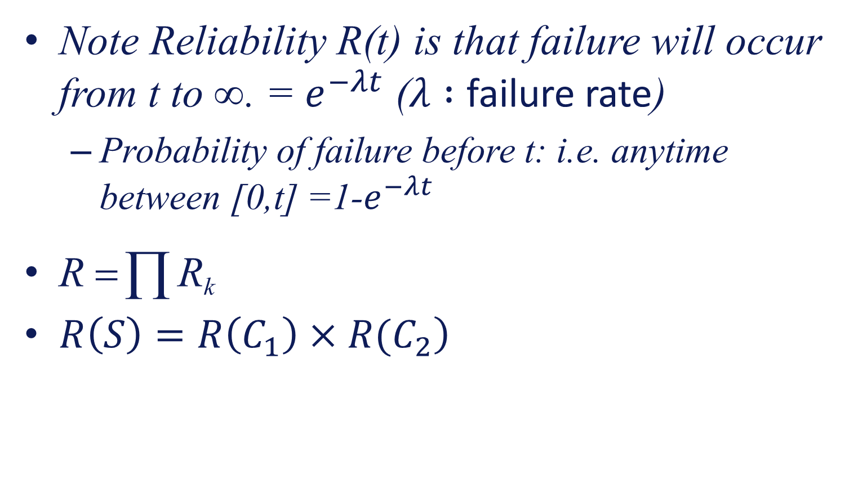
Example (Series RBD)
Note Reliability R(t) is that failure will occur from t to ∞. = $e^{−λt}$ ($λ :$ failure rate)
Probability of failure before t: i.e. anytime between [0,t] =1-$e^{−λt}$
R = ∏ R_{k}
$\left.R\left(S\right)=R\left(C_{1}\right)×R(C_{2}\right)$

Slide 14
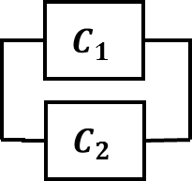
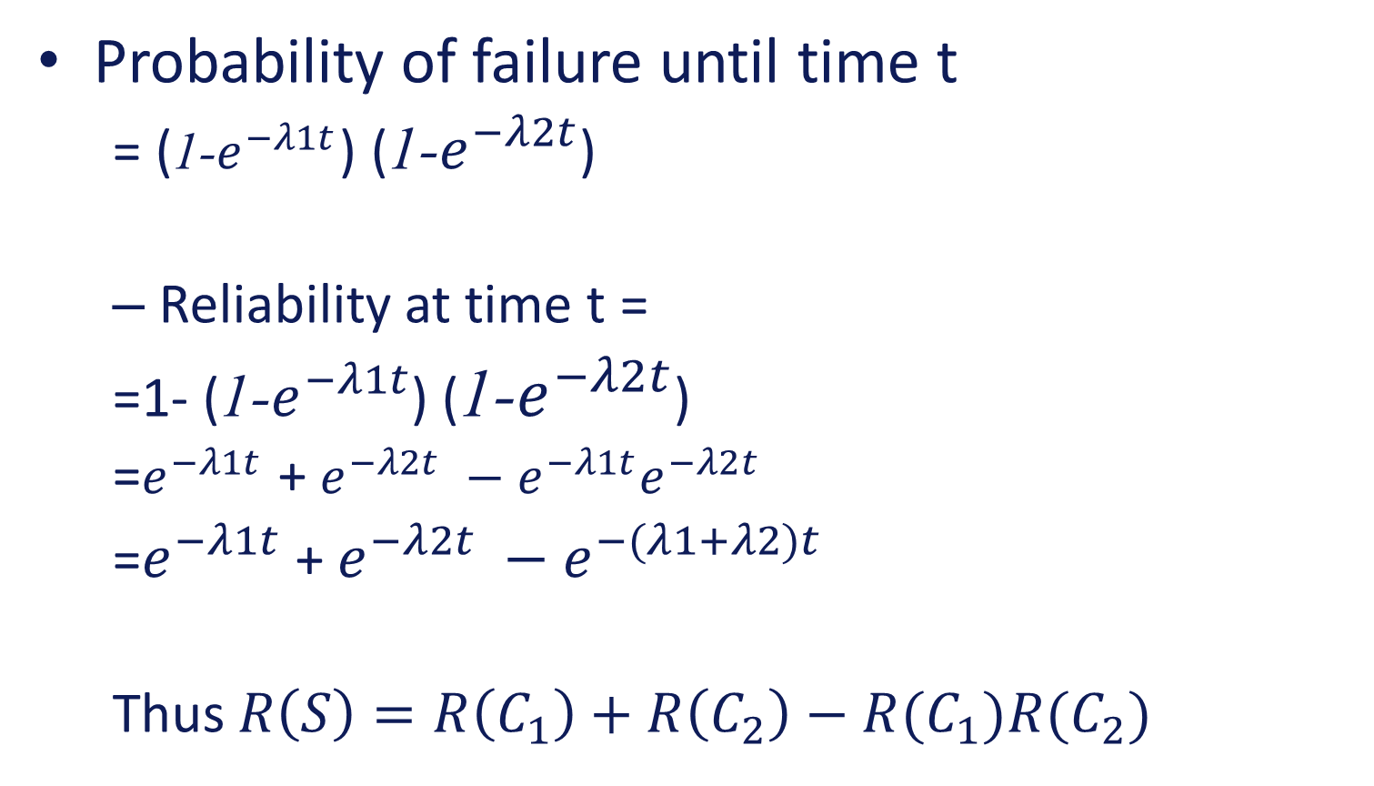
Parallel connections
Probability of failure until time t
= (1-$e^{−λ1t}$) (1-$e^{−λ2t}$)
Reliability at time t =
=1- (1-$e^{−λ1t}$) (1-$e^{−λ2t}$)
=$e^{−λ1t}$ + $e^{−λ2t} −e^{−λ1t}e^{−λ2t}$
=$e^{−λ1t}$ + $e^{−λ2t} −e^{−(λ1+λ2)t}$
Thus $R\left(S\right)=R\left(C_{1}\right)+R\left(C_{2}\right)−R(C_{1})R(C_{2})$

Slide 15
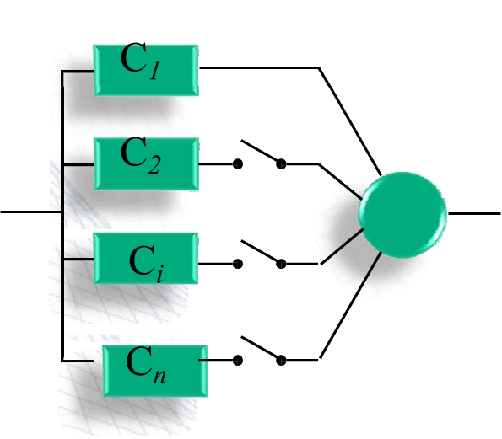
Reliability of redundant structures
Redundancy is the duplication of critical components in a system in order to improve reliability.
Redundancy is normally a parallel connection of identical components – can be active or standby
Standby parallel (the redundant component is started when the primary fails.) e.g., telephone switching circuits)
This is done in sequence until no components left
Standby-parallel

Slide 16
Reliability of active and standby systems
Reliability of active redundant system is same as a parallel connection

Slide 17
Reliability of standby systems
The standby system does not start operating until the primary unit fails
The system can survive until time t if the primary unit survives until time t or the primary unit fails before time t, but the second unit survives until time t

Slide 18
Reliability of standby systems
Assuming we are computing the reliability at time t
The two possibilities can be restated as T₁ > t or T₁ occurs at α < t and T₂ > t − α (because the second unit was not started till α)

Slide 19
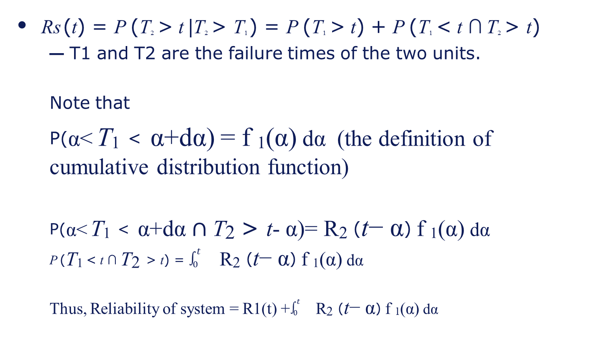
Reliability of standby systems
Rs (t) = P (T2 > t |T2 > T1 ) = P (T1 > t) + P (T1 < t ∩ T2 > t)
T1 and T2 are the failure times of the two units.
Note that
P(α< T₁ < α+dα) = f ₁(α) dα (the definition of cumulative distribution function)
P(α< T₁ < α+dα $∩\text{T}\text{2 }\text{> }\text{t}\text{−}$ α)= R$\text{2}$ ($\text{t}\text{−}$ α) f ₁(α) dα
P (T₁ < t ∩ $\text{T}\text{2}$ > t) = $\int_{0}^{t}{}\text{R}\text{2}\text{ (}\text{t}\text{−} \text{α}\text{)} \text{f} \text{1}\text{(}\text{α}\text{)} \text{d}\text{α}$
Thus, Reliability of system = R1(t) +$\int_{0}^{t}{}\text{R}\text{2}\text{ (}\text{t}\text{−} \text{α}\text{)} \text{f} \text{1}\text{(}\text{α}\text{)} \text{d}\text{α}$

Slide 20
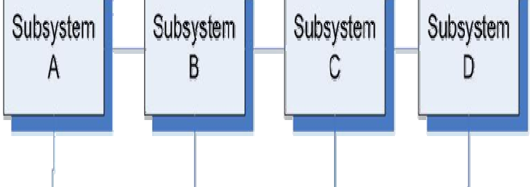
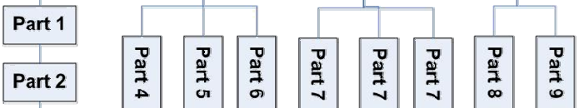

Example
In reliability prediction for an assembled system we usually use a “bottoms-up” approach by estimating the failure rate for each subsystem and then combining the failure rates for the entire assembly. The following figure illustrates a system in which the subsystems A, B, C, and D are in a serial configuration. Each subsystem is composed of several parts which are connected as serial or parallel as shown.

Slide 21


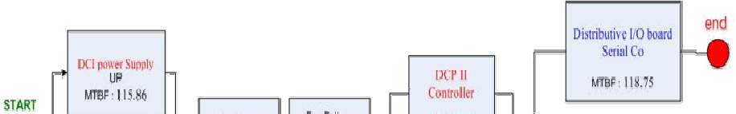

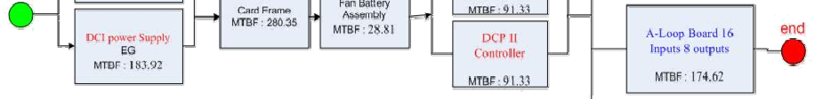

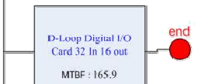

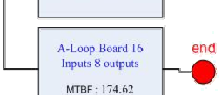
Example 2
Possible single point of failure (SPF)

Slide 22
What do about single point of failures
Adopt redundancy ← Use dissimilar methods – consider common-cause vulnerability
Adopt a fundamental design change
Use equipment which is extremely reliable/robust
Perform frequent Preventive Maintenance/ Replacement ← repair before failure happens
Reduce or eliminate service and/or environmental stresses ← extreme stress leads to failure

Slide 23
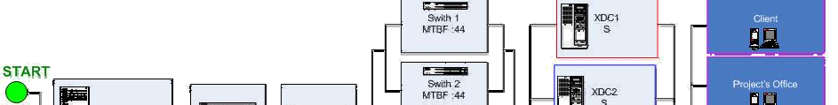
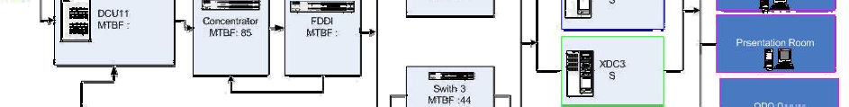
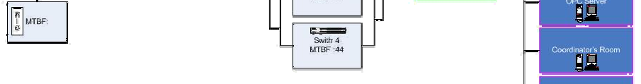

Example 3
Possible over redundancy

Slide 24
When to use RBD
When to use RBD?
When reliability of a complex system must be calculated and the reliability-wise weaknesses of the system must be identified.
How to use RBD?
Draw the RDB diagram.
Calculate the system reliability using the RBD diagram.
Perform calculation such as availability and downtime.
There are a number of automated tools, integrated with the other methods, such as Fault Tree Analysis (FTA), to generate the diagram and to analyze it.

Slide 25
RBD Limitations
RBD is the simplest way of visualizing the reliability of the complex systems.
The benefits of the RBD are:
Establishes reliability goals; Evaluates component failure impact on overall system safety; Provides a basis for “what if” analysis; Allocates component reliability by calculating system MTBF;
Provides cost savings in large system trouble-shooting; Estimates system reliability; Analyzes various system configurations in trade-off studies; Identifies potential design problems; Determines system sensitivity to component failures
Disadvantages are that some complex constructs, such as standby, branching and load sharing, etc., cannot be clearly represented using the traditional RBD constructs.

Slide 26

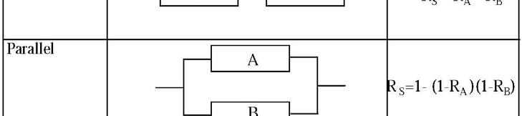
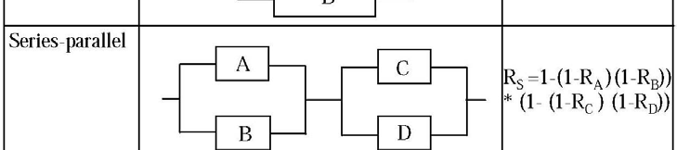
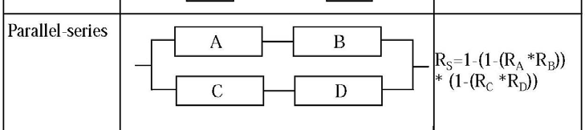
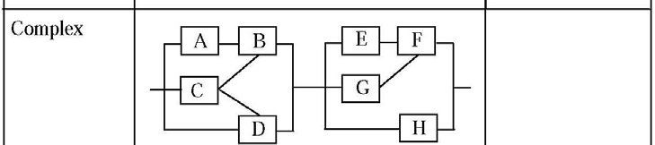
RBD Conclusions
Restricting assumptions:
Statistical independence
Failures independence
Repairs independence

Slide 27
Hazard analysis

Slide 28
Hazard analysis
A common mistake in engineering, is to put too much confidence in software. There seems to be a feeling among non-software professionals that software will not or cannot fail, which leads to complacency and over reliance on computer functions.”
Nancy G. Leveson

Slide 29
Hazard Analysis
Goal
Identify events that may eventually lead to accidents
Identify individual elements/operations within a system that render it vulnerable…(Single Point Failures)
Determine impact on system
Techniques
FMEA: Failure Modes and Effects Analysis
FMECA: Failure Modes, Effects and Criticality Analysis
ETA: Event Tree Analysis
FTA: Fault Tree Analysis
HAZOP: HAZard and OPerability studies

Slide 30
FMEA
FMEA is a technique to identify and prioritize how items fail, and identify the effects of failure.
FMEA is used when
Designing products or processes, to identify and avoid failure-prone designs.
Investigating why existing systems have failed and to identify possible causes.
Investigating possible solutions, to help select one with an acceptable risk.
Planning actions, in order to identify risks in the plan and hence identify countermeasures.

Slide 31
FMEA
Industries that frequently use FMEA:
Consumer products: toys/home appliances/home electronics
Automotive industry
Aero/space: Boeing, NASA
Defence industry: DoD
Process industries, e.g., oil and gas, chemical plants ← industrial control systems
Software industry? ← not quite popular yet

Slide 32
FMEA
FMEA cannot be done until design has proceeded to the point that system elements have been selected at the level the analysis is to explore ← in software system after software architecture is finalized (requirement volatility kills FMEA!)
FMEA can be done anytime in the system lifetime, from initial design onward

Slide 33
FMEA Process
Define the system to be analyzed, and obtain necessary drawings, charts, descriptions, diagrams, component lists.
Know exactly what you’re analyzing; is it an area, activity, equipment? – all of it, or part of it? What targets are to be considered? What mission phases are included?
Break the system down into convenient and logical elements.
System breakdown can be either functional (according to what the System elements “do”), or geographic/architectural (i.e., according to where the system elements “are”), or both (i.e., functional within the geographic, or vice versa).
Establish a coding system to identify system elements.
Analyze (FMEA) the elements.

Slide 34
FMEA Process
FMEA Outputs
– Spreadsheet documenting each
failure mode
possible causes
possible consequences
possible remedies
– Usually computer records kept

Slide 35
FMEA Questions
Identification: How ( i.e., in what ways) can this element fail (failure modes)?
Ramification: What will happen to the system and its environment if this element does fail in each of the ways available to it (failure effects)?
Prevention: What needs to be done to prevent or mitigate the problem?

Slide 36
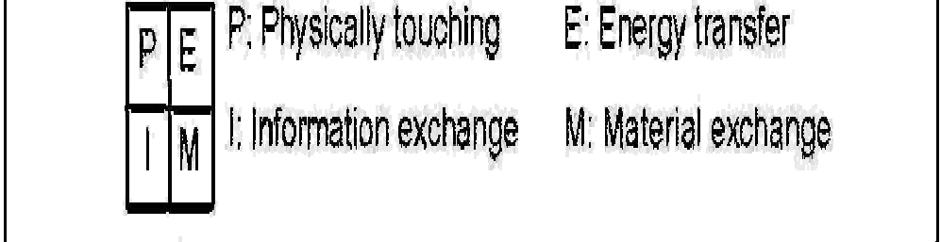
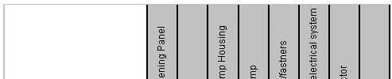
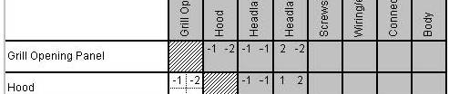
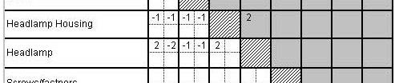
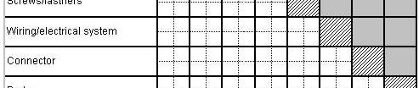
FMEA How to
Interface matrix
Reflects how components of the system are connected & function together
Numbers in each corner represent the interface type
+2 – interaction is necessary for function
+1 – interaction is beneficial but not absolutely necessary
0- interaction does not affect functionality
-1 interaction causes negative effect but does not prevent functionality
-2 interact must be prevented to achieve functionality
Components
Components

Slide 37




FMEA How to
N o . | Part Name Part No. | Function | Failure Mode | Mechanisms & Causes of Failure | Effect(s) of Failure | Current P.R.A. Recommended Control _{P S D R} Corrective
1 | Position | Receive | •Loose | •Wear and | •Motor fails |  | 2 | 4 | 1 | 8 | •Replace faulty
 | Controller | a | cable | tear | to move |  | 4 | 4 | 3 | 48 | wire
 |  | demand | connection | •Operator | •Position |  |  |  |  |  | •QC checked
 |  | position | •Incorrect | error | controller |  |  |  |  |  | •Intensive
 |  |  | demand |  | breakdown |  |  |  |  |  | training for
 |  |  | signal |  | in a long-run |  |  |  |  |  | operators.
Action Taken
Action
P = Probabilities (chance) of occurrences S = Seriousness of failure
D = Likelihood that the defect will reach the customer R = Risk priority measure (P x S x D)
1 = very low or none 2 = low or minor
3 = moderate or significant 4 = high
5 = very high or catastrophic
Use the interface matrix to propagate failures

Slide 38
FMEA benefits
Discover potential single-point failures.
Assesses risk (FMECA) for potential, single-element failures for each identified target, within each mission phase.
Knowing these things helps to:
Optimize reliability, hence mission accomplishment.
Guide design evaluation and improvement.
Guide design of system to “fail safe” or crash softly.
Guide design of system to operate satisfactorily using equipment of “low” reliability.
Guide component/manufacturer selection.

Slide 39
FMEA limitations
FMEA will find and summarize system vulnerability in terms of SPFs, and it requires lots of time, money, and effort to do so.
What if several SPFs are identified?
Developing SPF paranoia ← leading to total system redundification!
But SPFs are abundant and we encounter them daily, yet continue to function.
Most system nastiness failures come from complex threats, not from SPFs ← don’t ignore SPFs, just keep them in perspective.

Slide 40
FMEA summary
Method: from known or predicted failure modes of components, determine possible effects on system
Good for hazard identification early in development, by considering possible failures of system functions:
loss of function (omission failure)
function performed incorrectly
function performed when not required (commission failure)
No good for concurrent multiple failures
No good when requirements change

Slide 41
Fault tree analysis

Slide 42
Fault Tree Analysis
Fault tree analysis is a graphical representation of the major faults or critical failures associated with a product, the causes for the faults, and potential countermeasures.
FTA helps identify areas of concern for new system design or for improvement of existing systems. It also helps identify corrective actions to correct or mitigate problems.
FTA can also be defined as a graphic “model” of the pathways within a system that can lead to a foreseeable, undesirable event.
The pathways interconnect contributory events and conditions, using standard logic symbols.
Fault tree analysis is useful both in designing new systems, products or services or in dealing with identified problems in existing products/services.
As part of process improvement, it can be used to help identify root causes of trouble and to design remedies and countermeasures.

Slide 43
FTA Operators
And Gate
The preceding events must all happen to enable the output (parallel RBD connection)
Or Gate
Either of the two events can lead to the undesirable output (series RBD connection)

Slide 44
FTA
Hazard
AND
Basic Event₁
Basic Event₂
Compound Event_{A}
Basic Event₅
OR
Hazard arises only if basic events 1, 2 and 5 occur AND compound event A occurs.
Compound event A occurs if basic event 3 OR 4 occurs.
Basic Event₃
Basic Event₄

Slide 45
FTA – with probabilities (reliability)
Hazard
P₅ x P₄ x (P₁+P₂) x P₃
AND
Multiplication because of AND
P₁+P₂ P₃
P₅
P₄
Basic Event
Basic Event
Compound Event
Basic Event
OR
All events assumed independent in this case.
Basic Event
Basic Event
P₁
P₂

Slide 46
History of FTA
FTA was first used by Bell Labs in connection with the safety analysis of the Minuteman missile launch control system in 1961.
Boeing further developed the technique, applying it to the entire Minuteman system and then to commercial aircraft.
Boeing applied FTA as part of a comprehensive safety review of the Apollo system following the launch pad fire on January 27, 1967.
FTA was used in the WASH-1400 study (1976) conducted to review nuclear plant power design and to assure the public that the probability of nuclear accidents was very small. The 3-mile island accident occurred March 28, 1979.

Slide 47





































Example Flight Display
Network Cpnnection
Database Servers
Application Servers
Display Client
Operator’s Console
Airport display system
Critical information source
Public Displays

Slide 48
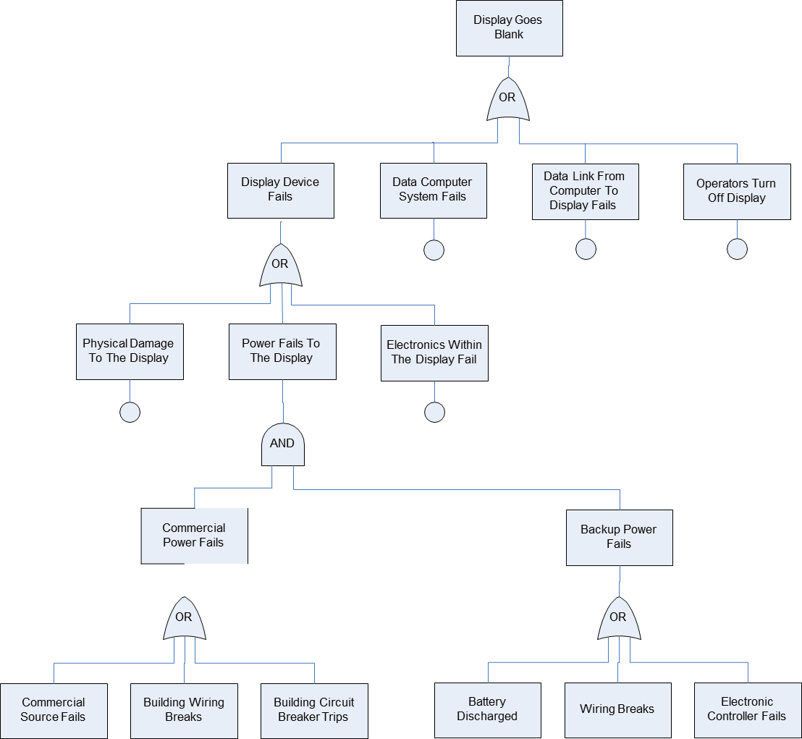
Display fault tree
Airport flight departure display
Hazards:
No display
Faulty data
Fault trees identify possible causes

Slide 49

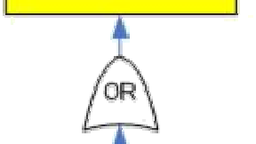

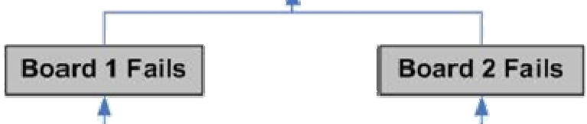
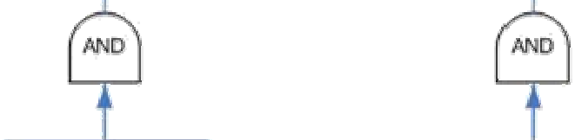
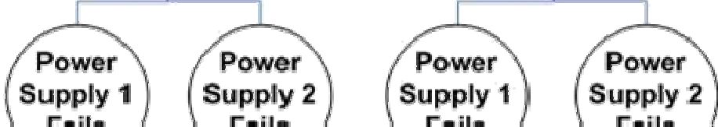
FTA Example 2

Slide 50
Software and fault trees
Events corresponding to software failure will be present in fault tree
How do we deal with them?
Is event probability a meaningful concept?
What is the probability that the software will fail:
1?
0?
Neither?
Be careful with this — correct approach is to model the operating environment the software will see
Probability is actually the probability of an input vector arising that causes a software fault to manifest itself

Slide 51
FTA: Summary
Method: trace faults stepwise back through system design to possible causes
a tree with a top event at the root
logic gates at branches, linking each event with its “immediate” causes
initiating faults at leaves (eventually)
Good for tracing system hazards to component failures, and allocating safety requirements
Good for systems with multiple failures
Good for checking completeness of safety requirements
Can be difficult, time-consuming, hard to maintain

Slide 52
FTA: Summary
Benefits: The primary advantages of fault tree analyses are the meaningful data they produce which allow evaluation and improvement of the overall reliability of the system. It also evaluates the effectiveness of and need for redundancy.
Limitation: The undesired event evaluated must be foreseen and all significant contributors to the failure must be anticipated. This effort may be very time consuming and expensive. Finally, the overall success of the process depends on the skill of the analyst involved.
Tend to be very large for real systems
Evolve as insight is gained

Slide 53
Cut Sets
A cut set is a set of basic events whose simultaneous occurrence insures that the TOP (TOP of the Fault tree) event occurs.
A cut set is minimal if it cannot be reduced without losing its status as a cut set.

Slide 54
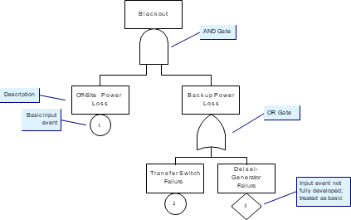
Example
cut sets
{1, 2, 3} , {1, 2} , {1, 3}
minimal cut sets
{1, 2} , {1, 3}
Cut sets are used to simplify reliability computation in complex system.
They can also help find bottlenecks

