Slide 1
Service Level Objectives
Recall failure is the inability to meet service level objectives

Slide 2
Service Level Objectives
An SLO sets a target level of reliability for the service’s customers. Above this threshold, almost all users should be happy with your service (assuming they are otherwise happy with the utility of the service).
Below this threshold, users are likely to start complaining or to stop using the service.
SLO is expressed as a threshold on a quantitative metric often called as service level indicators

Slide 3
Service Level Indicators
SLI as the ratio of two numbers: the number of good events divided by the total number of events
Examples
Number of successful HTTP requests / total HTTP requests (success rate)
Number of gRPC calls (https://grpc.io/about/) that completed successfully in < 100 ms / total gRPC requests
Number of search results that used the entire corpus / total number of search results, including those that degraded gracefully
Number of “stock check count” requests from product searches that used stock data fresher than 10 minutes / total number of stock check requests

Slide 4
SLI
The SLI ranges from 0% to 100%, where 0% means nothing works, and 100% means nothing is broken.
making all of your SLIs follow a consistent style allows you to take better advantage of tooling: you can write
alerting logic,
SLO analysis tools,
error budget
calculation, and reports to expect the same inputs: numerator, denominator, and threshold

Slide 5
SLI
When attempting to formulate SLIs for the first time, you might find it useful to further divide SLIs into SLI specification and SLI implementation:
SLI specification
The assessment of service outcome that you think matters to users, independent of how it is measured.
For example: Ratio of home page requests that loaded in < 100 ms

Slide 6
SLI Implementation is tricky
Ratio of home page requests that loaded in < 100 ms, as measured from the Latency column of the server log.
This measurement will miss requests that fail to reach the backend.
Ratio of home page requests that loaded in < 100 ms, as measured by probers that execute JavaScript in a browser running in a virtual machine. [from client side]
This measurement will catch errors when requests cannot reach our network, but may miss issues that affect only a subset of users.
Ratio of home page requests that loaded in < 100 ms, as measured by instrumentation in the JavaScript on the home page itself, and reported back to a dedicated telemetry recording service.
This measurement will more accurately capture the user experience, although we now need to modify the code to capture this information and build the infrastructure to record it—a specification that has its own reliability requirements.

Slide 7
Runtime Performance Monitoring
SLI quantification requires runtime monitoring

Slide 8
Performance Monitoring
Understand the basic terminology of performance monitoring and analysis.
Understand proper methods of monitoring a system’s performance.
Knowledge of the tools that allow you to monitor system performance.
Understand how to analyze the data provided by the monitoring tools.
Understand how to apply the data to improve system performance.
Understand what to tune, and why to tune it.

Slide 9
General Performance Tuning Rules
Monitor critical systems from day one in order to get a baseline of what “normal” job mixes and performance levels are for each system.
Before making changes to a system configuration, make sure user jobs are not causing problems.
users running too many jobs, or jobs of an inappropriate size on the system.
A performance problem may be temporary, so you need to think through any changes before you implement them.
You might also want to discuss proposed changes with other system administrators as a sanity check.

Slide 10
Terminology
Bandwidth:
The amount of a resource available. If a highway contains four lanes (two in each direction), each car holds four people, and the maximum speed limit allows 6 cars per second to pass over a line across the road, the “bandwidth” of the road is 24 people per second. Increasing the number of lanes will increase the bandwidth.
Throughput:
Percentage of the bandwidth you are actually getting. Continuing with the road example, if the cars only hold one person, the protocol is inefficient (not making use of the available capacity). If traffic is backed up due to an accident and only one or two cars per second can pass the line, the system is congested, and the throughput is impacted. Likewise, if there is a toll booth on the road, the system experiences delays (latency) related to the operation of the toll booth.

Slide 11
Terminology
Utilization:
How much of the resource was used. It is possible to use 100% of the resource, and yet have 0% throughput (consider a traffic jam at rush hour).
Latency:
How long it takes for something to happen. In the case of the road example, how long does it take to pay the toll?
Response time:
How long the user thinks it takes for something to occur.
Knee:
Point at which throughput starts to drop off as load increases.

Slide 12
Terminology
Benchmark:
Set of statistics that (hopefully) shows the true bandwidth and/or throughput of a system.
Baseline:
Set of statistics that shows the performance of a system over a long period of time.
Instantaneous data about the system’s performance is rarely useful for tuning the system. But long-term data is not very useful either, as peaks and valleys in the performance graph tend to disappear over time.
You need to know the long-term performance characteristics, as well as the “spikes” caused by short-lived processes. A good way to obtain long-term (and short-term) information is to run the vmstat command (virtual memory statistics) every five seconds for a 24-hour period. Collect the data points, reduce/graph these data points, and study the results.

Slide 13
Basic System Monitoring

Slide 14
UNIX Monitoring
ps
top
vmstat
iostat
nfsstat
netstat
mpstat
Process accounting

Slide 15
Proc File system
> cat /proc/stat cpu 2255 34 2290 22625563 6290 127 456 cpu0 1132 34 1441 11311718 3675 127 438 cpu1 1123 0 849 11313845 2614 0 18 intr 114930548 113199788 3 0 5 263 0 4 [... lots more numbers ...] ctxt 1990473 btime 1062191376 processes 2915 procs_running 1 procs_blocked 0
The very first "cpu" line aggregates the numbers in all of the other "cpuN" lines.
See https://www.centos.org/docs/5/html/5.2/Deployment_Guide/s1-proc-topfiles.html

Slide 16
Proc File system
> cat /proc/stat cpu 2255 34 2290 22625563 6290 127 456 cpu0 1132 34 1441 11311718 3675 127 438 cpu1 1123 0 849 11313845 2614 0 18 intr 114930548 113199788 3 0 5 263 0 4 [... lots more numbers ...] ctxt 1990473 btime 1062191376 processes 2915 procs_running 1 procs_blocked 0
Cpu Line
user: normal processes executing in user mode
nice: niced processes executing in user mode
system: processes executing in kernel mode
idle: twiddling thumbs
iowait: waiting for I/O to complete
irq: servicing interrupts
softirq: servicing softirqs
The very first "cpu" line aggregates the numbers in all of the other "cpuN" lines.

Slide 17
Proc File system
Q: How do you compute CPU Utilization?
> cat /proc/stat cpu 2255 34 2290 22625563 6290 127 456 cpu0 1132 34 1441 11311718 3675 127 438 cpu1 1123 0 849 11313845 2614 0 18 intr 114930548 113199788 3 0 5 263 0 4 [... lots more numbers ...] ctxt 1990473 btime 1062191376 processes 2915 procs_running 1 procs_blocked 0
Cpu Line
user: normal processes executing in user mode
nice: niced processes executing in user mode
system: processes executing in kernel mode
idle: twiddling thumbs
iowait: waiting for I/O to complete
irq: servicing interrupts
softirq: servicing softirqs
The very first "cpu" line aggregates the numbers in all of the other "cpuN" lines.

Slide 18
Proc File system
> cat /proc/stat cpu 2255 34 2290 22625563 6290 127 456 cpu0 1132 34 1441 11311718 3675 127 438 cpu1 1123 0 849 11313845 2614 0 18 intr 114930548 113199788 3 0 5 263 0 4 [... lots more numbers ...] ctxt 1990473 btime 1062191376 processes 2915 procs_running 1 procs_blocked 0
The very first "cpu" line aggregates the numbers in all of the other "cpuN" lines.
The "intr" line gives counts of interrupts serviced since boot time, for each of the possible system interrupts. The first column is the total of all interrupts serviced; each subsequent column is the total for that particular interrupt.

Slide 19
Proc File system
> cat /proc/stat cpu 2255 34 2290 22625563 6290 127 456 cpu0 1132 34 1441 11311718 3675 127 438 cpu1 1123 0 849 11313845 2614 0 18 intr 114930548 113199788 3 0 5 263 0 4 [... lots more numbers ...] ctxt 1990473 btime 1062191376 processes 2915 procs_running 1 procs_blocked 0
The "ctxt" line gives the total number of context switches across all CPUs.
The "btime" line gives the time at which the system booted, in seconds since
the Unix epoch.
The "processes" line gives the number of processes and threads created, which includes (but is not limited to) those created by calls to the fork() and clone() system calls.
The "procs_running" line gives the number of processes currently running on CPUs.
The "procs_blocked" line gives the number of processes currently blocked, waiting for I/O to complete.
The very first "cpu" line aggregates the numbers in all of the other "cpuN" lines.

Slide 20
Meminfo
MemTotal — Total amount of physical RAM, in kilobytes.
MemFree — The amount of physical RAM, in kilobytes, left unused by the system.
Buffers — The amount of physical RAM, in kilobytes, used for file buffers.
Cached — The amount of physical RAM, in kilobytes, used as cache memory.
SwapCached — The amount of swap, in kilobytes, used as cache memory.
Active — The total amount of buffer or page cache memory, in kilobytes, that is in active use. This is memory that has been recently used and is usually not reclaimed for other purposes.
Inactive — The total amount of buffer or page cache memory, in kilobytes, that are free and available. This is memory that has not been recently used and can be reclaimed for other purposes.
HighTotal and HighFree — The total and free amount of memory, in kilobytes, that is not directly mapped into kernel space. The HighTotal value can vary based on the type of kernel used.
LowTotal and LowFree — The total and free amount of memory, in kilobytes, that is directly mapped into kernel space. The LowTotal value can vary based on the type of kernel used.
SwapTotal — The total amount of swap available, in kilobytes.
SwapFree — The total amount of swap free, in kilobytes.
Dirty — The total amount of memory, in kilobytes, waiting to be written back to the disk.
Writeback — The total amount of memory, in kilobytes, actively being written back to the disk.
Mapped — The total amount of memory, in kilobytes, which have been used to map devices, files, or libraries using the mmap command.
Slab — The total amount of memory, in kilobytes, used by the kernel to cache data structures for its own use.
Committed_AS — The total amount of memory, in kilobytes, estimated to complete the workload. This value represents the worst case scenario value, and also includes swap memory.
PageTables — The total amount of memory, in kilobytes, dedicated to the lowest page table level.
VMallocTotal — The total amount of memory, in kilobytes, of total allocated virtual address space.
VMallocUsed — The total amount of memory, in kilobytes, of used virtual address space.
VMallocChunk — The largest contiguous block of memory, in kilobytes, of available virtual address space.
MemTotal: 255908 kB
MemFree: 69936 kB
Buffers: 15812 kB
Cached: 115124 kB
SwapCached: 0 kB
Active: 92700 kB
Inactive: 63792 kB
HighTotal: 0 kB
HighFree: 0 kB
LowTotal: 255908 kB
LowFree: 69936 kB
SwapTotal: 524280 kB
SwapFree: 524280 kB
Dirty: 4 kB
Writeback: 0 kB
Mapped: 42236 kB
Slab: 25912 kB
Committed_AS: 118680 kB
PageTables: 1236 kB
VmallocTotal: 3874808 kB
VmallocUsed: 1416 kB
VmallocChunk: 3872908 kB
HugePages_Total: 0
HugePages_Free: 0
Hugepagesize: 4096 kB

Slide 21
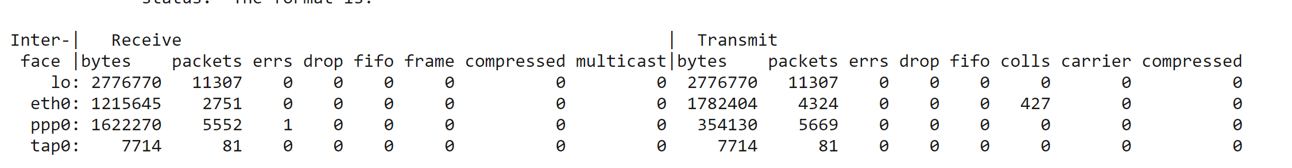
Network Characteristics
/proc/net/dev The dev pseudo-file contains network device status information.
This gives the number of received and sent packets,
the number of errors and collisions
and other basic statistics.
The format is

Slide 22
Per process information
Per process information is available in /proc/<pid> folder.

Slide 23
Writing Monitors
Write programs that utilize the kernel counters from /proc and provide periodic statistics.
Issue alerts when degradation is noticed.
Don’ts of monitoring
Don’t put too heavy a load on monitoring.
Interesting problems occur if you try to monitor on a set of machines at the same time.
Read the following paper
Dubey, Abhishek et al. “Compensating for Timing Jitter in Computing Systems with General-Purpose Operating Systems.” 2009 IEEE International Symposium on Object/Component/Service-Oriented Real-Time Distributed Computing (2009): 55-62.

Slide 24
Identify process shutdowns.
Parent will know about child termination
SIGCHLD Handler
Can restart the child
Linux provides another notification mechanism.
Netlink socket
https://www.systutorials.com/docs/linux/man/7-netlink/
Check out https://github.com/Parrot-Developers/fusion/blob/master/pidwatch/src/pidwatch.c

Slide 25
Locking Down Resources

Slide 26
Resource Constraints on Processes
setrlimit
Cgroups
Disk Quota
Linux tc – network management

Slide 27
Setrlimit/getrlimit/getrusage
http://man7.org/linux/man-pages/man2/getrusage.2.html
http://man7.org/linux/man-pages/man2/getrlimit.2.html (setrlimit and getrlimit)
Soft limit
Hard limit

Slide 28
Control Groups aka “cgroups”
Two basic kernel abstractions:
1) nested groups of processes
2) “controllers” which limit resources

Slide 29
Cgroup controllers
Cpu
Memory
freezer

Slide 30
Try out memory controller
sudo apt-get install libcgroup1 cgroup-tools
sudo mkdir /sys/fs/cgroup/memory/foo
echo 50000000 > /sys/fs/cgroup/memory/foo/memory.limit_in_bytes
./myapplication &
echo 3000> /sys/fs/cgroup/memory/foo/cgroup.procs
Note: if a task exceeds its defined limits, the kernel will intervene and, in some cases, kill that task.
Again, when you read the value back, it always will be a multiple of the kernel page size.
So, although you set it to 500 bytes, it's really set to 4 KB:

Slide 31
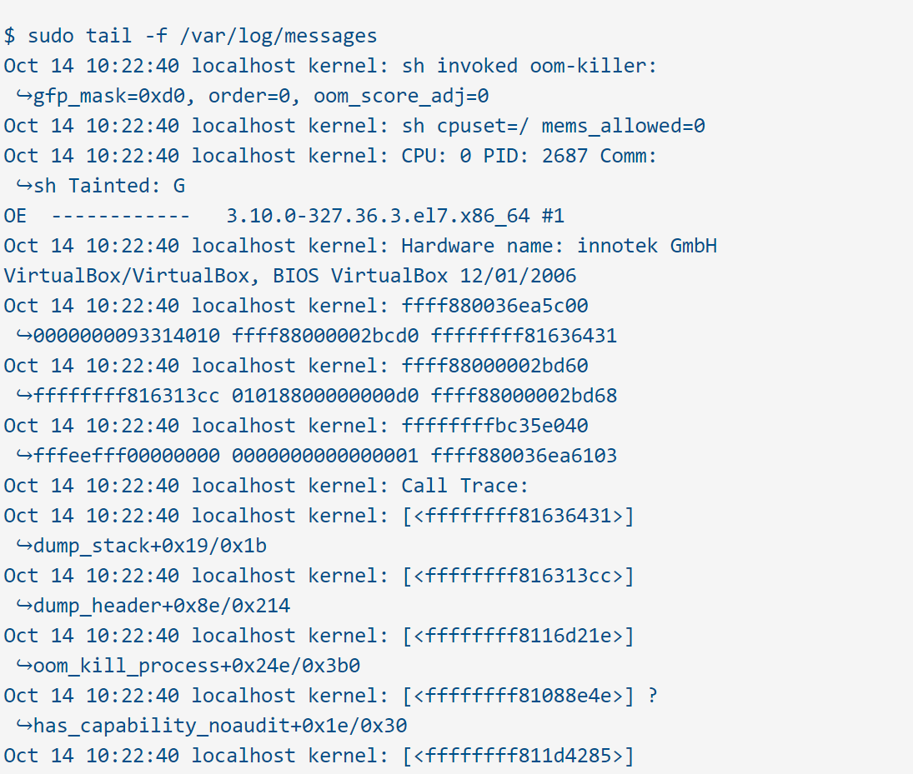
OOM Killer
If the task exceeds budget.

Slide 32
Automatic process start and management
Systemd in linux provides the ability to manage and start long running background processes.

Slide 33
Distributed Monitoring
Based on Slides from Trend Micro and Cisco

Slide 34





Goal
Be metric, event, and log
Allow us to easily visualize the
stat of our environment
Provide contextual and useful
notification.
Focus on whitebox monitoring instead of blackbox monitoring
Destinations Store Visualize
Alert
Router
Business Logic
Application
Operating System
Metrics Events Logs
Monitoring Framwork

Slide 35

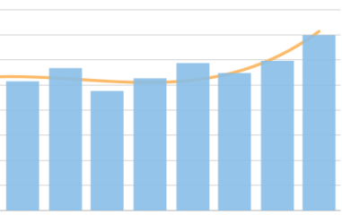




The key idea is to collect metrics
Provide a dynamic, real-time picture of the state of
your infrastructure
Business Logic
Application
Operating System
Collect
Store
Visualize
10
Copyright 2016 Trend Micro Inc.

Slide 36
Pull Mode
Push Mode
Metrics are periodically sent by each monitored system to a central collector
A central collector periodically requests metrics from each monitored system
Server #1
Server #1
Service
Scrape Metrics
Agent
Push
Metrics
Server #2
Server #2
Service
Monitoring
Monitoring
Agent
Server #3
Service
Server #3
Agent
11
Copyright 2016 Trend Micro Inc.

Slide 37
collectd

Slide 38
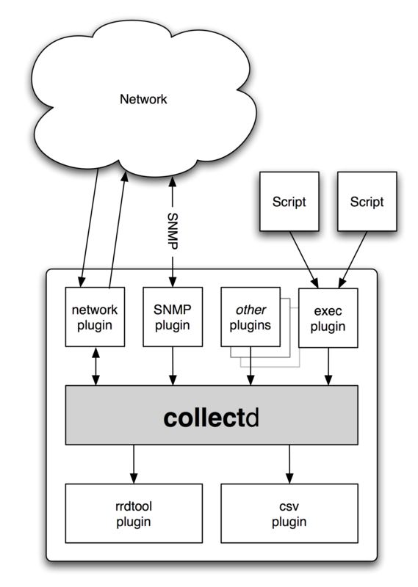
collectd
collectd collects performance data of systems
Some (simple) examples: CPU utilization memory utilization network traffic •
collectd collects and stores the performance data
Stored data is usually used to generate graphs
performance analysis, capacity planning

Slide 39
collectd
collectd collects performance data of systems
Some (simple) examples: CPU utilization memory utilization network traffic •
collectd collects and stores the performance data
Stored data is usually used to generate graphs
performance analysis, capacity planning
Plugin architecture: https://collectd.org/wiki/index.php/Table_of_Plugins

Slide 40
cAdvisor
Collects, aggregates, processes, and exports information about running containers.

Slide 41

Container OS Metric
cAdvisor (Container Advisor) provides container users an understanding of the resource usage and performance characteristics of their running containers.
It is a running daemon that collects, aggregates, processes, and exports information about running containers.
Specifically, for each container it keeps resource isolation parameters, historical resource usage, histograms of complete historical resource usage and network statistics.
This data is exported by container and machine-wide.
Kubernetes Cluster
Monitor
K8S Master
API Server
InfluxDB
Grafana
cAdvisor
Database
Elasticsearch
K8S Minion
K8S Minion
kube
cAdvisor
cAdvisor
https://github.com/google/cadvisor

Slide 42

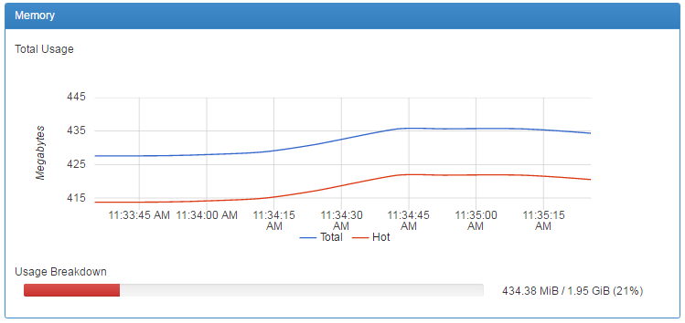
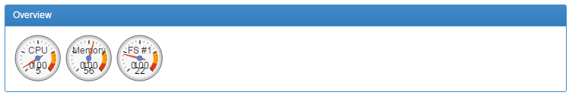
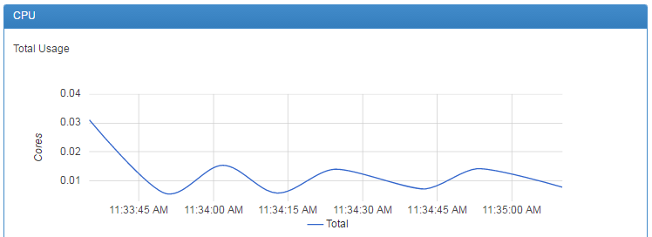
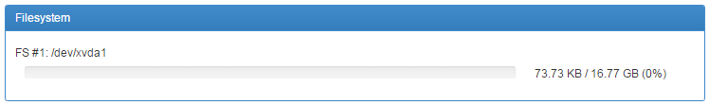
http://127.0.0.1:4194
http://127.0.0.1:4194/metrics

Slide 43
Telegraf
Collects time series data from a variety of sources

Slide 44
Application Metric – Pull Mode
Kubernetes Cluster
Monitor
Telegraf
K8S Master
API Server
InfluxDB
Grafana
Database
Elasticsearch
K8S Minion
K8S Minion
Postgres
ES
Nginx
Redis

Slide 45
Application Metric – Push Mode
Kubernetes Cluster
Monitor
K8S Master
API Server
InfluxDB
Grafana
Database
Elasticsearch
K8S Minion
K8S Minion
Postgres
ES
Nginx
Redis
Pod
Pod
Telegraf
Telegraf
Telegraf
Telegraf

Slide 46

Telegraf
An agent written in Go
Easy to contribute or develop your plugins
Supported Input Plugins
System: cpu, mem, net, disk, processes and etc.
Application: docker, nginx, postgresql, redis, and etc.
Third party api: aws cloudwatch
Supported output plugins
influxdb, graphite, cloudwatch, datadog and etc.

Slide 47
Pull Mode
Collector discoveries services
periodically
Collector needs to talk to target
services
Overlay network. Ex: Flannel,
Weave, etc.
Forward proxy
Server #1
Service
Scrape Metrics
Server #2
Service
Monitoring
Server #3
Service

Slide 48
Push Mode
Agent sends metrics as soon as it
starts up
Suitable for short-lived containers
or dynamic environments
Server #1
Agent
Push
Metrics
Server #2
Agent
Monitoring
Server #3
Agent

Slide 49
Storing Metrics
Influx DB

Slide 50

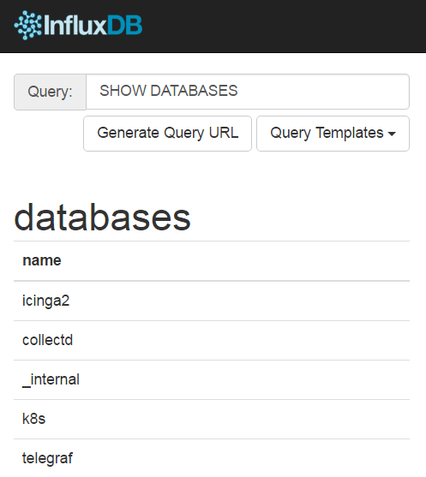
Written in Go
No external dependency
Ready for billions row
Several client libraries
SQL style queries

Slide 51
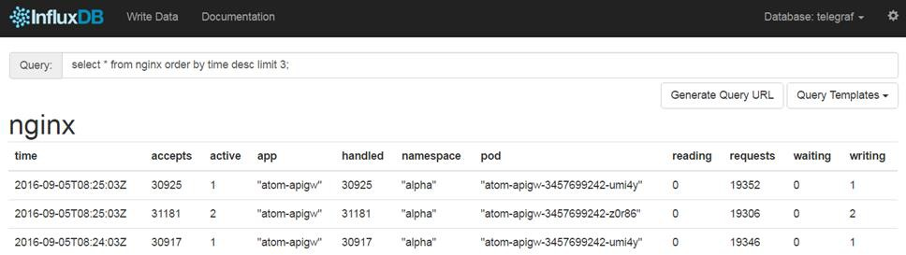
InfluxDB Schema
Measurements (e.g. cpu, mem, disk, net, nginx)
Timestamp (nano second)
Tags (e.g. app=atom-apigw namespace=alpha)
Fields (e.g. accepts=30925, active=1, handled=30925)

Slide 52
InfluxDB Schema
Measurements (e.g. cpu, mem, disk, net, nginx)
Timestamp (nano second)
Tags (e.g. app=atom-apigw namespace=alpha)
Fields (e.g. accepts=30925, active=1, handled=30925)
Copyright 2016 Trend Micro Inc.

Slide 53
InfluxDB Schema
Measurements (e.g. cpu, mem, disk, net, nginx)
Timestamp (nano second)
Tags (e.g. app=atom-apigw namespace=alpha)
Fields (e.g. accepts=30925, active=1, handled=30925)

Slide 54
InfluxDB Schema
Measurements (e.g. cpu, mem, disk, net, nginx)
Timestamp (nano second)
Tags (e.g. app=atom-apigw namespace=alpha)
Fields (e.g. accepts=30925, active=1, handled=30925)

Slide 55
InfluxDB Schema
Measurements (e.g. cpu, mem, disk, net, nginx)
Timestamp (nano second)
Tags (e.g. app=atom-apigw namespace=alpha)
Fields (e.g. accepts=30925, active=1, handled=30925)

Slide 56
Visualization
Grafana

Slide 57
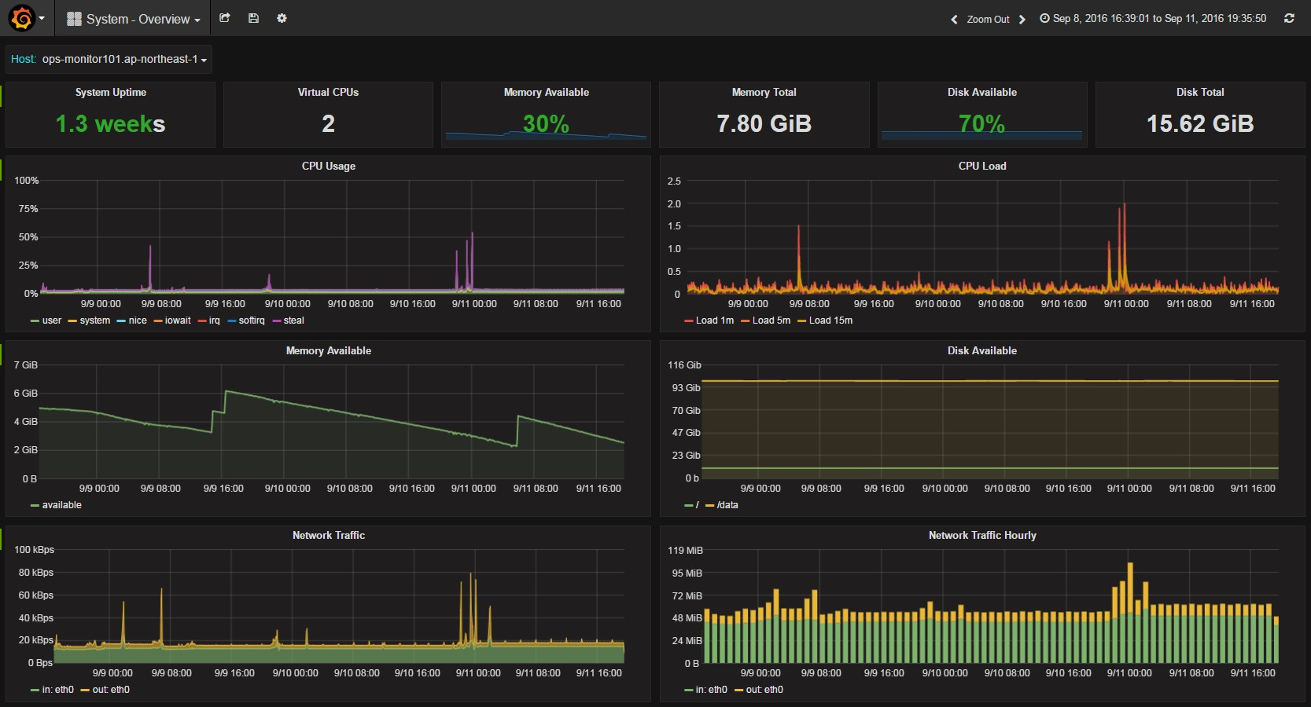
32 Copyright 2016 Trend Micro Inc.

Slide 58
Events – Identifying changes

Slide 59

Originally forked from Nagios in 2009
Independent version Icinga2 since 2014
Monitors everything
Gathering status
Collect performance data
/use/lib/nagios/plugins/plugin_name
Any program which returns
0 – OK
1 – WARNING
2 – CRITICAL
Message to STDOUT

Slide 60
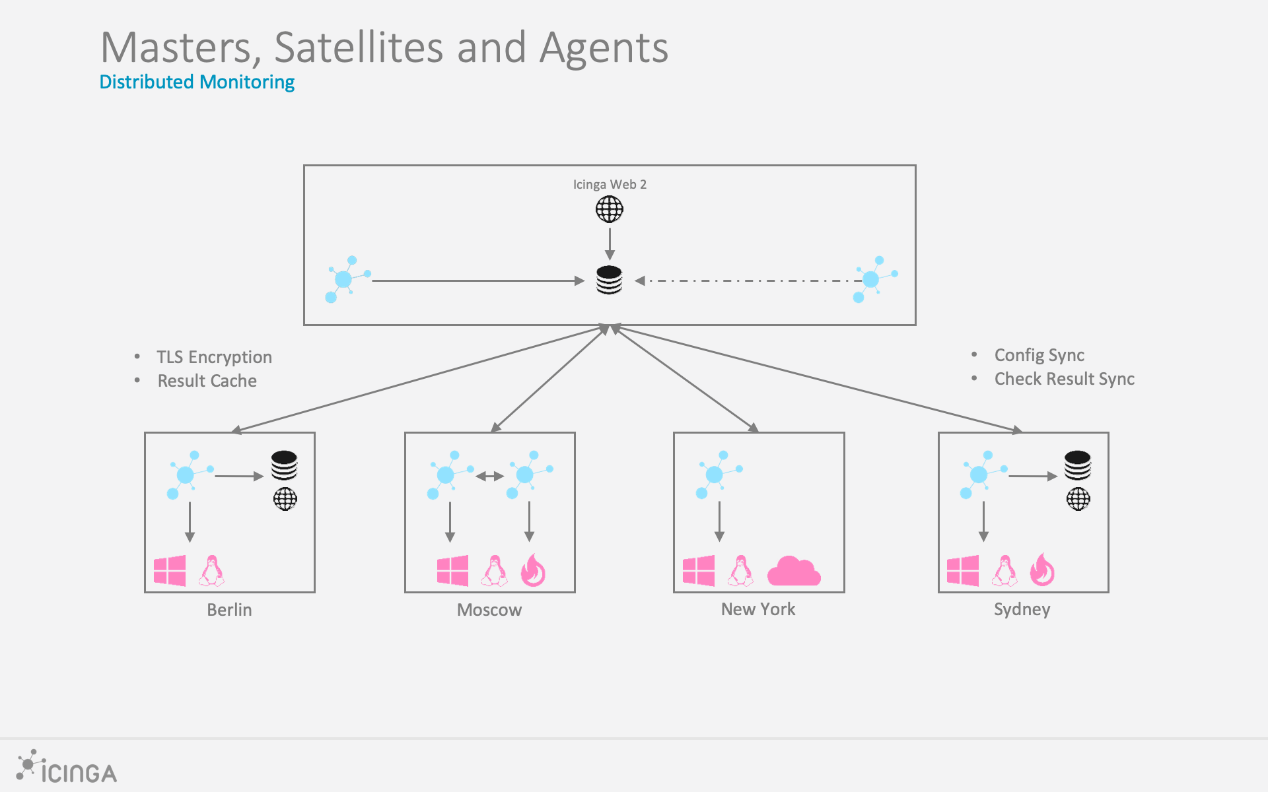
Icinga2
A monitoring system which checks the availability of your resources, notifies users of outages
https://icinga.com/docs/icinga2/latest/doc/03-monitoring-basics/

Slide 61
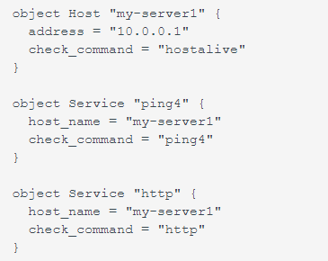
Icinga example
The example creates two services ping4 and http which belong to the host my-server1.
It also specifies that the host should perform its own check using the host alive check command.
The address attribute is used by check commands to determine which network address is associated with the host object.

Slide 62
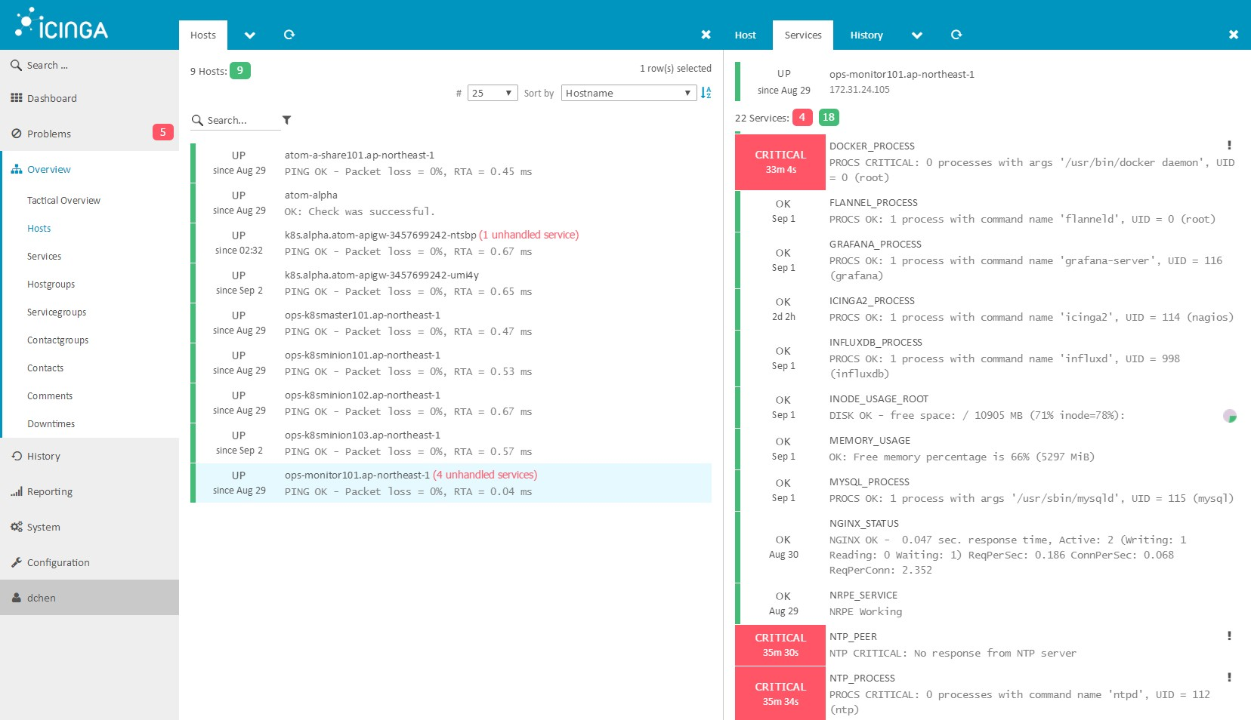
Icinga example 2

Slide 63
Summary

Slide 64
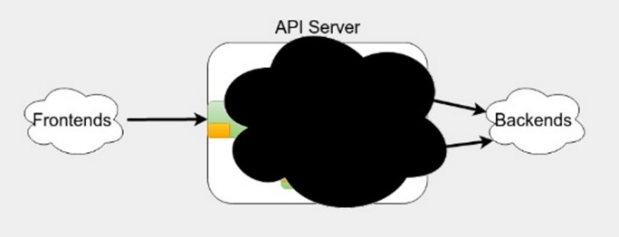
Server Monitoring
About changes and occurrences in our environment
Is cpu load too high?
Is memory not enough?
Is docker engine still alive?
External Monitoring
End to end test from user’s perspective
Can you connect ssh port 22?
Can you browse web page?
Can you request RESTful API successfully?

Slide 65
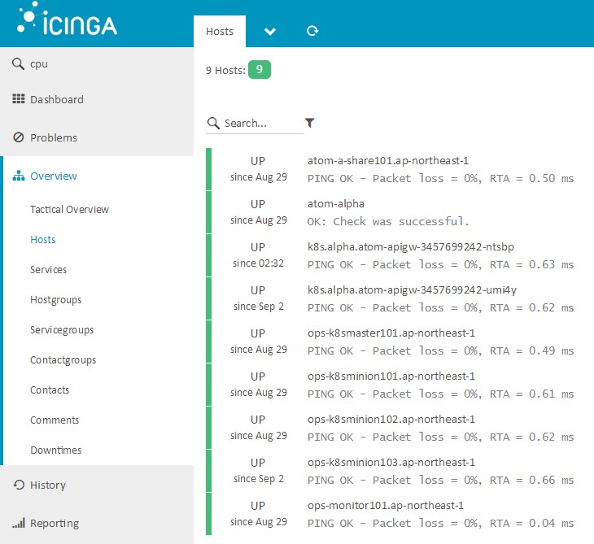




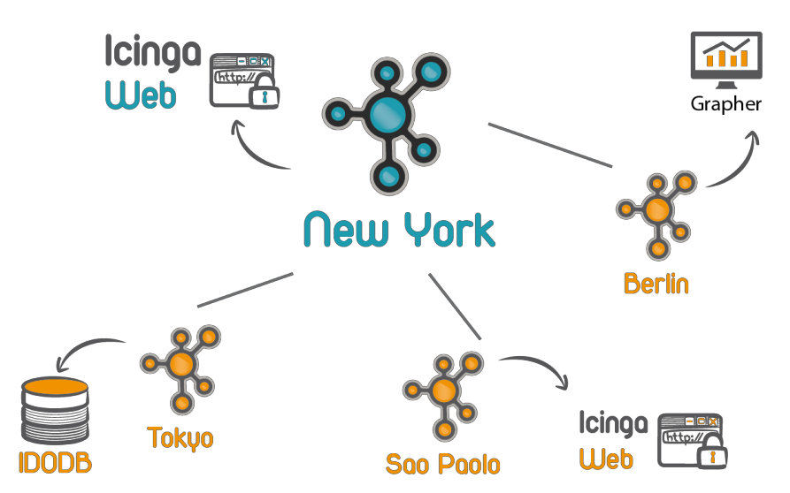
Dashboard
Provides a clear view for current environment
Alerting
Notifies using email, slack, pager and etc.
Notification escalation
Others…
Distributed Monitoring
Reloads config without interrupt checks

Slide 66








Monitoring Service Stack
Collect
Store
Visualize
Alert
Collectd
cAdvisor
InfluxDB
Grafana
Icinga2
Telegraf
Fluentd
Elasticserach
Kibana

