Slide 1
Exponential Distribution
Think about usually how long it takes for the elevator to arrive.
Most likely, the it frequently comes in a short while and once in a while, it may come pretty late.
In another word, if we want to use a random variable to measure the waiting time for elevator to come, we can say that:
1. It must be continuous.
2. Smaller values have larger probability and larger values have smaller probability.

Slide 2
Exponential Distribution
Usually, exponential distribution is used to describe the time or distance until some event happens.
It is in the form of:
where x ≥ 0 and μ>0. μ is the mean or expected value.

Slide 3
Another form of exponential distribution
In this case,
Then the mean or expected value is

Slide 4
Exponential Distribution and Poisson Distribution
Poisson is a discrete random variable that measures the number of occurrence of some given event over a specific interval (time, distance)
Exponential describes the length of the interval between occurrence.

Slide 5

Survivor function
f(x)=λexp{−λx}.
The survivor function is showing the probability of X>t
Obtained by
= exp{−λxt}.

Slide 6
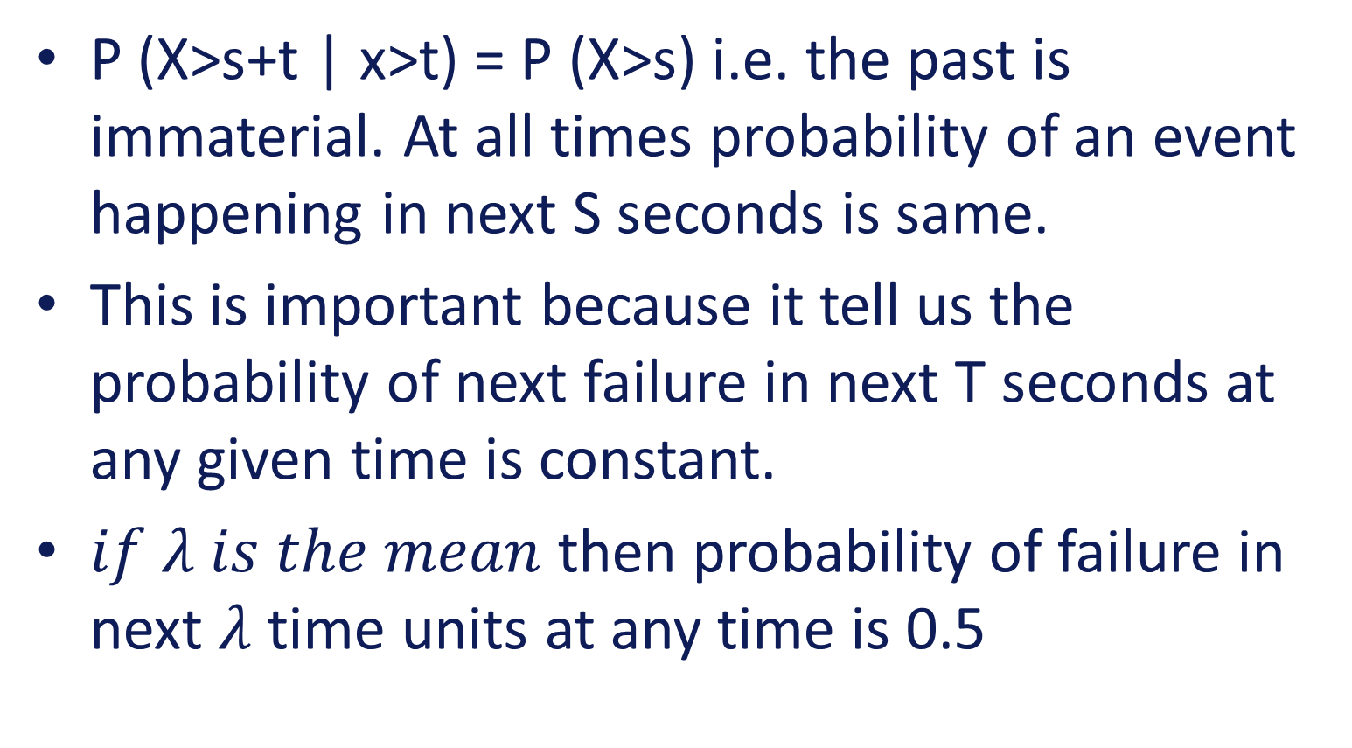
Important: memory less property of Survivor Function
P (X>s+t | x>t) = P (X>s) i.e. the past is immaterial. At all times probability of an event happening in next S seconds is same.
This is important because it tell us the probability of next failure in next T seconds at any given time is constant.
$if λ is the mean$ then probability of failure in next $λ$ time units at any time is 0.5

Slide 7

Memory less proof.
$P\left(X>s\right)P\left(X>t\right)={e^{−s/a}}^{}{e^{−\frac{t}{a}}}^{}$
$=e^{−(s+t)/a}$
P(X>s+t)

Slide 8


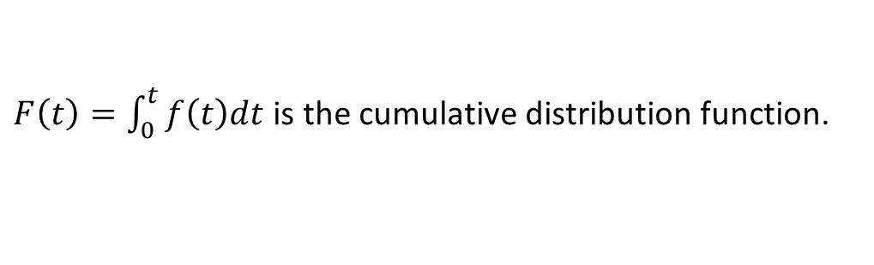



Reliability function and failure rate
For a pdf $f(x)$ for the time till failure, define:
Reliability function
Probability of surviving at least till age $t$. i.e. that failure time is later than $t$
$$R\left(t\right)=P\left(T>t\right)=\int_{t}^{∞}{f\left(x\right)dx}$$
$$=1−F(t)$$
$F\left(t\right)=\int_{0}^{t}{f\left(t\right)dt}$is the cumulative distribution function.
Failure rate (aka Hazard Rate)
This is failure rate at time $t$ given that it survived until time $t$:
$$φ\left(t\right)=\frac{f\left(t\right)}{R\left(t\right)}$$

Slide 9
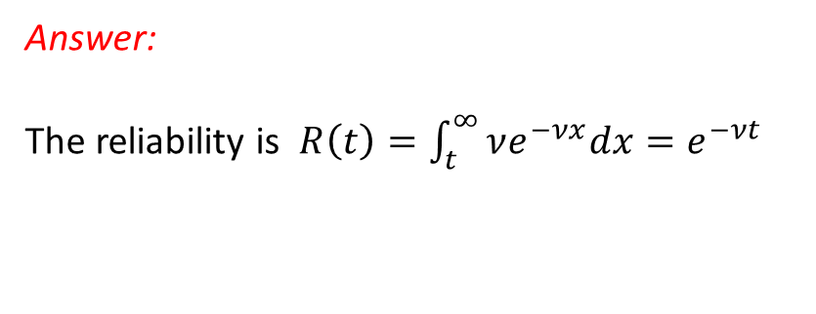


Example: Find the failure rate of the Exponential distribution
Answer:
The reliability is $R\left(t\right)=\int_{t}^{∞}{νe^{−νx}dx}=e^{−νt}$
Failure rate, $φ\left(t\right)=\frac{f\left(t\right)}{R\left(t\right)}=\frac{νe^{−νt}}{e^{−νt}}=ν$
Note: $ν$ is a constant
The fact that the failure rate is constant is a special “lack of ageing property” of the exponential distribution.
- But often failure rates actually increase with age.

Slide 10
Reliability Block Diagram and Fault Tree Analysis

Slide 11
Review
Degradation related failures
Exponential distribution
Random Variable: Time between failure events
Reliability computation
Memoryless property
Estimating mean time to failure.
Poisson Distribution
Number of failure events
Poisson is a special case of binomial distribution

Slide 12



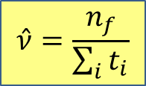
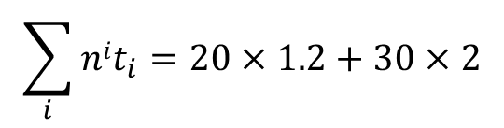
Review- Right censuring testing
Example:
50 components are tested for two weeks. 20 of them fail in this time, with an average failure time of 1.2 weeks.
What is the mean time till failure assuming a constant failure rate?
Answer:
$$\hat{ν}=\frac{n_{f}}{\sum_{i}{t_{i}}}$$
$n=50$, $n_{f}=20$
$$\sum_{i}{nit_{i}}=20×1.2+30×2$$
$=84$ weeks
$$⇒\hat{ν}=\frac{n_{f}}{\sum_{i}{t_{i}}}=\frac{20}{84}=0.238/week$$
$⇒$ mean time till failure is estimated to be $\frac{1}{\hat{ν}}=\frac{1}{0.238}=4.2 weeks$

Slide 13
System Dependability Models
Reliability Graph
Fault Trees
Probabilistic fault trees
Reliability Block Diagrams
Timed Failure Propagation Graphs (covered later in the class)

Slide 14
System Reliability
A system usually consists of components
Each component consists of sub-components
Components may have
Different reliability
Different dependencies between them
System reliability is a function of the reliabilities of the (sub-) components and of the relationships between the components

Slide 15
Problem
For a system consisting of n components
Every component can be in one of the two conditions: working or failed
How many possible combinations of the status of these n components?
How do you calculate the reliability of the system given the probability of each component being working (or failed)?

Slide 16
RBD – reliability block diagram
Reliability Block Diagram (RBD) is a graphical representation of how the components of a system are connected from reliability point of view.
RBD is used to model the various series-parallel and complex block combinations (paths) that result in system success.
Reliability of the system is derived in terms of reliabilities of its individual components.
The most common configurations of an RBD are the series and parallel configurations.
A system is usually composed of combinations of serial and parallel configurations.
RBD analysis is essential for determining reliability, availability and down time of the system.

Slide 17
RBD
Reliability Block Diagram helps reliability analysis using a functional diagram to portray and analyze the reliability relationship of components in a system.
Each element of a system is represented by a block that is in some way interconnected with or through the other blocks of the system at a desired level of assembly. The basic relationship between components are depicted as lines that may be:
Serial: if a single failure results in entire assembly or system failure
Parallel: if all redundant units failure causes system failure
Or a combination of these two

Slide 18
RBD
In a serial system configuration, the elements must all work for the system to work and the system fails if one of the components fails. The overall reliability of a serial system is lower than the reliability of its individual components.
In parallel configuration, the components are considered to be redundant and the system will still cease to work if all the parallel components fail. The overall reliability of a parallel system is higher than the reliability of its individual components.

Slide 19
RBD - Steps
Define boundary of the system for analysis
Break system into functional components
Determine serial-parallel combinations
Represent each components as a separate block in the diagram
Draw lines connecting the blocks in a logical order for mission success

Slide 20

Example (serial RBD)
No redundancy
ALL component of the system are needed to make the system function properly
If any one of the components fails, the system fails
Example
System block diagram
Power Unit
Processor
Monitor

Slide 21
Example (Series RBD)
Reliability Block Diagram
System is composed of n independent serially connected components.
Failure of any component has a cross system effect, i.e., results in failure of the whole system.
...
R₁/λ₁ R₂ /λ₂
Example
Power Unit
R /λ
Processor
R /λ
Monitor
R /λ
Power Unit
R1 /λ1
Processor
R2 /λ2
Monitor
R3 /λ3
1 1
2 2
3 3

Slide 22

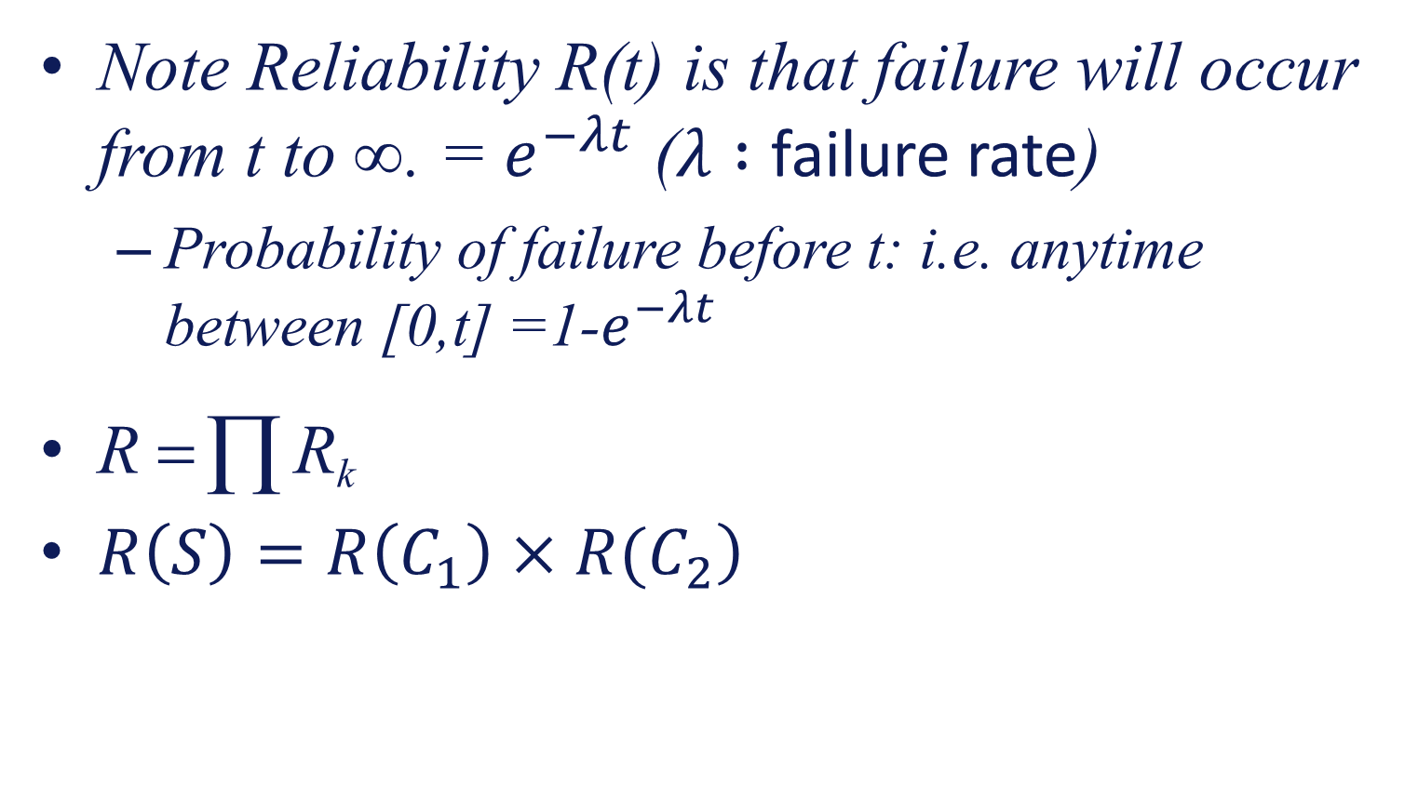
Example (Series RBD)
Note Reliability R(t) is that failure will occur from t to ∞. = $e^{−λt}$ ($λ :$ failure rate)
Probability of failure before t: i.e. anytime between [0,t] =1-$e^{−λt}$
R = ∏ R_{k}
$\left.R\left(S\right)=R\left(C_{1}\right)×R(C_{2}\right)$

Slide 23
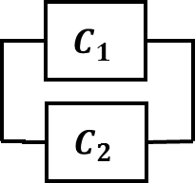
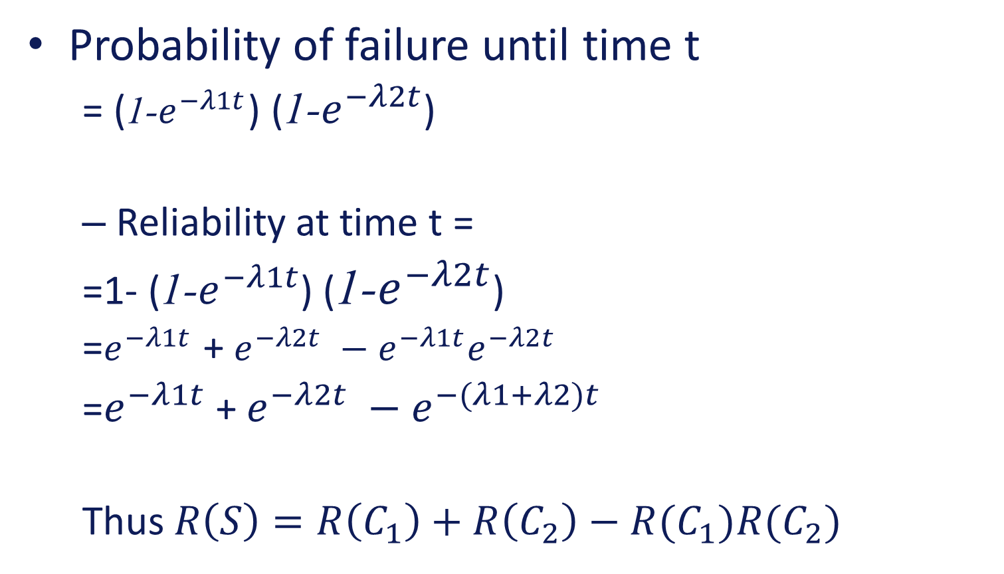
Parallel connections
Probability of failure until time t
= (1-$e^{−λ1t}$) (1-$e^{−λ2t}$)
Reliability at time t =
=1- (1-$e^{−λ1t}$) (1-$e^{−λ2t}$)
=$e^{−λ1t}$ + $e^{−λ2t} −e^{−λ1t}e^{−λ2t}$
=$e^{−λ1t}$ + $e^{−λ2t} −e^{−(λ1+λ2)t}$
Thus $R\left(S\right)=R\left(C_{1}\right)+R\left(C_{2}\right)−R(C_{1})R(C_{2})$

Slide 24
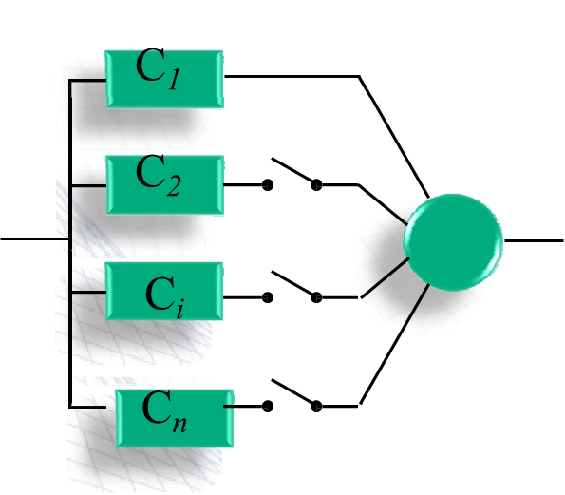
Reliability of redundant structures
Redundancy is the duplication of critical components in a system in order to improve reliability.
Redundancy is normally a parallel connection of identical components – can be active or standby
Standby parallel (the redundant component is started when the primary fails.) e.g., telephone switching circuits)
This is done in sequence until no components left
Standby-parallel

Slide 25
Reliability of active and standby systems
Reliability of active redundant system is same as a parallel connection

Slide 26
Reliability of standby systems
The standby system does not start operating until the primary unit fails
The system can survive until time t if the primary unit survives until time t or the primary unit fails before time t, but the second unit survives until time t

Slide 27
Reliability of standby systems
Assuming we are computing the reliability at time t
The two possibilities can be restated as T₁ > t or T₁ occurs at α < t and T₂ > t − α (because the second unit was not started till α)

Slide 28
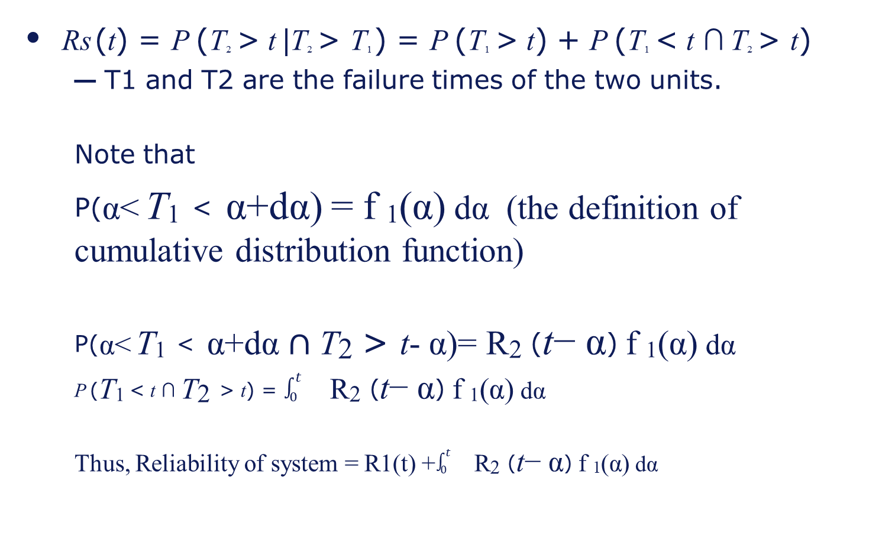
Reliability of standby systems
Rs (t) = P (T2 > t |T2 > T1 ) = P (T1 > t) + P (T1 < t ∩ T2 > t)
T1 and T2 are the failure times of the two units.
Note that
P(α< T₁ < α+dα) = f ₁(α) dα (the definition of cumulative distribution function)
P(α< T₁ < α+dα $∩\text{T}\text{2 }\text{> }\text{t}\text{−}$ α)= R$\text{2}$ ($\text{t}\text{−}$ α) f ₁(α) dα
P (T₁ < t ∩ $\text{T}\text{2}$ > t) = $\int_{0}^{t}{}\text{R}\text{2}\text{ (}\text{t}\text{−} \text{α}\text{)} \text{f} \text{1}\text{(}\text{α}\text{)} \text{d}\text{α}$
Thus, Reliability of system = R1(t) +$\int_{0}^{t}{}\text{R}\text{2}\text{ (}\text{t}\text{−} \text{α}\text{)} \text{f} \text{1}\text{(}\text{α}\text{)} \text{d}\text{α}$

Slide 29
Fault Tree Analysis
Fault tree analysis is a graphical representation of the major faults or critical failures associated with a product, the causes for the faults, and potential countermeasures. FTA helps identify areas of concern for new system design or for improvement of existing systems. It also helps identify corrective actions to correct or mitigate problems.
FTA can also be defined as a graphic “model” of the pathways within a system that can lead to a foreseeable, undesirable event. The pathways interconnect contributory events and conditions, using standard logic symbols.
Fault tree analysis is useful both in designing new systems, products or services or in dealing with identified problems in existing products/services. As part of process improvement, it can be used to help identify root causes of trouble and to design remedies and countermeasures.

Slide 30
FTA Operators
And Gate
The preceding events must all happen to enable the output (parallel RBD connection)
Or Gate
Either of the two events can lead to the undesirable output (series RBD connection)

Slide 31
FTA
Hazard
AND
Basic Event₁
Basic Event₂
Compound Event_{A}
Basic Event₅
OR
Hazard arises only if basic events 1, 2 and 5 occur AND compound event A occurs.
Compound event A occurs if basic event 3 OR 4 occurs.
Basic Event₃
Basic Event₄

Slide 32
FTA – with probabilities (reliability)
Hazard
P₅ x P₄ x (P₁+P₂) x P₃
AND
Multiplication because of AND
P₁+P₂ P₃
P₅
P₄
Basic Event
Basic Event
Compound Event
Basic Event
OR
All events assumed independent in this case.
Basic Event
Basic Event
P₁
P₂

Slide 33
History of FTA
FTA was first used by Bell Labs in connection with the safety analysis of the Minuteman missile launch control system in 1961.
Boeing further developed the technique, applying it to the entire Minuteman system and then to commercial aircraft.
Boeing applied FTA as part of a comprehensive safety review of the Apollo system following the launch pad fire on January 27, 1967.
FTA was used in the WASH-1400 study (1976) conducted to review nuclear plant power design and to assure the public that the probability of nuclear accidents was very small. The 3-mile island accident occurred March 28, 1979.

Slide 34





































Example Flight Display
Network Cpnnection
Database Servers
Application Servers
Display Client
Operator’s Console
Airport display system
Critical information source
Public Displays

Slide 35
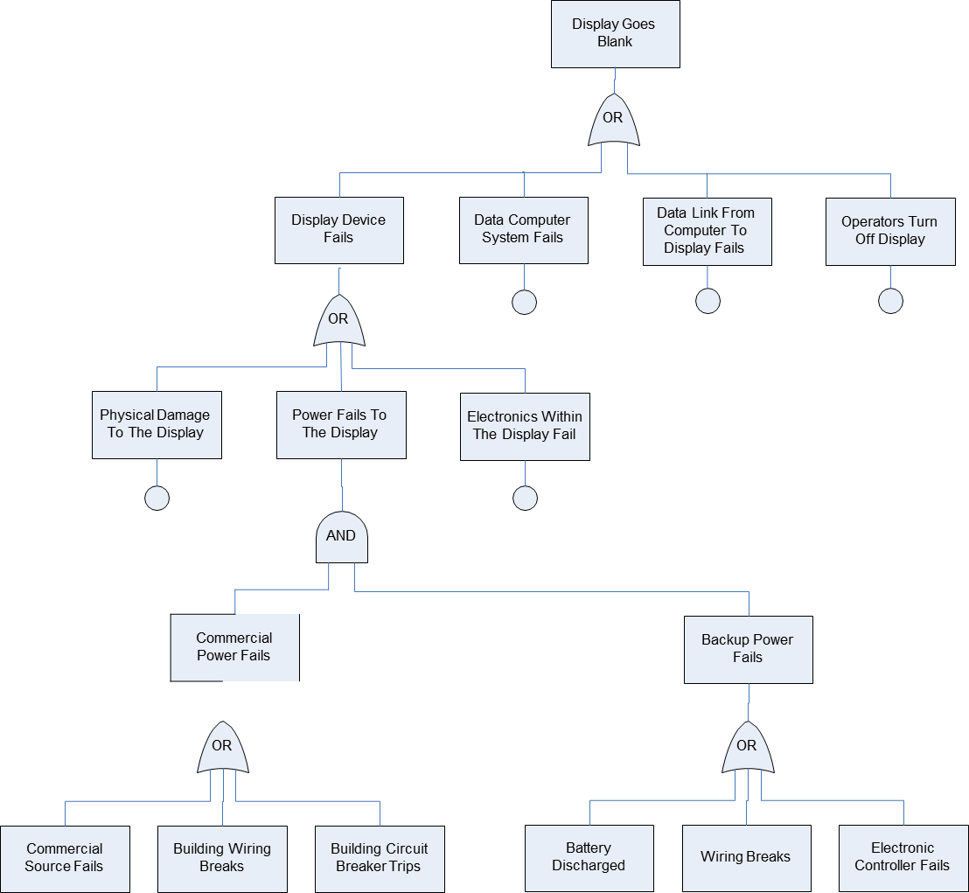
Display fault tree
Airport flight departure display
Hazards:
No display
Faulty data
Fault trees identify possible causes

Slide 36
Software and fault trees
Events corresponding to software failure will be present in fault tree
How do we deal with them?
Is event probability a meaningful concept?
What is the probability that the software will fail:
1?
0?
Neither?
Be careful with this — correct approach is to model the operating environment the software will see
Probability is actually the probability of an input vector arising that causes a software fault to manifest itself

Slide 37
FTA: Summary
Benefits: The primary advantages of fault tree analyses are the meaningful data they produce which allow evaluation and improvement of the overall reliability of the system. It also evaluates the effectiveness of and need for redundancy.
Limitation: The undesired event evaluated must be foreseen and all significant contributors to the failure must be anticipated. This effort may be very time consuming and expensive. Finally, the overall success of the process depends on the skill of the analyst involved.
Tend to be very large for real systems
Evolve as insight is gained

Slide 38
Cut Sets
A cut set is a set of basic events whose simultaneous occurrence insures that the TOP (TOP of the Fault tree) event occurs.
A cut set is minimal if it cannot be reduced without losing its status as a cut set.

Slide 39
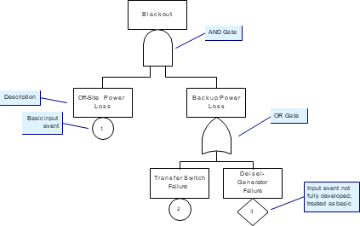
Example
cut sets
{1, 2, 3} , {1, 2} , {1, 3}
minimal cut sets
{1, 2} , {1, 3}
Cut sets are used to simplify reliability computation in complex system.
They can also help find bottlenecks

