Slide 1
Resilient Distributed Systems
Networking Background
Abhishek Dubey
Fall 2019
Notes:
Module 1 and 2

Slide 2
Networking Introduction
Sockets are a method of IPC that allow data to be exchanged between applications, either on the same host (computer) or on different hosts connected by a network
In a typical client-server scenario, applications communicate using sockets as follows:
Each application creates a socket. A socket is the “apparatus” that allows communication, and both applications require one.
The server binds its socket to a well-known address (name) so that clients can locate it.

Slide 3
Sockets
A socket is created using the socket() system call, which returns a file descriptor used to refer to the socket in subsequent system calls:
fd = socket(domain, type, protocol);
Q: Do you remember what is a file descriptor?

Slide 4
Socket Domains
Modern operating systems support at least the following domains:
The UNIX (AF_UNIX) domain allows communication between applications on the same host. (POSIX.1g used the name AF_LOCAL as a synonym for AF_UNIX, but this name is not used in SUSv3.)
The IPv4 (AF_INET) domain allows communication between applications running on hosts connected via an Internet Protocol version 4 (IPv4) network.
The IPv6 (AF_INET6) domain allows communication between applications running on hosts connected via an Internet Protocol version 6 (IPv6) network.
Although IPv6 is designed as the successor to IPv4, the latter protocol is currently still the most widely used.

Slide 5
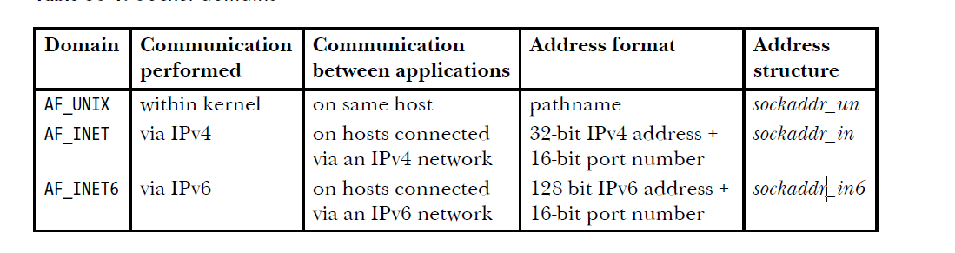
Socket Domains
Q: What is an IP Address?

Slide 6
Stream Sockets
Stream sockets (SOCK_STREAM) provide a reliable, bidirectional, byte-stream communication channel. By the terms in this description, we mean the following:
Reliable means that we are guaranteed that either the transmitted data will arrive intact at the receiving application, exactly as it was transmitted by the sender (assuming that neither the network link nor the receiver crashes), or that we’ll receive notification of a probable failure in transmission.
Bidirectional means that data may be transmitted in either direction between two sockets.
Byte-stream means that, as with pipes, there is no concept of message boundaries
Stream sockets operate in connected pairs. For this reason, stream sockets are described as connection-oriented
The term peer socket refers to the socket at the other end of a connection; peer address denotes the address of that socket; and peer application denotes the application utilizing the peer socket
Sometimes, the term remote (or foreign) is used synonymously with peer. Analogously, sometimes the term local is used to refer to the application, socket, or address for this end of the connection. A stream socket can be connected to only one peer.

Slide 7
Datagram Sockets
Datagram sockets (SOCK_DGRAM) allow data to be exchanged in the form of messages called datagrams. With datagram sockets, message boundaries are preserved, but data transmission is not reliable. Messages may arrive out of order, be duplicated, or not arrive at all.
Datagram sockets are an example of the more generic concept of a connectionless socket. Unlike a stream socket, a datagram socket doesn’t need to be connected to another socket in order to be used.

Slide 8
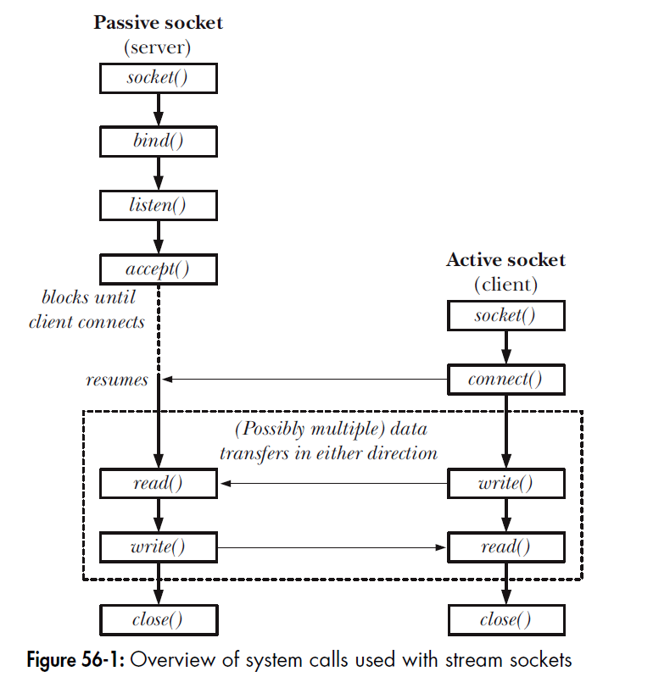
Socket System Calls
The socket() system call creates a new socket.
The bind() system call binds a socket to an address. Usually, a server employs this call to bind its socket to a well-known address so that clients can locate the socket.
The listen() system call allows a stream socket to accept incoming connections from other sockets.
The accept() system call accepts a connection from a peer application on a listening stream socket, and optionally returns the address of the peer socket.
The connect() system call establishes a connection with another socket.

Slide 9
Let's now look at an example in use for both stream socket and datagram socket

Slide 10
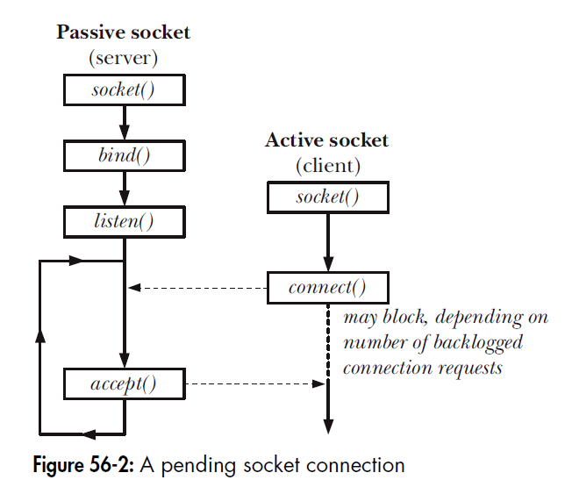
The concept of backlog
We can’t apply listen() to a connected socket—that is, a socket on which a connect() has been successfully performed or a socket returned by a call to accept().
The kernel must record some information about each pending connection request so that a subsequent accept() can be processed. The backlog argument allows us to limit the number of such pending connections. Connection requests up to this limit succeed immediately.
A pending socket connection

Slide 11
Accept
server_address = ('localhost', 10000) print('starting up on {} port {}'.format(*server_address)) sock.bind(server_address)
# Listen for incoming connections sock.listen(1)
while True: # Wait for a connection print('waiting for a connection') connection, client_address = sock.accept() try: print('connection from', client_address)
# Receive the data in small chunks and retransmit it while True: data = connection.recv(16) print('received {!r}'.format(data)) if data: print('sending data back to the client') connection.sendall(data) else: print('no data from', client_address) break
finally: # Clean up the connection connection.close()
The key point to understand about accept() is that it creates a new socket, and it is this new socket that is connected to the peer socket that performed the connect().
A file descriptor for the connected socket is returned as the function result of the accept() call. The listening socket (sockfd) remains open, and can be used to accept further connections.
A typical server application creates one listening socket, binds it to a well-known address, and then handles all client requests by accepting connections via that socket

Slide 12
Connect
The connect() system call connects the active socket referred to by the file descriptor sockfd to the listening socket whose address is specified by addr and addrlen.
# Create a TCP/IP socket sock = socket.socket(socket.AF_INET, socket.SOCK_STREAM)
# Connect the socket to the port where the server is listening server_address = ('localhost', 10000) print('connecting to {} port {}'.format(*server_address)) sock.connect(server_address)

Slide 13
Close and input output
The usual way of terminating a stream socket connection is to call close().
If multiple file descriptors refer to the same socket, then the connection is terminated when all of the descriptors are closed.
Q – when will you have multiple descriptors for the same socket?
To perform I/O, we use the read() and write() system calls (or the socket-specific send() and recv(),

Slide 14
TCP/IP and Networks

Slide 15
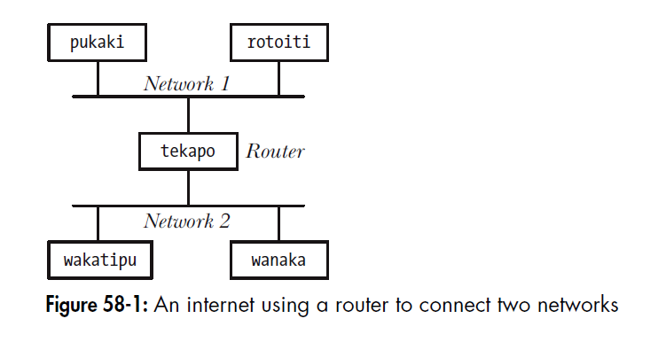
Router
A router has multiple network interfaces, one for each of the subnets to which it is connected.
The more general term multihomed host is used for any host—not necessarily a router—with multiple network interfaces. (Another way of describing a router is to say that it is a multihomed host that forwards packets from one subnet to another.)
A multihomed host has a different network address for each of its interfaces (i.e., a different address on each of the subnets to which it is connected).

Slide 16
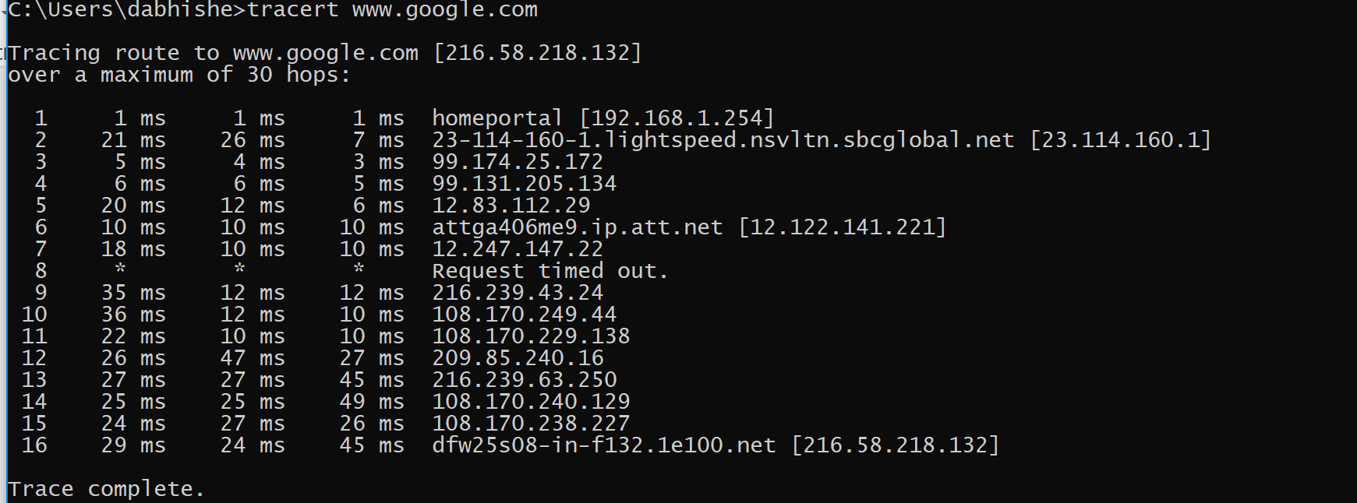
Tracert – example of networked connection

Slide 17
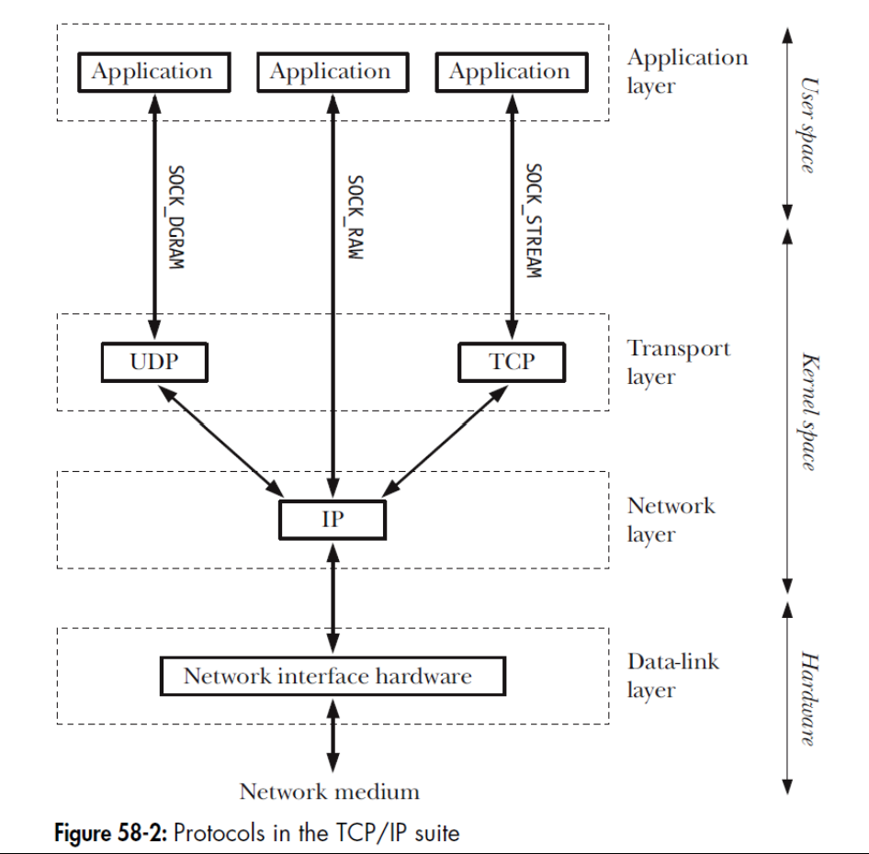
Protocol
A networking protocol is a set of rules defining how information is to be transmitted across a network.
Networking protocols are generally organized as a series of layers, with each layer building on the layer below it to add features that are made available to higher layers.
The code that implements these various layers is commonly referred to as a protocol stack

Slide 18
Protocol
Includes
Syntax: how a communication is specified and structured
Format of messages sent and received
Order of messages
Semantics: what a communication means
What actions are taken when transmitting, receiving, or when a timer expires

Slide 19
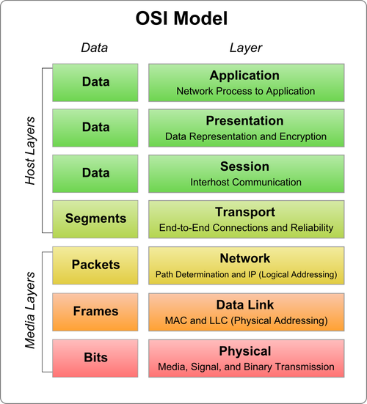
Why layering
One of the notions that lends great power and flexibility to protocol layering is transparency—each protocol layer shields higher layers from the operation and complexity of lower layers
It also provides a place you can do error checks.

Slide 20
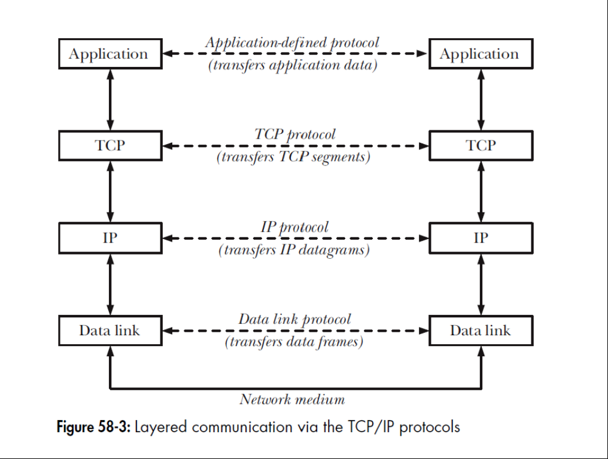
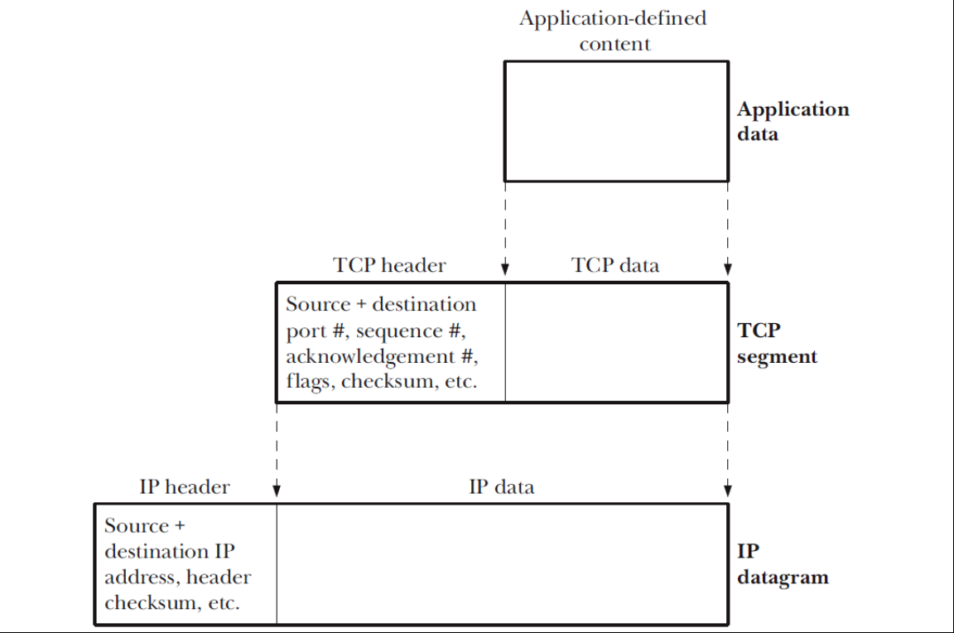
Layered Communication via the TCP/IP
Additional meta data is added through layers

Slide 21

Network layer: IP
Problem
Many different network technologies
E.g., Ethernet, WiFi, fiber, Satellite, etc.
How can you hook them together?
n x n translations
IP was designed to glue them together
n translations
Minimal requirements (datagram)
The Internet is founded on IP
“IP over everything”
Packet switching
Divide messages into a sequence of packets
Each packet (datagram) is dealt with individually
“Best-effort” delivery
Packets may be lost
Packets may be corrupted
Packets may be delivered out of order
The same packet may be delivered multiple times
source
destination
IP network

Slide 22
Network Layer: IP
Most routers operate at this level. There is no difference between TCP and UDP at this level.
Above the data-link layer is the network layer, which is concerned with delivering packets (data) from the source host to the destination host. This layer performs a variety of tasks, including:

Slide 23
More about IP
IP is responsible for breaking data into fragments small enough for transmission via the data-link layer (if necessary);
routing data across the internet; and
providing services to the transport layer.
IP is described as a connectionless protocol, since it doesn’t provide the notion of a virtual circuit connecting two hosts.
IP is also an unreliable protocol: it makes a “best effort” to transmit datagrams from the sender to the receiver, but doesn’t guarantee that packets will arrive in the order they were transmitted, that they won’t be duplicated, or even that they will arrive at all.

Slide 24
More about IP …
IPv4 datagrams can be up to 65,535 bytes. By default, IPv6 allows datagrams of up to 65,575 bytes (40 bytes for the header, 65,535 bytes for data), and provides an option for larger datagrams (so-called jumbograms).
When an IP datagram is larger than the MTU, IP fragments (breaks up) the datagram into suitably sized units for transmission across the network.
These fragments are then reassembled at the final destination to re-create the original datagram.
Each IP fragment is itself an IP datagram that contains an offset field giving the location of that fragment within the original datagram.
IP fragmentation occurs transparently to higher protocol layers, but nevertheless is generally considered undesirable -- why? In some cases, this can lead to significant rates of data loss (for higher protocol layers that don’t perform retransmission, such as UDP) or degraded transfer rates (for higher protocol layers that do perform retransmission, such as TCP)

Slide 25
IP Header: The foundation of Current Computer Communications
4-bit
Version
4-bit
Header
Length
8-bit
Type of Service
(TOS)
Addresses: datagram destination & source
Framing: datagram length
Priority: any special forwarding?
Extensibility: what if we need to tweak/change IP?
Dealing with problems:
Integrity: is the header what it’s supposed to be?
Loop avoidance: make sure packets don’t endlessly circulate
Fragmentation: what if the datagram is too large?
16-bit Total Length (Bytes)
16-bit Identification
3-bit
Flags
13-bit Fragment Offset
8-bit Time to
Live (TTL)
8-bit Protocol
16-bit Header Checksum
IP Header
32-bit Source IP Address
32-bit Destination IP Address
Options (if any) + Padding (if needed)
Payload

Slide 26
IP Packet Header Fields
Version number (4 bits)
Indicates the version of the IP protocol
Necessary to know what other fields to expect
Typically “4” (for IPv4), and sometimes “6” (for IPv6)
Header length (4 bits)
Number of 32-bit words in the header
Typically “5” (for a 20-byte IPv4 header)
Can be more when IP options are used
Type-of-Service (8 bits)
Allow packets to be treated differently based on needs
E.g., low delay for audio, high bandwidth for bulk transfer
4-bit
Version
4-bit
Header
Length
8-bit
Type of Service
(TOS)
16-bit Total Length (Bytes)
16-bit Identification
3-bit
Flags
13-bit Fragment Offset
8-bit Time to
Live (TTL)
8-bit Protocol
16-bit Header Checksum
32-bit Source IP Address
32-bit Destination IP Address
Options (if any) + Padding (if needed)
Payload

Slide 27
IP Packet Header Fields (Continued)
4-bit
Version
4-bit
Header
Length
8-bit
Type of Service
(TOS)
16-bit Total Length (Bytes)
Total length (16 bits)
Number of bytes in the packet
Maximum size is 65,535 bytes (2¹⁶ -1)
… though underlying links may impose smaller limits
Fragmentation: when forwarding a packet, an Internet router can split it into multiple pieces (“fragments”) if too big for next hop link
Fragmentation information (32 bits)
Packet identifier, flags, and fragment offset
16-bit Identification
3-bit
Flags
13-bit Fragment Offset
8-bit Time to
Live (TTL)
8-bit Protocol
16-bit Header Checksum
32-bit Source IP Address
32-bit Destination IP Address
Options (if any) + Padding (if needed)
Payload

Slide 28
Where does Reassemble Happen?
Host A
MTU=1000B
MTU=1000B
MTU=500B
Host B
R1
1000
R2
500
500
1000
MTU (Maximum Transfer Unit) = Maximum packet size handled by network
A1: router R2

Slide 29
Where does Reassemble Happen?
Host A
MTU=1000B
MTU=1000B
MTU=500B
Host B
R1
R2
500
500
1000
MTU (Maximum Transfer Unit) = Maximum packet size handled by network
A2: end-host B (receiver)

Slide 30
Where does Reassemble Happen?
Host A
MTU=1000B
R3
MTU=1000B
MTU=500B
Host B
R1
R2
500
500
1000
MTU (Maximum Transfer Unit) = Maximum packet size handled by network
A2: correct answer
Fragments can travel across different paths!
Why reassemble in network, if it could be further fragmented later?

Slide 31
Time-to-Live (TTL) Field (8 bits)
Potentially lethal problem
Forwarding loops can cause packets to cycle forever
As these accumulate, eventually consume all capacity
Time-to-live field in packet header
Decremented at each hop, packet discarded
if reaches 0
…and “time exceeded” message is sent to the source
Using “ICMP” control message; basis for traceroute

Slide 32
IP Packet Header (cont’d)
Two IP addresses
Source IP address (32 bits)
Destination IP address (32 bits)
Destination address
Unique identifier/locator for the receiving host
Allows each node to make forwarding decisions
Source address
Unique identifier/locator for the sending host
Recipient can decide whether to accept packet
Enables recipient to send a reply back to source
4-bit
Version
4-bit
Header
Length
8-bit
Type of Service
(TOS)
16-bit Total Length (Bytes)
16-bit Identification
3-bit
Flags
13-bit Fragment Offset
8-bit Time to
Live (TTL)
8-bit Protocol
16-bit Header Checksum
32-bit Source IP Address
32-bit Destination IP Address
Options (if any) + Padding (if needed)
Payload

Slide 33
IP Addresses (IPv4)
A unique 32-bit number
Identifies an interface (on a host, on a router, …)
Represented in dotted-quad notation. E.g, 12.34.158.5:
12
34
158
5
00001100
00100010
10011110
00000101

Slide 34
Hierarchical Addressing: IP Prefixes
Divided into network (left) & host portions (right)
12.34.158.0/24 is a 24-bit prefix with 2⁸ addresses
Terminology: “Slash 24”
12
34
158
5
00001100
00100010
10011110
00000101
Network (24 bits)
Host (8 bits)

Slide 35
Addressing Hosts in the Internet
The Internet is an “inter-network”
Used to connect networks together, not hosts
Needs a way to address a network (i.e., group of hosts)
host
host
...
host
host
host
...
host
LAN 1
LAN 2
router
router
router
WAN
WAN
LAN = Local Area Network
WAN = Wide Area Network

Slide 36
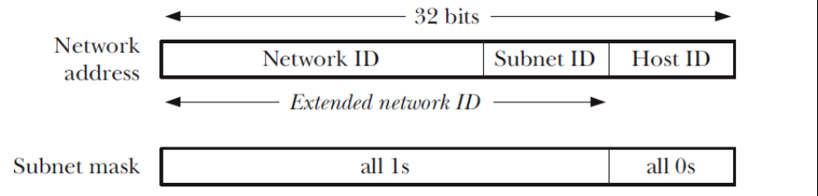
Subnets
Typically, IPv4 addresses are subnetted. Subnetting divides the host ID part of an IPv4 address into two parts: a subnet ID and a host ID.
The rationale for subnetting is that an organization often doesn’t attach all of its hosts to a single network. Instead, the organization may operate a set of subnetworks (an “internal internetwork”), with each subnetwork being identified by the combination of the network ID plus the subnet ID

Slide 37
Ports
The task of the transport protocol is to provide an end-to-end communication service to applications residing on different hosts (or sometimes on the same host). In order to do this, the transport layer requires a method of differentiating the applications on a host. In TCP and UDP, this differentiation is provided by a 16-bit port number.
Privileged
Some well-known port numbers are permanently assigned to specific applications (also known as services). For example, the ssh (secure shell) daemon uses the well known port 22, and HTTP (the protocol used for communication between web servers and browsers) uses the well-known port 80.
Ephemeral
If an application doesn’t select a particular port (i.e., in sockets terminology, it doesn’t bind() its socket to a particular port), then TCP and UDP assign a unique ephemeral port (i.e., short-lived) number to the socket.
sock = socket.socket(socket.AF_INET, socket.SOCK_STREAM)

Slide 38
Routers
Router consists of
Set of input interfaces where packets arrive
Set of output interfaces from which packets depart
Some form of interconnect connecting inputs to outputs
Router implements
Forward packet to corresponding output interface
(Manage bandwidth and buffer space resources)
host
host
...
host
host
host
...
host
LAN 1
LAN 2
router
router
router
WAN
WAN
Router

Slide 39
Forwarding Table
Store a mapping between IP addresses and output interfaces
Forward an incoming packet based on its destination address
1.2.3.5
1
1.2.3.6
3
1.2.3.4
2
…
…
1.2.3.4
1
1.2.3.5
2

Slide 40
Scalability Challenge
Suppose hosts had arbitrary addresses
Then every router would need a lot of information
…to know how to direct packets toward the host
1.2.3.4
5.6.7.8
2.4.6.8
1.2.3.5
5.6.7.9
2.4.6.9
host
host
...
host
host
host
...
host
LAN 1
LAN 2
router
router
router
WAN
WAN
1.2.3.4
1.2.3.5
forwarding table

Slide 41
Scalability Improved
Number related hosts from a common subnet
1.2.3.0/24 on the left LAN
5.6.7.0/24 on the right LAN
1.2.3.4
1.2.3.7
1.2.3.156
5.6.7.8
5.6.7.9
5.6.7.212
host
host
...
host
host
host
...
host
LAN 1
LAN 2
router
router
router
WAN
WAN
1.2.3.0/24
5.6.7.0/24
forwarding table

Slide 42
Easy to Add New Hosts
No need to update the routers
E.g., adding a new host 5.6.7.213 on the right
Doesn’t require adding a new forwarding entry
1.2.3.4
1.2.3.7
1.2.3.156
5.6.7.8
5.6.7.9
5.6.7.212
host
host
...
host
host
host
...
host
LAN 1
LAN 2
router
router
router
host
WAN
WAN
5.6.7.213
1.2.3.0/24
5.6.7.0/24
forwarding table

Slide 43

Special-Purpose Address Blocks
Private addresses
By agreement, not routed in the public Internet
For networks not meant for general Internet connectivity
Blocks: 10.0.0.0/8, 172.16.0.0/12, 192.168.0.0/16
Link-local
By agreement, not forwarded by any router
Used for single-link communication only
Intent: autoconfiguration (especially when DHCP fails)
Block: 169.254.0.0/16
Loopback
Address blocks that refer to the local machine
Block: 127.0.0.0/8
Usually only 127.0.0.1/32 is used
Limited broadcast
Sent to every host attached to the local network
Block: 255.255.255.255/32

Slide 44
Host Names vs. IP addresses
Host names
Mnemonic name appreciated by humans
Variable length, full alphabet of characters
Provide little (if any) information about location
Examples: www.cnn.com and bbc.co.uk
IP addresses
Numerical address appreciated by routers
Fixed length, binary number
Hierarchical, related to host location
Examples: 129.59.15.60 and 192.168.0.1

Slide 45
Domain Name System (DNS)
Properties of DNS
Hierarchical name space divided into zones
Zones distributed over collection of DNS servers
Hierarchy of DNS servers
Root (hardwired into other servers)
Top-level domain (TLD) servers
Authoritative DNS servers
Performing the translations
Local DNS servers
Resolver software
You should read up on how DNS’s hierarchical translation works

Slide 46
Transport Protocols
Provide logical communication between application processes running on different hosts
Run on end hosts
Sender: breaks application messages into segments, and passes to network layer
Receiver: reassembles segments into messages, passes to application layer
Multiple transport protocol available to applications
Internet: TCP and UDP (mainly)

Slide 47
Internet Transport Protocols
Datagram messaging service (UDP)
No-frills extension of “best-effort” IP
Multiplexing/demultiplexing among processes
Reliable, in-order delivery (TCP)
Connection set-up & tear-down
Discarding of corrupted packets
Retransmission of lost packets
Flow control
Congestion control
Services not available
Delay guarantees
Bandwidth guarantees
Sessions that survive change-of-IP-address

Slide 48
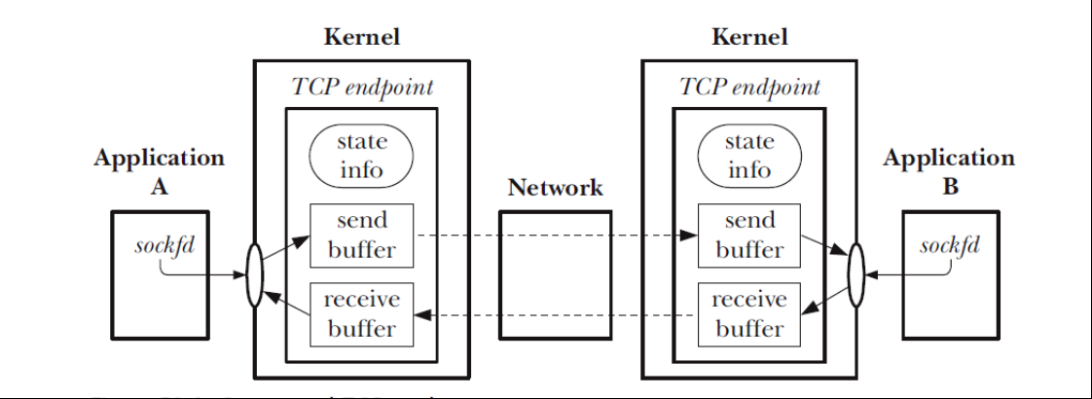
Transmission Control Protocol

Slide 49
TCP
Connection establishment
Packaging of data in segments

Slide 50
TCP
Connection establishment
Packaging of data in segments
Acknowledgements, retransmissions, and timeouts -
When a TCP segment arrives at its destination without errors, the receiving TCP sends a positive acknowledgement to the sender, informing it of the successfully delivered data.
If a segment arrives with errors, then it is discarded, and no acknowledgement is sent.
To handle the possibility of segments that never arrive or are discarded, the sender starts a timer when each segment is transmitted
If an acknowledgement is not received before the timer expires, the segment is retransmitted.
Since the time taken to transmit a segment and receive its acknowledgement varies according to the range of the network and the current traffic loading, TCP employs an algorithm to dynamically adjust the size of the retransmission timeout (RTO).

Slide 51
TCP
Connection establishment
Packaging of data in segments
Acknowledgements, retransmissions, and timeouts -
Sequencing:
Each byte that is transmitted over a TCP connection is assigned a logical sequence number. This number indicates the position of that byte in the data stream for the connection.
The initial sequence number (ISN) for a stream doesn’t start at 0. Instead, it is generated via an algorithm that increases the ISN assigned to successive TCP connections

Slide 52
TCP
Flow Control:
Flow control prevents a fast sender from overwhelming a slow receiver. To implement flow control, the receiving TCP maintains a buffer for incoming data
Data accumulates in this buffer as it is received from the sending TCP, and is removed as the application reads data
With each acknowledgement, the receiver advises the sender of how much space is available in its incoming data buffer (i.e., how many bytes the sender can transmit).

Slide 53
TCP
Flow Control:
Congestion control:
TCP’s congestion-control algorithms are designed to prevent a fast sender from overwhelming a network.
If a sending TCP transmits packets faster than they can be relayed by an intervening router, that router will start dropping packets
Slow start: The slow-start algorithm causes the sending TCP to initially transmit segmentsat a slow rate, but allows it to exponentially increase the rate as these segments are acknowledged by the receiving TCP. Slow start attempts to prevent a fast TCP sender from overwhelming a network.

Slide 54
TCP
Flow Control:
Congestion control:
…
At the beginning of a connection, the sending TCP starts with a small congestion window, which limits the amount of unacknowledged data that it can transmit.
As the sender receives acknowledgements from the peer TCP, the congestion window initially grows exponentially.
However, once the congestion window reaches a certain threshold believed to be close to the transmission capacity of the network, its growth becomes linear, rather than exponential
Congestion Avoidance: if unrestrained, slow start’s exponential increase in the transmission rate could mean that the sender would soon overwhelm the network.

Slide 55
Multicast and Broadcast

Slide 56
Broadcast
Set host bits to all 1. That is send the datagram (UDP) to all sockets on all ipaddresses in my network.
my_socket = socket.socket(socket.AF_INET, socket.SOCK_DGRAM)
my_socket.setsockopt(socket.SOL_SOCKET, socket.SO_BROADCAST,1)
my_socket.send(“message", ('<broadcast>’ ,portnum))
00001100
00100010
10011110
00000101
Network (24 bits)
Host (8 bits)

Slide 57
Multicast
Selective group broadcast
Only send message to a subset of recipients

Slide 58

Multicast Example
See the associated example.

