Slide 1
Chandy-Lamport Snapshotting
[Content adapted from Melissaris and Daniel Suo and Prof. Alan Kaminsky
https://www.cs.rit.edu/~ark/winter2012/730/module04/notes.shtml

Slide 2
Outline
What are global snapshots?
Brief refresher on lamport clocks
The Chandy-Lamport algorithm
Why does Chandy-Lamport work?

Slide 3
Background and Review

Slide 4
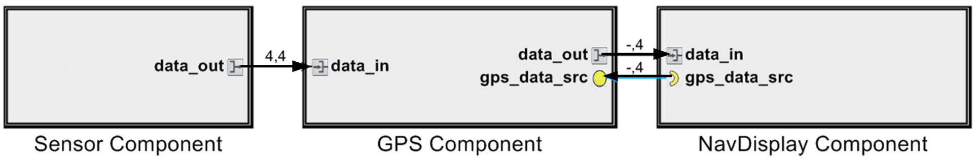
Recall the definition of distributed systems
P1
P2
P3
P4
Example
Key concepts
Processes (single threaded in simple cases, multiple threads possible)
Access to a channel (unbounded in simple cases), but bounded in practice
All processes
(Compute, send, compute)
Or, receive-compute-receive-compute
Or, compute-poll-receive-compute

Slide 5
Synchronous Distributed systems
There is a known upper bound on the time required to send a message
Including the computation time needed to generate the message
And the communication time needed to transfer the message across the network
This lets the processes organize the message passing into rounds
If a process has not received a message by the end of a round, the process can conclude the message will never be received

Slide 6
Asynchronous Distributed Systems
There is no upper bound on the time required to send a message
Message passing cannot be organized into rounds
Designing distributed algorithms for asynchronous message passing is much harder than for synchronous message passing

Slide 7
Lamport: Logical Clocks

Slide 8
Reading List
https://swizec.com/blog/week-7-time-clocks-and-ordering-of-events-in-a-distributed-system/swizec/6444
http://amturing.acm.org/p558-lamport.pdf
Cited more than 10K times.

Slide 9
Ordering of Events (Logical Clocks)
A way to impose an order on events is timestamps.
Each process attaches its current clock value to each event the process generates
All processes handle events in timestamp order
However, we can't assume the clocks are identical in all processes
Real-time clock synchronization protocols exist, but are complicated and only guarantee agreement to some nonzero tolerance

Slide 10
Ordering of Events (Logical Clocks)
Another way to impose an order on events is a logical clock
Invented by Leslie Lamport in 1978
There are N processes p₁, p₂, . . . p_{N}
Each process experiences a sequence of events e_{i}
Send a message: e_{i} = send(m)
Receive a message: e_{i} = receive(m)
There is an event causality relation: e_{i} → e_{j} , "e_{i} caused e_{j}"
If e_{i} and e_{j} happen in the same process and e_{i} happens first, then e_{i} → e_{j}
If e_{i} = send(m) and e_{j} = receive(m) (send and receive of the same message), then e_{i} → e_{j}
Otherwise, neither e_{i} → e_{j} nor e_{j} → e_{i} is true, and we say that e_{i} and e_{j} are concurrent events
The causality relation is transitive: If e_{i} → e_{j} and e_{j} → e_{k} , then e_{i} → e_{k}
The causality relation defines an ordering (partial ordering) among events
Each process has a logical clock LC, an integer
The logical clock is used to associate a logical timestamp with each event in the process: LC(e_{i})
We want to use the events' logical timestamps to reflect the order of the events; specifically:
If e_{i} → e_{j} , then LC(e_{i}) < LC(e_{j})

Slide 11
Logical clock algorithm
In each process: Initialize LC = 0
To send a message, e_{i} = send(m):
Increment logical clock: LC = LC + 1
Use that as the logical timestamp of the send event: LC(e_{i}) = LC
Also use that as the logical timestamp of the message: TS(m) = LC
Send m and TS(m) to recipient
When a message is received, e_{i} = receive(m):
Fast-forward logical clock to message timestamp if necessary: LC = max (LC, TS(m))
Increment logical clock: LC = LC + 1
Use that as the logical timestamp of the receive event: LC(e_{i}) = LC
Note: Logical clocks cannot be used to infer causality. It is true that if e_{i} → e_{j} , then LC(e_{i}) < LC(e_{j})
It is not true that if LC(e_{i}) < LC(e_{j}), then e_{i} → e_{j}

Slide 12
Global snapshots
Chandy, K. M., & Lamport, L. (1985). Distributed snapshots: Determining global states of distributed systems. ACM Transactions on Computer Systems (TOCS), 3(1), 63-75.

Slide 13
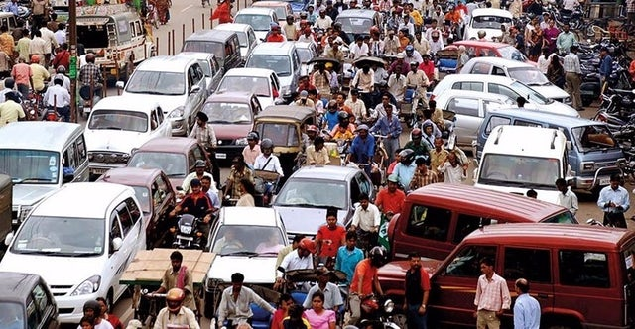
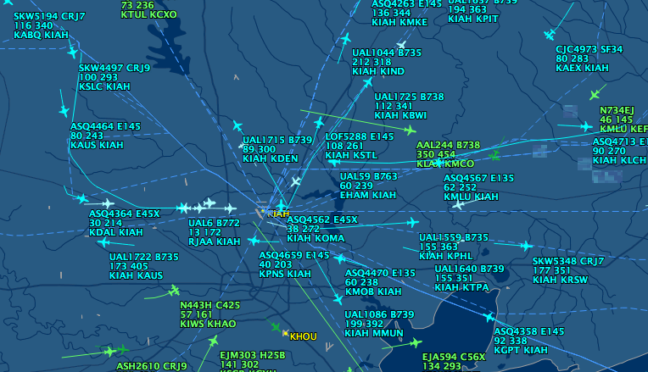
Global Snapshot
A global snapshot includes the state of each local process and information in the channels at the time the snapshot was taken.
The snapshot should not affect the final result of the distributed system.
Note that in practice it does delay the final result.

Slide 14
Global snapshot is global state
Each distributed application has a number of processes (leaders) running on a number of physical servers
These processes communicate with each other via channels (text messaging)
A snapshot captures the local states of each process (e.g., program variables) along with the state of each communication channel
14

Slide 15
Why do we need snapshots?
Checkpointing: restart if the application fails
Collecting garbage: remove objects that don’t have any references
Detecting deadlocks: can examine the current application state
Other debugging: a little easier to work with than printf…
15

Slide 16
We could just synchronize clocks
Each process records state at time some agreed upon t
But clocks skew
And we wouldn’t record messages
Do we need synchronization?
Recall the lamport logical clock
16

Slide 17



Example of global snapshots v2
Two processes: P₁ and P₂
P₁
P₂
17

Slide 18


Example of global snapshots v2
Channel C₁₂ from P₁ to P₂
Channel C₂₁ from P₂ to P₁
^{C}12
P₁
P₂
^{C}21

Slide 19










Example of global snapshots v2
Process states for P₁ and P₂
^{C}12
X: 0
X: 1
Y: 0
P₁
P₂
Y: 2
Z: 0
Z: 3
^{C}21

Slide 20




Example of global snapshots v2
Channel states (i.e., messages) for C₁₂ and C₂₁
This is our initial global state
Also a global snapshot
C₁₂: [Empty]
X₁: 0
X₂: 1
Y₁: 0
Z₁: 0
P₁
P₂
Y₂: 2
Z₂: 3
C₂₁: [Empty]

Slide 21
Example of global snapshots v2
P₁ tells P₂ to change its state variable, X₂, from 1 to 4
This is another global snapshot
C₁₂: [X₂ → 4]
X₁: 0
X₂: 1
Y₁: 0
Z₁: 0
P₁
P₂
Y₂: 2
Z₂: 3
C₂₁: [Empty]

Slide 22
Example of global snapshots v2
P₂ receives the message from P₁
Another global snapshot
C₁₂: [Empty]
X → 4
X₁: 0
2
X₂: 1
Y₁: 0
Z₁: 0
P₁
P₂
Y₂: 2
Z₂: 3
C₂₁: [Empty]

Slide 23
Example of global snapshots v2
P₂ changes its state variable, X₂, from 1 to 4
And another global snapshot
C₁₂: [Empty]
X₁: 0
X₂: 4
Y₁: 0
Z₁: 0
P₁
P₂
Y₂: 2
Z₂: 3
C₂₁: [Empty]

Slide 24
Snapshot
The global state changes whenever an event happens
Process sends message
Process receives message
Process takes a step
Moving from state to state obeys causality

Slide 25
Chandy-Lamport algorithm

Slide 26
System model
Problem: record a global snapshot (state for each process and channel)
Model
N processes in the system with no failures
There are two FIFO unidirectional channels between every process pair (P_{i} → P_{j} and P_{j} → P_{i}), written as channel C_{ij} and C_{ji} respectively.
All messages arrive, intact, not duplicated
Future work relaxes these assumptions

Slide 27
System requirements
Taking a snapshot shouldn’t interfere with normal application behavior
Don’t stop sending messages
Don’t stop the application!
Each process can record its own state
Collect state in a distributed manner
Any process can initiate a snapshot

Slide 28
Initiating a snapshot
Let’s say process P_{i} initiates the snapshot
P_{i} records its own state and prepares a special marker message (distinct from application messages)
Send the marker message to all other processes (using N-1 outbound channels)
Start recording all incoming messages from channels C_{ji} for j not equal to i
20

Slide 29
Propagating a snapshot
For all processes P_{j} (including the initiator), consider a message on channel C_{kj}
If we see marker message for the first time from Process P_{k}
P_{j} records own state and marks C_{kj} as empty
Send the marker message to all other processes (using N-1 outbound channels)
Start recording all incoming messages from channels C_{lj} for l not equal to j or k
Else add all messages from inbound channels since we began recording to their states
21

Slide 30
Terminating a snapshot
All processes have received a marker (and recorded their own state)
All processes have received a marker on all the N-1 incoming channels (and recorded their states)
Later, a central server can gather the partial state to build a global snapshot

Slide 31
Example
P₁ initiates a snapshot
C₁₂: [Empty]
X₁: 0
X₂: 4
Y₁: 0
Z₁: 0
P₁
P₂
Y₂: 2
Z₂: 3
C₂₁: [Empty]

Slide 32
Example
First, P₁ records its state
C₁₂: [Empty]
X₁: 0
X₂: 4
Y₁: 0
Z₁: 0
P₁
P₂
Y₂: 2
Z₂: 3
C₂₁: [Empty]

Slide 33
Example
Then, P₁ sends a marker message to P₂ and begins recording all messages on inbound channels
Meanwhile, P₂ sent a message to P₁
C₁₂: [<marker>]
X₁: 0 X₂: 4
Y₁: 0 P₁ P₂ Y₂: 2
Z₁: 0 Z₂: 3
C₂₁: [M₁]

Slide 34
Example
P₂ receives a marker message for the first time, so records its state
P₂ then sends a marker message to P₁
C₁₂: [Empty]
<marker>
X₁: 0
X₂: 4
Y₁: 0
P₁
P₂
Y₂: 2
Z₁: 0
Z₂: 3
M₁
C₂₁: [<marker>]

Slide 35
Example
P₁ has already sent a marker message, so it records all messages it received on inbound channels to the appropriate channel’s state
C₁₂: [Empty]
X₁: 0
X₂: 4
Y₁: 0
Z₁: 0
P₁
P₂
Y₂: 2
Z₂: 3
M₁
C₂₁: [Empty]

Slide 36
Example
Both processes have recorded their state and all the state of all incoming channels
Our snapshotted state is highlighted in blue
C₁₂: [Empty]
X₁: 0
X₂: 4
Y₁: 0
Z₁: 0
P₁
P₂
Y₂: 2
Z₂: 3
M₁
C₂₁: [Empty]

Slide 37
Summary
The global snapshot algorithmp₀ sends a "take snapshot" message to every process p₀ through p_{N}
The first time p_{j} receives a "take snapshot" message, p_{j} does the following:
Records its own local state
Sets c_{ij} to an empty list for all incoming channels i
Sends a "take snapshot" message on all outgoing channels
Whenever p_{j} receives a regular application message after the first "take snapshot" message, p_{j} does the following:
Records the application message in the list c_{ij} for the incoming channel i on which the application message arrived
Whenever p_{j} receives another "take snapshot" message after the first "take snapshot" message, p_{j} does the following:
Stops recording application messages for the incoming channel i on which the "take snapshot" message arrived (it is possible to receive multiple take snapshot messages.)
When p_{j} has received a "take snapshot" message from all incoming channels, p_{j} does the following:
Sends its local state and all message lists c_{ij} to p₀

Slide 38
Causal consistency
Related to the Lamport clock partial ordering
An event is presnapshot if it occurs before the local snapshot on a process
Postsnapshot if afterwards
If event A happens causally before event B, and B is presnapshot, then A is too
30

Slide 39
Message in snapshots
In order for an application message m in the channel from process p to process q to be in the snapshot
Must happen after q has received its first marker
Before p has sent its marker to q
A message m will only be in the snapshot if the sending process was presnapshot and the receiving process was postsnapshot

Slide 40
Message in snapshots
How do we order concurrent events?
Remember, all processes communicate
What if a process receives a marker in between sending a marker and some event?
These should happen atomically (the updates on each process should occur atomically.)
Remember that snapshots are causally consistent

Slide 41
Taking snapshot in practice
Fork is one way to snapshot a process
Another is to serialize all objects to disk

