Slide 1
Lecture 2 Terminology and concepts
Based on slides and Material from John Knight

Slide 2
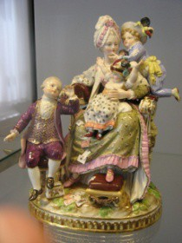


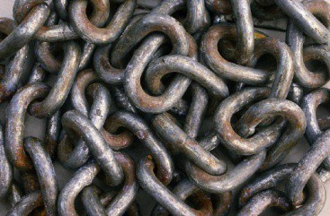



The weakest link
A chain is only as strong as its weakest link...
Many things could go wrong:
Attachment could break
Box could break
Chain could break
Etc.
Ahhhhh

Slide 3
How to make it dependable?
Decide how strong the chain/box has to be
Define dependability requirements
Determine how chain/box might fail
Determine all possible faults that might occur
Buy high quality chain/box so as to avoid defects
Practice fault avoidance during construction
Fix any broken links that remain
Practice fault elimination during construction
Cope with broken links you didn’t find or that break
Practice fault tolerance during operation

Slide 4
How to make it dependable?
Decide how strong the chain/box has to be
Define dependability requirements
Determine how chain/box might fail
Determine all possible faults that might occur
Buy high quality chain/box so as to avoid defects
Practice fault avoidance during construction
Fix any broken links that remain
Practice fault elimination during construction
Cope with broken links you didn’t find or that break
Practice fault tolerance during operation

Slide 5
How to make it dependable?
Decide how strong the chain/box has to be
Define dependability requirements
Determine how chain/box might fail
Determine all possible faults that might occur
Buy high quality chain/box so as to avoid defects
Practice fault avoidance during construction
Fix any broken links that remain
Practice fault elimination during construction
Cope with broken links you didn’t find or that break
Practice fault tolerance during operation

Slide 6
How to make it dependable?
Decide how strong the chain/box has to be
Define dependability requirements
Determine how chain/box might fail
Determine all possible faults that might occur
Buy high quality chain/box so as to avoid defects
Practice fault avoidance during construction
Fix any broken links that remain
Practice fault elimination during construction
Cope with broken links you didn’t find or that break
Practice fault tolerance during operation

Slide 7
Dependability steps
Decide how strong the chain/box has to be
Define dependability requirements
Determine how chain/box might fail
Determine all possible faults that might occur
Buy high quality chain/box so as to avoid defects
Practice fault avoidance during construction
Fix any broken links that remain
Practice fault elimination during construction
Cope with broken links you didn’t find or that break
Practice fault tolerance during operation

Slide 8
How To Think About Failures
Accidents are very complex:
Do not jump to conclusions
There is unlikely a “root” or single cause
There are usually many causal factors
Lessons learned must be comprehensive:
Prevent future occurrences of all causal factors
Always investigate failures

Slide 9
Understand the progression of failures

Slide 10
The fundamental chain of fault propagation
Error is a fault
Error if detected is an anomaly
Internal faults or connected faults lead to error
Service Outage is a failure

Slide 11
Step 1
Determine Consequences of Failure
Remember failure is absence of risk , which must be quantified.
What Happens If The Chain Breaks?

Slide 12
Consequences of Failure
Direct—device fails and causes injury
Indirect—defective support tool leads to device that fails
Combinations of losses:
Immediate damage to equipment
Subsequent loss of service
Subsequent loss of business reputation
Subsequent law suits

Slide 13
Hidden Costs of Failure
Some costs of failure are obvious, others not
Ariane V example:
Obvious:
Loss of launch vehicle
Loss of payload
Not so obvious:
Environmental cleanup
Loss of service from payload
Vehicle redesign
Increased insurance rates for launches

Slide 14
Consequences of Failure
Loss of revenue
Software defects : $200 billion/year (SCC)
Note: recent worms and viruses
1 hour of downtime costs
Brokerage: $6,450,000/hr
Credit card auth 2,600,000/hr
You can search on web about impact of Netflix/amazon outages.

Slide 15

Step 2
Define the dependability requirements
How Strong Does The Chain Have To Be?

Slide 16
Dependability requirements
Informal statements are inadequate:
“System should not fail.”
“System must be very reliable.”
Need a target so that, if we meet it, system will perform “acceptably”
Need terminology to define requirements

Slide 17
Terminology of Dependability

Slide 18
Dependability
Webster
Dependable: capable of being depended on: RELIABLE
suitable or fit to be relied on: DEPENDABLE
Rely:
to be dependent- <the system for which we depend on water>
to have confidence based on experience- <someone you can rely on>

Slide 19
dependability
Old: Dependability is the ability to deliver service that can justifiably be trusted
New: The dependability of a system is the ability to avoid service failures that are more frequent and more severe than is acceptable

Slide 20
dependability
Old: Dependability is the ability to deliver service that can justifiably be trusted
New: The dependability of a system is the ability to avoid service failures that are more frequent and more severe than is acceptable
Why the change? To allow for the possibility of failure yet the system remaining acceptable

Slide 21
Failure Taxonomy
Correct service is delivered when the service implements the system function.
A service failure, often abbreviated here to failure, is an event that occurs when the delivered service deviates from correct service.
A service fails either because it does not comply with the functional specification, or because this specification did not adequately describe the system function.
A service failure is a transition from correct service to incorrect service, i.e., to not implementing the system function.
The period of delivery of incorrect service is a service outage. The transition from incorrect service to correct service is a service restoration.
The deviation from correct service may assume different forms that are called service failure modes and are ranked according to failure severities

Slide 22
Failure viewpoints
Failure domain
Detectability of failures
Consistency of failures
Consequences of failure

Slide 23
Failure Domain
Content failure:
Supplied service has incorrect information
Timing failure:
Timing or duration of information incorrect
Halt failure:
System halts and remains in fixed state
Erratic failure:
Service delivery is erratic

Slide 24
Detectability And Consistency
Detectability:
Signaled, unsignaled, false alarm
False positives, false negatives
Consistency:
Consistent—incorrect service seen identically by all users
Inconsistent—incorrect service seen differently by different users, Byzantine failures

Slide 25
Attributes of Dependability
Reliability
Availability
Safety
Confidentiality
Integrity
Maintainability
Customers must identify the dependability requirements of their system and developers must design so as to achieve them
Requirements: These are properties that might be required of a given system

Slide 26
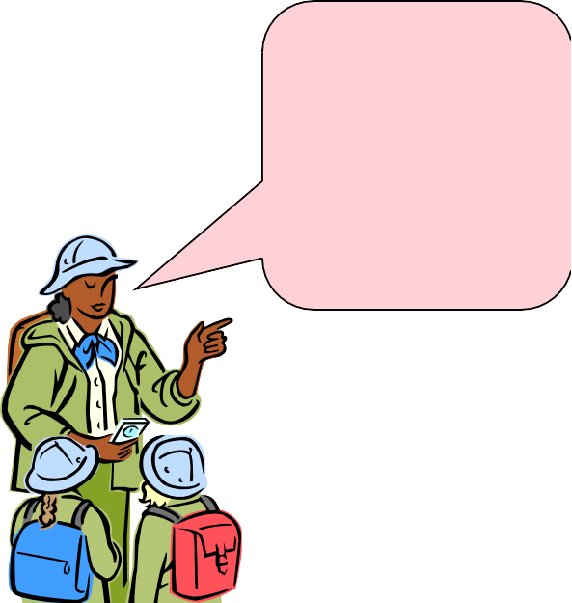
Attributes of Dependability
Note this very carefully…
Fault tolerance is not a system requirement or a system property
It is a mechanism used to provide dependability
Fault tolerance is not a system property

Slide 27
Reliability
R(t) =Probability that the system will
operate correctly in a specified
operating environment up until time t
System’s ability to provide continuous service
Note that t is important
If a system only needs to operate for ten hours at a time, then that is the reliability target

Slide 28
Failure Per Demand
Sometimes, the notion of time, t, is not what we need
Some systems are only called to act on demand:
E.g., Protection systems
For such systems, what we need is:
Probability of failure per demand

Slide 29
Availability
A(t) = Probability that the system will
be operational at time t
Literally, readiness for service
Admits the possibility of brief outages
Fundamentally different concept

Slide 30
Reliability vs. Availability
They are not the same.....
Example:
A system that fails, on average, once per hour but which restarts automatically in ten milliseconds would not be considered very reliable but is highly available
Availability = 0.9999972

Slide 31
Nines of Availability
# 9’s | % | Downtime / year | Systems
2 | 99% | ~5000 minutes | General web site
3 | 99.9% | ~500 minutes | Amazon.com
4 | 99.99% | ~50 minutes | Enterprise server
5 | 99.999% | ~5 minutes | Telephone System
6 | 99.9999% | ~30 seconds | Phone switches
Caveats: How measured? What does it mean to be operational?

Slide 32
Design Tradeoffs
MTTF = Mean Time To Failure
MTTR = Mean Time To Repair
Availability =
MTTF
-------------------- MTTF + MTTR
How to make availability approach 100%?
MTTF →→ infinity (high reliability)
MTTR →→ zero (fast recovery)
Need to define maximum repair time
Need to define how Availability is measured

Slide 33
Subtleties
Which has higher availability?
Two 4.5 hour outage / year
1 minute outage / day

Slide 34
Subtleties
Which has higher availability?
Two 4.5 hour outage / year -99.89
1 minute outage / day – 99.999
For an Internet-based company such as EBay or Amazon, which would be more desirable? Why

Slide 35
Subtleties
Which has higher availability?
Two 4.5 hour outage / year -99.89
1 minute outage / day – 99.999
For an Internet-base company such as EBay or Amazon, which would be more desirable? Why
For an autonomous rover?

Slide 36
Subtleties
Which has higher availability?
Two 4.5 hour outage / year -99.89
1 minute outage / day – 99.999
For an Internet-base company such as EBay or Amazon, which would be more desirable? Why
For an autonomous rover?
Need to specify details of acceptable outages

Slide 37
How to specify availability
Minimum probability of readiness for service
Period over which probability is measured
Fixed or moving window
Maximum acceptable outage
Time to repair
Minimum sustained operating time

Slide 38
Specifying Safety
Absence of catastrophic consequences on the users or the environment
Are commercial aircraft “safe”?
They crash occasionally
How many crashes are too many?
Are cars “safe”? They crash quite a lot

Slide 39
Specifying Safety
Absence of catastrophic consequences on the users or the environment
Are commercial aircraft “safe”?
They crash occasionally
How many crashes are too many?
Are cars “safe”? They crash quite a lot
40K deaths/yr; 800/week = 2 fully loaded Boeing 747/week

Slide 40
Define Risk
Risk is defined to be expected loss per unit time
Safety is defined to be an acceptable level of risk:
Risk = Σ pr(accident_{i}) x cost(accident_{i})
Risk < pre-defined_delta

Slide 41
Reliability vs. Availability vs. Safety
They are not the same.....
Example:
A system that is turned off is not very reliable, is not very available,
but is probably very safe
In practice, safety often involves specific intervention

Slide 42
Confidentiality
Absence of unauthorized disclosure of information
Microsoft source code vs. Linux source code
Web browsing
Operating systems security model
Files, memory
Medical records
Credit card transaction records
School grades

Slide 43
Integrity
Absence of improper system state alterations
Operating systems:
Files, memory, network packets
Linux kernel backdoor attempt
Database records
Your bank account
File transfer
Did I really get the right version of software XYZ?
…

Slide 44
Security is a Dependability Issue
Security is a combination of attributes:
Integrity
Confidentiality
Availability
Under different circumstances, these attributes are more or less important:
Denial of service is an availability issue
Exposure of information is a confidentiality issue

Slide 45
Maintainability
Ability to undergo repairs and modifications

Slide 46
General Dependability Requirements
Telecommunications:
Availability, maintainability
Transportation:
Reliability, availability, safety
Weapons:
Safety
Nuclear systems:
Safety

Slide 47
Attributes of Dependability
Reliability
Availability
Safety
Confidentiality
Integrity
Maintainability
Customers must identify the dependability requirements of their system and developers must design so as to achieve them
Requirements: These are properties that might be required of a given system

Slide 48
How Much Is Enough?
Dilemma—could we achieve higher dependability:
If more resources were expended on developing a given system then the rate of failure might be reduced. That being the case, should the developers expend all possible resources on developing the system?
For example, formal verification:
 Known to detect defects
 Considered difficult and expensive to apply
 Should its use be required of all systems with large consequences of failure?

Slide 49
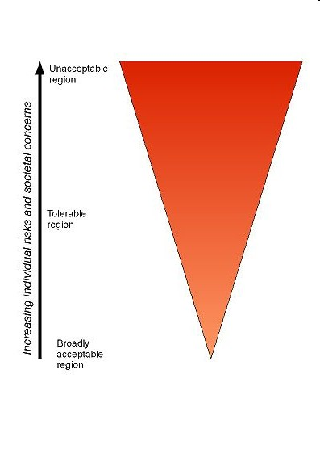
ALARP
As Low As Reasonably Practicable
Three degrees of risk:
 Tolerable (broadly acceptable)
 Unacceptable—has to be reduced
 ALARP region
Carrot Diagram

