Slide 1
Anomaly Detection
Reliable Distributed Systems
Abhishek Dubey

Slide 2
Example 1

Slide 3
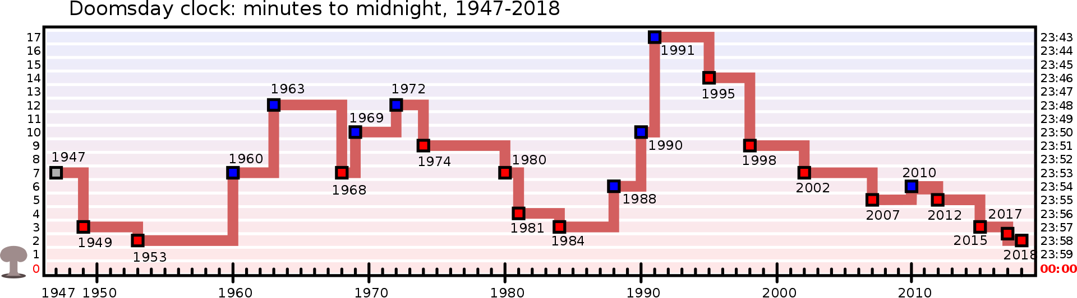

Slide 5
Doomsday Clock graph, 1947–2018. The lower points on the graph represent a higher probability of technologically or environmentally-induced catastrophe, and the higher points represent a lower probability.

Slide 6
Example 2

Slide 8
a=5
b=100
N=100;
y = a.*randn(N,1) + b;
% Y = movmean(X,K) for a vector X and positive integer scalar K computes
% a centered moving average by sliding a window of length K along X. Each
% element of Y is the local mean of the corresponding values of X inside
% the window, with Y the same size as X. When K is even, the window is
% centered about the current and previous elements of X. The sliding
% window is truncated at the endpoints where there are fewer than K
% elements from X to fill the window.
z=movmean(y,10);
%find the residual.
residual=y-z;
std1=std(residual);
anomaly=zeros(N,1);

Slide 10
Background

Slide 11
Definitions
Precision: The proportion of events detected that were significant. Precision is 100% if every alert corresponds to a significant event. Note that alerting can become particularly sensitive to nonsignificant events during low-traffic periods
Recall - The proportion of significant events (real-problems) detected. Recall is 100% if every significant event results in an alert.
Detection time How long it takes to send notifications in various conditions. Long detection times can negatively impact the error budget.
Reset time - How long alerts fire after an issue is resolved. Long reset times can lead to confusion or to issues being ignored.
The error budget gives the number of allowed bad events
The error rate is the ratio of bad events to total events

Slide 12
Evaluation of Anomaly Detection – F-value
Accuracy is not sufficient metric for evaluation
Example: network traffic data set with 99.9% of normal data and 0.1% of intrusions
Trivial classifier that labels everything with the normal class can achieve 99.9% accuracy !!!!!
anomaly class – C
normal class – NC
Focus on both recall and precision
Recall (R) = TP/(TP + FN)‏
Precision (P) = TP/(TP + FP)‏
F – measure = 2*R*P/(R+P)‏
Notes:
12

Slide 13
Evaluation of Outlier Detection – ROC & AUC
anomaly class – C
normal class – NC
Standard measures for evaluating anomaly detection problems:
Recall (Detection rate) - ratio between the number of correctly detected anomalies and the total number of anomalies
False alarm (false positive) rate – ratio between the number of data records from normal class that are misclassified as anomalies and the total number of data records from normal class
ROC Curve is a trade-off between detection rate and false alarm rate
Area under the ROC curve (AUC) is computed using a trapezoid rule
Ideal ROC curve
AUC
Notes:
13

Slide 14
Basic Approach – Pre-configured Threshold

Slide 15
Anomalies
Your goal is to be notified for a significant event: an event that consumes a large fraction of the error budget.
Error budget is the margin around the quality of service agreement.
This significant event can be detected by a filter, which can be configured using
Pre-configured rule.

Slide 16
Target Error Rate ≥ SLO Threshold
Choose a time window
Compute the error rate (e.g. CPU Utilization is greater than 70% in the time window)
For example, if the SLO is 99.9% over 30 days, alert if the error rate over the previous 10 minutes is ≥ 0.1%:
Note that time series databases allow creation of such alerts
https://prometheus.io/
https://docs.influxdata.com/chronograf/v1.4/administration/managing-alerts/

Slide 17
How to choose the alerting window size
Small window advantage
Detection time is good: 0.6 seconds for a total outage.
This alert fires on any event that threatens the SLO, exhibiting good recall.
Small window disadvantage
Precision is low: The alert fires on many events that do not threaten the SLO. A 0.1% error rate for 10 minutes would alert, while consuming only 0.02% of the monthly error budget.
Taking this example to an extreme, you could receive up to 144 alerts per day every day, not act upon any alerts, and still meet the SLO.

Slide 18
Alert Duration
Most monitoring systems allow you to add a duration parameter to the alert criteria so the alert won’t fire unless the value remains above the threshold for some time.
Pros
Alerts can be higher precision.
Requiring a sustained error rate before firing means that alerts are more likely to correspond to a significant event.
Cons
Poor recall and poor detection time: Because the duration does not scale with the severity of the incident, a 100% outage alerts after one hour, the same detection time as a 0.2% outage.
If the metric even momentarily returns to a level within SLO, the duration timer resets.

Slide 19
More General Anomaly Detection
What if we don’t know what is abnormal.
Based on paper
Varun Chandola, Arindam Banerjee, and Vipin Kumar. 2009. Anomaly detection: A survey. ACM Comput. Surv. 41, 3, Article 15 (July 2009), 58 pages. DOI=http://dx.doi.org/10.1145/1541880.1541882

Slide 20
Anomalies
Y
However, what happens if the anomaly is not tied to a service level objective, but is rather due to some abnormality in the system
Something that has not been seen before.
Note:
Anomaly is a pattern in the data that does not conform to the expected behaviour
Also referred to as outliers, exceptions, peculiarities, surprise, etc.
N₁
o₁
O₃
o₂
N₂
X
N₁ and N₂ are regions of normal behaviour
Points o₁ and o₂ are anomalies
Points in region O₃ are anomalies

Slide 21
Key Challenges
Defining a representative normal region is challenging
The boundary between normal and outlying behaviour is often not precise
The exact notion of an outlier is different for different application domains
Availability of labelled data for training/validation
Data might contain noise
Normal behaviour keeps evolving

Slide 22
Data Labels
Supervised Anomaly Detection
Labels available for both normal data and anomalies
Semi-supervised Anomaly Detection
Labels available only for normal data
Unsupervised Anomaly Detection
No labels assumed
Based on the assumption that anomalies are very rare compared to normal data

Slide 23
Output of Anomaly Detection
Label
Each test instance is given a normal or anomaly label
This is especially true of classification-based approaches
Score
Each test instance is assigned an anomaly score
Allows the output to be ranked
Requires an additional threshold parameter

Slide 24
Variants of anomaly detection problem
Given a dataset D, find all the data points
x ∈ D with anomaly scores greater than some threshold t.
Given a dataset D, find all the data points
x ∈ D having the top-n largest anomaly scores.
Given a dataset D, containing mostly normal data points, and a test point x, compute the anomaly score of x with respect to D.

Slide 25
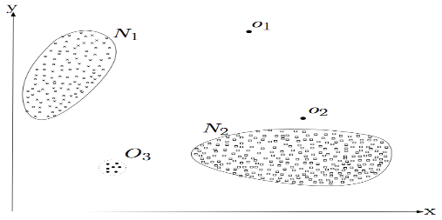
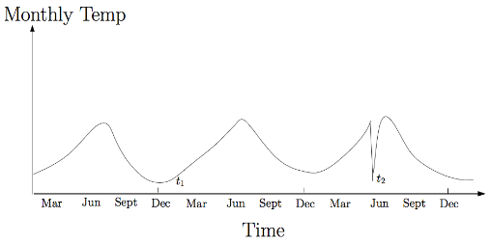
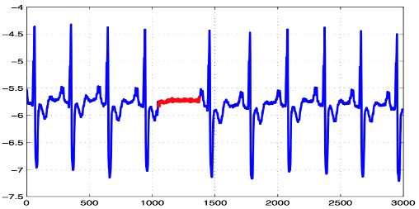
Types of Anomaly
Point Anomalies
Contextual Anomalies
Collective Anomalies
Simplest
Can occur in any data set
Individual instance
Anomalous in a specific context
A collection of data instances
Their occurrence together as a collection is anomalous

Slide 26
Point Anomalies
An individual data instance is anomalous w.r.t. the data
Y
N₁
o₁
O₃
o₂
N₂
X

Slide 27
Contextual Anomalies
An individual data instance is anomalous within a context
Requires a notion of context
Also referred to as conditional anomalies*
Anomaly
Normal
* Xiuyao Song, Mingxi Wu, Christopher Jermaine, Sanjay Ranka, Conditional Anomaly Detection, IEEE Transactions on Data and Knowledge Engineering, 2006.

Slide 28
Collective Anomalies
A collection of related data instances is anomalous
Requires a relationship among data instances
Sequential Data
Spatial Data
Graph Data
The individual instances within a collective anomaly are not anomalous by themselves. However, a series of them are abnormal
Anomalous Subsequence

Slide 29
Techniques for Anomaly Detection
Point Anomalies
Contextual Anomalies
Collective Anomalies
Classification Based
Clustering Based
Nearest Neighbor Based
Statistical
Reduction to Point Anomaly Detection Problem
Utilizing the Structure in Data
Handling Sequential Anomalies
Handling Spatial Anomalies

Slide 30
Point Anomaly Detection

Slide 31
Techniques for anomaly detection
Statistical
Proximity-based
Density-based
Clustering-based

Slide 32
Statistical outlier detection
Outliers are objects that are fit poorly by a statistical model.
Estimate a parametric model describing the distribution of the data
Apply a statistical test that depends on
Properties of test instance
Parameters of model (e.g., mean, variance)
Confidence limit (related to number of expected outliers)

Slide 33
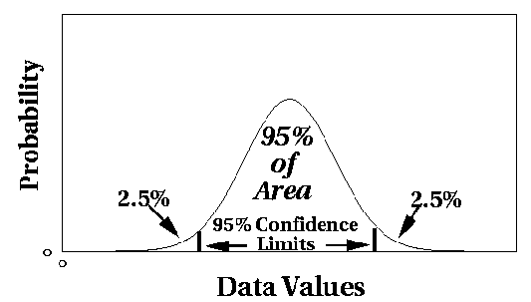
Statistical outlier detection
Univariate Gaussian distribution
– Outlier defined by z-score > threshold

Slide 34
Grubbs’ test
Detect outliers in univariate data
Assume data comes from normal distribution
Detects one outlier at a time, remove the outlier, and repeat
– H₀: There is no outlier in data
– H_{A}: There is at least one outlier
Grubbs’ test statistic:
max X − X
G =
s
Reject H₀ if:
_{t}2
( N − 1)
N
G >
(α / N , N −2 )
N − 2 + t²
(α / N , N −2 )
Student-t-test

Slide 35
Matlab routine
https://www.mathworks.com/help/matlab/ref/isoutlier.html

Slide 36
CUSUM
A cumulative sum (CUSUM) chart is a type of control chart used to monitor small shifts in the process mean. It uses the cumulative sum of deviations from a target. The CUSUM chart plots the cumulative sum of deviations from the target for individual measurements or subgroup means

Slide 37
Control Charts
Control charts provide a mechanism for recognizing situations where assignable causes may be adversely affecting product quality. A basic element is that samples have been selected from the process of interest at a sequence of time points.

Slide 38
Let X be a rv and assume that for an in-control process, X has a normal distribution with mean and standard deviation Let denote the sample mean for a random sample of size n at a particular time point.

Slide 39
Properties of
3.
has a normal distribution.

Slide 40
The Chart
Suppose that at each of the time points 1,2,3…, a random sample of size n is available. Let denote the corresponding sample means. An chart results from plotting these over time and then drawing horizontal lines at

Slide 41
The Chart
UCL
LCL
Time
Any point outside the control limits suggests that the process may have been out of control at that time.

Slide 42
The Chart Based on Estimated parameters
sample standard deviations
Student t distribution tables

Slide 43
Control Limits Based on the Sample Standard Deviations

Slide 44
Recomputing Control Limits
Suppose that one of the points on the control chart falls outside the control limits. If an assignable cause can be found, it is recommended that new control limits be calculated after deleting the corresponding sample from the data set.

Slide 45
Performance Characteristics of Control Charts
The use of 3-sigma limits makes it highly unlikely that an out-of-control signal will result from an in-control process.
When the process is in control, we expect to observe many samples before seeing one whose lies outside the control limits.
The chart is effective in detecting large process mean shifts but less effective at quickly identifying small shifts.

Slide 46
CUSUM
A defect of the traditional X chart is its inability to detect a relatively small change in a process mean. Cumulative Sum (CUSUM) control charts and procedures are designed to remedy this defect.
See the online example in git repository for this.

Slide 47
Classification Based Approaches

Slide 48
Classification Based Techniques
Main idea: build a classification model for normal (and anomalous (rare)) events based on labeled training data, and use it to classify each new unseen event
Classification models must be able to handle skewed (imbalanced) class distributions
Categories:
Supervised classification techniques
Require knowledge of both normal and anomaly class
Build classifier to distinguish between normal and known anomalies
Semi-supervised classification techniques
Require knowledge of normal class only!
Use modified classification model to learn the normal behavior and then detect any deviations from normal behavior as anomalous

Slide 49
Classification Based Techniques
Advantages:
Supervised classification techniques
Models that can be easily understood
High accuracy in detecting many kinds of known anomalies
Semi-supervised classification techniques
Models that can be easily understood
Normal behaviour can be accurately learned
Drawbacks:
Supervised classification techniques
Require both labels from both normal and anomaly class
Cannot detect unknown and emerging anomalies
Semi-supervised classification techniques
Require labels from normal class
Possible high false alarm rate - previously unseen (yet legitimate) data records may be recognized as anomalies

Slide 50
Proximity Based approaches

Slide 51
Nearest Neighbor Based Techniques
Key assumption: normal points have close neighbors while anomalies are located far from other points
General two-step approach
Compute neighborhood for each data record
Analyze the neighborhood to determine whether data record is anomaly or not
Categories:
Distance based methods
Anomalies are data points most distant from other points
Density based methods
Anomalies are data points in low density regions

Slide 52
Nearest Neighbor Based Techniques
Advantage
Can be used in unsupervised or semi-supervised setting (do not make any assumptions about data distribution)
Drawbacks
If normal points do not have sufficient number of neighbors the techniques may fail
Computationally expensive
In high dimensional spaces, data is sparse and the concept of similarity may not be meaningful anymore.
Due to the sparseness, distances between any two data records may become quite similar => Each data record may be considered as potential outlier!

Slide 53
Clustering Based Techniques
Key assumption: normal data records belong to large and dense clusters, while anomalies belong do not belong to any of the clusters or form very small clusters
Categorization according to labels
Semi-supervised – cluster normal data to create modes of normal behavior. If a new instance does not belong to any of the clusters or it is not close to any cluster, is anomaly
Unsupervised – post-processing is needed after a clustering step to determine the size of the clusters and the distance from the clusters is required for the point to be anomaly
Anomalies detected using clustering based methods can be:
Data records that do not fit into any cluster (residuals from clustering)‏
Small clusters
Low density clusters or local anomalies (far from other points within the same cluster)

Slide 54
Clustering Based Techniques
Advantages:
No need to be supervised
Easily adaptable to on-line / incremental mode suitable for anomaly detection from temporal data
Drawbacks
Computationally expensive
If normal points do not create any clusters the techniques may fail
In high dimensional spaces, data is sparse and distances between any two data records may become quite similar.
Clustering algorithms may not give any meaningful clusters

Slide 55
Contextual Anomaly Detection

Slide 56
Contextual Anomaly Detection
Detect context anomalies
General Approach
Identify a context around a data instance (using a set of contextual attributes)
Determine if the data instance is anomalous w.r.t. the context (using a set of behavioral attributes)
Assumption
All normal instances within a context will be similar (in terms of behavioral attributes), while the anomalies will be different

Slide 57
Contextual Anomaly Detection
Advantages
Detect anomalies that are hard to detect when analyzed in the global perspective
Challenges
Identifying a set of good contextual attributes
Determining a context using the contextual attributes

Slide 58
Contextual Attributes
Contextual attributes define a neighborhood (context) for each instance
For example:
Spatial Context
Latitude, Longitude
Graph Context
Edges, Weights
Sequential Context
Position, Time
Profile Context
User demographics

Slide 59
Contextual Anomaly Detection Techniques
Techniques
Reduction to point outlier detection
Segment data using contextual attributes (clustering)
Apply a traditional point outlier within each context using behavioural attributes

Slide 60
Collective Anomaly Detection

Slide 61
Collective Anomaly Detection
Detect collective anomalies
Exploit the relationship among data instances
Sequential anomaly detection
Detect anomalous sequences
Spatial anomaly detection
Detect anomalous sub-regions within a spatial data set
Graph anomaly detection
Detect anomalous sub-graphs in graph data

Slide 62
Sequential Anomaly Detection
Detect anomalous sequences in a database of sequences, or
Detect anomalous subsequence within a sequence
Data is presented as a set of symbolic sequences
System call intrusion detection
Proteomics
Climate data

Slide 63
Sequence Time Delay Embedding (STIDE)*
Assumes a training data containing normal sequences
Training
Extracts fixed length (k) subsequences by sliding a window over the training data
Maintain counts for all subsequences observed in the training data
Testing
Extract fixed length subsequences from the test sequence
Find empirical probability of each test subsequence from the above counts
If probability for a subsequence is below a threshold, the subsequence is declared as anomalous
Number of anomalous subsequences in a test sequence is its anomaly score
Applied for system call intrusion detection
* Warrender, Christina, Stephanie Forrest, and Barak Pearlmutter. Detecting Intrusions Using System Calls: Alternative Data Models. To appear, 1999 IEEE Symposium on Security and Privacy. 1999.

Slide 64
Follow up
Anomaly.io/anomaly-detection-clustering

