Slide 1
Time and synchronization
(“There’s never enough time…”)

Slide 2
Reading List
https://swizec.com/blog/week-7-time-clocks-and-ordering-of-events-in-a-distributed-system/swizec/6444
http://amturing.acm.org/p558-lamport.pdf
Cited more than 10K times.

Slide 3
Background and Review

Slide 4
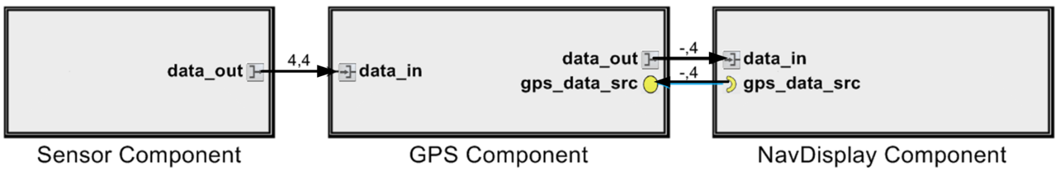
Recall the definition of distributed systems
P1
P2
P3
P4
Example
Key concepts
Processes (single threaded in simple cases, multiple threads possible)
Access to a channel (unbounded in simple cases), but bounded in practice
All processes
(Compute, send, compute)
Or, receive-compute-receive-compute
Or, compute-poll-receive-compute

Slide 5
Synchronous Distributed systems
There is a known upper bound on the time required to send a message
Including the computation time needed to generate the message
And the communication time needed to transfer the message across the network
This lets the processes organize the message passing into rounds
If a process has not received a message by the end of a round, the process can conclude the message will never be received

Slide 6
Asynchronous Distributed Systems
There is no upper bound on the time required to send a message
Message passing cannot be organized into rounds
Designing distributed algorithms for asynchronous message passing is much harder than for synchronous message passing

Slide 7
Today’s outline
Global Time
Time in distributed systems
A baseball example
Synchronizing real clocks
Cristian’s algorithm
The Berkeley Algorithm
Network Time Protocol (NTP)
Logical time
Lamport logical clocks
Vector Clocks

Slide 8
Time Standards
UT1
Based on astronomical observations
“Greenwich Mean Time”
TAI
Started Jan 1, 1958
Each second is 9,192,631,770 cycles of radiation emitted by Cesium atom
Has diverged from UT1 due to slowing of earth’s rotation
UTC
TAI + leap seconds to be within 800ms of UT1

Slide 9
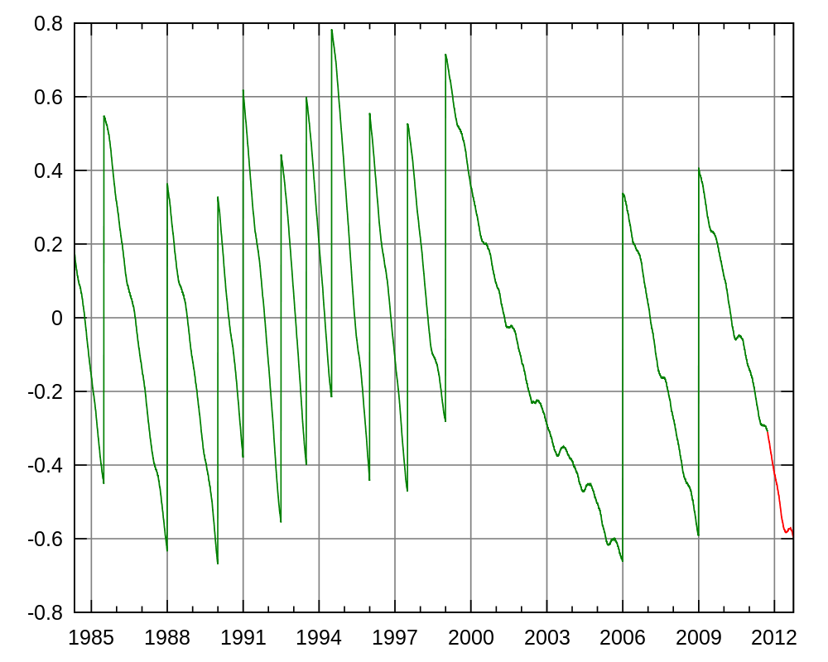
Comparing Time Standards
UT1 − UTC

Slide 10
Distributed time
Premise
The notion of time is well-defined (and measurable) at each single location
But the relationship between time at different locations is unclear
Can minimize discrepancies, but never eliminate them
Reality
Stationary GPS receivers can get global time with < 1µs error
Few systems designed to use this

Slide 11
A baseball example
Four locations: pitcher’s mound, first base, home plate, and third base
Ten events:
e₁: pitcher throws ball to home
e₂: ball arrives at home
e₃: batter hits ball to pitcher
e₄: batter runs to first base
e₅: runner runs to home
e₆: ball arrives at pitcher
e₇: pitcher throws ball to first base
e₈: runner arrives at home
e₉: ball arrives at first base
e₁₀: batter arrives at first base

Slide 12
A baseball example
Pitcher knows e₁ happens before e₆, which happens before e₇
Home plate umpire knows e₂ is before e₃, which is before e₄, which is before e₈, …
Relationship between e₈ and e₉ is unclear

Slide 13
Ways to synchronize
Send message from first base to home?
Or to a central timekeeper
How long does this message take to arrive?
Synchronize clocks before the game?
Clocks drift
million to one => 1 second in 11 days
Synchronize continuously during the game?
GPS, pulsars, etc

Slide 14
Perfect networks
Messages always arrive, with propagation delay exactly d
Sender sends time T in a message
Receiver sets clock to T+d
Synchronization is exact

Slide 15
Synchronous networks
Messages always arrive, with propagation delay at most D
Sender sends time T in a message
Receiver sets clock to T + D/2
Synchronization error is at most D/2

Slide 16
Synchronization in the real world
Real networks are asynchronous
Propagation delays are arbitrary
Real networks are unreliable
Messages don’t always arrive

Slide 17
Cristian’s algorithm
https://en.wikipedia.org/wiki/Cristian%27s_algorithm
Request time, get reply
Measure actual round-trip time d
Sender’s time was T between t₁ and t₂
Receiver sets time to T + d/2
Synchronization error is at most d/2
Can retry until we get a relatively small d

Slide 18
The Berkeley algorithm
Master uses Cristian’s algorithm to get time from many clients
Computes average time
Can discard outliers
Sends time adjustments back to all clients

Slide 19
The Network Time Protocol (NTP)
Uses a hierarchy of time servers
Class 1 servers have highly-accurate clocks
connected directly to atomic clocks, etc.
Class 2 servers get time from only Class 1 and Class 2 servers
Class 3 servers get time from any server
Synchronization similar to Cristian’s alg.
Modified to use multiple one-way messages instead of immediate round-trip
Accuracy: Local ~1ms, Global ~10ms

Slide 20
Real synchronization is imperfect
Clocks never exactly synchronized
Often inadequate for distributed systems
might need totally-ordered events
might need millionth-of-a-second precision

Slide 21
Logical time
Capture just the “happens before” relationship between events
Discard the infinitesimal granularity of time
Corresponds roughly to causality
Time at each process is well-defined
Definition (→_{i}): We say e →_{i} e’ if e happens before e’ at process i

Slide 22
Global logical time
Definition (→): We define e → e’ using the following rules:
Local ordering: e → e’ if e →_{i} e’ for any process i
Messages: send(m) → receive(m) for any message m
Transitivity: e → e’’ if e → e’ and e’ → e’’
We say e “happens before” e’ if e → e’

Slide 23
Concurrency
→ is only a partial-order
Some events are unrelated
Definition (concurrency): We say e is concurrent with e’ (written e║e’) if neither e → e’ nor e’ → e

Slide 24
The baseball example revisited
e₁ → e₂
by the message rule
e₁ → e₁₀, because
e₁ → e₂, by the message rule
e₂ → e₄, by local ordering at home plate
e₄ → e₁₀, by the message rule
Repeated transitivity of the above relations
e₈║e₉, because
No application of the → rules yields either e₈ → e₉ or e₉ → e₈

Slide 25
Ordering of Events (Logical Clocks)
A way to impose an order on events is timestamps.
Each process attaches its current clock value to each event the process generates
All processes handle events in timestamp order
However, we can't assume the clocks are identical in all processes
Real-time clock synchronization protocols exist, but are complicated and only guarantee agreement to some nonzero tolerance

Slide 26
Lamport logical clocks
Lamport clock L orders events consistent with logical “happens before” ordering
If e → e’, then L(e) < L(e’)
But not the converse
L(e) < L(e’) does not imply e → e’
Similar rules for concurrency
L(e) = L(e’) implies e║e’ (for distinct e,e’)
e║e’ does not imply L(e) = L(e’)
i.e., Lamport clocks arbitrarily order some concurrent events

Slide 27
Logical clock algorithm
In each process: Initialize LC = 0
To send a message, e_{i} = send(m):
Increment logical clock: LC = LC + 1
Use that as the logical timestamp of the send event: LC(e_{i}) = LC
Also use that as the logical timestamp of the message: TS(m) = LC
Send m and TS(m) to recipient
When a message is received, e_{i} = receive(m):
Fast-forward logical clock to message timestamp if necessary: LC = max (LC, TS(m))
Increment logical clock: LC = LC + 1
Use that as the logical timestamp of the receive event: LC(e_{i}) = LC
Note: Logical clocks cannot be used to infer causality. It is true that if e_{i} → e_{j} , then LC(e_{i}) < LC(e_{j})
It is not true that if LC(e_{i}) < LC(e_{j}), then e_{i} → e_{j}

Slide 28
Lamport on the baseball example
Initializing each local clock to 0, we get
L(e₁) = 1 (pitcher throws ball to home)
L(e₂) = 2 (ball arrives at home)
L(e₃) = 3 (batter hits ball to pitcher)
L(e₄) = 4 (batter runs to first base)
L(e₅) = 1 (runner runs to home)
L(e₆) = 4 (ball arrives at pitcher)
L(e₇) = 5 (pitcher throws ball to first base)
L(e₈) = 5 (runner arrives at home)
L(e₉) = 6 (ball arrives at first base)
L(e₁₀) = 7 (batter arrives at first base)
For our example, Lamport’s algorithm says that the run scores!

Slide 29
Total-order Lamport clocks
Many systems require a total-ordering of events, not a partial-ordering
Use Lamport’s algorithm, but break ties using the process ID
L(e) = M * L_{i}(e) + i
M = maximum number of processes

Slide 30
Important Points
Physical Clocks
Can keep closely synchronized, but never perfect
Logical Clocks
Encode causality relationship
Lamport clocks provide only one-way encoding
Vector clocks provide exact causality information

Slide 31
Global snapshots
Chandy, K. M., & Lamport, L. (1985). Distributed snapshots: Determining global states of distributed systems. ACM Transactions on Computer Systems (TOCS), 3(1), 63-75.

Slide 32
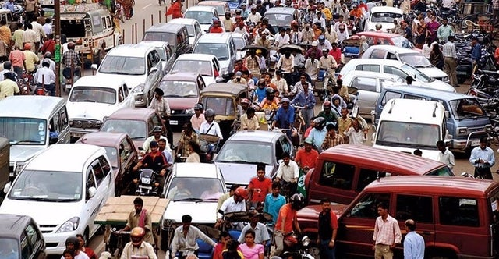
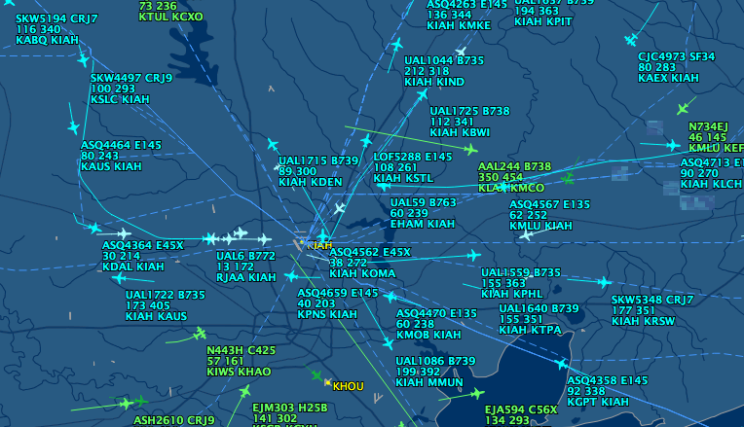
Global Snapshot
A global snapshot includes the state of each local process and information in the channels at the time the snapshot was taken.
The snapshot should not affect the final result of the distributed system.
Note that in practice it does delay the final result.

Slide 33
Global snapshot is global state
Each distributed application has a number of processes (leaders) running on a number of physical servers
These processes communicate with each other via channels (text messaging)
A snapshot captures the local states of each process (e.g., program variables) along with the state of each communication channel
33

Slide 34
Why do we need snapshots?
Checkpointing: restart if the application fails
Collecting garbage: remove objects that don’t have any references
Detecting deadlocks: can examine the current application state
Other debugging: a little easier to work with than printf…
34

Slide 35
We could just synchronize clocks
Each process records state at time some agreed upon t
But clocks skew
And we wouldn’t record messages
Do we need synchronization?
Recall the lamport logical clock
35

Slide 36



Example of global snapshots v2
Two processes: P₁ and P₂
P₁
P₂
36

Slide 37


Example of global snapshots v2
Channel C₁₂ from P₁ to P₂
Channel C₂₁ from P₂ to P₁
^{C}12
P₁
P₂
^{C}21

Slide 38










Example of global snapshots v2
Process states for P₁ and P₂
^{C}12
X: 0
X: 1
Y: 0
P₁
P₂
Y: 2
Z: 0
Z: 3
^{C}21

Slide 39




Example of global snapshots v2
Channel states (i.e., messages) for C₁₂ and C₂₁
This is our initial global state
Also a global snapshot
C₁₂: [Empty]
X₁: 0
X₂: 1
Y₁: 0
Z₁: 0
P₁
P₂
Y₂: 2
Z₂: 3
C₂₁: [Empty]

Slide 40
Example of global snapshots v2
P₁ tells P₂ to change its state variable, X₂, from 1 to 4
This is another global snapshot
C₁₂: [X₂ → 4]
X₁: 0
X₂: 1
Y₁: 0
Z₁: 0
P₁
P₂
Y₂: 2
Z₂: 3
C₂₁: [Empty]

Slide 41
Example of global snapshots v2
P₂ receives the message from P₁
Another global snapshot
C₁₂: [Empty]
X → 4
X₁: 0
2
X₂: 1
Y₁: 0
Z₁: 0
P₁
P₂
Y₂: 2
Z₂: 3
C₂₁: [Empty]

Slide 42
Example of global snapshots v2
P₂ changes its state variable, X₂, from 1 to 4
And another global snapshot
C₁₂: [Empty]
X₁: 0
X₂: 4
Y₁: 0
Z₁: 0
P₁
P₂
Y₂: 2
Z₂: 3
C₂₁: [Empty]

Slide 43
Snapshot
The global state changes whenever an event happens
Process sends message
Process receives message
Process takes a step
Moving from state to state obeys causality

Slide 44
Chandy-Lamport algorithm

Slide 45
System model
Problem: record a global snapshot (state for each process and channel)
Model
N processes in the system with no failures
There are two FIFO unidirectional channels between every process pair (P_{i} → P_{j} and P_{j} → P_{i}), written as channel C_{ij} and C_{ji} respectively.
All messages arrive, intact, not duplicated
Future work relaxes these assumptions

Slide 46
System requirements
Taking a snapshot shouldn’t interfere with normal application behavior
Don’t stop sending messages
Don’t stop the application!
Each process can record its own state
Collect state in a distributed manner
Any process can initiate a snapshot

Slide 47
Initiating a snapshot
Let’s say process P_{i} initiates the snapshot
P_{i} records its own state and prepares a special marker message (distinct from application messages)
Send the marker message to all other processes (using N-1 outbound channels)
Start recording all incoming messages from channels C_{ji} for j not equal to i
20

Slide 48
Propagating a snapshot
For all processes P_{j} (including the initiator), consider a message on channel C_{kj}
If we see marker message for the first time from Process P_{k}
P_{j} records own state and marks C_{kj} as empty
Send the marker message to all other processes (using N-1 outbound channels)
Start recording all incoming messages from channels C_{lj} for l not equal to j or k
Else add all messages from inbound channels since we began recording to their states
21

Slide 49
Terminating a snapshot
All processes have received a marker (and recorded their own state)
All processes have received a marker on all the N-1 incoming channels (and recorded their states)
Later, a central server can gather the partial state to build a global snapshot

Slide 50
Example
P₁ initiates a snapshot
C₁₂: [Empty]
X₁: 0
X₂: 4
Y₁: 0
Z₁: 0
P₁
P₂
Y₂: 2
Z₂: 3
C₂₁: [Empty]

Slide 51
Example
First, P₁ records its state
C₁₂: [Empty]
X₁: 0
X₂: 4
Y₁: 0
Z₁: 0
P₁
P₂
Y₂: 2
Z₂: 3
C₂₁: [Empty]

Slide 52
Example
Then, P₁ sends a marker message to P₂ and begins recording all messages on inbound channels
Meanwhile, P₂ sent a message to P₁
C₁₂: [<marker>]
X₁: 0 X₂: 4
Y₁: 0 P₁ P₂ Y₂: 2
Z₁: 0 Z₂: 3
C₂₁: [M₁]

Slide 53
Example
P₂ receives a marker message for the first time, so records its state
P₂ then sends a marker message to P₁
C₁₂: [Empty]
<marker>
X₁: 0
X₂: 4
Y₁: 0
P₁
P₂
Y₂: 2
Z₁: 0
Z₂: 3
M₁
C₂₁: [<marker>]

Slide 54
Example
P₁ has already sent a marker message, so it records all messages it received on inbound channels to the appropriate channel’s state
C₁₂: [Empty]
X₁: 0
X₂: 4
Y₁: 0
Z₁: 0
P₁
P₂
Y₂: 2
Z₂: 3
M₁
C₂₁: [Empty]

Slide 55
Example
Both processes have recorded their state and all the state of all incoming channels
Our snapshotted state is highlighted in blue
C₁₂: [Empty]
X₁: 0
X₂: 4
Y₁: 0
Z₁: 0
P₁
P₂
Y₂: 2
Z₂: 3
M₁
C₂₁: [Empty]

Slide 56
Summary
The global snapshot algorithmp₀ sends a "take snapshot" message to every process p₀ through p_{N}
The first time p_{j} receives a "take snapshot" message, p_{j} does the following:
Records its own local state
Sets c_{ij} to an empty list for all incoming channels i
Sends a "take snapshot" message on all outgoing channels
Whenever p_{j} receives a regular application message after the first "take snapshot" message, p_{j} does the following:
Records the application message in the list c_{ij} for the incoming channel i on which the application message arrived
Whenever p_{j} receives another "take snapshot" message after the first "take snapshot" message, p_{j} does the following:
Stops recording application messages for the incoming channel i on which the "take snapshot" message arrived (it is possible to receive multiple take snapshot messages.)
When p_{j} has received a "take snapshot" message from all incoming channels, p_{j} does the following:
Sends its local state and all message lists c_{ij} to p₀

Slide 57
Causal consistency
Related to the Lamport clock partial ordering
An event is presnapshot if it occurs before the local snapshot on a process
Postsnapshot if afterwards
If event A happens causally before event B, and B is presnapshot, then A is too
30

Slide 58
Message in snapshots
In order for an application message m in the channel from process p to process q to be in the snapshot
Must happen after q has received its first marker
Before p has sent its marker to q
A message m will only be in the snapshot if the sending process was presnapshot and the receiving process was postsnapshot

Slide 59
Message in snapshots
How do we order concurrent events?
Remember, all processes communicate
What if a process receives a marker in between sending a marker and some event?
These should happen atomically (the updates on each process should occur atomically.)
Remember that snapshots are causally consistent

Slide 60
Taking snapshot in practice
Fork is one way to snapshot a process
Another is to serialize all objects to disk

