Slide 1



Software Vulnerability Analysis for Cybersecurity
Daniel Balasubramanian, Gabor Karsai (Vanderbilt)
Corina Pasareanu (CMU)
Tevfik Bultan (UCSB)

Slide 2
Motivation
“Once new defense technologies make vulnerabilities based on flawed implementations less common, adversaries will turn their attention to vulnerabilities inherent in the algorithms themselves.”¹
Specifically, vulnerabilities stemming from space and time resource usage
These enable two types of cyber attacks:
Algorithmic complexity attacks
Side-channel attacks
¹https://www.darpa.mil/program/space-time-analysis-for-cybersecurity

Slide 3
Motivation (cont’d)
Algorithmic complexity attacks — denial-of-service attacks, the adversary's goal is to deny service to the system's users, or to disable the system by choosing a worst-case input
Side-channel attacks — recover secret inputs to programs from non-functional characteristics of computations, such as time consumed, number of memory accesses or size of output files
These vulnerabilities aren’t “bugs” in the traditional sense

Slide 4
Complexity attack examples
What systems are vulnerable to such attacks?
Network filter rules in Snort
Carefully constructed packets cause repeated backtracking causing packet processing to be 1.5 million times slower than average
Hashtables: degenerate to linked lists with carefully selected inputs
Used against the Bro intrusion detection system
Backtracking regular expression matchers
Carefully constructed expressions cause exponential blowup
“Lol” bomb: recursively defined XML
When expanded, it consumes all your memory
Web-server based systems in general…

Slide 5
Side-channel attacks
Can an attacker “learn” some secret by observing program outputs
Observables: size of response, time for response, memory usage, file size, etc
Attacker doesn’t directly see secret, but sees outputs whose characteristics are controlled by computations involving the secret
Example: can an attacker learn a secret password by observing the amount of time the response takes?
Especially if the number of correct characters influences the response time

Slide 6
Research goal
Write algorithms/tools to detect whether a program contains a complexity or side-channel vulnerability
We do this on Java Bytecode programs; our methods apply to other technologies
This is a hard problem:
Rice’s theorem (1953): all interesting questions about the behavior of a program are undecidable
Programs are large (and libraries can be even larger)
Manual analysis is too slow
We can still build practically useful tools!

Slide 7



ISSTAC Architecture
Java Bytecode
Static Analysis
Inspection
(Human)
Symbolic
Execution
Analysis
Results
Worst-case inputs
Estimated bounds
Distributed
Symbolic
Analysis
Worst-case analysis
(worst-case bounds)
Symbolic Listeners
Information
leakage
Side-channel analysis
Cost Model
Constraint Solving
Model Counting
Compute from the bytecode its worst-case time/space bounds, produce example inputs that trigger them, estimate information leakage through observables related to time/memory
via
symbolic execution of the code performed on a cloud-based computing platform using a model-counting constraint-solver.

Slide 8

Static analysis
Java Bytecode
Static Analysis
Inspection
(Human)
Symbolic
Execution
Analysis
Results
Worst-case inputs
Estimated bounds
Distributed
Symbolic
Analysis
Worst-case analysis
(worst-case bounds)
Symbolic Listeners
Information
leakage
Side-channel analysis
Cost Model
Constraint Solving
Model Counting

Slide 9
Static analysis overview
Goal: quickly identify potential vulnerabilities
We’d like to know things like:
Where are the loops, which ones are “suspicious”, where are the recursive methods
Which branches are “unbalanced”, which loops/branches depend on user input
For these, we need to compute:
Call graphs, control flow graphs, data dependency graphs, etc

Slide 10
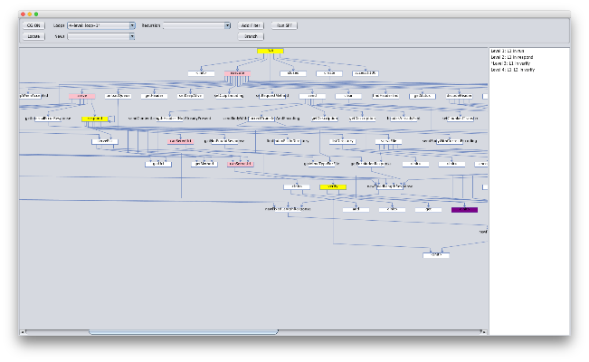

Static analysis
Java Analyzer is our static analysis tool
Quickly identifies potential vulnerabilities
Highlights:
Inter-procedural nested loops
Recursive calls
Looping memory allocations
Unbalanced branch finder
Program slicer
Automated driver generation
Uses IBM’s WALA framework
Janalyzer screenshot

Slide 11
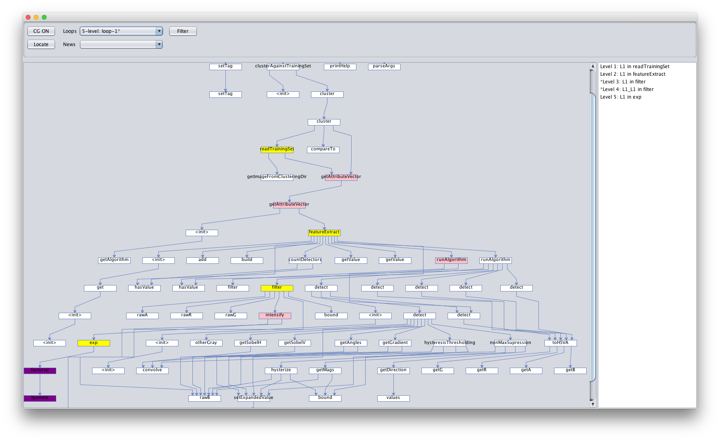
Janalyzer highlights (1)
Call graph: shows what methods each method calls
Forms the basis for most other analyses
Notes:
WALA computes the CG automatically, but it can still be slow…
The Java class libraries are very large
rt.jar, the jar containing the java base class libraries, is 64MB for Java 1.8!
Reflection also makes it hard
How can we handle these problems?
We do two things:
Use smaller placeholder libraries that over-approximate (a tool called Averroes)
Over-approximation is done in most program analysis. It leads to imprecision.
Use information from dynamic runs to decide which classes are actually dynamically loaded (a tool called TamiFlex)
This is also frequently done in program analysis. It makes the analysis unsound.

Slide 12
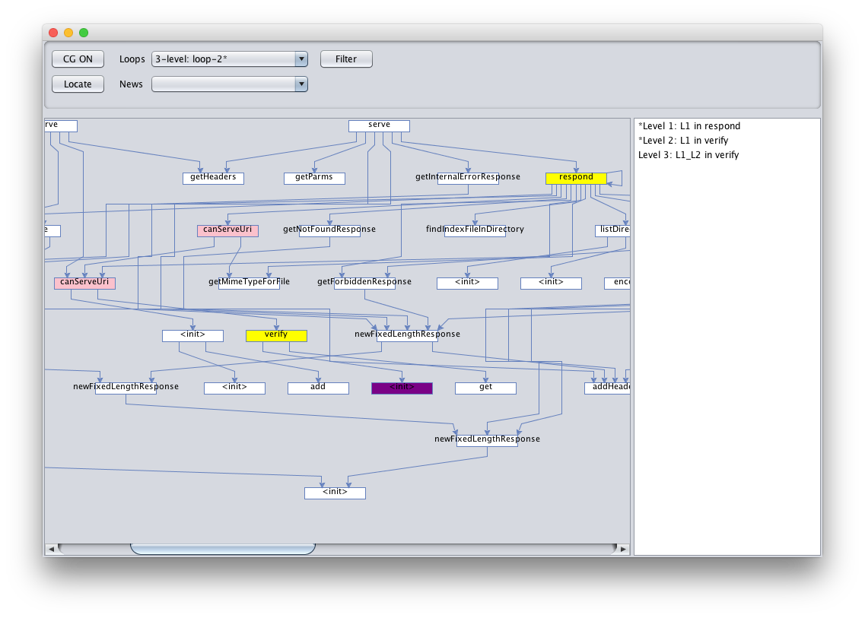
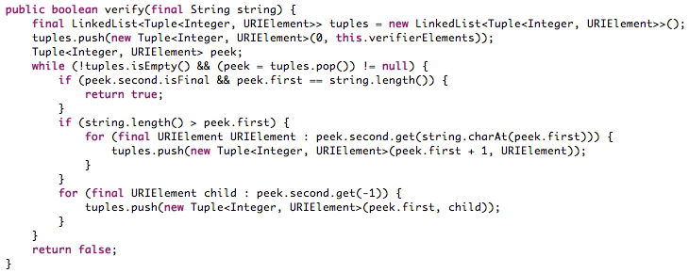
Janalyzer highlights (2)
Suspicious loop finder: flags loops with suspicious exit conditions
Suspicious: loop exit condition changed inside the loop body
Uses library method summaries, data dependency analysis
Example: exit condition modified inside loop
Notes:
Behind the scenes, the suspicious loop finder uses library method summaries and a data dependency analysis that uses the library summaries. These improve the precision of this suspicious loop finder and help reduce the number of false positives.

Slide 13
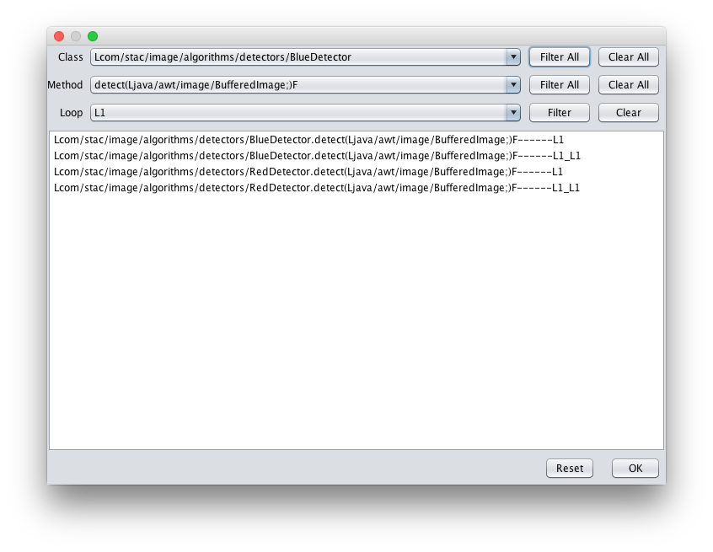
Janalyzer highlights (3)
Problem: too many loops; most (maybe all) are non-vulnerable
Solution: filter at the loop, method or class level

Slide 14
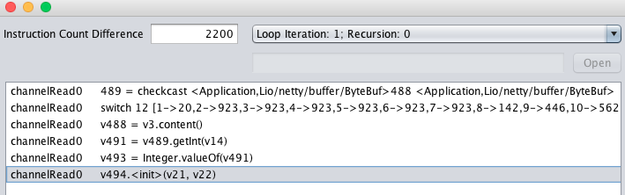
Janalyzer highlights (4)
How can we spot potential side channels?
One way: look for “unbalanced” code fragments
Unbalanced branch finder: finds unequal branches with respect to some metric (e.g. # of instructions)
Based on control dependency graph
Computes reachable instructions that are control dependent on a branch true/false
Challenge: need precise loop bounds and recursion depths

Slide 15
Janalyzer highlights (5)
Information from dynamic runs can also provide valuable insights about program behavior
We collect and display this in two steps:
Use an agent (jBond) to monitor information about a dynamic run (method running times, number of calls, total execution time). Store that information.
Load that information into the Janalyzer and overlay it.

Slide 16
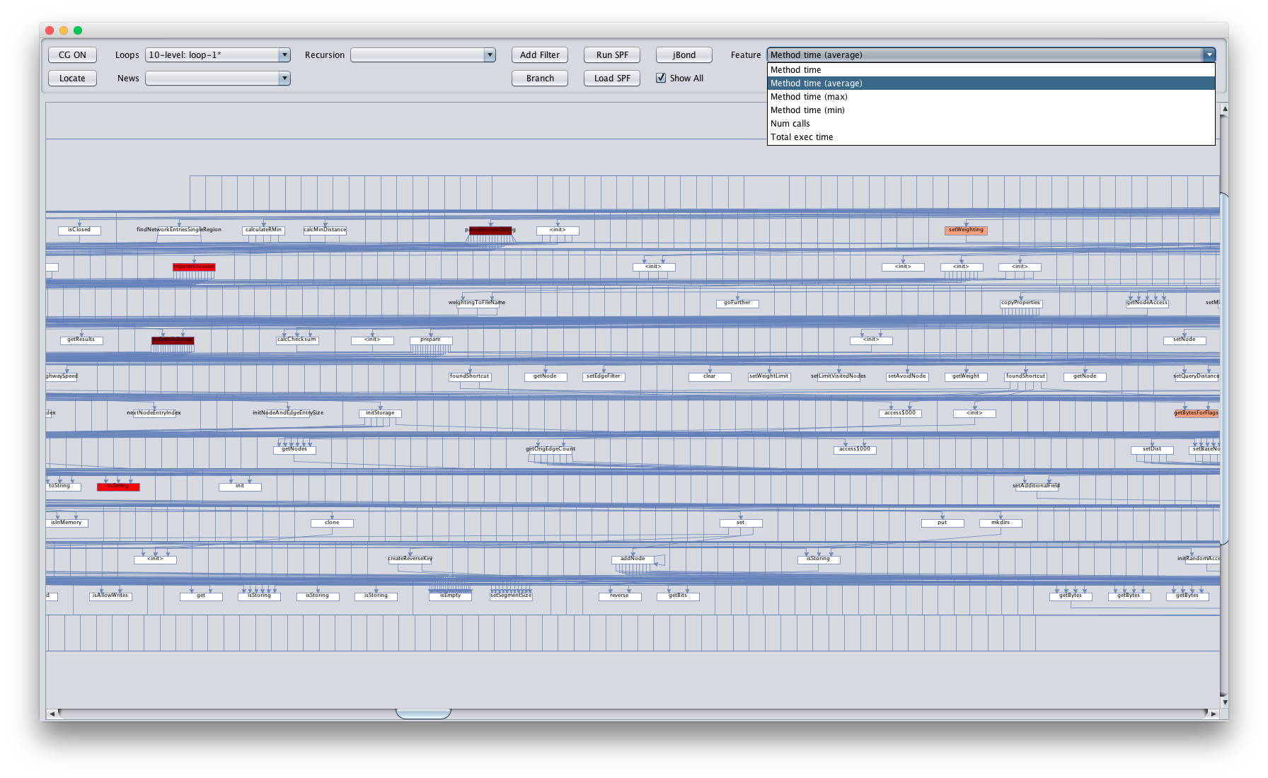
Janalyzer highlights (5)
Example of jBond information overlaid on the Janalyzer

Slide 17
Worst-case analysis with symbolic execution
Java Bytecode
Static Analysis
Inspection
(Human)
Symbolic
Execution
Analysis
Results
Worst-case inputs
Estimated bounds
Distributed
Symbolic
Analysis
Worst-case analysis
(worst-case bounds)
Symbolic Listeners
Information
leakage
Side-channel analysis
Cost Model
Constraint Solving
Model Counting

Slide 18
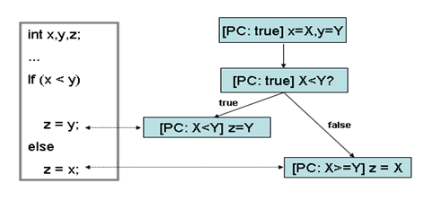
Symbolic execution
Once suspicious areas are identified, we need automated methods to confirm
We use symbolic execution
Concrete execution uses concrete inputs to explore a single path at a time
Symbolic execution uses symbolic inputs to explore multiple paths simultaneously
Feed the path condition to a constraint (SMT) solver to determine satisfiability
A solution to a path condition provides a concrete input through that path!
Example of symbolic execution

Slide 19
Worst-case analysis
Use symbolic execution to find the worst case path
Simple approach (but not scalable):
Perform symbolic execution over the program — compute cost of each path
Return the path with largest cost
Scalable approach: symbolic execution guided by path policies
Explore exhaustively at small input sizes; record choices along worst-case path
Use these choices to guide the exploration at larger input sizes
Intuition: worst-case behavior for small input can predict worst-case behavior for larger input

Slide 20
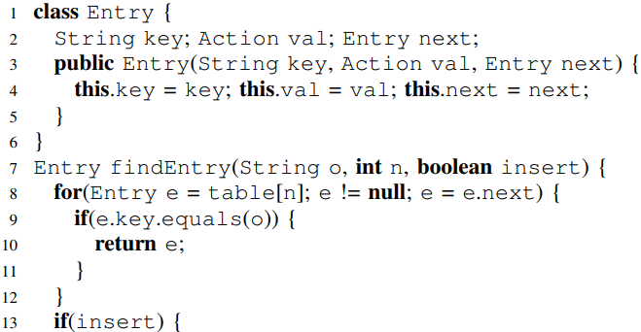
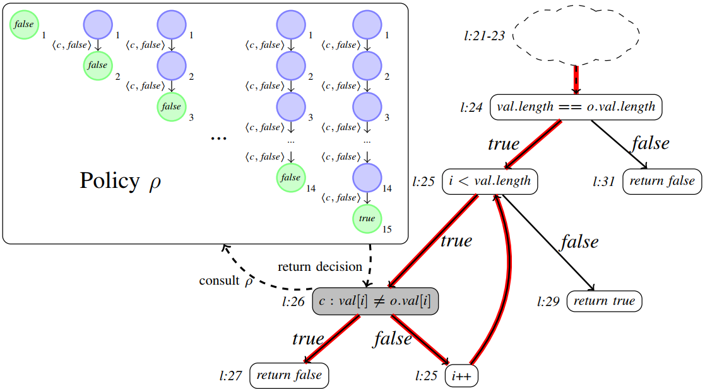
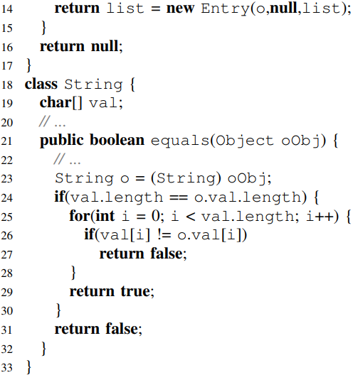
Worst-case analysis example
Partial CFG for the equals() method in class java.util.String. The worst-case path is highlighted. The policy ρ guides the choices for the decision node marked with gray (for k=15). ρ can be stored as a single path in a trie
Key idea: we automatically discover that the worst case path for comparing two Strings occurs when all characters except the last are equal
Symbolic complexity analysis using context-preserving histories,
by K. Luckow, R. Kersten, C. Pasareanu [ICST’17] Best Paper Award!
Notes:
- Our worst-case analysis is based on distributed symbolic execution with an iterative deepening approach (and more precisely a beam-search):
- Iterative symbolic execution explores the program up to an increment depth, for example 5. (use figure as example)
- During exploration with the increment depth, the execution paths may lead to successful termination (or fail due to assertion error or an exception being thrown -- this represents an error) or they will hit the depth bound.
- For the paths that terminate, we record the number of instructions executed up until that point. We keep track of the longest path in terms of instructions executed.
- The paths that hit the increment bound define an exploration frontier.
- Each frontier state (i.e., the state of symbolic execution at the point the bound was hit) are submitted to workers in the distributed infrastructure.
- Some filtering will be done, e.g., only submit frontier states that are likely to lead to the worst case behavior being exercised (guidance, "beam-search")
- The frontier state defines the initial state for the exploration of the worker
- From this state the worker performs symbolic execution up to the same increment depth, and returns the result to the driver (i.e., the node that submitted the state to it)
- When the analysis returns, the length of the worst-case path is plotted for the particular input size. The input size is increased, driving a new round of analysis.
- Using a fitting function, the worst-case complexity can be derived
- Solving the path constraint of the longest path generates concrete program input that is guaranteed to exercise the exposed vulnerability/worst-case behavior
- The symbolic execution-based analysis is under-approximate
- For the over-approximate analysis, we intent to use static analysis -- likely we will use Implicit path enumeration, that based on the control flow (and loop bounds) derives arithmetic constraints. The worst case cost (time/memory) is obtained by maximizing the total execution time under the constraints.

Slide 21
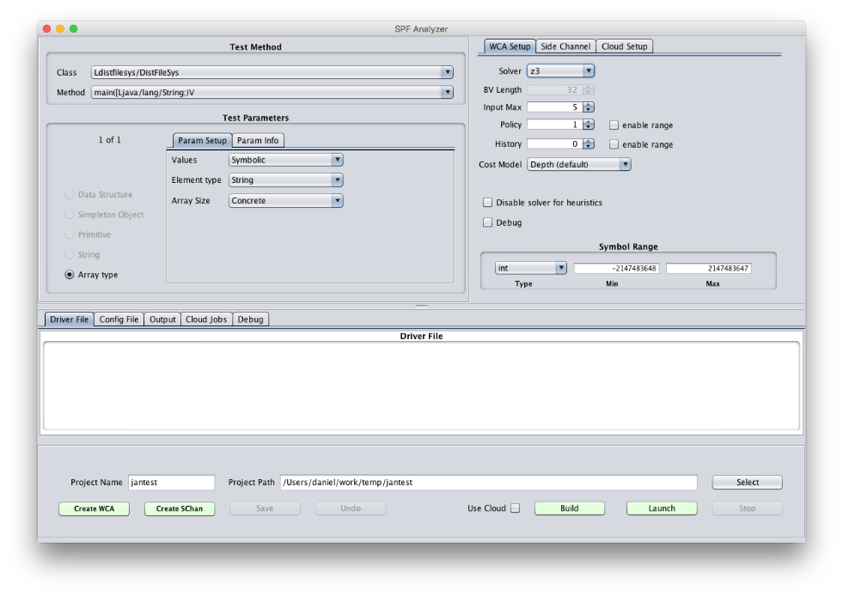
Janalyzer highlights (6)
Previously: had to manually construct JPF driver and configuration file
Now automated and integrated into JAnalyzer

Slide 22
Cloud platform architecture
We use a distributed cloud platform to further scale our symbolic execution!
The problem is defined at the Client and sent with its assets to one of the task-specific Dispatchers
The results are reported back to the Client
Client
The Dispatcher partitions the problem and directs the individual work requests to the Bridge
The Dispatcher integrates the results into one coherent picture that is updated continuously
Dispatcher
Dispatcher
Dispatcher
The Bridge routes work requests to available Daemon nodes
The Bridge routes work progress updates back to the original Dispatcher
Bridge
Daemon nodes manage the work items and instantiate Workers to perform work
Based on status reports, Daemons evaluate work load and report status and progress to the Bridge
Daemon
Daemon
Daemon
Worker
Worker
Worker
Workers report status and progress continuously while the task is being executed
Individual Worker actors perform the assigned tasks
Worker
Worker
Worker

Slide 23
Design Goals (and Achievements)
Near 100% utilization of available compute resources at all times
Almost linear scaling with respect to compute resources available
A speedup of around two orders of magnitude for a 128-node cluster
Example of measured speedup on challenge program: 14 hours (desktop) vs. 11 minutes (cluster)
Real-time reporting of intermediate results
Long-running tasks present usable results well before overall completion
Self-contained and agnostic to the underlying hardware and software
Complete turnkey solution suitable for deployment to AWS, Azure, etc.
No software requirements outside of a Linux VM, a network, and a JVM

Slide 24
Side-channel analysis
Java Bytecode
Static Analysis
Inspection
(Human)
Symbolic
Execution
Analysis
Results
Worst-case inputs
Estimated bounds
Distributed
Symbolic
Analysis
Worst-case analysis
(worst-case bounds)
Symbolic Listeners
Information
leakage
Side-channel analysis
Cost Model
Constraint Solving
Model Counting

Slide 25

Side-channel analysis
High-level idea:
Side-channels are based on “observations” on a program run – for instance, execution time or packet size
Counting the number of these observables can help quantify the information leakage in a program
We use symbolic execution to explore program paths and measure their cost (execution time, for instance)
Paths with equivalent costs are considered equivalent
We can then bound the side-channel capacity:
The number of observables are the number of paths with different costs

Slide 26
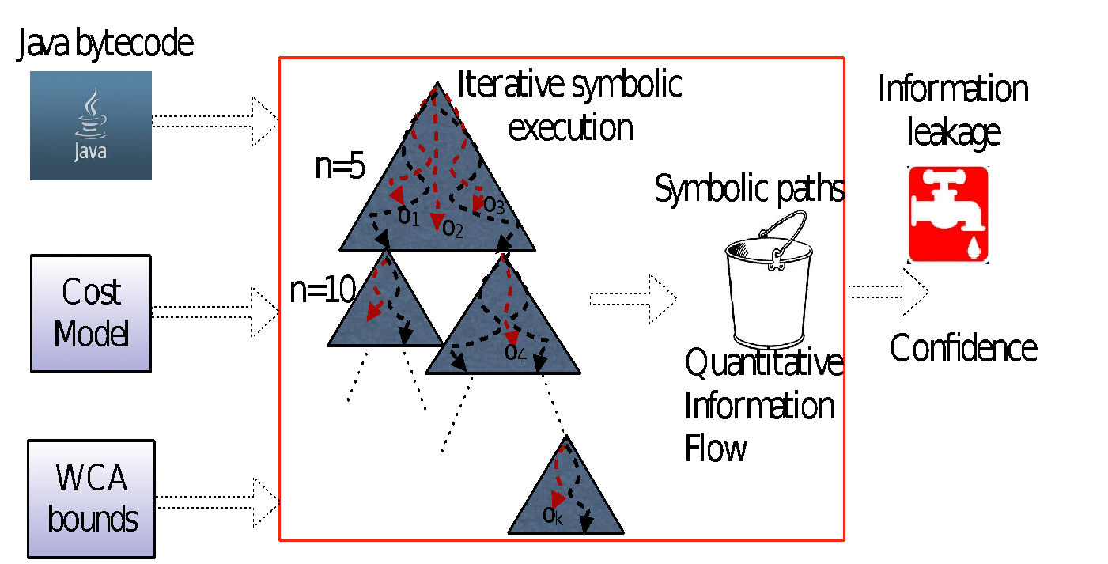
Side-channel analysis
Implemented “listeners” to collect time/memory costs for all explored (complete) paths — Costs form the “observables”
Quantitative Information-Flow Analysis (QIF) to determine side-channel capacity — maximum possible leakage
Notes:
Big idea with QIF: rather than qualitatively check for non-interference, which is too strict, we try to quantify the leakage, and accept programs with small leakage as secure.

Slide 27
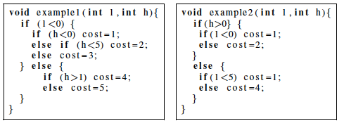
Single-run analysis example
Example 1: 5 possible observables
L < 0: 3 observables
l >= 0: 2 observables
Example 2: 3 observables
l=0: 2 observables
Goal: derive “low” value that maximizes leakage automatically
MaxSMT formulation: assemble PCs that lead to the same observable into “clauses” of weight “1”;
Solution gives maximal assignment corresponding to largest number of observables reached by a public input

Slide 28

Multi-run analysis
In real programs, attackers need multiple runs
Generalization over multiple-run side-channel analysis
An “observable” is a sequence of costs
MaxSMT used to synthesize a sequence of public inputs
Have also done work on adaptive attacks
Attacker chooses next input based on previous observations

Slide 29
Side-channel analysis process
Use JAnalyzer and code inspection to figure out parts of the code that relate to the mentioned operations
Write a SPF driver to execute the identified code
Run symbolic execution (SPF) on the resulting system using the time or memory listener
Remove or stub out code that breaks symbolic execution
Path constraints generated by symbolic execution identify the relationship between the secret and the observable
SPF Side Channel Analysis (SPF-SCA) computes the entropy and channel capacity to quantify the leakage
Devise an attack based on the results

Slide 30
Measuring effectiveness
How can we determine if our tools/methods are practically useable?
Use them on programs!
A “red team” builds challenge programs that may or may not contain vulnerabilities
“Blue” teams try to find vulnerabilities using their tools
Our performance:
Won the first engagement with more vulnerabilities identified and higher accuracy than any other team
Answered more questions and had highest overall accuracy on second engagement

Slide 31
Questions?
Thank you!

Slide 32




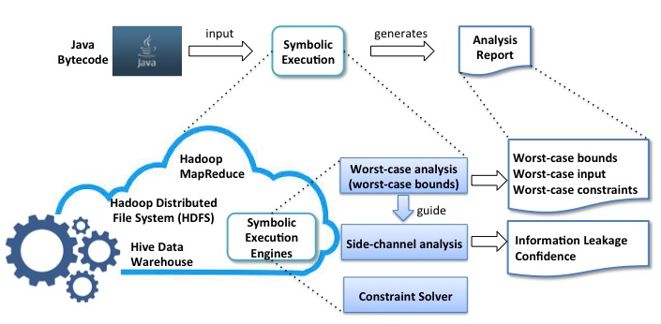
Integrated Symbolic Execution for Space-Time Analysis for Code (ISSTAC)
Gabor Karsai, Daniel Balasubramanian, Vanderbilt University
Corina Pasareanu, Carnegie Mellon University
Tevfik Bultan, University of California, Santa Barbara
Pasquale Malacaria, Queen Mary University of London, UK (Collaborator)
The Problem
Inherent space-time complexity of algorithms used for building software systems offer new attack surfaces for cyber exploits
Complexity analysis is very hard for real systems
The Idea
Symbolic execution of code has been successfully applied for automated test input generation – could be used for space-time complexity analysis as well.
Use the same technique extended with quantitative reasoning to perform side-channel analysis.
For scalability exploit natural parallelism in symbolic execution and use a cloud platform.
The ISSTAC approach
Expected outcomes
Distributed execution framework for parallel symbolic execution of Java bytecode
Automated approach to worst-case execution and side-channel analysis
Novel model-counting constraint solver
Open source implementation

