Slide 1
Byzantine Faults
Based on https://marknelson.us/posts/2007/07/23/byzantine.html

Slide 2
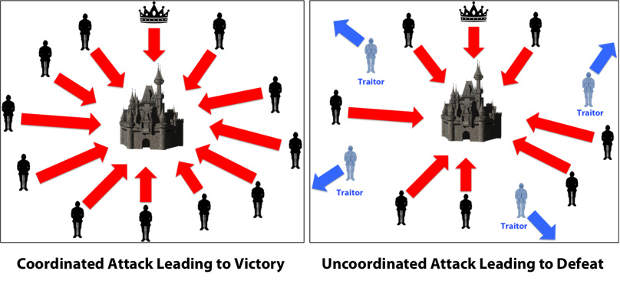
BFT - Lamport
The Byzantine General’s Problem is one of many in the field of agreement protocols.
This problem is built around an imaginary General who makes a decision to attack or retreat, and must communicate the decision to his lieutenants.
A given number of these actors are traitors (possibly including the General.)
Traitors cannot be relied upon to properly communicate orders; worse yet, they may actively alter messages in an attempt to subvert the process.

Slide 3
Byzantine Faults
They are real, they do occur
Mostly associated with data transmission
They are caused by many physical effects including:
Voltages and clocks at marginal levels
Faulty connectors
Electrical noise
Other external sources (cosmic rays, etc.)

Slide 4
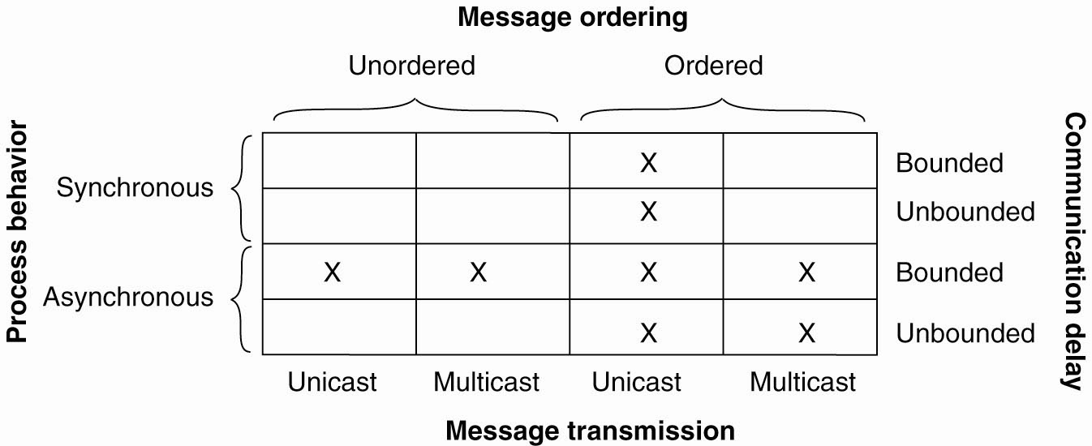
Background: Agreement in Faulty Systems
Synchronous versus asynchronous systems.
A system is synchronized if the process operation in lock-step mode. Otherwise, it is asynchronous.
Communication delay is bounded or not.
Message delivery is ordered or not.
Message transmission is done through unicasting or multicasting.

Slide 5
Classical Byzantine Fault Tolerance
Byzantine Agreement [Lamport, Shostak, Pease, 1982]
Assumptions:
Every message that is sent is delivered correctly
The receiver knows who sent the message
Message delivery time is bounded

Slide 6
Understanding the problem

Slide 7
BFT - Lamport
The Byzantine General’s Problem is one of many in the field of agreement protocols.
This problem is built around an imaginary General who makes a decision to attack or retreat, and must communicate the decision to his lieutenants.
A given number of these actors are traitors (possibly including the General.)
Traitors cannot be relied upon to properly communicate orders; worse yet, they may actively alter messages in an attempt to subvert the process.

Slide 8
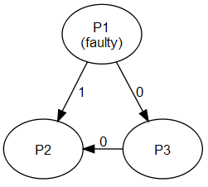
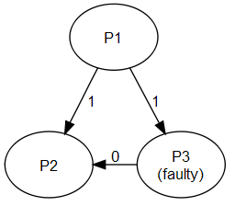
Contextualizing to real-world
Imagine the generals are processes (replicas of a database)
The general who initiates the order is the source process (P1) , and the orders sent to the other processes are messages.
Traitorous generals and lieutenants are faulty processes, and loyal generals and lieutenants are correct processes.
The order to retreat or attack is a message with a single bit of information: a one or a zero.
P1 sends different data to P2 and P3
P3 misrepresents data received from P1

Slide 9
Solution requirements
Any solution to an agreement problem must pass three tests: termination, agreement, and validity.
A solution has to guarantee that all correct processes eventually reach a decision regarding the value of the order they have been given.
All correct processes have to decide on the same value of the order they have been given.
If the source process is a correct process, all processes have to decide on the value that was original given by the source process.
In database source process is aka primary replica.

Slide 10
Difficulty
Imagine, for example, that the source process is the only faulty process. It tells half the processes that the value of their order is zero, and the other half that their value is one.
Recall: A solution has to guarantee that all correct processes eventually reach a decision regarding the value of the order they have been given.
- What happens to decisions of P2 and P3

Slide 11
Difficulty
After receiving the order from the source process, the remaining processes have to agree on a value that they will all decide on. The processes could quickly poll one another to see what value they received from the source process.

Slide 12
Difficulty
Imagine the decision algorithm of a process which receives an initial message of zero from the source process, but sees that one of the other processes says that the correct value is one.
Given the conflict, the process knows that either the source process is faulty, having given different values to two different peers, or the peer is faulty, and is lying about the value it received from the source process.

Slide 13
Difficulty
In this case it is easy to find out that there is a conflict
However, what is the correct value is difficult to find out.
Actually there is a basic result about this.

Slide 14
Basic Result -- impossibility
General 1
General 1
attack
attack
attack
retreat
General 2
General 3
General 2
General 3
retreat
retreat
No solution for three processes that can handle a single traitor.
In a system with m faulty processes agreement can be achieved only if there are 2m+1 (more than 2/3) functioning correctly. Thus if m are faulty then we need 3m+1 total processes

Slide 15
Mapping to blockchains
objective(generals) = agree on a strategy
objective(blockchain) = agree on valid transactions
spatiality(generals) = distributed camps
spatiality(blockchain) = distributed nodes in the network
loyalists(generals) = honest generals
loyalists(blockchain) = honest nodes
traitors(generals) = traitorous generals
traitors(blockchain) = malicious nodes
attack(generals) = corrupting a message
attack(blockchain) = adding an invalid transaction to the blockchain
problem(generals) = what message is true?
problem(blockchain) = what transaction is valid?
https://medium.com/@alexandratran/a-cursory-introduction-to-byzantine-fault-tolerance-and-alternative-consensus-1155a5594f18

Slide 16
Solution Approach

Slide 17
Assumption about messages

Slide 18
The Lamport, Pease and Shostak Algorithm
Algorithm OM(0)
The general sends his value to every lieutenant.
Each lieutenant uses the value he receives from the general.
Algorithm OM(m), m > 0
The general sends his value to each lieutenant.
For each i, let vi be the value lieutenant i receives from the general. Lieutenant i acts as the general in Algorithm OM(m-1) to send the value vi to each of the n-2 other lieutenants.
For each i, and each j≠i, let vi be the value lieutenant i received from lieutenant j in step 2 (using Algorithm (m-1)). Lieutenant i uses the value majority (v1, v2, … vn).<>
The algorithm runs for m+1 rounds where
m is the number of traitors

Slide 19
Round 0 – m==0
In round 0, the General sends the order to all of its lieutenants. Having completed his work, the General now retires and stands by idly waiting for the remaining work to complete. Nobody sends any additional messages to the General, and the General won’t send any more messages.

Slide 20
Round 0 – m==0
In round 0, the General sends the order to all of its lieutenants. Having completed his work, the General now retires and stands by idly waiting for the remaining work to complete. Nobody sends any additional messages to the General, and the General won’t send any more messages.
How do you know who is the general
You designate the primary copy. Hence it is known by designation.

Slide 21
Round 1
Each process broadcasts a message to all the other processes, including itself, but excluding the General, with the value it received from the General and its own process ID.
You try not to have cycles.

Slide 22
Round 1
Imagine we have 7 processes P₁ ₋₋ P_{7.}
For example, let’s suppose that in Round 0 that P₁, a faulty general told P₂, P₃, and P₄ that the command value was 0, and told P₅, P₆, and P₇ that the command value was 1. In round 1, the following messages would be sent:
Sender=P₂ |  | Sender=P₃ |  | Sender=P₄ |  | Sender=P₅ |  | Sender=P₆ |  | Sender=P₇
Dest | Msg | Dest | Msg | Dest | Msg | Dest | Msg | Dest | Msg | Dest | Msg
P₂ | {0,12} | P₂ | {0,13} | P₂ | {0,14} | P₂ | {1,15} | P₂ | {1,16} | P₂ | {1,17}
P₃ | {0,12} | P₃ | {0,13} | P₃ | {0,14} | P₃ | {1,15} | P₃ | {1,16} | P₃ | {1,17}
P₄ | {0,12} | P₄ | {0,13} | P₄ | {0,14} | P₄ | {1,15} | P₄ | {1,16} | P₄ | {1,17}
P₅ | {0,12} | P₅ | {0,13} | P₅ | {0,14} | P₅ | {1,15} | P₅ | {1,16} | P₅ | {1,17}
P₆ | {0,12} | P₆ | {0,13} | P₆ | {0,14} | P₆ | {1,15} | P₆ | {1,16} | P₆ | {1,17}
P₇ | {0,12} | P₇ | {0,13} | P₇ | {0,14} | P₇ | {1,15} | P₇ | {1,16} | P₇ | {1,17}

Slide 23

Round 1
Imagine we have 7 processes P₁ ₋₋ P_{7.}
For example, let’s suppose that in Round 0 that P₁, a faulty general told P₂, P₃, and P₄ that the command value was 0, and told P₅, P₆, and P₇ that the command value was 1. In round 1, the following messages would be sent:
Sender=P₂ |  | Sender=P₃ |  | Sender=P₄ |  | Sender=P₅ |  | Sender=P₆ |  | Sender=P₇
Dest | Msg | Dest | Msg | Dest | Msg | Dest | Msg | Dest | Msg | Dest | Msg
P₂ | {0,12} | P₂ | {0,13} | P₂ | {0,14} | P₂ | {1,15} | P₂ | {1,16} | P₂ | {1,17}
P₃ | {0,12} | P₃ | {0,13} | P₃ | {0,14} | P₃ | {1,15} | P₃ | {1,16} | P₃ | {1,17}
P₄ | {0,12} | P₄ | {0,13} | P₄ | {0,14} | P₄ | {1,15} | P₄ | {1,16} | P₄ | {1,17}
P₅ | {0,12} | P₅ | {0,13} | P₅ | {0,14} | P₅ | {1,15} | P₅ | {1,16} | P₅ | {1,17}
P₆ | {0,12} | P₆ | {0,13} | P₆ | {0,14} | P₆ | {1,15} | P₆ | {1,16} | P₆ | {1,17}
P₇ | {0,12} | P₇ | {0,13} | P₇ | {0,14} | P₇ | {1,15} | P₇ | {1,16} | P₇ | {1,17}
{0,12} means that 2 is telling others that I received a message from 1 and the value was 0. Think about the Chinese whisper game.

Slide 24
Round2
Each process (not the source general) will send message to all other lieutenants – cycles are not allowed.
Sender=P₂ | Sender=P₃ | Sender=P₄ | Sender=P₅ | Sender=P₆ | Sender=P₇
{0,132} {0,142} {1,152} {1,162} {1,172} | {0,123} {0,143} {1,153} {1,163} {1,173} | {0,124} {0,134} {1,154} {1,164} {1,174} | {0,125} {0,135} {0,145} {1,165} {1,175} | {0,126} {0,136} {0,146} {1,156} {1,176} | {0,127} {0,137} {0,147} {1,157} {1,167}
{0,132} Two is telling others that I received a message from 3 which says that 3 received a message from 1 which was 0

Slide 25
Tree Storage
Each process stores all messages it has received in a tree structure.
While sending messages in each round, processes are also accumulating incoming messages. The messages are stored in a tree format, with each round of messages occupying one level of the tree.

Slide 26
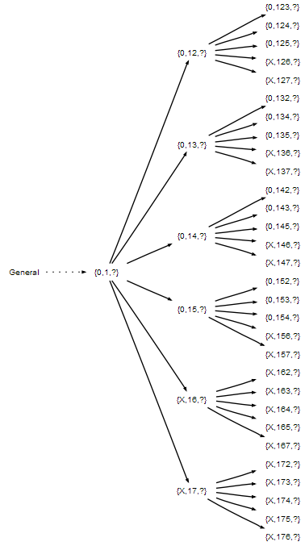
Tree Storage
Each process stores all messages it has received in a tree structure.
While sending messages in each round, processes are also accumulating incoming messages. The messages are stored in a tree format, with each round of messages occupying one level of the tree.
An example tree with n=7, m=2, and faulty processes P₆ and P₇

Slide 27
Tree Storage
Number of messages….
An example tree with n=7, m=2, and faulty processes P₆ and P₇

Slide 28
Tree Storage
Number of messages….
(N-1)*(N-2)….(N-M)
N total number of nodes
M (max) number of faulty nodes.
= (N-1)!/(N-(M+1))!
An example tree with n=7, m=2, and faulty processes P₆ and P₇

Slide 29
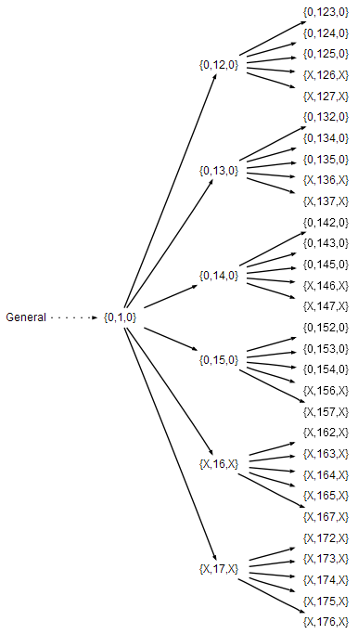
Decision criteria
Majority voting – fold the tree back up from leaves

