Slide 1
PBFT

Slide 2
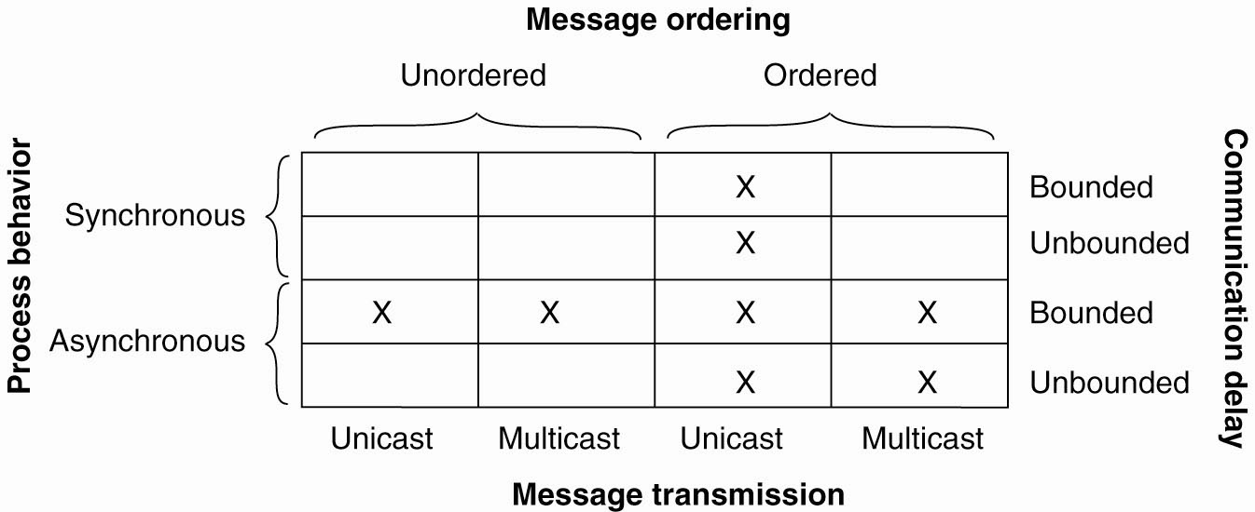
Asynchronous

Slide 3
Practical Byzantine Fault Tolerance
Why async BFT? BFT:
Malicious attacks, software errors
Need N-version programming?
Faulty client can write garbage data, but can’t make system inconsistent (violate operational semantics)
Why async?
Faulty network can violate timing assumptions
But can also prevent liveness

Slide 4
Important theorem of impossibility
FLP impossibility: Async consensus may not terminate
Sketch of proof: System starts in “bivalent” state (may decide 0 or 1). At some point, the system is one message away from deciding on 0 or 1. If that message is delayed, another message may move the system away from deciding.
Holds even when servers can only crash (not Byzantine)!
Hence, protocol cannot always be live (but there exist randomized BFT variants that are probably live)
[See Fischer, M. J., Lynch, N. A., and Paterson, M. S. 1985. Impossibility of distributed consensus with one faulty process. J. ACM 32, 2 (Apr. 1985), 374-382.]
In the system Fischer, Lynch, and Paterson studied, messages were unordered, communication was unbounded, and processors were asynchronous.

Slide 5
PBFT ideas
PBFT, “Practical Byzantine Fault Tolerance”, M. Castro and B. Liskov, SOSP 1999
Replicate service across many nodes
Assumption: only a small fraction of nodes are Byzantine
Rely on a super-majority of votes to decide on correct computation.
Makes some weak synchrony (message delay) assumptions to ensure liveness
Would violate FLP impossibility otherwise
PBFT property: tolerates <=f failures using a replicating state machine (RSM) with 3f+1 replicas

Slide 6
PBFT main ideas
Static configuration (same 3f+1 nodes)
To deal with malicious primary
Use a 3-phase protocol to agree on sequence number
To deal with loss of agreement
Use a bigger quorum (2f+1 out of 3f+1 nodes)
Need to authenticate communications

Slide 7
PBFT main ideas.
A client sends a request to invoke a service operation to the primary
The primary multicasts the operation to the backups
Replicas execute the request and reply to the client
The client waits for f+1 replies from different replicas with the same result, this is the result of the operation.

Slide 8
What if client does not receive enough replies?
If the client does not receive replies soon enough, it broadcasts the request to all replicas.
If the request has already been processed, the replicas simply re-send the reply; replicas remember the last reply message they sent to each client.
Otherwise, if the replica is not the primary, it relays the request to the primary.
If the primary does not multicast the request to the group, it will eventually be suspected to be faulty by enough replicas to cause a view change.

Slide 9
PBFT Strategy
In the normal case, the primary runs a three-phase protocol to coordinate with the replicas.
The three phases are pre-prepare, prepare, and commit.
The pre-prepare and prepare phases are used to totally order requests sent in the same view even when the primary, which proposes the ordering of requests, is faulty.
Replicas watch the primary and do a view change if it fails

Slide 10
Replica state
A replica id i (between 0 and N-1)
Replica 0, replica 1, …
A view number v#, initially 0
Primary is the replica with id
i = v# mod N
A log of <op, seq#, status> entries
Status = pre-prepared or prepared or committed

Slide 11
Normal Case
Client sends request to primary
or to all

Slide 12
Normal Case
Primary sends pre-prepare message to all
Pre-prepare contains <v#,seq#,op>
Records operation in log as pre-prepared
Keep in mind that primary might be malicious
Send different seq# for the same op to different replicas
Use a duplicate seq# for op

Slide 13
Normal Case
Replicas check the pre-prepare and if it is ok:
Record operation in log as pre-prepared
Send prepare messages to all
Prepare contains <i,v#,seq#,op>
All to all communication
A backup accepts a pre-prepare message if the digest and signature are correct, it is for the correct view, and it hasn’t already accepted a pre-prepare message for the current view and sequence number with a different digest

Slide 14
Normal Case:
It then enters a prepare phase by multicasting a prepare message to all other replicas. Once the replica has received 2f+1 prepares from different backups that match the pre-prepare, it considers itself prepared and multicasts a commit message
Record operation in log as prepared
Send commit message to all
Commit contains <i,v#,seq#,op>
What does this stage achieve:
All honest nodes that are prepared prepare the same value
At least f+1 honest nodes have sent prepare/pre-prepare

Slide 15
Normal Case:
Replicas wait for 2f+1 matching commits
Ensures that at least f+1 trustworthy nodes have committed
Record operation in log as committed
Execute the operation
Send result to the client

Slide 16
Normal Case
Client waits for f+1 matching replies
Ensures at least one node has committed and executed

Slide 17
PBFT
Request
Pre-Prepare
Prepare
Commit
Reply
Client
Primary
Replica 2
Replica 3
Replica 4

Slide 18
View Change
Replicas watch the primary
Request a view change
send a do-viewchange request to all
new primary requires 2f+1 requests to accept new role
sends new-view with proof that it got the 2f+1 requests

Slide 19
Additional Issues
State transfer
Checkpoints (garbage collection of the log)
Selection of the primary
Timing of view changes

Slide 20
Practical limitations of BFTs
Expensive
Protection is achieved only when <= f nodes fail
Does not prevent many types of attacks:
Turn a machine into a botnet node
Steal SSNs from servers

Slide 21
Homework
Implement the BFT algorithm using the client server synchronous communication pattern from zeromq
http://learning-0mq-with-pyzmq.readthedocs.io/en/latest/pyzmq/patterns/client_server.html
Due 17th
Everyone Need to read these 1 papers.
Reading RAFT
Submit 1 page summary comparing RAFT with PBFT by October 25.

