Slide 1
Resilient Distributed Systems
Networking Background
Abhishek Dubey
Fall 2019
Notes:
Module 1 and 2

Slide 2

What is this lecture about
Networking fundamentals
Protocols
Sockets
Routing
Multicast/Broadcast

Slide 3
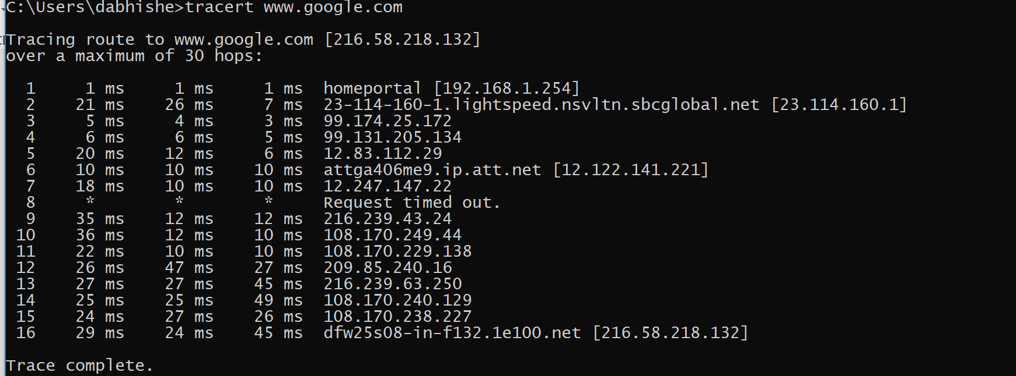
Tracert – example of networked connection

Slide 4
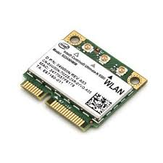
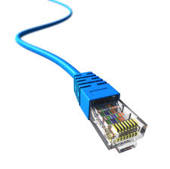
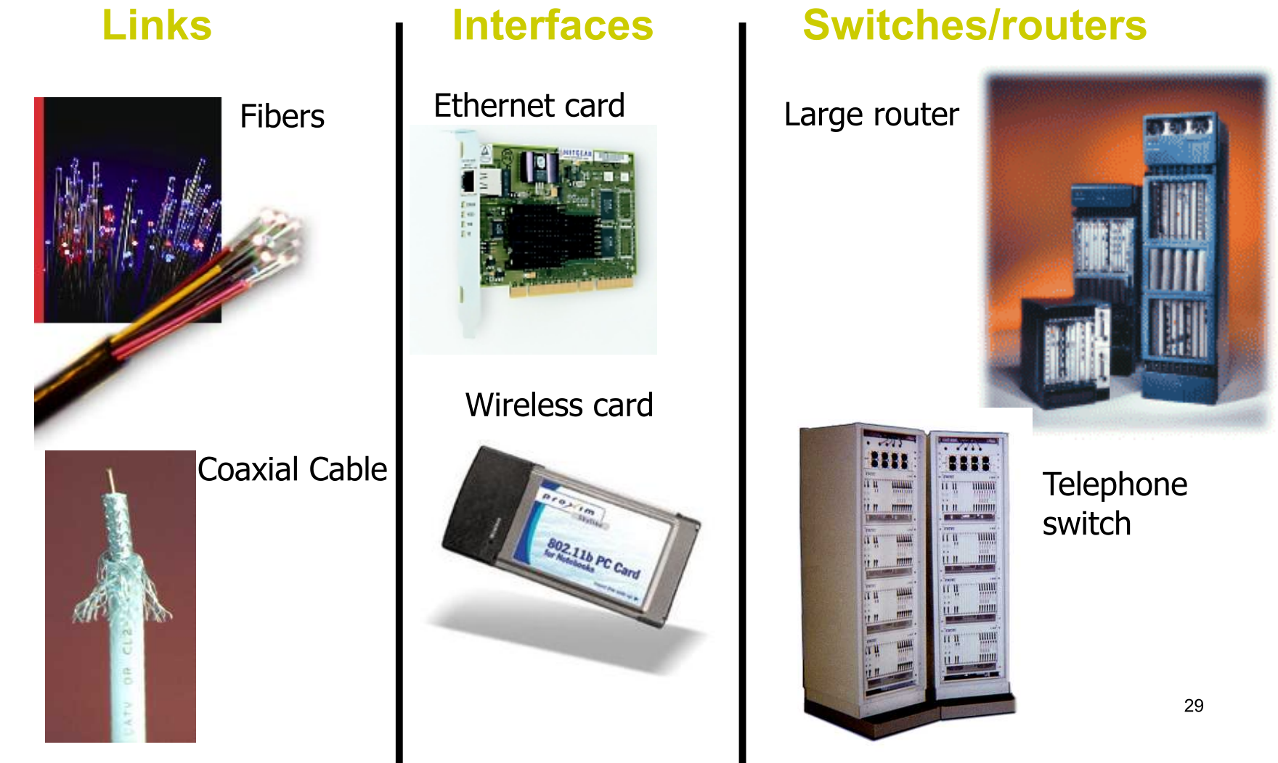
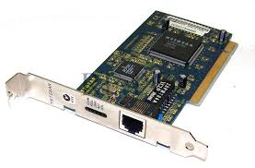
Network components

Slide 5
Taxonomy of Communication Networks
Communication networks can be classified according to the way in which nodes exchange information
Communication
Network
Switched Communication
Network
Broadcast Communication
Network
Circuit-Switched
Communication
Network
Packet-Switched
Communication
Network
A hybrid of circuits and packets; headers include a circuit identifier established during a setup phase
Datagram
Network
Virtual Circuit
Network

Slide 6
Layering
Separation of concerns
Break problem into separate parts
Solve each one independently
Tie together through common interfaces: abstraction
Encapsulate data from the layer above inside data from the layer below
This allows independent evolution

Slide 7

Networking Layers - Physical Layer (1)
Service: move information between two systems connected by a physical link
Service Interface: specifies how to send and receive bits
Protocol: coding scheme used to represent a bit, voltage levels, duration of a bit
Examples: coaxial cable, optical fiber links, radio transmitter/receiver

Slide 8
Networking Layers - Link Layer (2)
Service: enable end hosts to exchange atomic messages with one another
Using abstract addresses (not just direct physical connections)
Perhaps over multiple physical links
But using the same framing (headers, footers)
Possible other services
Arbitrate access to common physical media
Reliable transmission, flow control
Service Interface: send messages to other end hosts; receive messages addressed to end host
Protocols: addressing, routing, Media Access Control (MAC)

Slide 9

Networking Layers - Network Layer (3)
Service
Deliver packets to specified inter-network destination
Inter-network = across multiple layer-2 networks
Works across networking technologies (e.g., Ethernet + Wifi + 3G)
No longer the same framing all the way
Possible other services
Packet scheduling, priorities
Buffer management
Service Interface: send packets to specified inter-network destinations; receive packets destined for end host
Protocols: define inter-network addresses (globally unique); construct routing tables

Slide 10
Networking Layers - Transport Layer (4)
Service:
Provide end-to-end communication between processes
Demultiplexing of communication between hosts
Possible other services:
Reliability in the presence of errors
Timing properties
Rate adaptation (flow control, congestion control)
Service Interface: send message to specific process at given destination; local process receives messages sent to it
Protocol: port numbers, perhaps implement reliability, flow control, packetization of large messages, framing
Examples: TCP and UDP

Slide 11
Networking Layers - Application Layer (7 – not 5)
Service: any service provided to the end user
Service Interface: depends on the application
Protocol: depends on the application
Examples: Skype, SMTP (email), HTTP (Web), Halo, etc.
What happened to layers 5 and 6?
Session and Presentation layers
Part of OSI architecture, but not Internet architecture

Slide 12
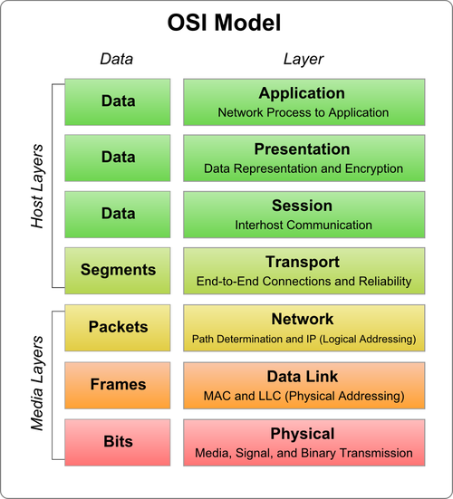
All Networking Layers Together

Slide 13
Distributed System Communication Depends on Protcol
A protocol is an agreement on how to communicate
Includes
Syntax: how a communication is specified and structured
Format of messages sent and received
Order of messages
Semantics: what a communication means
What actions are taken when transmitting, receiving, or when a timer expires

Slide 14

Example Protocol- IP Service: Best-Effort Packet Delivery
Problem
Many different network technologies
E.g., Ethernet, WiFi, fiber, Satellite, etc.
How can you hook them together?
n x n translations
IP was designed to glue them together
n translations
Minimal requirements (datagram)
The Internet is founded on IP
“IP over everything”
Packet switching
Divide messages into a sequence of packets
Each packet (datagram) is dealt with individually
“Best-effort” delivery
Packets may be lost
Packets may be corrupted
Packets may be delivered out of order
The same packet may be delivered multiple times
source
destination
IP network

Slide 15
IP Service: “Best Effort” Suffices
No error detection or correction
Payload may be corrupted, fragments of a packet might be missing
Higher-level protocol can provide error checking
Successive packets may not follow the same path
Not a problem as long as packets reach the destination
Packets can be delivered out-of-order
Receiver can put packets back in order (if necessary)
Packets may be lost or arbitrarily delayed
Sender can send the packets again (if desired)
No network congestion control (beyond “drop”)
Sender can slow down in response to loss or delay

Slide 16
IP Header: The foundation of Current Computer Communications
4-bit
Version
4-bit
Header
Length
8-bit
Type of Service
(TOS)
Addresses: datagram destination & source
Framing: datagram length
Priority: any special forwarding?
Extensibility: what if we need to tweak/change IP?
Dealing with problems:
Integrity: is the header what it’s supposed to be?
Loop avoidance: make sure packets don’t endlessly circulate
Fragmentation: what if the datagram is too large?
16-bit Total Length (Bytes)
16-bit Identification
3-bit
Flags
13-bit Fragment Offset
8-bit Time to
Live (TTL)
8-bit Protocol
16-bit Header Checksum
IP Header
32-bit Source IP Address
32-bit Destination IP Address
Options (if any) + Padding (if needed)
Payload

Slide 17
IP Packet Header Fields
Version number (4 bits)
Indicates the version of the IP protocol
Necessary to know what other fields to expect
Typically “4” (for IPv4), and sometimes “6” (for IPv6)
Header length (4 bits)
Number of 32-bit words in the header
Typically “5” (for a 20-byte IPv4 header)
Can be more when IP options are used
Type-of-Service (8 bits)
Allow packets to be treated differently based on needs
E.g., low delay for audio, high bandwidth for bulk transfer
4-bit
Version
4-bit
Header
Length
8-bit
Type of Service
(TOS)
16-bit Total Length (Bytes)
16-bit Identification
3-bit
Flags
13-bit Fragment Offset
8-bit Time to
Live (TTL)
8-bit Protocol
16-bit Header Checksum
32-bit Source IP Address
32-bit Destination IP Address
Options (if any) + Padding (if needed)
Payload

Slide 18
IP Packet Header Fields (Continued)
4-bit
Version
4-bit
Header
Length
8-bit
Type of Service
(TOS)
16-bit Total Length (Bytes)
Total length (16 bits)
Number of bytes in the packet
Maximum size is 65,535 bytes (2¹⁶ -1)
… though underlying links may impose smaller limits
Fragmentation: when forwarding a packet, an Internet router can split it into multiple pieces (“fragments”) if too big for next hop link
Fragmentation information (32 bits)
Packet identifier, flags, and fragment offset
16-bit Identification
3-bit
Flags
13-bit Fragment Offset
8-bit Time to
Live (TTL)
8-bit Protocol
16-bit Header Checksum
32-bit Source IP Address
32-bit Destination IP Address
Options (if any) + Padding (if needed)
Payload

Slide 19
Where does Reassemble Happen?
Host A
MTU=1000B
MTU=1000B
MTU=500B
Host B
R1
1000
R2
500
500
1000
MTU (Maximum Transfer Unit) = Maximum packet size handled by network
A1: router R2

Slide 20
Where does Reassemble Happen?
Host A
MTU=1000B
MTU=1000B
MTU=500B
Host B
R1
R2
500
500
1000
MTU (Maximum Transfer Unit) = Maximum packet size handled by network
A2: end-host B (receiver)

Slide 21
Where does Reassemble Happen?
Host A
MTU=1000B
R3
MTU=1000B
MTU=500B
Host B
R1
R2
500
500
1000
MTU (Maximum Transfer Unit) = Maximum packet size handled by network
A2: correct answer
Fragments can travel across different paths!
Why reassemble in network, if it could be further fragmented later?

Slide 22
Time-to-Live (TTL) Field (8 bits)
Potentially lethal problem
Forwarding loops can cause packets to cycle forever
As these accumulate, eventually consume all capacity
Time-to-live field in packet header
Decremented at each hop, packet discarded
if reaches 0
…and “time exceeded” message is sent to the source
Using “ICMP” control message; basis for traceroute

Slide 23
IP Packet Header (cont’d)
Two IP addresses
Source IP address (32 bits)
Destination IP address (32 bits)
Destination address
Unique identifier/locator for the receiving host
Allows each node to make forwarding decisions
Source address
Unique identifier/locator for the sending host
Recipient can decide whether to accept packet
Enables recipient to send a reply back to source
4-bit
Version
4-bit
Header
Length
8-bit
Type of Service
(TOS)
16-bit Total Length (Bytes)
16-bit Identification
3-bit
Flags
13-bit Fragment Offset
8-bit Time to
Live (TTL)
8-bit Protocol
16-bit Header Checksum
32-bit Source IP Address
32-bit Destination IP Address
Options (if any) + Padding (if needed)
Payload

Slide 24
IP Addresses (IPv4)
A unique 32-bit number
Identifies an interface (on a host, on a router, …)
Represented in dotted-quad notation. E.g, 12.34.158.5:
12
34
158
5
00001100
00100010
10011110
00000101

Slide 25
Hierarchical Addressing: IP Prefixes
Divided into network (left) & host portions (right)
12.34.158.0/24 is a 24-bit prefix with 2⁸ addresses
Terminology: “Slash 24”
12
34
158
5
00001100
00100010
10011110
00000101
Network (24 bits)
Host (8 bits)

Slide 26
IP Address and a 24-bit Subnet Mask
Address
12
34
158
5
00001100
00100010
10011110
00000101
11111111
11111111
11111111
00000000
255
255
255
0
Mask

Slide 27
Addressing Hosts in the Internet
The Internet is an “inter-network”
Used to connect networks together, not hosts
Needs a way to address a network (i.e., group of hosts)
host
host
...
host
host
host
...
host
LAN 1
LAN 2
router
router
router
WAN
WAN
LAN = Local Area Network
WAN = Wide Area Network

Slide 28
Routers
Router consists of
Set of input interfaces where packets arrive
Set of output interfaces from which packets depart
Some form of interconnect connecting inputs to outputs
Router implements
Forward packet to corresponding output interface
(Manage bandwidth and buffer space resources)
host
host
...
host
host
host
...
host
LAN 1
LAN 2
router
router
router
WAN
WAN
Router

Slide 29
Forwarding Table
Store a mapping between IP addresses and output interfaces
Forward an incoming packet based on its destination address
1.2.3.5
1
1.2.3.6
3
1.2.3.4
2
…
…
1.2.3.4
1
1.2.3.5
2

Slide 30
Scalability Challenge
Suppose hosts had arbitrary addresses
Then every router would need a lot of information
…to know how to direct packets toward the host
1.2.3.4
5.6.7.8
2.4.6.8
1.2.3.5
5.6.7.9
2.4.6.9
host
host
...
host
host
host
...
host
LAN 1
LAN 2
router
router
router
WAN
WAN
1.2.3.4
1.2.3.5
forwarding table

Slide 31
Scalability Improved
Number related hosts from a common subnet
1.2.3.0/24 on the left LAN
5.6.7.0/24 on the right LAN
1.2.3.4
1.2.3.7
1.2.3.156
5.6.7.8
5.6.7.9
5.6.7.212
host
host
...
host
host
host
...
host
LAN 1
LAN 2
router
router
router
WAN
WAN
1.2.3.0/24
5.6.7.0/24
forwarding table

Slide 32
Easy to Add New Hosts
No need to update the routers
E.g., adding a new host 5.6.7.213 on the right
Doesn’t require adding a new forwarding entry
1.2.3.4
1.2.3.7
1.2.3.156
5.6.7.8
5.6.7.9
5.6.7.212
host
host
...
host
host
host
...
host
LAN 1
LAN 2
router
router
router
host
WAN
WAN
5.6.7.213
1.2.3.0/24
5.6.7.0/24
forwarding table

Slide 33
Special-Purpose Address Blocks
Private addresses
By agreement, not routed in the public Internet
For networks not meant for general Internet connectivity
Blocks: 10.0.0.0/8, 172.16.0.0/12, 192.168.0.0/16
Link-local
By agreement, not forwarded by any router
Used for single-link communication only
Intent: autoconfiguration (especially when DHCP fails)
Block: 169.254.0.0/16
Loopback
Address blocks that refer to the local machine
Block: 127.0.0.0/8
Usually only 127.0.0.1/32 is used
Limited broadcast
Sent to every host attached to the local network
Block: 255.255.255.255/32

Slide 34
Host Names vs. IP addresses
Host names
Mnemonic name appreciated by humans
Variable length, full alphabet of characters
Provide little (if any) information about location
Examples: www.cnn.com and bbc.co.uk
IP addresses
Numerical address appreciated by routers
Fixed length, binary number
Hierarchical, related to host location
Examples: 129.59.15.60 and 192.168.0.1

Slide 35
Domain Name System (DNS)
Properties of DNS
Hierarchical name space divided into zones
Zones distributed over collection of DNS servers
Hierarchy of DNS servers
Root (hardwired into other servers)
Top-level domain (TLD) servers
Authoritative DNS servers
Performing the translations
Local DNS servers
Resolver software
You should read up on how DNS’s hierarchical translation works

Slide 36
Transport Protocols
Provide logical communication between application processes running on different hosts
Run on end hosts
Sender: breaks application messages into segments, and passes to network layer
Receiver: reassembles segments into messages, passes to application layer
Multiple transport protocol available to applications
Internet: TCP and UDP (mainly)
application
transport
network
data link
physical
network
data link
physical
network
data link
physical
network
data link
physical
logical end-end transport
network
data link
physical
network
data link
physical
application
transport
network
data link
physical

Slide 37
Internet Transport Protocols
Datagram messaging service (UDP)
No-frills extension of “best-effort” IP
Multiplexing/demultiplexing among processes
Reliable, in-order delivery (TCP)
Connection set-up & tear-down
Discarding of corrupted packets
Retransmission of lost packets
Flow control
Congestion control
Services not available
Delay guarantees
Bandwidth guarantees
Sessions that survive change-of-IP-address

Slide 38
UDP
Lightweight communication between processes
Avoid overhead and delays of ordered, reliable delivery
Send messages to and receive them from a socket
User Datagram Protocol (UDP; RFC 768 - 1980!)
IP plus port numbers to support (de)multiplexing
Optional error checking on the packet contents
(checksum field = 0 means “don’t verify checksum”)
SRC port
DST port
checksum
length
DATA

Slide 39
Ports
Need to decide which application gets which packets
Solution: map each socket to a port
Client must know server’s port
Separate 16-bit port address space for UDP and TCP
(src_IP, src_port, dst_IP, dst_port) uniquely identifies TCP connection
Well known ports (0-1023): everyone agrees which services run on these ports
e.g., ssh:22, http:80
On UNIX, must be root to gain access to these ports (why?)
Ephemeral ports (most 1024-65535): given to clients
e.g. chat clients, p2p networks

Slide 40
Why Would Anyone Use UDP?
Finer control over what data is sent and when
As soon as an application process writes into the socket
… UDP will package the data and send the packet
No delay for connection establishment
UDP just blasts away without any formal preliminaries
… which avoids introducing any unnecessary delays
No connection state
No allocation of buffers, sequence #s, timers …
… making it easier to handle many active clients at once
Small packet header overhead
UDP header is only 8 bytes

Slide 41

Popular Applications That Use UDP
Multimedia streaming
Retransmitting lost/corrupted packets often pointless - by the time the packet is retransmitted, it’s too late
E.g., telephone calls, video conferencing, gaming
Simple query protocols like Domain Name System
Connection establishment overhead would double cost
Easier to have application retransmit if needed
“Address for bbc.co.uk?”
“212.58.224.131”

Slide 42
Transmission Control Protocol (TCP)
Connection oriented
Explicit set-up and tear-down of TCP session
Stream-of-bytes service
Sends and receives a stream of bytes, not messages
Congestion control
Dynamic adaptation to network path’s capacity
Reliable, in-order delivery
TCP tries very hard to ensure byte stream (eventually) arrives intact
In the presence of corruption and loss
Flow control
Ensure that sender doesn’t overwhelm receiver

Slide 43
TCP Support for Reliable Delivery
Sequence numbers
Used to detect missing data
... and for putting the data back in order
Checksum
Used to detect corrupted data at the receiver
…leading the receiver to drop the packet
No error signal sent - recovery via normal retransmission
Retransmission
Sender retransmits lost or corrupted data
Timeout based on estimates of round-trip time (RTT)

Slide 44
Timeout
Timeout
If haven’t heard anything from receiver, send again
Problem: for how long do you wait?
TCP uses function of estimated RTT
Problem: what if no Ack for retransmission?
TCP (and other schemes) employs exponential backoff
Double timer up to maximum - tapers off load during congestion

Slide 45
Multicast

Slide 46
Multicast Communication
Multipoint communications support communications between more than two hosts
One-to-many
Many-to-many
Unlike broadcast, allows a proper subset of hosts to participate
Example standards
IP Multicast (RFC 1112, standard)

Slide 47
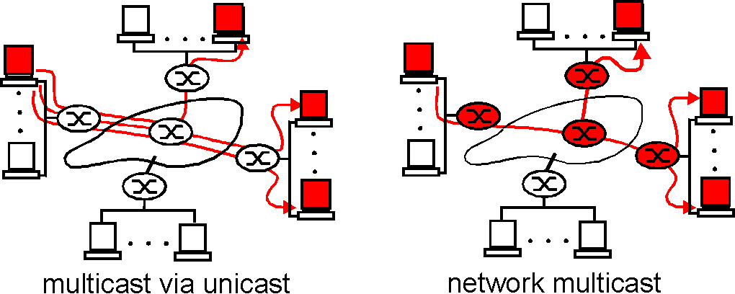
Multicast Communication
Multicast abstraction is peer-to-peer
Application-level multicast
Network-level multicast
Requires router support (multicast-enabled routers)
Multicast provided at network protocol level → IP multicast

Slide 48
Unicast versus Broadcast versus Multicast
A unicast address identifies a single IP interface
A broadcast address identifies all IP interfaces on the subnet
A multicast address identifies a set of IP interfaces
A multicast datagram is received only by those interfaces interested in the datagram (applications wishing to participate in the multicast group)

Slide 49
Multicast
Transport mechanism and network layer must support multicast
Internet multicast limited to UDP (not TCP)
Unreliable: No acknowledgements or other error recovery schemes (perhaps at application level)
Connectionless: No connection setup (although there is routing information provided to multicast-enabled routers)
Datagram: Message-based multicast

Slide 50
IP Multicast
IP supports multicasting
Uses only UDP, not TCP
Special IP addresses (Class D) identify multicast groups
Internet Group Management Protocol (IGMP) to provide group routing information
Multicast-enabled routers selectively forward multicast datagrams
IP TTL field limits extent of multicast
Requires underlying network and adapter to support broadcast or, preferably, multicast
Ethernet (IEEE 802.3) supports multicast

Slide 51
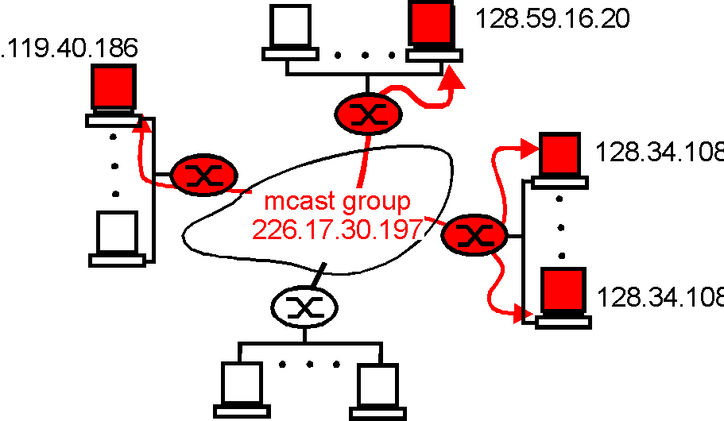
Multicast group addresses
How to identify the receivers of a multicast datagram?
How to address a datagram sent to these receivers?
Each multicast datagram to carry the IP addresses of all recipients? → Not scalable for large number of recipients
Use address indirection
A single identifier used for a group of receivers

Slide 52
Multicast Address – IPv4
Class D addresses in the range 224.0.0.0 through 239.255.255.255
224.0.0.0 reserved
224.0.0.1 all-host group
224.0.0.2 all-routers group
224.0.0.1 through 224.0.0.255 reserved for routing-protocols
Datagrams destined to any of theses addresses are never forwarded by a multicast router

Slide 53
Sending and receiving multicast messages
Receiving Multicast Messages
Create a UDP socket
Bind it to a UDP port, e.g., 1234
All processes must bind to the same port in order to receive the multicast messages
Join a multicast group address
Use recv or recvfrom to read the messages
Sending Multicast Messages
You may use the same socket (you used for receiving) for sending multicast messages or you can use any other UDP socket (it does not have to join any multicast group)

Slide 54
Sending and receiving multicast messages
Receiving Multicast Messages
Create a UDP socket
Bind it to a UDP port, e.g., 1234
All processes must bind to the same port in order to receive the multicast messages
Join a multicast group address
Use recv or recvfrom to read the messages
Sending Multicast Messages
You may use the same socket (you used for receiving) for sending multicast messages or you can use any other UDP socket (it does not have to join any multicast group)
How would you send broadcast messages?

Slide 55
Multicast issues
Time To Live
Set TTL for outgoing multicast datagrams (default is 1 → local subnet)
Loopback mode
Enable or disable local loopback of multicast datagrams
By default loopback is enabled
A copy of each multicast datagram sent by a process on the host will also be looped back and processed as a received datagram by that host
Port Reuse
Allow the same multicast application to have several instances running on the same host
In Java, Port reuse is enabled by default

Slide 56

Multicast Example
See the associated example.

