Slide 1
TFPG
ISIS/ Vanderbilt University
Nashville, TN
Gabor Karsai + Nag Mahadevan+Abhishek Dubey

Slide 2
Timed Failure Propagation Graphs
Failure Cascades
Propagation
links
Alarm Allocation
Failure Modes
Discrepancies
Alarms
Causal models that describe the system behavior in presence of faults.
Model is a labeled directed graph where
Nodes represent either failure modes or discrepancies
Edges between nodes in the graph represent causality
Edges are attributed with timing and mode constraints on failure propagation.
A discrepancy can be either monitored (attached to an alarm) or unmonitored.

Slide 3
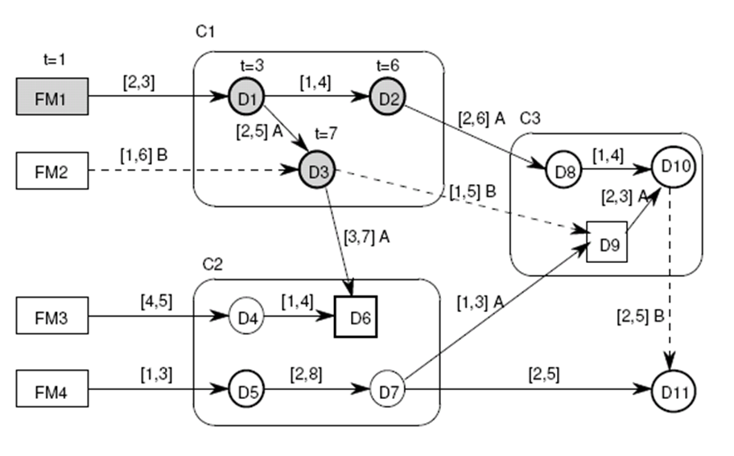
Temporal Failure Propagation Graph (TFPG)
Nodes:
Failure modes
Discrepancies
AND/OR
Monitored (option)
Edges:
Propagation delay: [min, max]
Discrete Modes (activation)
Modeling variants
Untimed, causal network (no modes, propagation = [0..inf])
Modal networks: edges are mode dependent
Timed models
Hierarchical component models
Example models (#components,#failuremodes,#alarms)
Trivial examples
Simplified fuel system (~30,~80,~100)
Realistic fuel system (~200,~400,~600)
Aircraft avionics (~2000,~8000,~25000) – generated

Slide 4
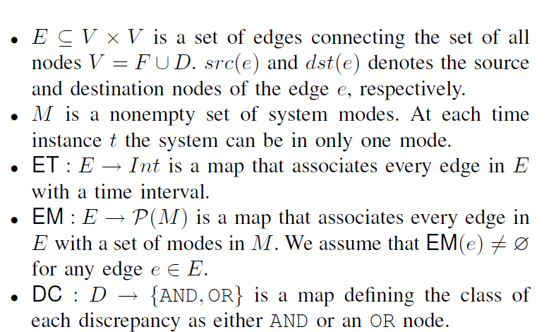
Formal Model of TFPG
G = (F;D;E;M; ET;EM;DC)
F is a nonempty set of failure nodes.
D is a nonempty set of discrepancy nodes.

Slide 5
Failure Propagation Semantics
0
A
6
B
22
t=2
t=2
D1
D1
Activation period
[9,11] ⊗ [4,6] ⊗ [8,15]
= [9,15]
Activation period
[9,11] ∪ [4,6] ∪ [8,15]
3,5
B
3,5
B
t=3
t=3
D4
D4
FM1
FM1
1,4
A
1,4
A
t=7
1,8
A,B
t=7
1,8
A,B
D3
D3
OR propagation
Node is triggered by any parent
Propagation time is counted from the last time the edge is activated
Node must be activated before the end of the activation period
AND propagation
All parents must be active
Failure effects are not required to reach the node at the same time
Activation occur when the last failure effect reaches the node

Slide 6
Failure propagation semantics
Failure can only reach nodes of AND type only if it already reached all its parents.
For an OR type node v0 and an edge e = (v; v0) , once a failure effect reaches v at time t it must reaches v0 at a time t0 where e. tmin <= t0 - t <= e.tmax
the activation period of an AND alarm v0 is the min/max composition of the activation periods for each link (v; v0)
If the link is deactivated any time during the propagation (because of mode switching), the propagation stops

Slide 7
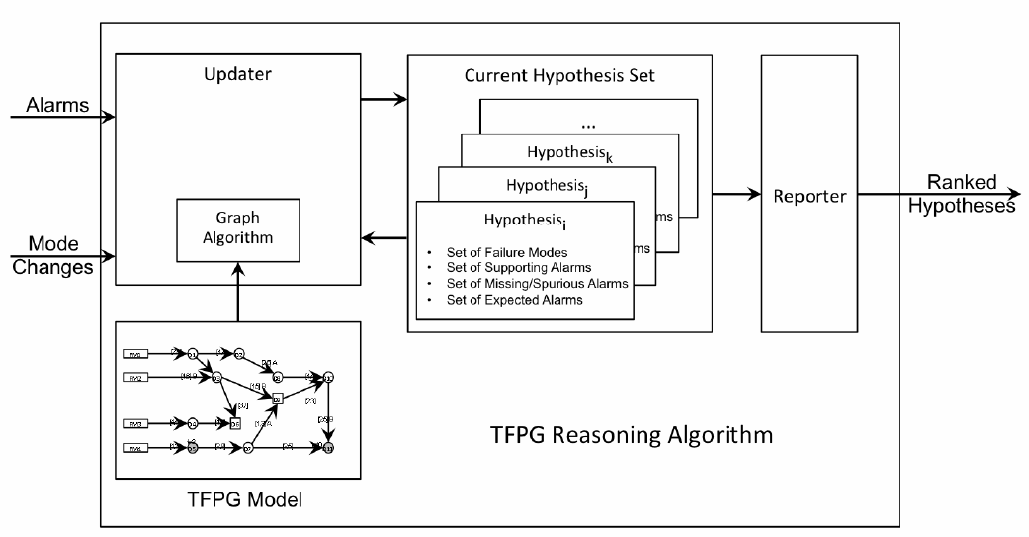
TFPG Reasoning
On-line diagnostics:
Input: Sequence of alarms and mode changes
Output: Sequence of sorted and ranked hypotheses containing failure mode(s) that explain the observations (alarms, mode changes)

Slide 8
TFPG Hypothesis
TFPG Hypothesis - estimation of the current system state.
Directly, points to failure modes that “best” explain the current set of observed alarms.
Indirectly, points to failed monitored discrepancies; those with a state that is inconsistent with the (hypothesized) state of the failure modes

Slide 9
Hypothesis
A hypothetical state is a map that defines node states and the interval at which each node changes its state.
Formally a hypothetical state at time t is a map Ht : V -> {ON, OFF} X RX R
The estimated earliest (latest) time of state change is denoted H(v).terl (H(v).tlat).

Slide 10
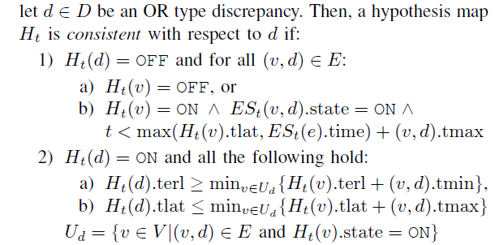
Consistency of Hypothesis

Slide 11
Hypothesis structure
Structure
List of possible Failure Modes
List of alarms in each set ( Consistent (C)/ Inconsistent (IC)/Missing (M) / Expected (E))
Metrics : Plausibility/ Robustness/ Failure Rate

Slide 12
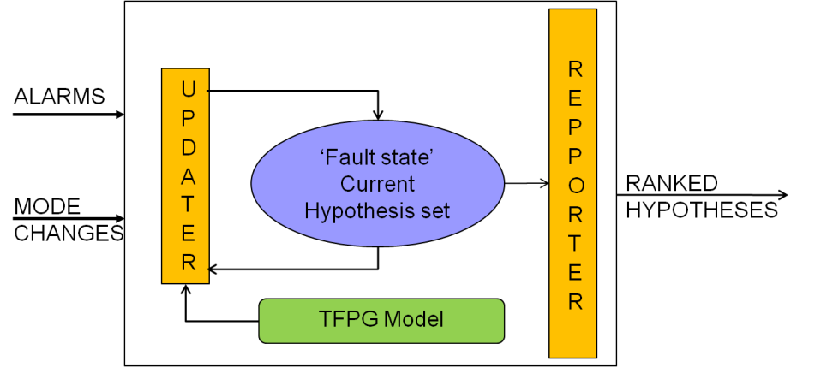
TFPG Diagnostics
Algorithm outline:
Check if new evidence is explained by current hypotheses.
If not, create a new hypothesis that assumes a hypothetical state of the system consistent with observations
Rank hypotheses for plausibility and robustness
Discard low-rank hypotheses, keep plausible ones

Slide 13
Hypotheses Evaluation Metrics (Rank)
Hypotheses are evaluated based on the following metrics:
Plausibility: reflects the support of a hypothesis based on the current observed alarm state. It answers the question: Which hypothesis to consider?
Robustness: reflects the potential of a hypothesis (evidence) to change based on remaining alarms. It answers the question: When to take an action?
Failure Rate: is a measure of how often a particular failure mode has occurred in the past.

Slide 14

Discrete (TFPG) Diagnostics - Features
Modal edges: Propagation happens only if edge is enabled (controlled by system mode)
Diagnosis takes into consideration last propagation effect
Non-monotonic alarms:
Alarm retraction triggers a re-computation of the diagnosis
Intermittent failure modes
Consequence: alarm/s change to ‘Off’
Assumption: low frequency intermittents
Upon alarm changing to ‘Off’, backtrack to last change to ‘On’ and re-evaluate
Maintain alternate branches (for alarms ‘On’ and ‘Off’)
Multi-fault hypothesis is the default
Fault state == State of all failure modes/discrepancies
Reasoner works with sets of failure modes (instead of individual failure modes)
Robust algorithm: can tolerate missing/inconsistent alarms
Parsimony principle: Use simplest explanation
Time-dependent diagnosis
Reasoner can be asked to recompute diagnosis upon advance of time

Slide 15
Application to Software

Slide 16
Mapping to Software
(strict semantics required) example, Component-based software construction: Developed for ARINC-653 based systems.
Monitoring the component
Interfaces (synchronous/asynchronous calls)
Component state
Scheduling and timing (WCET)
Resource usage
Detection:
Pre/post conditions over call parameters, rates, and component state
Conditions over timing properties
Conditions over resource usage (e.g. memory footprint)
Combinations of the above
System-Level Diagnosis
Generate causal fault models from the knowledge of component interconnections.
Mitigation: Component Level and System-Level
Take action given detected anomaly and state of the component
Actions: restart, initialize, block call, inject value, inject call, release resource, modify state; combination of the above
All of the above are facilitated by model-based software construction techniques.
Notes:
Component-based software construction is required to provide structure to the system and increase reusability.

Slide 17
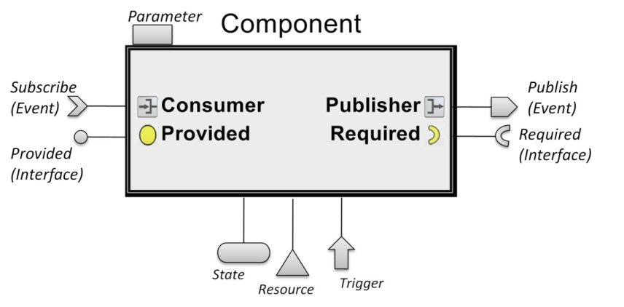
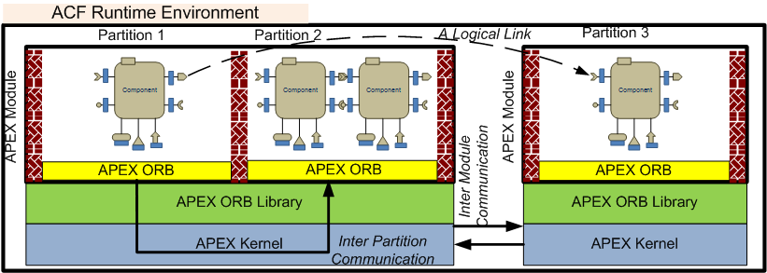
Example ARINC-653 Component Model
A CORBA Component Model-like layer on top of ARINC-653 abstractions.
Synchronous Interfaces: call/return
Periodic: time-triggered
Aperiodic: event-triggered
Asynchronous Interfaces: publish-subscribe
Periodic: time-triggered
Aperiodic: event-triggered
Additional Monitoring interfaces
State: to observe component state variables
Resource: to monitor resource usage
Trigger: to monitor execution timing
Built using MICO ORB and
ARINC 653 primitives

Slide 18
Component Monitoring
Post/Pre condition violations: threshold, rate, custom filter (moving average)
Resource Violations: Deadline
Validity Violation: Stale data on a consumer
Concurrency Violations: Lock Time Outs.
User code violations: reported error conditions from application code.
ARINC-653 style errors.

Slide 19
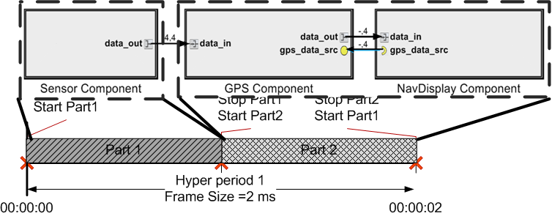
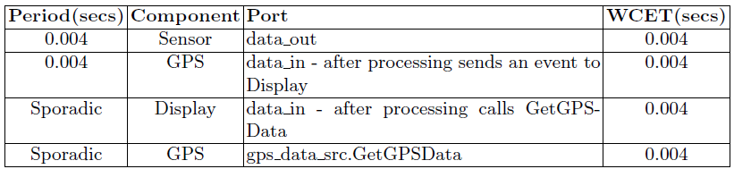
Example: Assembly of 3 components deployed on two partitions
Validity(GPS.data_in)<4ms
Delta(Nav.data_in.time)>0
Rate(gps_data_src.data)>1
Specified Monitoring Conditions
The Sensor component is triggered periodically and it publishes an event upon each activation.
The GPS component subscribes to this event and is triggered periodically to obtain GPS data from the receiver. It publishes its own output event.
The Nav Display component is triggered sporadically via this event and it uses a required interface to retrieve the position data from the GPS component.

Slide 20
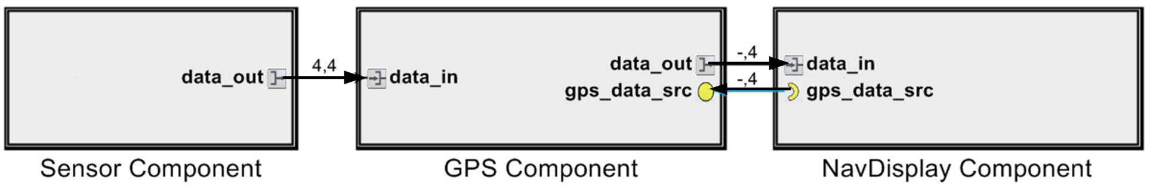
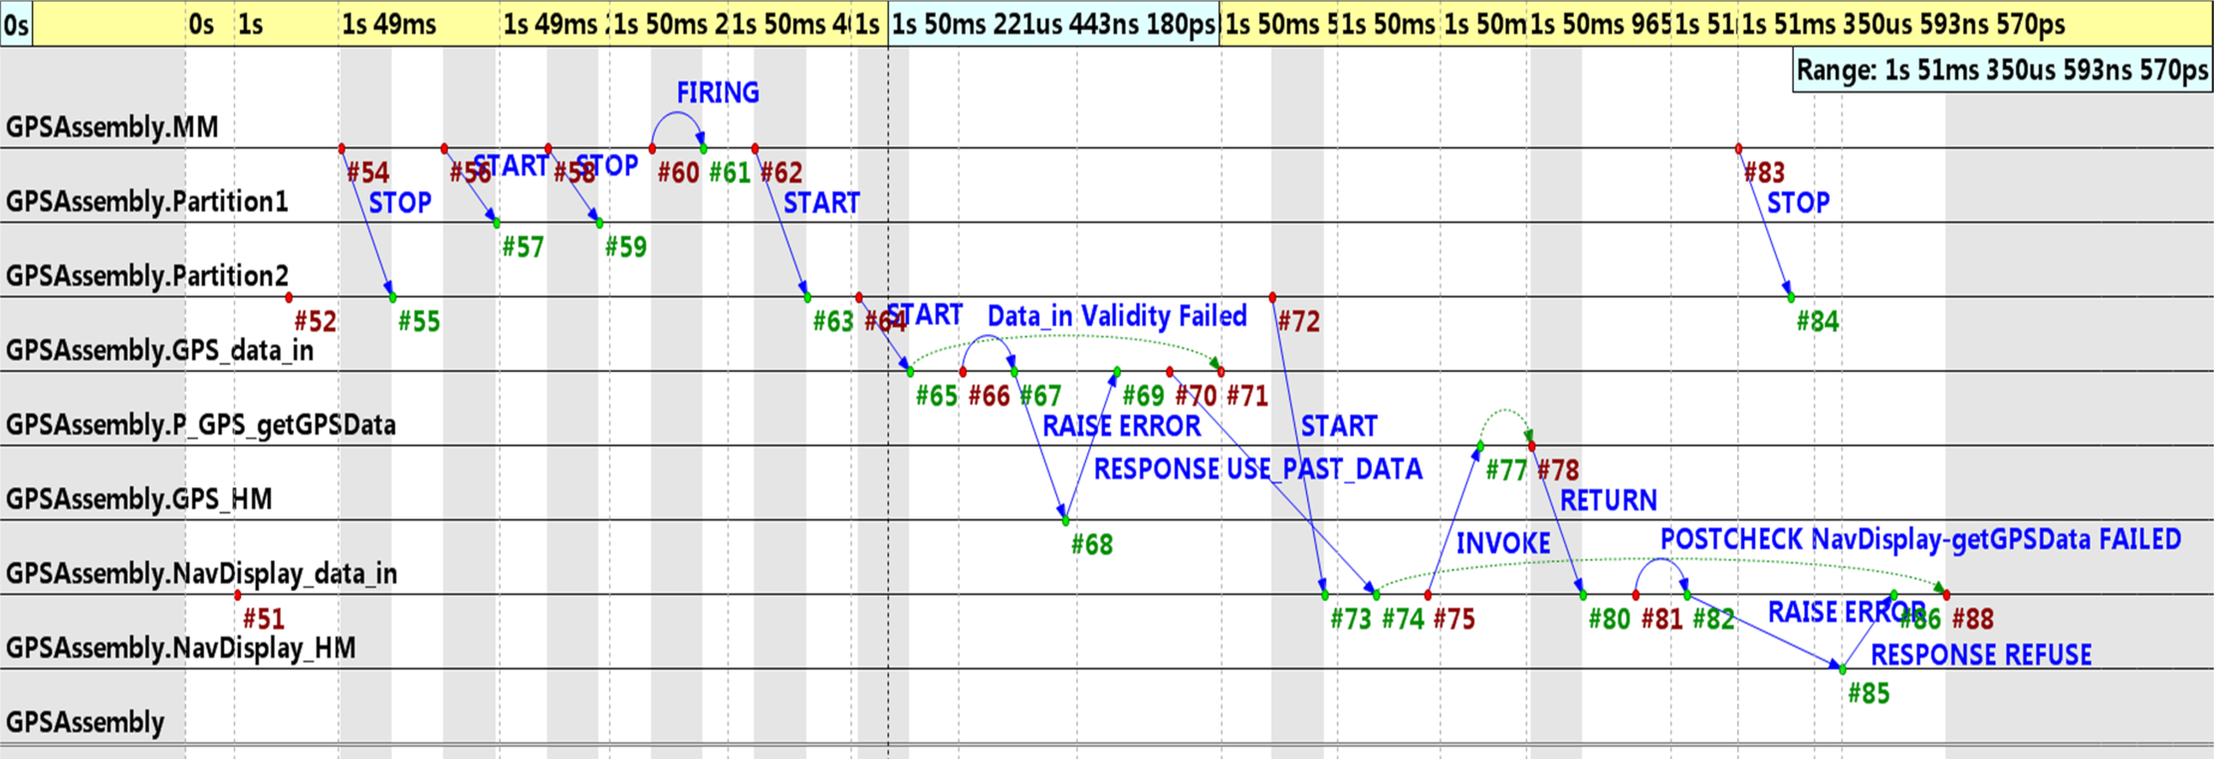
Fault Scenario:
Injected fault such that sensor stops publication

Slide 21
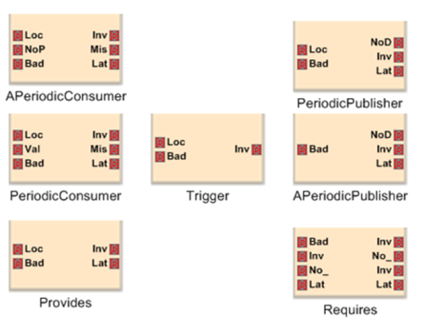
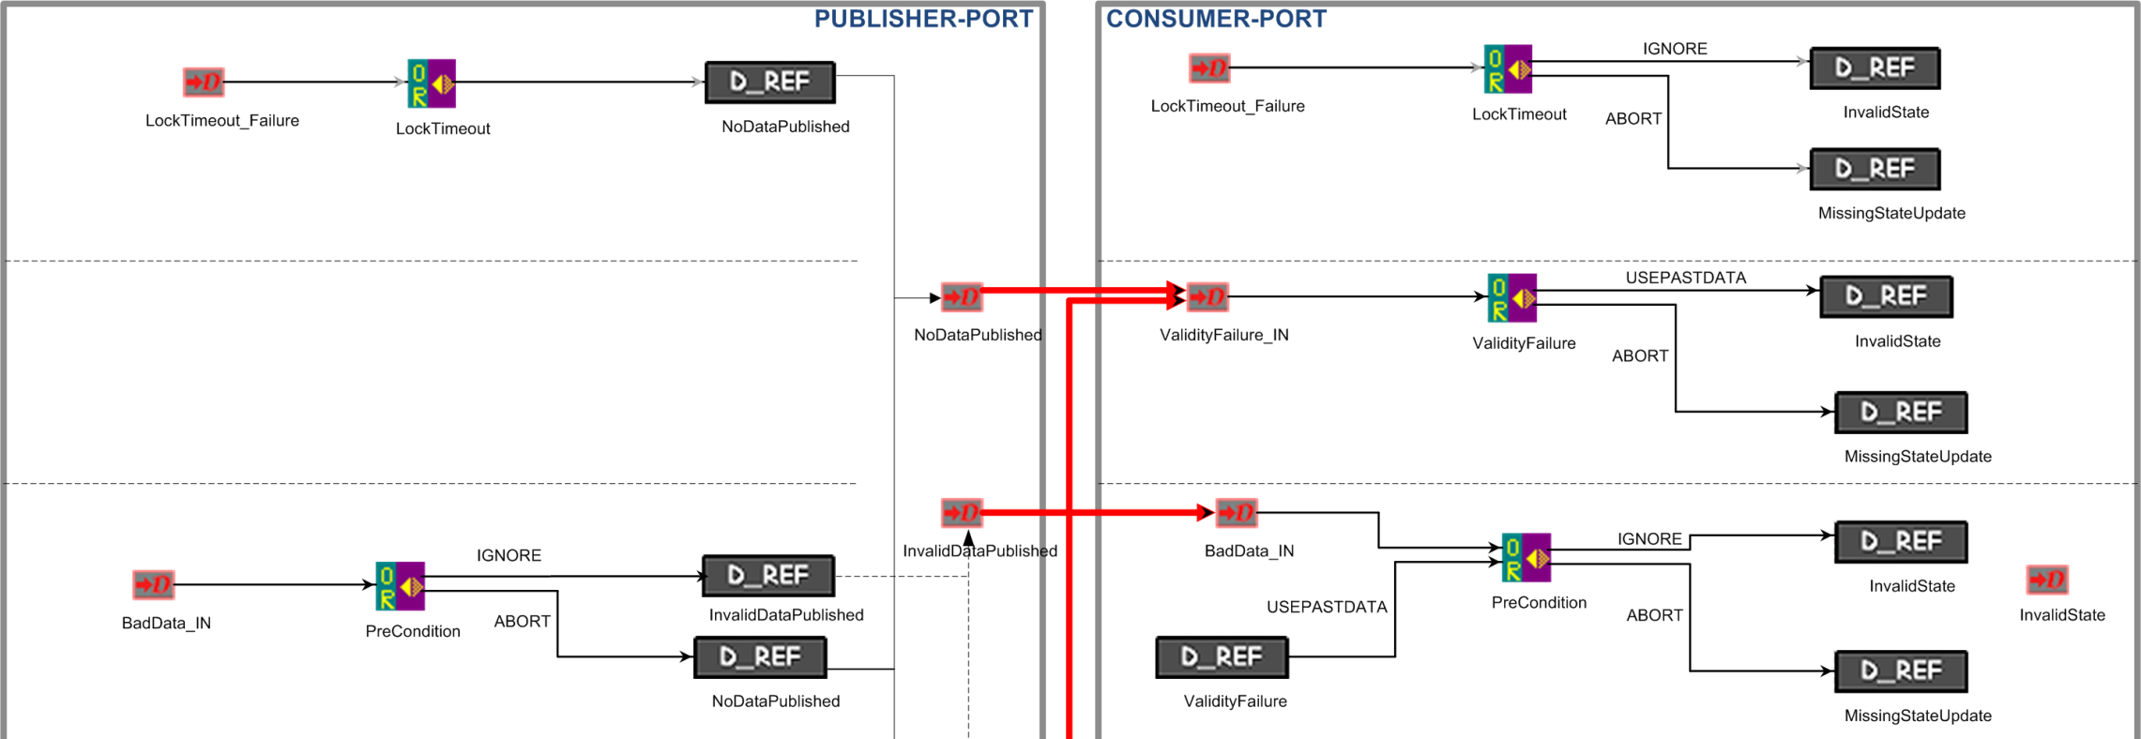
Modeling Inter-Component Cascading Faults
We don’t. The cascades can be computed from the component assemblies, if the anomaly types and their interactions are known.
Component ‘elements’
Methods belong to one of these (7)
Fault cascades within component
(A few of the 38 patterns)
Example

Slide 22
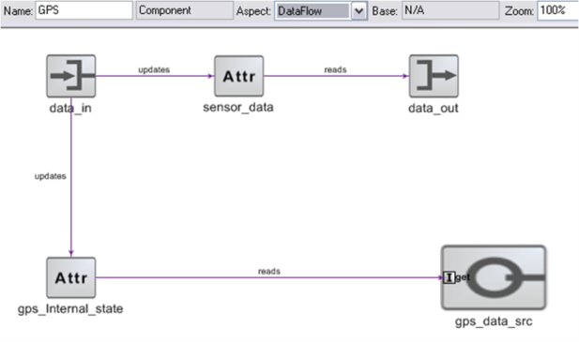
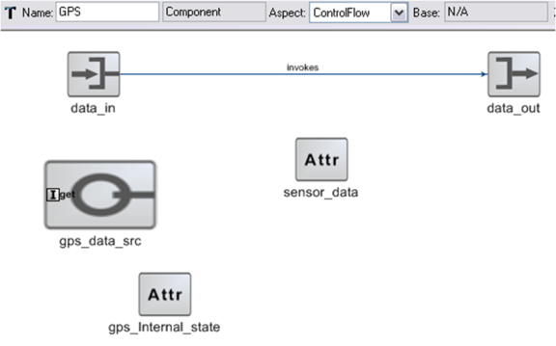
Modeling Intra-Component Cascading Faults
Inter-component propagation is regular – always follows the same pattern
Intra-component propagation depends on the component! → Need to model internal dataflow and control flow of the component.
Note: Could be determined via source code analysis.

Slide 23
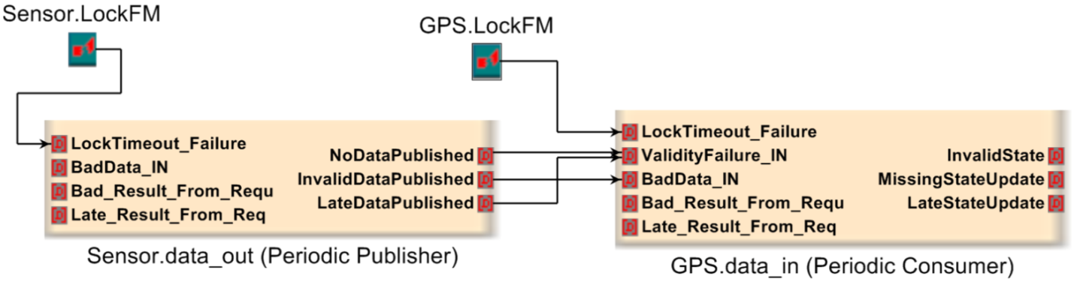
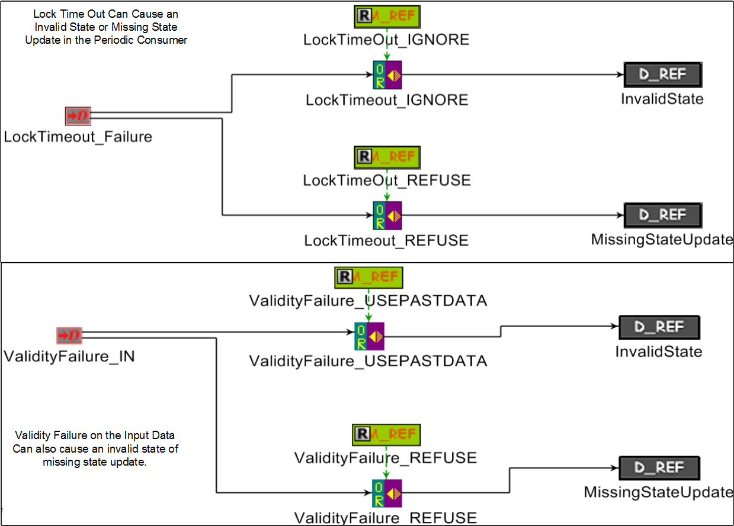
Modeling Intra-Component Cascading Faults

Slide 24
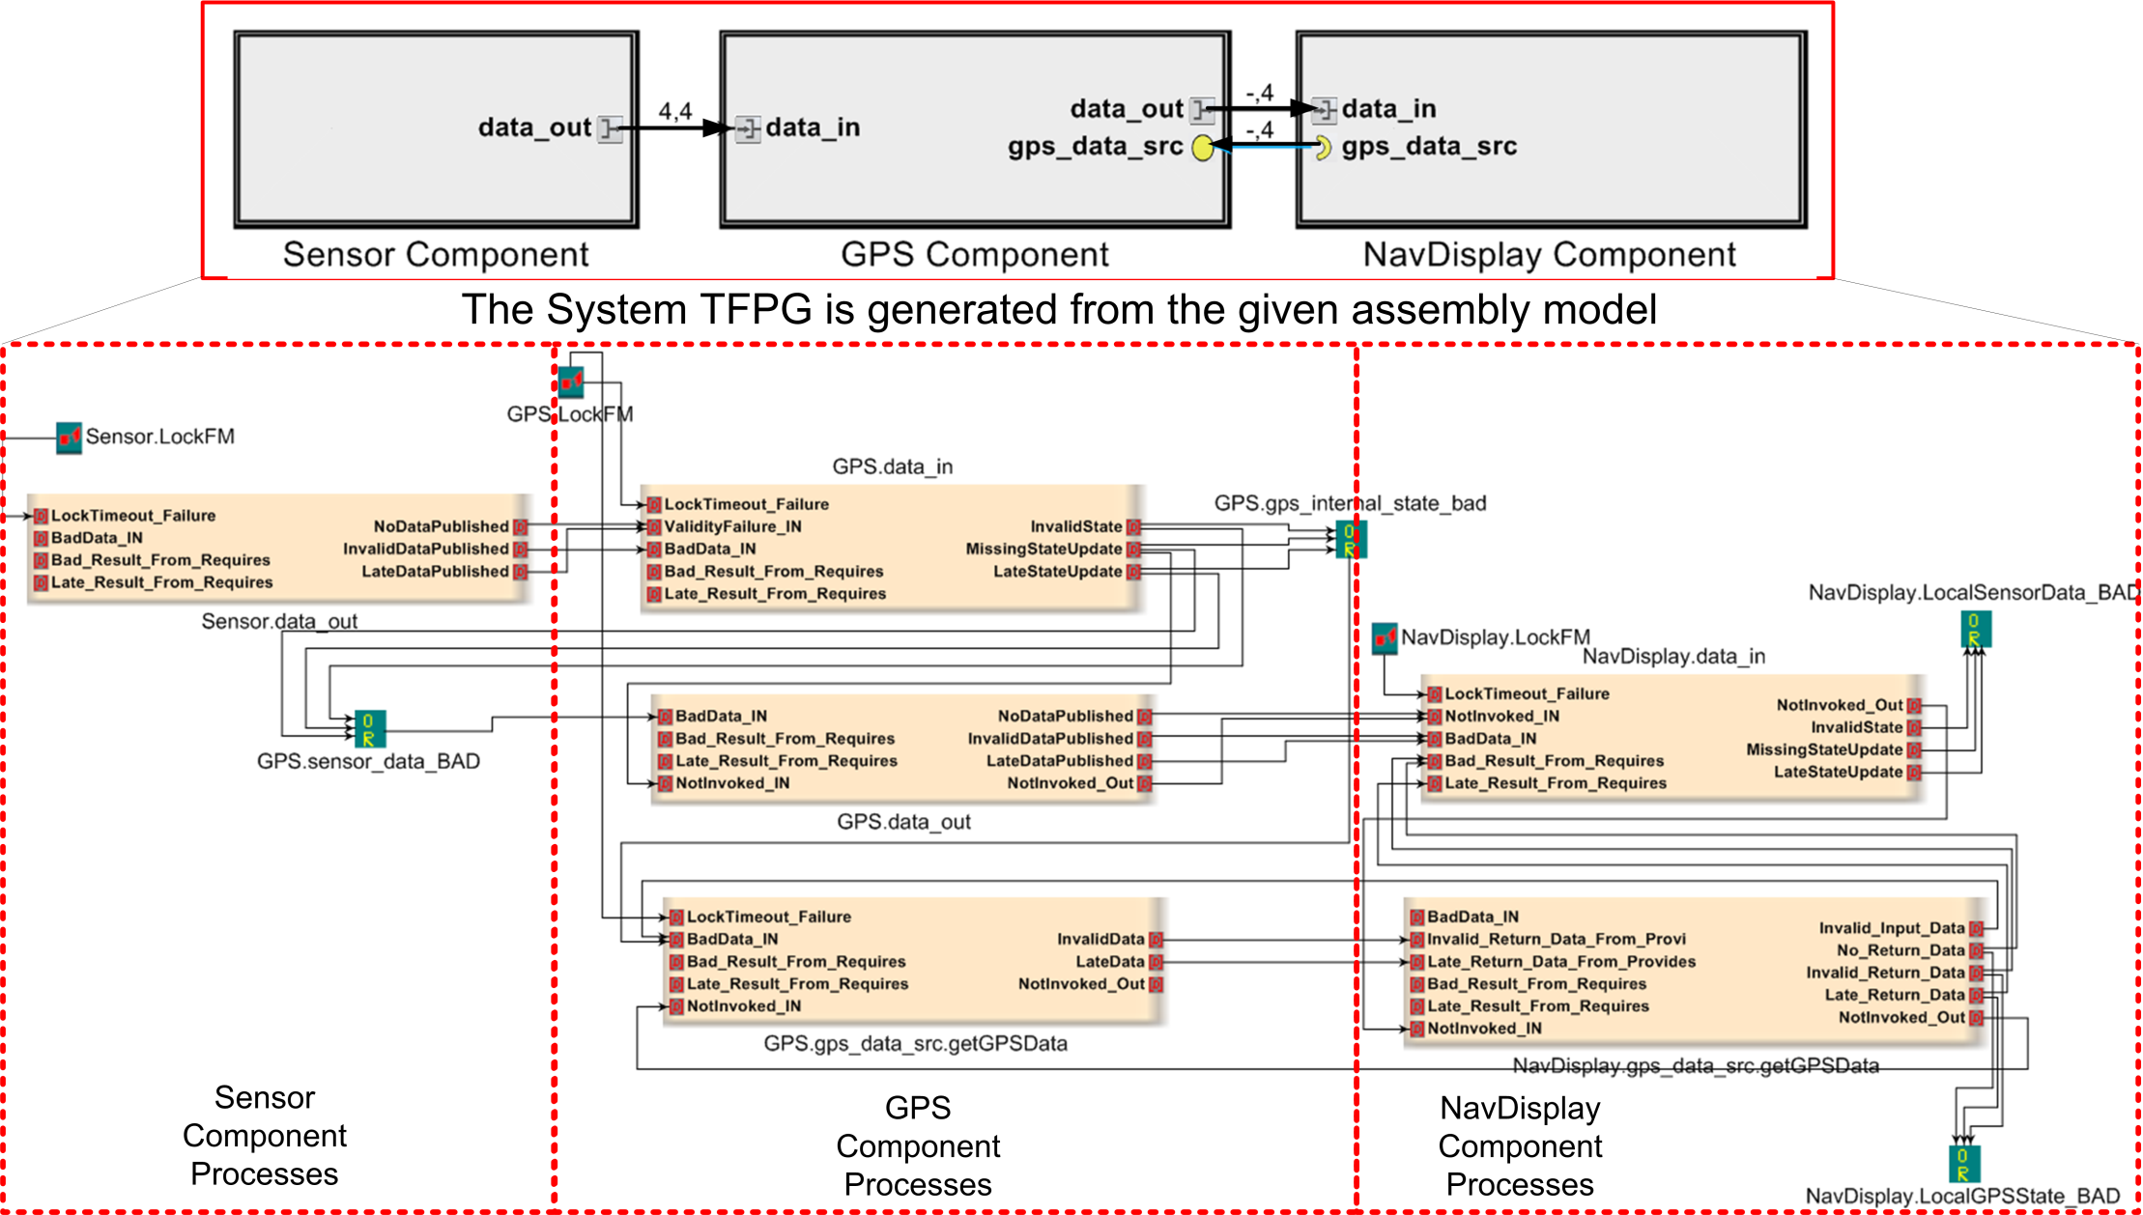
Integrated Model for GPS Assembly

Slide 25
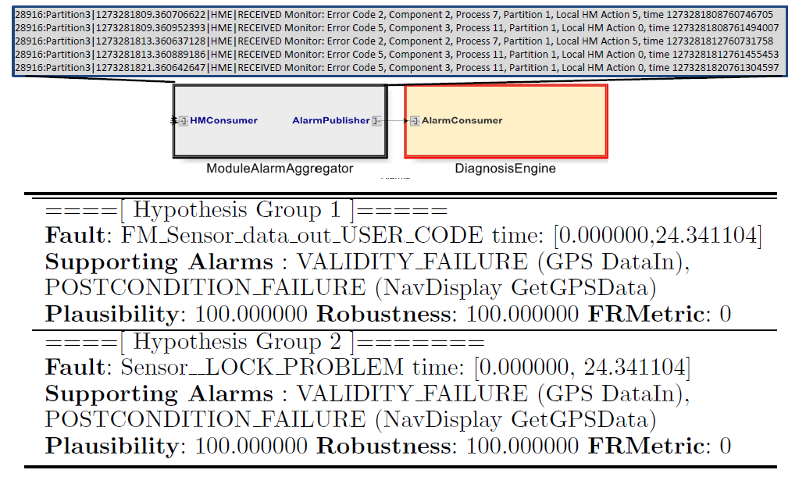
Diagnosis Example

Slide 26
Next Week
Tuesday – JAVA Code Analysis – Daniel
We will have presentations and discussions in class every Thursday from now on.
Thursday: Sanchita will present :
Sanchita Basak | Software Engineering for Self-Adaptive Systems: A Research Roadmap

