Slide 1
Software Fault Tolerance

Slide 2
Review
Till the last class we have studied about the following
Why failures occur – the degradation hypothesis
Failure as a random process
Estimating failure probability and reducing failure likelihood by using parallel blocks.
Fault tree analysis and FMECA analysis.
We have also gone through the basics of distributed systems
We have reviewed various testing methods and how they can be used to find bugs.
We also discussed briefly about monitoring: Influx-db;collect-d and grafana.

Slide 3
Software Fault Tolerance
The point of fault tolerance is to absorb faults and prevent them from becoming failures without an active mitigation.
They key idea here is redundancy.
https://ntrs.nasa.gov/archive/nasa/casi.ntrs.nasa.gov/20000120144.pdf

Slide 4
Software Flaw Tolerance
Flaw avoidance strategies include (structured) design methodologies, software reuse, and formal methods
Given that a complex piece of software will contain bugs, can we use redundancy to reduce the probability of software-induced failures?
The ideas of masking redundancy, standby redundancy, and
self-checking design have been shown to be applicable to software, leading to various types of fault-tolerant software
“Flaw tolerance” is a better term; “fault tolerance” has been overused
Masking redundancy: N-version programming
Standby redundancy: the recovery-block scheme
Self-checking design: N-self-checking programming

Slide 5
N-Version Programming: The Idea
Independently develop N different programs (known as “versions”) from the same initial specification
Adjudicator;
Decider;
Data fuser
Version 1
Voter
Input
Version 2
Output
Version 3
The greater the diversity in the N versions, the less likely
that they will have flaws that produce correlated errors
Diversity in:
Programming teams (personnel and structure)
Software architecture
Algorithms used
Programming languages
Verification tools and methods
Data (input re-expression and output adjustment)

Slide 6
N-Version Programming: Some Objections
Developing programs is already a very expensive and slow process;
why multiply the difficulties by N?
Cannot produce flawless software, regardless of cost
Diversity does not ensure independent flaws (It has been amply documented that multiple programming teams tend to overlook the same details and to fall into identical traps, thereby committing very similar errors)
This is a criticism of reliability modeling with independence assumption, not of the method itself
Imperfect specification can be the source of common flaws
Multiple diverse specifications?
With truly diverse implementations, the output selection mechanism (adjudicator) is complicated and may contain its own flaws

Slide 7
N-Version Programming: Reliability Modeling
Fault-tree model: the version shown here is fairly simple, but the power of the method comes in handy when combined hardware/software modeling is attempted
Probabilities of coincident flaws are estimated from experimental failure data
Source: Dugan & Lyu,
1994 and 1995

Slide 8
N-Version Programming: Applications
Back-to-back testing: multiple versions can help in the testing process
B777 flight computer: 3 diverse processors running diverse software
Airbus A320/330/340 flight control: 4 dissimilar hardware/software modules drive two independent sets of actuators
Some experiments in N-version programming
Source: P. Bishop, 1995

Slide 9
Recovery Block Scheme: The Idea
The software counterpart to standby sparing for hardware
Suppose we can verify the result of a software module by subjecting it to an acceptance test
ensure acceptance test
by primary module
else by first alternate
.
.
.
else by last alternate
else fail
e.g., sorted list
e.g., quicksort
e.g., bubblesort
.
.
.
e.g., insertion sort
The acceptance test can range from a simple reasonableness check to a sophisticated and thorough test
Design diversity helps ensure that an alternate can succeed when the primary module fails

Slide 10
Recovery Blocks: The Acceptance-Test Problem
Design of acceptance tests (ATs) that are both simple and thorough is very difficult; for example, to check the result of sorting, it is not enough to verify that the output sequence is monotonic
Simplicity is desirable because acceptance test is executed after the primary computation, thus lengthening the critical path
Thoroughness ensures that an incorrect result does not pass the test (of course, a correct result always passes a properly designed test)
Some computations do have simple tests (inverse computation)
Examples: square-rooting can be checked through squaring, and
roots of a polynomial can be verified via polynomial evaluation
At worst, the acceptance test might be as complex as the primary computation itself

Slide 11
Combined NVP and Acceptance Testing
Recoverable N-version block scheme =
N-self-checking program
Voter acts only on module outputs that have passed an acceptance test
Modules
Voter
Tests
Consensus recovery block scheme (CRB)
Only when there is no majority agreement, acceptance test applied (in a prespecified order) to module outputs until one passes its test
Tests
Voter
Error
Error
Source: Parhami, B., “An Approach to Component-Based Synthesis of Fault-Tolerant Software,” Informatica, Vol. 25, pp. 533-543, Nov. 2001.

Slide 12
More General Hybrid NVP-AT Schemes
Source: Parhami, B., “An Approach to Component-Based Synthesis of Fault-Tolerant Software,” Informatica, Vol. 25, pp. 533-543, Nov. 2001.

Slide 13
Consistent Comparison Problem
N-version programming is not simple to implement
Even if all versions are correct - reaching a consensus is difficult
Example :
V ,…,V - N independently written versions for computing a quantity x and comparing it to C
x - value of x computed by version V
B - Boolean variable - B ≡ (x > C)
The comparison with C is said to be consistent if B = B for all i,j = 1,..., N
1
i
i
i
i
i
j

Slide 14
The problem of achieving consistent comparison in distributed systems

Slide 15
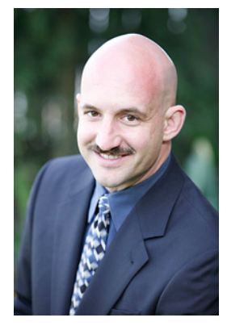
CAP Theorem
Conjectured by Prof. Eric Brewer at PODC (Principle of Distributed Computing) 2000 keynote talk
Described the trade-offs involved in distributed system
It is impossible for a web service to provide following three guarantees at the same time:
Consistency
Availability
Partition-tolerance

Slide 16
CAP Theorem
Consistency:
All nodes should see the same data at the same time
Availability:
Node failures do not prevent survivors from continuing to operate
Partition-tolerance:
The system continues to operate despite network partitions
A distributed system can satisfy any two of these guarantees at the same time but not all three

Slide 17
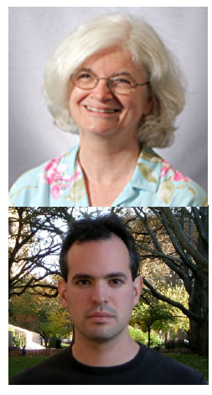
CAP Theorem: Proof
2002: Proven by research conducted by Nancy Lynch and Seth Gilbert at MIT
Gilbert, Seth, and Nancy Lynch. "Brewer's conjecture and the feasibility of consistent, available, partition-tolerant web services." ACM SIGACT News 33.2 (2002): 51-59.

Slide 18
CAP Theorem: Proof
A simple proof using two nodes:
A
B

Slide 19
CAP Theorem: Proof
A simple proof using two nodes:
Not Consistent!
A
B
Respond to client

Slide 20

CAP Theorem: Proof
A simple proof using two nodes:
Not Available!
A
B
Wait to be updated

Slide 21
CAP Theorem: Proof
A simple proof using two nodes:
Not Partition Tolerant!
A
B
A gets updated from B

Slide 22
Why this is important?
All modern databases are distributed (Big Data Trend, etc.)
CAP theorem describes the trade-offs involved in distributed systems
A proper understanding of CAP theorem is essential to making decisions about the distributed database design
Misunderstanding can lead to erroneous or inappropriate design choices

Slide 23
Problem for Relational Database to Scale
The Relational Database is built on the principle of ACID (Atomicity, Consistency, Isolation, Durability)
It implies that a truly distributed relational database should have availability, consistency and partition tolerance.
Which unfortunately is impossible …

Slide 24
Revisit CAP Theorem
Of the following three guarantees potentially offered a by distributed systems:
Consistency
Availability
Partition tolerance
Pick two
This suggests there are three kinds of distributed systems:
CP
AP
CA
C
A
P
Any problems?

Slide 25
Consistency or Availability
Consistency and Availability is not “binary” decision
AP systems relax consistency in favor of availability – but are not inconsistent
CP systems sacrifice availability for consistency- but are not unavailable
This suggests both AP and CP systems can offer a degree of consistency, and availability, as well as partition tolerance
C
A
P

Slide 26
AP: Best Effort Consistency
Example:
Web Caching
DNS
Trait:
Optimistic
Expiration/Time-to-live
Conflict resolution

Slide 27
CP: Best Effort Availability
Example:
Majority protocols
Distributed Locking (Google Chubby Lock service)
Trait:
Pessimistic locking
Make minority partition unavailable

Slide 28
Types of Consistency
Strong Consistency
After the update completes, any subsequent access will return the same updated value.
Weak Consistency
It is not guaranteed that subsequent accesses will return the updated value.
Eventual Consistency
Specific form of weak consistency
It is guaranteed that if no new updates are made to object, eventually all accesses will return the last updated value (e.g., propagate updates to replicas in a lazy fashion)

Slide 29
Eventual Consistency Variations
Causal consistency
Processes that have causal relationship will see consistent data
Read-your-write consistency
A process always accesses the data item after it’s update operation and never sees an older value
Session consistency
As long as session exists, system guarantees read-your-write consistency
Guarantees do not overlap sessions

Slide 30



Eventual Consistency - A Facebook Example
Bob finds an interesting story and shares with Alice by posting on her Facebook wall
Bob asks Alice to check it out
Alice logs in her account, checks her Facebook wall but finds:
- Nothing is there!
?

Slide 31

Eventual Consistency - A Facebook Example
Bob tells Alice to wait a bit and check out later
Alice waits for a minute or so and checks back:
- She finds the story Bob shared with her!

Slide 32
Eventual Consistency - A Facebook Example
Reason: it is possible because Facebook uses an eventual consistent model
Why Facebook chooses eventual consistent model over the strong consistent one?
Facebook has more than 1 billion active users
It is non-trivial to efficiently and reliably store the huge amount of data generated at any given time
Eventual consistent model offers the option to reduce the load and improve availability

Slide 33
The effect of CAP on building resilient systems

Slide 34
Review – Fault Models
We have studied degradation faults till now.
The other kind of faults are omission
Omission is when data is not sent to some receivers
Can be symmetric or asymmetric
Commission
When an incorrect data is sent
Can be symmetric or asymmetric
Voting or comparison based testing only applies for asymmetric faults.
Symmetric fault detection requires additional information.

Slide 35
Reaching Agreement (For both Symmetric as well as Asymmetric Faults)
If we are using replicas, how do replicas remain consistent.
Simple solution: transactional update.
Client talks to primary,
Primary updates all replicas and gets confirmation
Then primary answers back.
If primary fails, then a previously ordered sequence can be used to designate a new primary.

Slide 36
Example of Simple mechanism
Two Phase Commit

Slide 37
Problem Statement
Transaction T accessed data at resource managers R₁, … R_{n}.
The goal is to either
commit T at all of R₁, … R_{n}, or
abort T at all of R₁, … R_{n}
even if resource managers, nodes and communications links fail during the commit or abort activity
That is, never commit at R_{i} but abort at R_{k}.

Slide 38
The Protocol
(Begin Phase 1) The coordinator sends a Request-to-Prepare message to each participant
The coordinator waits for all participants to vote
Each participant
votes Prepared if it’s ready to commit
may vote No for any reason
may delay voting indefinitely
(Begin Phase 2) If coordinator receives Prepared from all participants, it decides to commit. (The transaction is now committed.) Otherwise, it decides to abort.

Slide 39
The Protocol (cont’d)
The coordinator sends its decision to all participants (i.e. Commit or Abort)
Participants acknowledge receipt of Commit or Abort by replying Done.

Slide 40
Performance
In the absence of failures, 2PC requires 3 rounds of messages before the decision is made
Request-to-prepare
Votes
Decision
Done messages are just for bookkeeping
they don’t affect response time
they can be batched

Slide 41
Uncertainty
Before it votes, a participant can abort unilaterally
After a participant votes Prepared and before it receives the coordinator’s decision, it is uncertain. It can’t unilaterally commit or abort during its uncertainty period.
Coordinator
Participant
Request-to-Prepare
Prepared
Uncertainty
Period
Commit
Done

Slide 42
Uncertainty (cont’d)
The coordinator is never uncertain
If a participant fails or is disconnected from the coordinator while it’s uncertain, at recovery it must find out the decision

Slide 43
Theorems
Uncertainty periods are unavoidable
Blocking - a participant must await a repair before continuing. Blocking is bad.
Theorem 1 - For every possible commit protocol (not just 2PC), a communications failure can cause a participant to become blocked.
Independent recovery - a recovered participant can decide to commit or abort without communicating with other nodes
Theorem 2 - No commit protocol can guarantee independent recovery of failed participants

Slide 44
Logging 2PC State Changes
Logging may be eager
meaning it’s flushed to disk before the next Send Message
Or it may be lazy = not eager
Coordinator
Log Start2PC
(eager)
Participant
Request-to-Prepare
Prepared
Log prepared (eager)
Log commit
(eager)
Commit
Done
Log commit (eager)
Log commit (lazy)

Slide 45
Coordinator Recovery
If the coordinator fails and later recovers, it must know the decision. It must therefore log
the fact that it began T’s 2PC protocol, including the list of participants, and
Commit or Abort, before sending Commit or Abort to any participant (so it knows whether to commit or abort after it recovers).
If the coordinator fails and recovers, it resends the decision to participants from whom it doesn’t remember getting Done
If the participant forgot the transaction, it replies Done
The coordinator should therefore log Done after it has received them all.

Slide 46
Participant Recovery
If a participant P fails and later recovers, it first performs centralized recovery (Restart)
For each distributed transaction T that was active at the time of failure
If P is not uncertain about T, then it unilaterally aborts T
If P is uncertain, it runs the termination protocol (which may leave P blocked)
To ensure it can tell whether it’s uncertain, P must log its vote before sending it to the coordinator
To avoid becoming totally blocked due to one blocked transaction, P should reacquire T’s locks during Restart and allow Restart to finish before T is resolved.

Slide 47
Paxos: Generalization of 2-PC

Slide 48
Some material for paxos
Lamport, Leslie. "Paxos made simple." ACM Sigact News 32, no. 4 (2001): 18-25.
Lamport, Leslie. "The part-time parliament." ACM Transactions on Computer Systems (TOCS) 16.2 (1998): 133-169.
This is the original paper but hard to understand so we use the first listed paper
YouTube lecture by Prof. Rachid Guerraoui (https://www.youtube.com/watch?v=WX4gjowx45E) – watch it please.

Slide 49
What is the Problem? (1/2)
Consider our CAP lecture from before
Say for availability purposes we create two replicas of the same service so clients can access the replica closest to them
Say two persons who are joint account holders are performing operations on their account more or less at the same time but on different replicas, which handle operations on their account
Replicas are supposed to synchronize state so there is a consistent view
Service
(e.g. bank)
R1
R2
C1
C2

Slide 50
What is the Problem? (2/2)
System is completely asynchronous
i.e. messages are sent at any time and that they can reach their replicas in any order and with any arbitrary delay (assume no loss or duplication)
Things that can go wrong
Say C2 wants to withdraw money assuming that C1 is going to deposit money before C2 issues a withdraw request (assume they have called each other and C1 has assured C2 that money will be deposited ASAP)
But what if C1’s request reaches R1 late, or even if it had reached R1, say the state had not gotten synchronized with R2
=> C2’s operation is a disaster ☹
Service
(e.g. bank)
R1
R2
Clients should remain oblivious to replication
C1
C2

Slide 51

Paxos In A Nutshell
Client

Slide 52

Paxos In A Nutshell
Client requests change to system
Client
Proposer

Slide 53

Paxos In A Nutshell
Proposer tells Acceptors to get ready for a change
Acceptor
Acceptor
Ready?
Client
Proposer
Acceptor
Acceptor

Slide 54
Paxos In A Nutshell
Acceptors tell that we are ready -- remember 2 PC commit.
Acceptor
Acceptor
yes?
Client
Proposer
Acceptor
Acceptor

Slide 55
Paxos In A Nutshell
If a majority is ready f/2+1 then the update is sent out.
Acceptor
Acceptor
Here is update?
Client
Proposer
Acceptor
Acceptor

Slide 56

Paxos In A Nutshell
Changes eventually propagate to learners.
Acceptor
Learner
Acceptor
Here is update?
Learner
Client
Proposer
Acceptor
Learner
Learners act as the replication factor for the protocol. Once a Client request has been agreed upon by the Acceptors, the Learner may take action (i.e.: execute the request and send a response to the client). To improve availability of processing, additional Learners can be added.
Acceptor
Learner

Slide 57
Paxos In A Nutshell
Changes eventually propagate to learners.
Acceptor
Learner
Acceptor
Here is update?
Learner
Client
Proposer
Acceptor
Learner
This repeats for every change. If proposer dies, a new leader is elected.
Acceptor
Learner

Slide 58
Paxos Algorithm: 3 Types of Agents
Proposers
Agents who propose the values
Acceptors
Agents who accept specific values
Multiple acceptors are needed to ensure a quorum
Learners
Agents who finally learn the consensus value
Implementation Note
One or more roles can be played by a single process

Slide 59
Intuition behind paxos (1/2)
Paxos happens in rounds where in each round a replica takes a turn to be the leader and sends out its notion of the order and expects ACKs from others
A leader for that round requests all other replicas for confirming it to be their leader for that round
These backups, which are like witnesses for that round, send their confirmation to the leader
For the leader to be satisfied that it indeed is the leader, we need majority of confirmations from the system of replicas => only a minority of replicas can fail
Once a majority of confirmations are received, the leader sends its notion of “ground truth” as the value to be accepted permanently for that round by all the replicas
On receiving this directive from the leader, each replica in that round accepts that value
Thus, a 2-phase protocol is enforced among all the replicas
The purpose of the rounds is to elect a leader and it can stay such until it dies

Slide 60
Intuition behind Paxos Rounds (2/2)
Duration of round need not be fixed
In fact, since it is hard to find a good value, a system can adapt the duration of the round such that it can tune itself to the duration of what makes the system eventually synchronous
Clocks of the system need not be synchronized
A leader of a round may receive a message from another replica from a previous round (because its clock was way behind)
A leader will simply ignore such old messages
Lamport’s logical clock idea can then be used to inform this “fallen behind” replica to enable it to update its clock to current round
Ordering (i.e., total ordering which enables all replicas to look like a single unit) is achieved by the consensus protocol
Recall that total ordering can be different depending on tie breaking rule
Here, whoever leader gets to be elected essentially dictates the tie breaking rules for the total ordering
Liveness of the algorithm stems from the notion of rounds where someone gets to try to become a leader and arrive at a consensus

Slide 61
Summary: The basic idea
Reaching agreement:
computation results
Electing a leader
synchronization
committing to a transaction
…
How much replication is necessary?
A system is k fault tolerant if it can survive faults in k components and still meet its specifications.
Need 2K+1 acceptors

Slide 62
Why 2K+1 nodes
What happens if acks never get received because either of the replica fails?
the remaining replica keeps assuming the role of the leader during its turn and endlessly keeps waiting for an ack but will never receive it
Therefore, 2 replicas are not sufficient if one of them were to fail
Thus, we need more replicas if consensus is to be formed in such “eventually synchronous” systems
In general, given N replicas, we need a majority to be alive, i.e, at least floor(N/2)+1 must remain alive
For N = 2 (all 2 must be alive => 0 failures tolerated), For N = 3 (2 must be alive, 1 failure ok); for N = 4 (3 must be alive, 1 failure ok); and so on

Slide 63
RAFT is a simpler version of Paxos.
https://raft.github.io/raft.pdf
Look at the raft slides

Slide 64
The problems with the agreement based systems
Byzantine failures

Slide 65
Agreement in Faulty Systems
Many things can go wrong…
Communication
Message transmission can be unreliable
Time taken to deliver a message is unbounded
Adversary can intercept messages
Processes
Can fail or team up to produce wrong results
Agreement very hard, sometime impossible, to achieve! (Byzantine case)

Slide 66
Clock Drift
Clocks drift even if they are built well
Many systems incorporate multiple redundant clocks
To bound error, clocks need to be synchronized
This is not hard—simple solution, mid-value select

Slide 67



Mid-Value Select
Will converge over time
Time = 100
OK, Everybody Synchronize!
(90, 100, 110)
90
(90, 100, 110)
Time = 110
(90, 100, 110)
Time = 90
110

Slide 68

Faulty Clock
100
OK, Everybody Synchronize!
(60, 100, 110)
Same Value
60
(60, 100, 110)
(60, 100, 110)
60
110
110

Slide 69
Byzantine Faulty Clock
100
OK, Everybody Synchronize!
(100, 105, 110)
Different Values
90
(90, 100, 110)
(90, 100, 110)
90
110
110

Slide 70
Byzantine Fault Tolerance
Leslie Lamport, Robert Shostak, and Marshall Pease. 1982. The Byzantine Generals Problem. ACM Trans. Program. Lang. Syst. 4, 3 (July 1982), 382-401. DOI=http://dx.doi.org/10.1145/357172.357176
Based on https://marknelson.us/posts/2007/07/23/byzantine.html

Slide 71
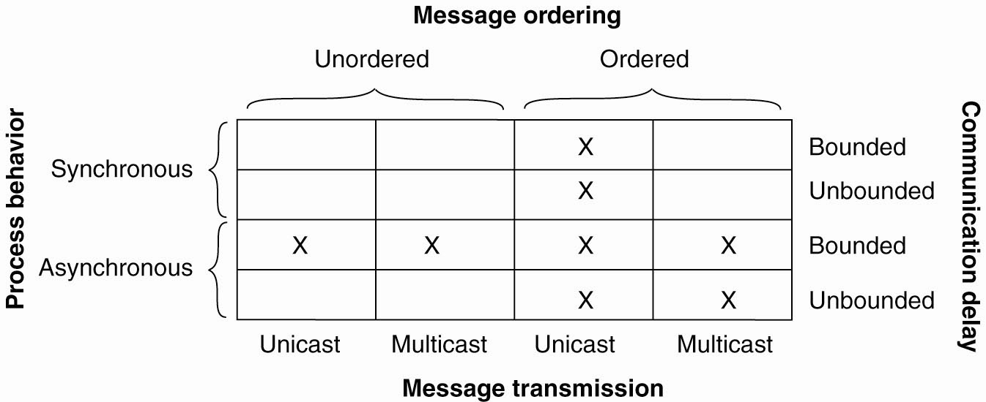
Agreement in Faulty Systems
Synchronous versus asynchronous systems.
A system is synchronized if the process operation in lock-step mode. Otherwise, it is asynchronous.
Communication delay is bounded or not.
Message delivery is ordered or not.
Message transmission is done through unicasting or multicasting.

Slide 72
Classical Byzantine Fault Tolerance
Byzantine Agreement [Lamport, Shostak, Pease, 1982]
Assumptions:
Every message that is sent is delivered correctly
The receiver knows who sent the message
Message delivery time is bounded

Slide 73
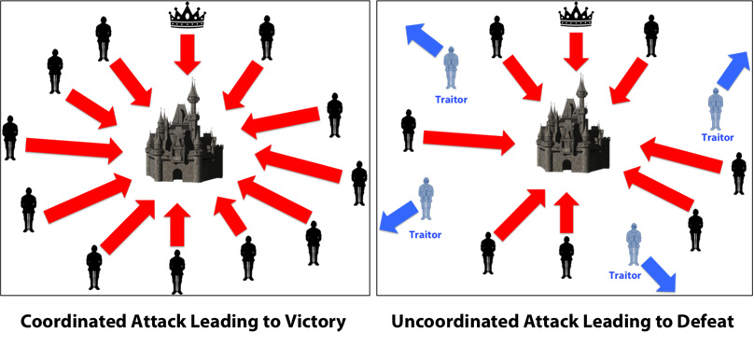
BFT - Lamport
The Byzantine General’s Problem is one of many in the field of agreement protocols.
This problem is built around an imaginary General who makes a decision to attack or retreat, and must communicate the decision to his lieutenants.
A given number of these actors are traitors (possibly including the General.)
Traitors cannot be relied upon to properly communicate orders; worse yet, they may actively alter messages in an attempt to subvert the process.

Slide 74
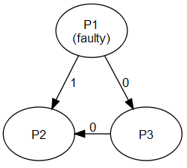
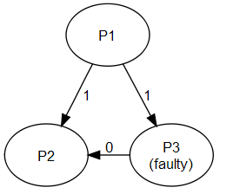
Contextualizing to real-world
Imagine the generals are processes (replicas of a database)
The general who initiates the order is the source process (P1) , and the orders sent to the other processes are messages.
Traitorous generals and lieutenants are faulty processes, and loyal generals and lieutenants are correct processes.
The order to retreat or attack is a message with a single bit of information: a one or a zero.
P1 sends different data to P2 and P3
P3 misrepresents data received from P1

Slide 75
Solution requirements
Any solution to an agreement problem must pass three tests: termination, agreement, and validity.
A solution has to guarantee that all correct processes eventually reach a decision regarding the value of the order they have been given.
All correct processes have to decide on the same value of the order they have been given.
If the source process is a correct process, all processes have to decide on the value that was original given by the source process.
In database source process is aka primary replica.

Slide 76
Difficulty
Imagine, for example, that the source process is the only faulty process. It tells half the processes that the value of their order is zero, and the other half that their value is one.
Recall: A solution has to guarantee that all correct processes eventually reach a decision regarding the value of the order they have been given.
- What happens to decisions of P2 and P3

Slide 77
Difficulty
After receiving the order from the source process, the remaining processes have to agree on a value that they will all decide on.
The processes could quickly poll one another to see what value they received from the source process.

Slide 78
Difficulty
Imagine the decision algorithm of a process which receives an initial message of zero from the source process, but sees that one of the other processes says that the correct value is one.
Given the conflict, the process knows that either the source process is faulty, having given different values to two different peers, or the peer is faulty, and is lying about the value it received from the source process.

Slide 79
Difficulty
In this case it is easy to find out that there is a conflict
However, what is the correct value is difficult to find out.
Actually there is a basic result about this.

Slide 80
Basic Result -- impossibility
General 1
General 1
attack
attack
attack
retreat
General 2
General 3
General 2
General 3
retreat
retreat
No solution for three processes that can handle a single traitor.
In a system with m faulty processes agreement can be achieved only if there are 2m+1 (more than 2/3) functioning correctly. Thus if m are faulty then we need 3m+1 total processes

Slide 81
The Lamport, Pease and Shostak Algorithm
Algorithm OM(0)
The general sends his value to every lieutenant.
Each lieutenant uses the value he receives from the general.
Algorithm OM(m), m > 0
The general sends his value to each lieutenant.
For each i, let vi be the value lieutenant i receives from the general. Lieutenant i acts as the general in Algorithm OM(m-1) to send the value vi to each of the n-2 other lieutenants.
For each i, and each j≠i, let vi be the value lieutenant i received from lieutenant j in step 2 (using Algorithm (m-1)).
Lieutenant i uses the majority of values (v1, v2, … vn)
The algorithm runs for m+1 rounds where
m is the number of traitors

Slide 82
Round 0 – m==0
In round 0, the General sends the order to all of its lieutenants. Having completed his work, the General now retires and stands by idly waiting for the remaining work to complete. Nobody sends any additional messages to the General, and the General won’t send any more messages.

Slide 83
Round 0 – m==0
In round 0, the General sends the order to all of its lieutenants. Having completed his work, the General now retires and stands by idly waiting for the remaining work to complete. Nobody sends any additional messages to the General, and the General won’t send any more messages.
How do you know who is the general
You designate the primary copy. Hence it is known by designation.

Slide 84
Round 1 (total m rounds)
Each process broadcasts a message to all the other processes, including itself, but excluding the General, with the value it received from the General and its own process ID.
You try not to have cycles.

Slide 85
Round 1
Imagine we have 7 processes P₁ ₋₋ P_{7.}
For example, let’s suppose that in Round 0 that P₁, a faulty general told P₂, P₃, and P₄ that the command value was 0, and told P₅, P₆, and P₇ that the command value was 1. In round 1, the following messages would be sent:
Sender=P₂ |  | Sender=P₃ |  | Sender=P₄ |  | Sender=P₅ |  | Sender=P₆ |  | Sender=P₇
Dest | Msg | Dest | Msg | Dest | Msg | Dest | Msg | Dest | Msg | Dest | Msg
P₂ | {0,12} | P₂ | {0,13} | P₂ | {0,14} | P₂ | {1,15} | P₂ | {1,16} | P₂ | {1,17}
P₃ | {0,12} | P₃ | {0,13} | P₃ | {0,14} | P₃ | {1,15} | P₃ | {1,16} | P₃ | {1,17}
P₄ | {0,12} | P₄ | {0,13} | P₄ | {0,14} | P₄ | {1,15} | P₄ | {1,16} | P₄ | {1,17}
P₅ | {0,12} | P₅ | {0,13} | P₅ | {0,14} | P₅ | {1,15} | P₅ | {1,16} | P₅ | {1,17}
P₆ | {0,12} | P₆ | {0,13} | P₆ | {0,14} | P₆ | {1,15} | P₆ | {1,16} | P₆ | {1,17}
P₇ | {0,12} | P₇ | {0,13} | P₇ | {0,14} | P₇ | {1,15} | P₇ | {1,16} | P₇ | {1,17}

Slide 86

Round 1
Imagine we have 7 processes P₁ ₋₋ P_{7.}
For example, let’s suppose that in Round 0 that P₁, a faulty general told P₂, P₃, and P₄ that the command value was 0, and told P₅, P₆, and P₇ that the command value was 1. In round 1, the following messages would be sent:
Sender=P₂ |  | Sender=P₃ |  | Sender=P₄ |  | Sender=P₅ |  | Sender=P₆ |  | Sender=P₇
Dest | Msg | Dest | Msg | Dest | Msg | Dest | Msg | Dest | Msg | Dest | Msg
P₂ | {0,12} | P₂ | {0,13} | P₂ | {0,14} | P₂ | {1,15} | P₂ | {1,16} | P₂ | {1,17}
P₃ | {0,12} | P₃ | {0,13} | P₃ | {0,14} | P₃ | {1,15} | P₃ | {1,16} | P₃ | {1,17}
P₄ | {0,12} | P₄ | {0,13} | P₄ | {0,14} | P₄ | {1,15} | P₄ | {1,16} | P₄ | {1,17}
P₅ | {0,12} | P₅ | {0,13} | P₅ | {0,14} | P₅ | {1,15} | P₅ | {1,16} | P₅ | {1,17}
P₆ | {0,12} | P₆ | {0,13} | P₆ | {0,14} | P₆ | {1,15} | P₆ | {1,16} | P₆ | {1,17}
P₇ | {0,12} | P₇ | {0,13} | P₇ | {0,14} | P₇ | {1,15} | P₇ | {1,16} | P₇ | {1,17}
Sender=P₂ |  | Sender=P₃ |  | Sender=P₄ |  | Sender=P₅ |  | Sender=P₆ |  | Sender=P₇
Dest | Msg | Dest | Msg | Dest | Msg | Dest | Msg | Dest | Msg | Dest | Msg
P₂ | {0,12} | P₂ | {0,13} | P₂ | {0,14} | P₂ | {1,15} | P₂ | {1,16} | P₂ | {1,17}
P₃ | {0,12} | P₃ | {0,13} | P₃ | {0,14} | P₃ | {1,15} | P₃ | {1,16} | P₃ | {1,17}
P₄ | {0,12} | P₄ | {0,13} | P₄ | {0,14} | P₄ | {1,15} | P₄ | {1,16} | P₄ | {1,17}
P₅ | {0,12} | P₅ | {0,13} | P₅ | {0,14} | P₅ | {1,15} | P₅ | {1,16} | P₅ | {1,17}
P₆ | {0,12} | P₆ | {0,13} | P₆ | {0,14} | P₆ | {1,15} | P₆ | {1,16} | P₆ | {1,17}
P₇ | {0,12} | P₇ | {0,13} | P₇ | {0,14} | P₇ | {1,15} | P₇ | {1,16} | P₇ | {1,17}
{0,12} means that 2 is telling others that I received a message from 1 and the value was 0. Think about the Chinese whisper game.

Slide 87
Round2
Each process (not the source general) will send message to all other lieutenants – cycles are not allowed.
Sender=P₂ | Sender=P₃ | Sender=P₄ | Sender=P₅ | Sender=P₆ | Sender=P₇
{0,132} {0,142} {1,152} {1,162} {1,172} | {0,123} {0,143} {1,153} {1,163} {1,173} | {0,124} {0,134} {1,154} {1,164} {1,174} | {0,125} {0,135} {0,145} {1,165} {1,175} | {0,126} {0,136} {0,146} {1,156} {1,176} | {0,127} {0,137} {0,147} {1,157} {1,167}
{0,132} Two is telling others that I received a message from 3 which says that 3 received a message from 1 which was 0
The five messages shown in P₂’s column in the table are sent to all six lieutenant processes, include itself.

Slide 88
Number of rounds
If 2 faulty nodes then there will be 3 rounds, rounds 0, round 1 and round 2.

Slide 89
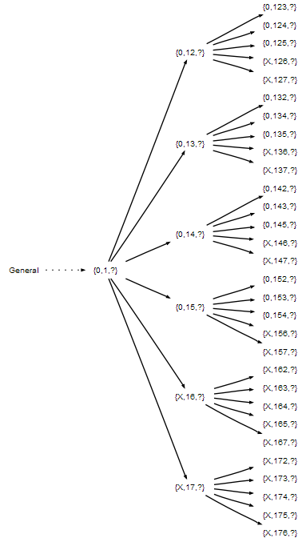
Tree Storage
Each process stores all messages it has received in a tree structure.
While sending messages in each round, processes are also accumulating incoming messages. The messages are stored in a tree format, with each round of messages occupying one level of the tree.
An example tree with n=7, m=2, and faulty processes P₆ and P₇

Slide 90
Tree Storage
Number of messages….
(N-1)*(N-2)….(N-M)
N total number of nodes
M (max) number of faulty nodes.
= (N-1)!/(N-(M+1))!
An example tree with n=7, m=2, and faulty processes P₆ and P₇

Slide 91
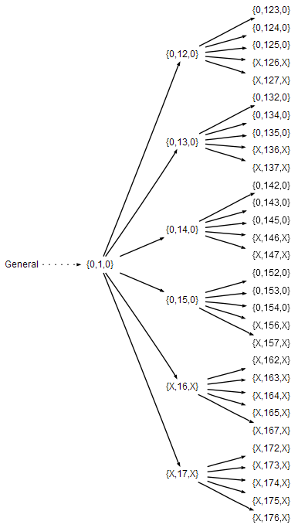
Decision criteria
Majority voting – fold the tree back up from leaves

Slide 92
Practical Byzantine Fault Tolerance
Miguel Castro and Barbara Liskov. 1999. Practical Byzantine fault tolerance. In Proceedings of the third symposium on Operating systems design and implementation (OSDI '99). USENIX Association, Berkeley, CA, USA, 173-186.

Slide 93
Classical Byzantine Fault Tolerance
Byzantine Agreement [Lamport, Shostak, Pease, 1982]
Assumptions:
Every message that is sent is delivered correctly
The receiver knows who sent the message
Message delivery time is bounded

Slide 94
Practical Byzantine Fault Tolerance

Slide 95
Important theorem of impossibility
FLP impossibility: Async consensus may not terminate
Sketch of proof: System starts in “bivalent” state (may decide 0 or 1). At some point, the system is one message away from deciding on 0 or 1. If that message is delayed, another message may move the system away from deciding.
Holds even when servers can only crash (not Byzantine)!
Hence, protocol cannot always be live (but there exist randomized BFT variants that are probably live)
[See Fischer, M. J., Lynch, N. A., and Paterson, M. S. 1985. Impossibility of distributed consensus with one faulty process. J. ACM 32, 2 (Apr. 1985), 374-382.]
In the system Fischer, Lynch, and Paterson studied, messages were unordered, communication was unbounded, and processors were asynchronous.

Slide 96
PBFT ideas
PBFT, “Practical Byzantine Fault Tolerance”, M. Castro and B. Liskov, SOSP 1999
Replicate service across many nodes
Assumption: only a small fraction of nodes are Byzantine
Rely on a super-majority of votes to decide on correct computation.
Makes some weak synchrony (message delay) assumptions to ensure liveness
Would violate FLP impossibility otherwise
PBFT property: tolerates <=f failures with 3f+1 replicas

Slide 97
PBFT main ideas
Static configuration (same 3f+1 nodes)
To deal with malicious primary
Use a 3-phase protocol to agree on sequence number
To deal with loss of agreement
Use a bigger quorum (2f+1 out of 3f+1 nodes)
Need to authenticate communications

Slide 98
PBFT main ideas.
A client sends a request to invoke a service operation to the primary
The primary multicasts the operation to the backups
Replicas execute the request and reply to the client
The client waits for f+1 replies from different replicas with the same result, this is the result of the operation.

Slide 99
What if client does not receive enough replies?
If the client does not receive replies soon enough, it broadcasts the request to all replicas.
If the request has already been processed, the replicas simply re-send the reply; replicas remember the last reply message they sent to each client.
Otherwise, if the replica is not the primary, it relays the request to the primary.
If the primary does not multicast the request to the group, it will eventually be suspected to be faulty by enough replicas to cause a view change.

Slide 100
PBFT Strategy
In the normal case, the primary runs a three-phase protocol to coordinate with the replicas.
The three phases are pre-prepare, prepare, and commit.
The pre-prepare and prepare phases are used to totally order requests sent in the same view even when the primary, which proposes the ordering of requests, is faulty.
Replicas watch the primary and do a view change if it fails

Slide 101
Replica state
A replica id i (between 0 and N-1)
Replica 0, replica 1, …
A view number v#, initially 0
Primary is the replica with id
i = v# mod N
A log of <op, seq#, status> entries
Status = pre-prepared or prepared or committed

Slide 102
Normal Case
Client sends request to primary
or to all

Slide 103
Normal Case
Primary sends pre-prepare message to all
Pre-prepare contains <v#,seq#,op>
Records operation in log as pre-prepared
Keep in mind that primary might be malicious
Send different seq# for the same op to different replicas
Use a duplicate seq# for op

Slide 104
Normal Case
Replicas check the pre-prepare and if it is ok:
Record operation in log as pre-prepared
Send prepare messages to all
Prepare contains <i,v#,seq#,op>
All to all communication
A backup accepts a pre-prepare message if the digest and signature are correct, it is for the correct view, and it hasn’t already accepted a pre-prepare message for the current view and sequence number with a different digest

Slide 105
Normal Case:
It then enters a prepare phase by multicasting a prepare message to all other replicas. Once the replica has received 2f+1 prepares from different backups that match the pre-prepare, it considers itself prepared and multicasts a commit message
Record operation in log as prepared
Send commit message to all
Commit contains <i,v#,seq#,op>
What does this stage achieve:
All honest nodes that are prepared prepare the same value
At least f+1 honest nodes have sent prepare/pre-prepare

Slide 106
Normal Case:
Replicas wait for 2f+1 matching commits
Ensures that at least f+1 trustworthy nodes have committed
Record operation in log as committed
Execute the operation
Send result to the client

Slide 107
Normal Case
Client waits for f+1 matching replies
Ensures at least one node has committed and executed

Slide 108
PBFT summary
Request
Pre-Prepare
Prepare
Commit
Reply
Client
Primary
Replica 2
Replica 3
Replica 4

Slide 109
View Change
Replicas watch the primary
Request a view change
send a do-viewchange request to all
new primary requires 2f+1 requests to accept new role
sends new-view with proof that it got the 2f+1 requests

Slide 110
Additional Issues
State transfer
Checkpoints (garbage collection of the log)
Selection of the primary
Timing of view changes

Slide 111
Practical limitations of BFTs
Expensive
Protection is achieved only when <= f nodes fail
Does not prevent many types of attacks:
Turn a machine into a botnet node
Steal SSNs from servers

