Slide 1
Lecture 3 Reliability Concepts

Slide 2
Important to understand
Why do systems fail?
Is it possible to predict failures.

Slide 3
Failure Prediction
It is important to be able to
Predict probability of failure of a component or system
Estimate the mean time to the next failure
Predict number of (remaining) failures during the development.
Such tasks are the target of the reliability

Slide 4
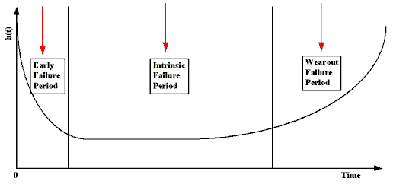
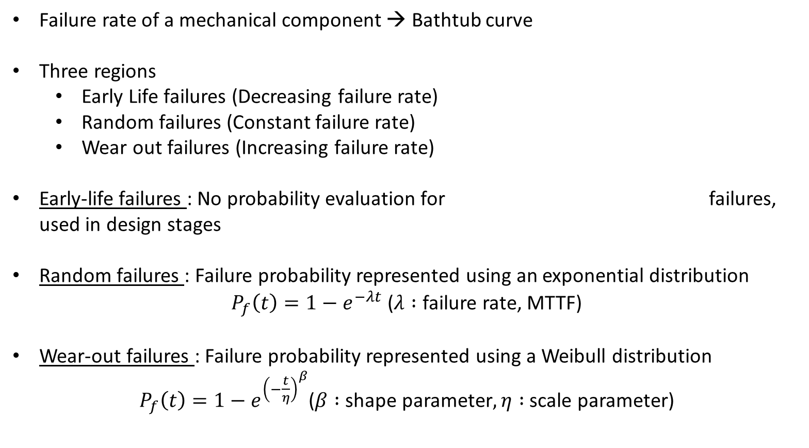
Reliability Theory - Summary
Failure rate of a mechanical component → Bathtub curve
Three regions
Early Life failures (Decreasing failure rate)
Random failures (Constant failure rate)
Wear out failures (Increasing failure rate)
Early-life failures : No probability evaluation for failures, used in design stages
Random failures : Failure probability represented using an exponential distribution
$P_{f}\left(t\right)=1−e^{−λt}$ ($λ :$ failure rate, MTTF)
Wear-out failures : Failure probability represented using a Weibull distribution
$P_{f}\left(t\right)=1−e^{{\left(−\frac{t}{η}\right)}^{β}}$($β :$shape parameter$, η :$ scale parameter)

Slide 5
Lets try to understand it in detail

Slide 6
Failure Specification
Time of failure
Time interval between failures
Cumulative failure up to a given time
Failures experienced in a time interval
Failure no. | Failure times (hours) | Failure interval (hours)
1 | 10 | 10
2 | 19 | 9
3 | 32 | 13
4 | 43 | 11
5 | 58 | 15
6 | 70 | 12
7 | 88 | 18
8 | 103 | 15
9 | 125 | 22
10 | 150 | 25
11 | 169 | 19
12 | 199 | 30
13 | 231 | 32
14 | 256 | 25
15 | 296 | 40

Slide 7
Failure Specification
Time of failure
Time interval between failures
Cumulative failure up to a given time
Failures experienced in a time interval
Interval based failure specification
Time(s) | Cumulative Failures | Failures in interval
30 | 2 | 2
60 | 5 | 3
90 | 7 | 2
120 | 8 | 1
150 | 10 | 2
180 | 11 | 1
210 | 12 | 1
240 | 13 | 1
270 | 14 | 1

Slide 8
Reliability Questions
Single failure specification:
What is the probability of failure of a system (or a component)?
Multiple failure specification:
If a system (or a component) fails at time t1, t2,
…, ti-1,
What is the expected time of the next failure?
What is the probability of the next failure?

Slide 9
Background
Random Processes

Slide 10
Randomness
Random actions in reliability engineering:
Introduction of defects into the code and their removal
Execution of the test-cases, etc.
We should define some random processes to represent the randomness
How to handle randomness?
Collect failure data through testing
Find a distribution function that is a best-fit for the collected data
Make assumptions about the presence of errors and reliability

Slide 11
Randomness
What is a random variable?
A random variable x on a sample space S is a rule that assigns a numerical value to each outcome of S (a function of S into a set of real numbers)
In reliability modeling what can be represented by random variable?
Number of failures in an interval
Time of failure within an interval
etc.
× × × × × ×
Current time interval
Previous
Next

Slide 12
Probability Distribution
Suppose that a random variable X assigns a finite number of values to a sample space S
Then X induces a distribution function f that assigns probabilities to the points in R_{x}
Rx ={x1, x2, x3, …, xn} f(xk) = P( X=xk)

Slide 13
Probability Distribution
The set of ordered pairs [xk, f(xk)] is usually represented by a table or a graph (histogram)
The expected value of X, denoted by E(X) is defined by
E(X) = x1 f(x1) + x2 f(x2) + …+ xn f(xn)
Note the continuous version of these equations change sum to integration.
Frequency
(Failure/time unit)
20
15
10
5
0
1 1.5 2 2.5 3 3.5
Time (days)
4 4.5 5

Slide 14
Probability Distribution
Let M(t) be a random process representing the
number of failures at time t
The mean function μ(t) represents the expected number of failures at time t
μ(t) = E(M(t))
Failure intensity is the rate of change of the expected number of failures with respect to time
λ(t) = d μ(t) / dt
λ(t) is the number of failures per unit time
λ(t) is an instantaneous value

Slide 15
Probability Distributions
Discrete distributions:
Binomial distribution
Poisson distribution

Slide 16
Binomial Distribution
Gives probability of exact number of successes in n independent trials, when probability of success p on single trial is a constant.
Situations with only 2 outcomes (success or failure)
Probability remains the same for all independent trials (Bernoulli trials)

Slide 17
Binomial Distribution
n : number of trials
f(x) : probability of x successes in n trials
: probability of success
: probability of failure
p + q =1

Slide 18
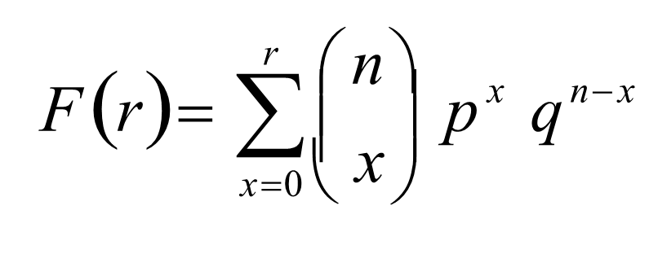
Binomial Distribution
Probability of having upto r successes:
n : number of trials
f(x) : probability of x successes in n trials
: probability of success
: probability of failure
p + q =1
Calculating F(r) becomes increasingly difficult as n (sample set) gets larger

Slide 19
Binomial Distribution
Average = n*p (n – number of trials, p success probability per trial)
Variance = n * P * ( 1 - P ).

Slide 20
Binomial Distribution Example
Acceptance sampling:
A lot is accepted if not more than 2 defects are found in a sample of 6. The defect probability is 25%.
Probability of having exactly 2 defects in the lot is:
⎛6⎞
f (2) = ⎜ ⎟ 0.25 × 0.75 = 0.297
⎜ ⎟
2 4
2
⎝ ⎠

Slide 21
Binomial Distribution Example 2
In a company there are 4 file servers each having the exact replica of a data set. The probability of failure for each server is 10%.
Probability of having exactly 2 servers fail:
f (2) = ^{⎛ 4 ⎞} 0.1² × 0.9² = 0.0486
⎜ ₂ ⎟
⎝ ⎠
Probability of having more than 3 servers fail:
F (r > 2) = F (3) + F (4) = ^{⎛ 4 ⎞} 0.1³ × 0.9¹ + 0.1⁴ = 0.00036
⎜ ₃ ⎟
⎝ ⎠

Slide 22
Poisson Distribution
Some events are rather rare, they don’t happen that often. Still, over a period of time, we want to say something about the nature of rare events.
Poisson distribution is special case of binomial distribution (p or q very small and n very large)
Conditions under which a Poisson distribution holds
counts of rare events, i.e. small probability
all events are independent
average rate (usually denoted by μ) does not change over the period of interest

Slide 23
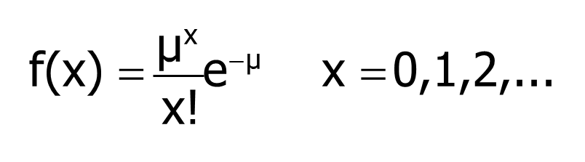
Poisson Distribution
Poisson distribution is a special case of binomial distribution (either p or q is very small and n very large): μ=np
μ: mean rate of occurrence (often denoted by λ)
x : observed number of failures

Slide 24
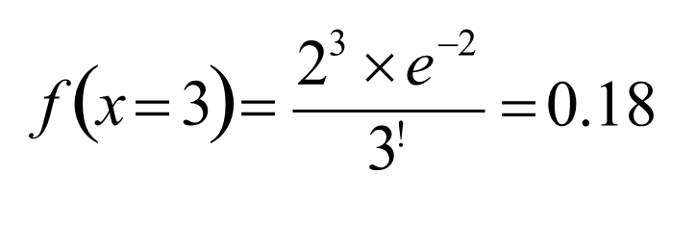
Poisson Example
Suppose that the defect rate is only 2%
find the probability that there are 3 defective items in a sample of 100 items. [Note you can also use binomial distribution]
μ = np = 100 × 0.02 = 2

Slide 25
Continuous case
The probability function that accompanies a continuous random variable is a continuous mathematical function that integrates to 1.
The probabilities associated with continuous functions are just areas under the curve (integrals!).
Probabilities are given for a range of values, rather than a particular value (e.g., the probability of getting a math SAT score between 700 and 800 is 2%).

Slide 26
Normal Distribution
The normal curve is symmetrical about the mean μ;
The mean is at the middle and divides the area into halves;
The total area under the curve is equal to 1;
It is completely determined by its mean and standard deviation σ (or variance σ²)
In a normal distribution, only 2 parameters are needed, namely μ and σ².

Slide 27
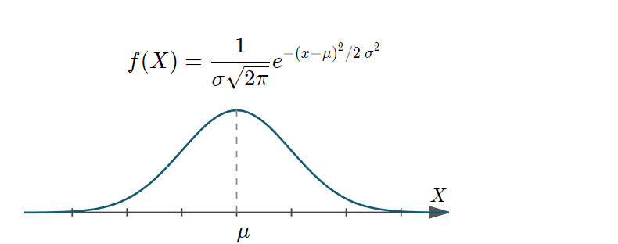
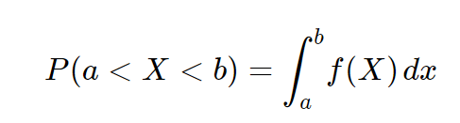
Normal Distribution
If we have the standardized situation of μ = 0 and σ = 1 (N(0,1))

Slide 28
Z-Table Normal Distribution
The areas under the curve bounded by the coordinates z = 0 and any positive value of z are found in the z-Table (for N(0,1)). From this table the area under the standard normal curve between any two ordinates can be found by using the symmetry of the curve about z = 0

Slide 29
Exponential Distribution

Slide 30
Exponential Distribution
Think about usually how long it takes for the elevator to arrive.
Most likely, the it frequently comes in a short while and once in a while, it may come pretty late.
In another word, if we want to use a random variable to measure the waiting time for elevator to come, we can say that:
1. It must be continuous.
2. Smaller values have larger probability and larger values have smaller probability.

Slide 31
Exponential Distribution
Usually, exponential distribution is used to describe the time or distance until some event happens.
It is in the form of:
where x ≥ 0 and μ>0. μ is the mean or expected value.

Slide 32
Another form of exponential distribution
In this case,
Then the mean or expected value is
Note the lambda here is analogous to the rate mentioned on slide 23

Slide 33
Exponential Distribution and Poisson Distribution
Poisson is a discrete random variable that measures the number of occurrence of some given event over a specific interval (time, distance)
Exponential describes the length of the interval between occurrence.

Slide 34

Survivor function
f(x)=λexp{−λx}.
The survivor function is showing the probability of X>t
Obtained by
= exp{−λt}.

Slide 35
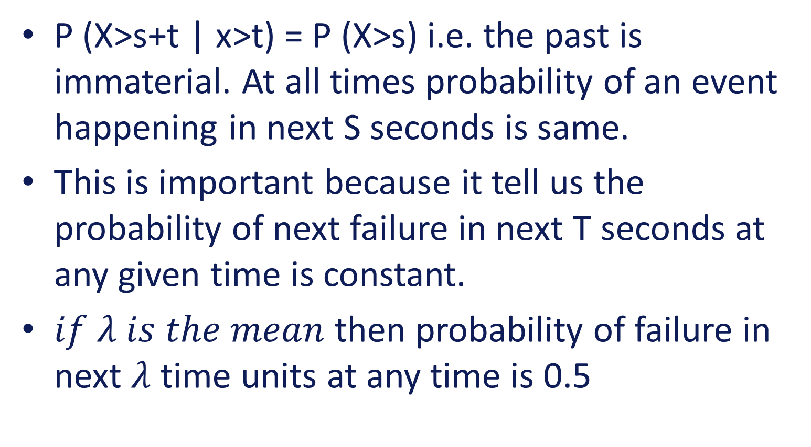
Important: memory less property of Survivor Function
P (X>s+t | x>t) = P (X>s) i.e. the past is immaterial. At all times probability of an event happening in next S seconds is same.
This is important because it tell us the probability of next failure in next T seconds at any given time is constant.
$if λ is the mean$ then probability of failure in next $λ$ time units at any time is 0.5

Slide 36

Memory less proof.
$P\left(X>s\right)P\left(X>t\right)={e^{−s/a}}^{}{e^{−\frac{t}{a}}}^{}$
$=e^{−(s+t)/a}$
P(X>s+t)

Slide 37


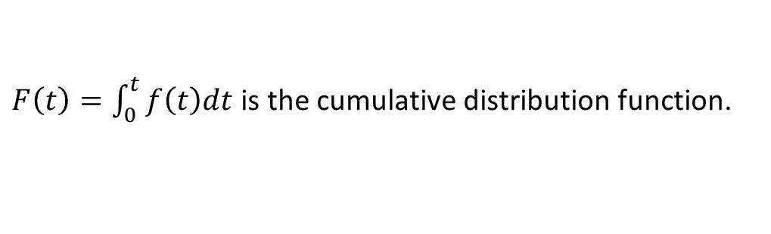



Reliability function and failure rate
For a pdf $f(x)$ for the time till failure, define:
Reliability function
Probability of surviving at least till age $t$. i.e. that failure time is later than $t$
$$R\left(t\right)=P\left(T>t\right)=\int_{t}^{∞}{f\left(x\right)dx}$$
$$=1−F(t)$$
$F\left(t\right)=\int_{0}^{t}{f\left(t\right)dt}$is the cumulative distribution function.
Failure rate (aka Hazard Rate)
This is failure rate at time $t$ given that it survived until time $t$:
$$φ\left(t\right)=\frac{f\left(t\right)}{R\left(t\right)}$$

Slide 38
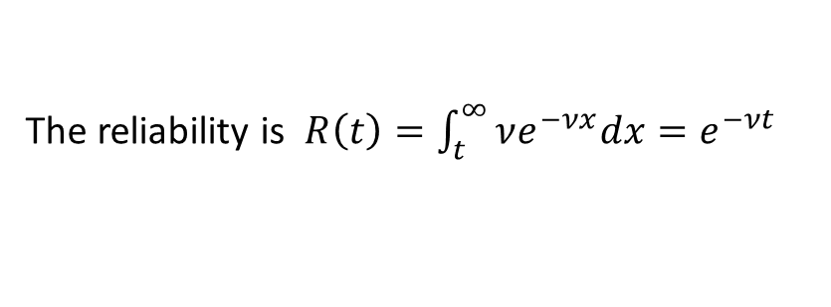

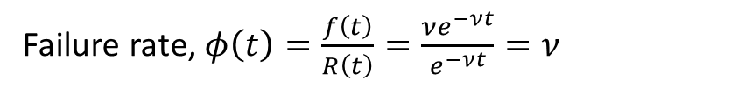
Failure Rate derivation
The reliability is $R\left(t\right)=\int_{t}^{∞}{νe^{−νx}dx}=e^{−νt}$
Failure rate, $φ\left(t\right)=\frac{f\left(t\right)}{R\left(t\right)}=\frac{νe^{−νt}}{e^{−νt}}=ν$
Note: $ν$ is a constant
The fact that the failure rate is constant is a special “lack of ageing property” of the exponential distribution.
- But often failure rates actually increase with age.

Slide 39


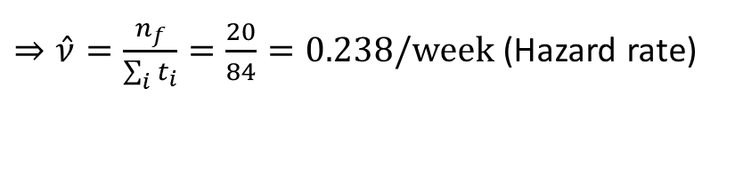
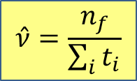
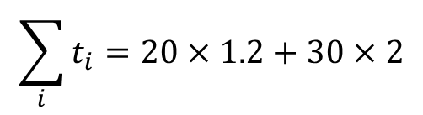
Example
Example (using right censoring):
50 components are tested for two weeks. 20 of them fail in this time, with an average failure time of 1.2 weeks.
What is the mean time till failure assuming a constant failure rate?
Answer:
$$\hat{ν}=\frac{n_{f}}{\sum_{i}{t_{i}}}$$
$n=50$, $n_{f}=20$
$$\sum_{i}{t_{i}}=20×1.2+30×2$$
$=84$ weeks
$⇒\hat{ν}=\frac{n_{f}}{\sum_{i}{t_{i}}}=\frac{20}{84}=0.238/week$ (Hazard rate)
$⇒$ mean time till failure is estimated to be $\frac{1}{\hat{ν}}=\frac{1}{0.238}=4.2 weeks$

Slide 40
References
http://www.reliabilityeducation.com/ReliabilityPredictionBasics.pdf

