Slide 1
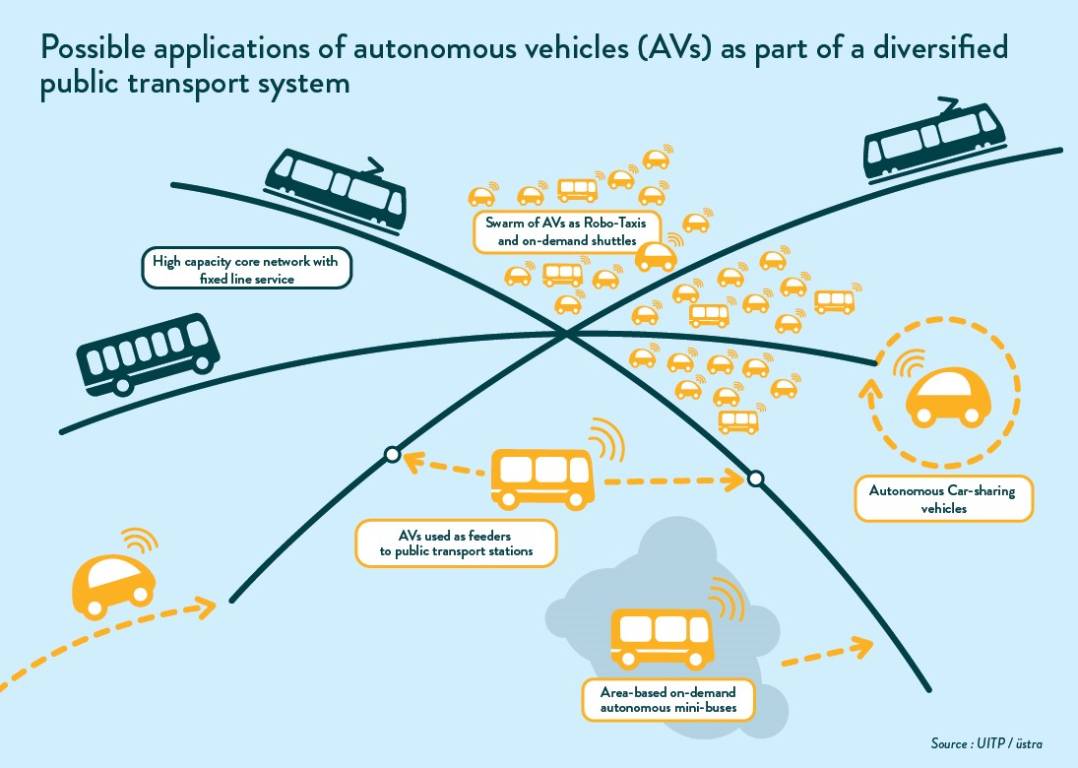
My project:
Database of voice based transport enquiry system

Slide 2

Outline
Introduction
Purpose of project
Methodology
Gantt chart
DDL: Creating tables, Altering
DML: Select, Update, Delete
Join Operator: Inner Join
Conclusion

Slide 3

Introduction
It was found that movement in the city cause considerable problems for blind people (Wall, 2005).
The application will receive voice messages and gives in detailed information in the form of audio.
The system tends to find everything in short time.

Slide 4

Purpose of the project
Make database of voice based transport enquiry system to create the site which saves our precious time by informing us with everything we need in the way and make easier the life of blind people

Slide 5
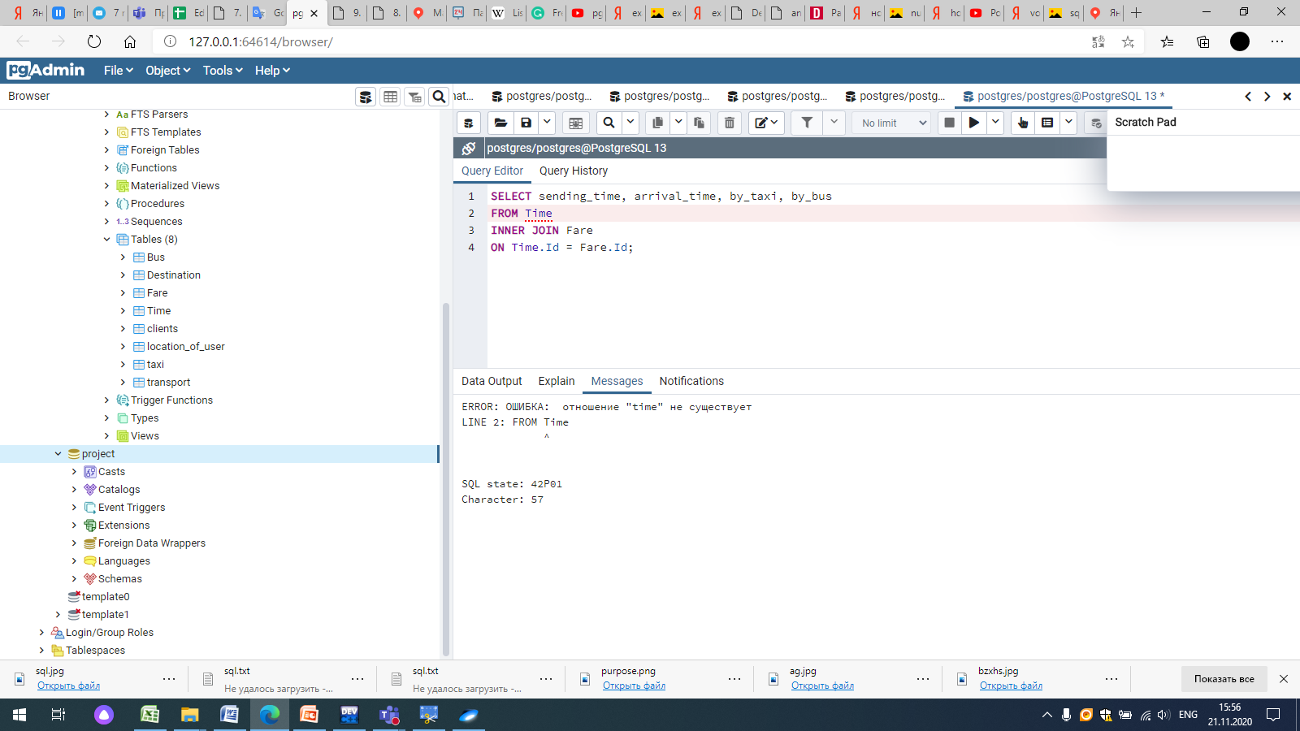
Methodology
SQL was used in order to make database of Voce based transport enquiry system
Tables:
1. “transport”
2. “Bus”
3. “Taxi”
4. “Clients”
5. “Time”
6. “Fare”
7. “Destination”
8. “Location”

Slide 6
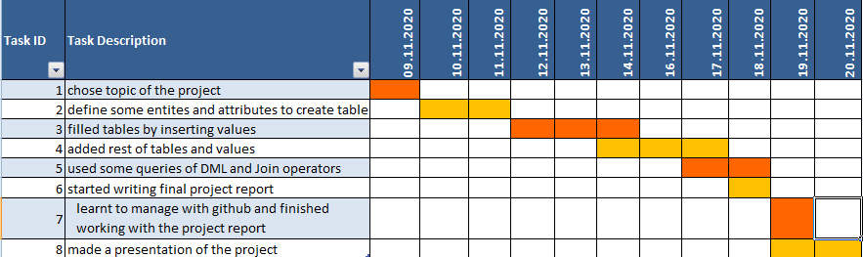

Gantt chart

Slide 7
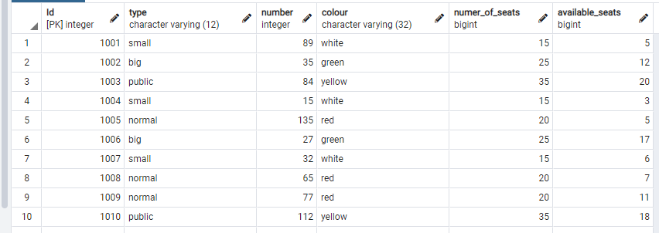
Creating database
CREATE TABLE public."Bus"
(
"Id" serial,
type character varying(12) NOT NULL,
"number" integer NOT NULL,
colour character varying(32),
numer_of_seats bigint NOT NULL,
available_seats bigint,
PRIMARY KEY ("Id")
);

Slide 8
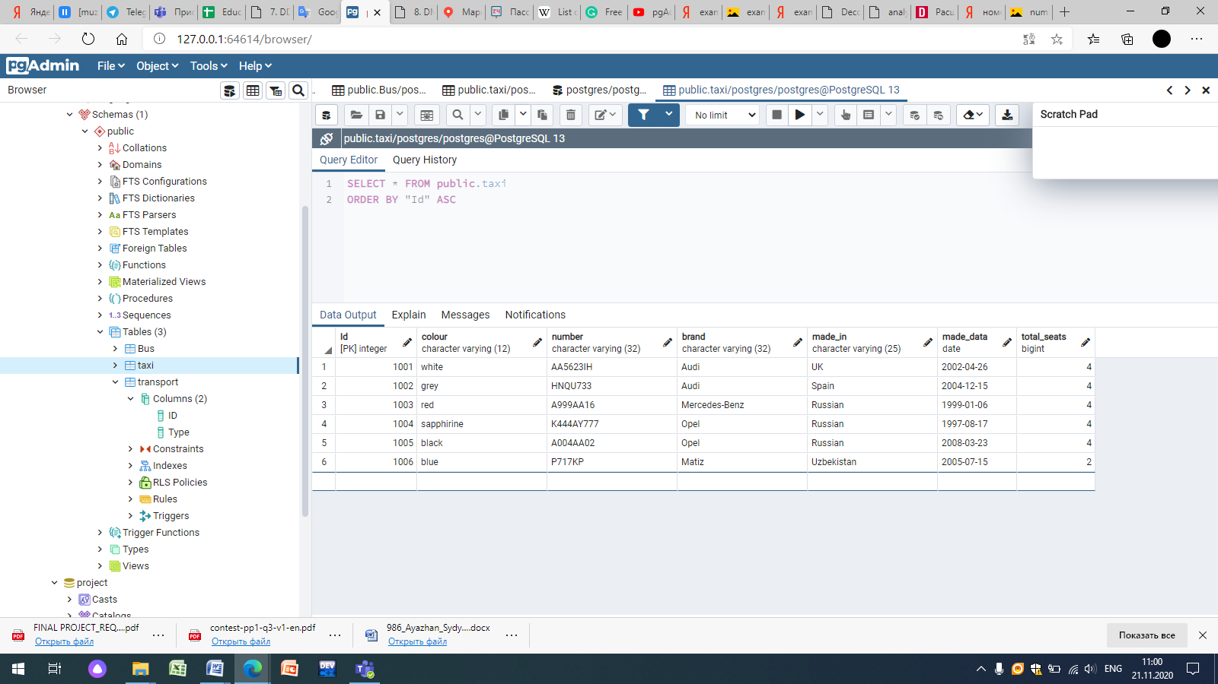
Creating database
CREATE TABLE public.taxi
(
"Id" integer NOT NULL DEFAULT nextval('"taxi_Id_seq"'::regclass),
colour character varying(12) COLLATE pg_catalog."default" NOT NULL,
"number" character varying(32) COLLATE pg_catalog."default" NOT NULL,
brand character varying(32) COLLATE pg_catalog."default" NOT NULL,
made_in character varying(25) COLLATE pg_catalog."default" NOT NULL,
made_data date NOT NULL,
total_seats bigint NOT NULL,
CONSTRAINT taxi_pkey PRIMARY KEY ("Id")
)

Slide 9
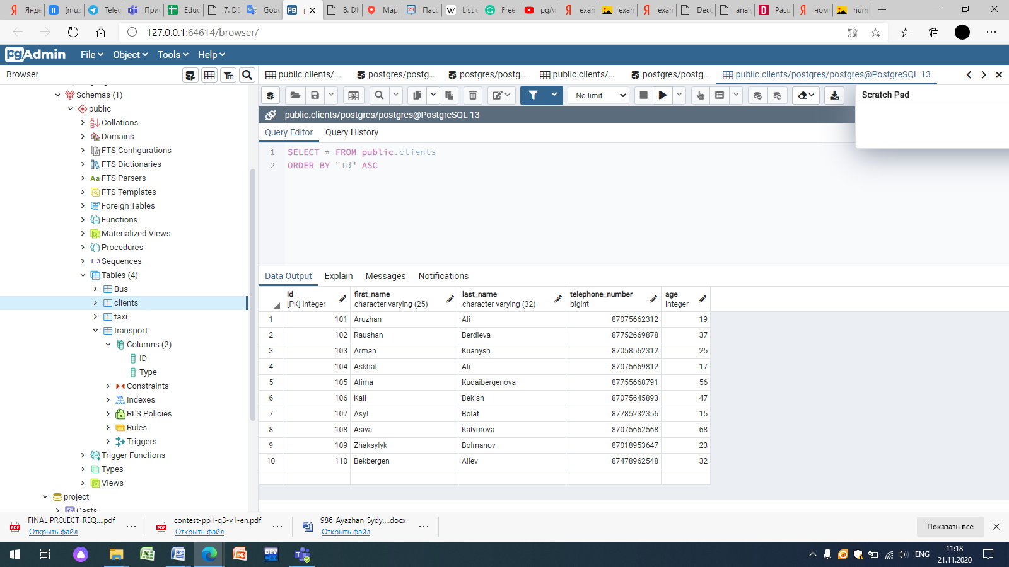
Creating Database
CREATE TABLE public.clients
(
"Id" integer NOT NULL DEFAULT nextval('"clients_Id_seq"'::regclass),
first_name character varying(25) COLLATE pg_catalog."default" NOT NULL,
last_name character varying(32) COLLATE pg_catalog."default" NOT NULL,
telephone_number bigint NOT NULL,
age integer NOT NULL,
CONSTRAINT clients_pkey PRIMARY KEY ("Id")
)

Slide 10
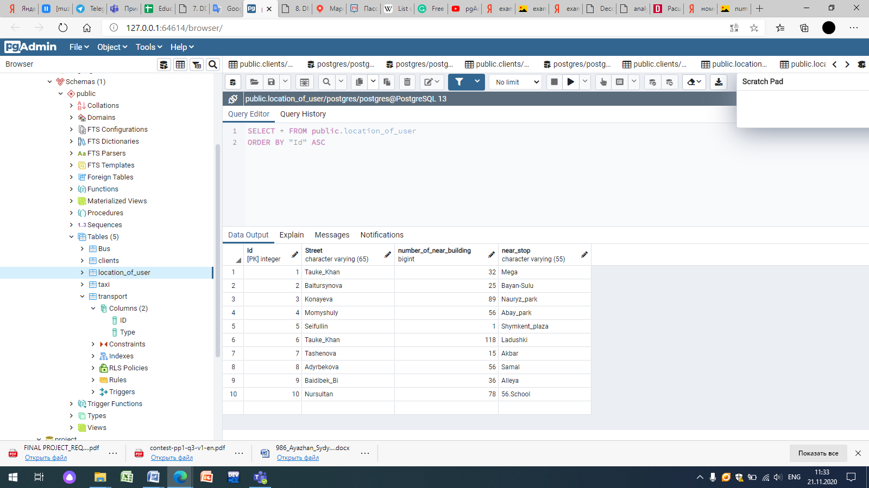
Creating Database
CREATE TABLE public."Location"
(
"Id" integer NOT NULL DEFAULT nextval('"Location_Id_seq"'::regclass),
Street character varying(255) COLLATE pg_catalog."default" NOT NULL,
number_of_ near_building varying(55) COLLATE pg_catalog."default" NOT NULL,
near_stop varying(55) COLLATE pg_catalog."default" NOT NULL,
CONSTRAINT "Location_pkey" PRIMARY KEY ("Id")
)

Slide 11
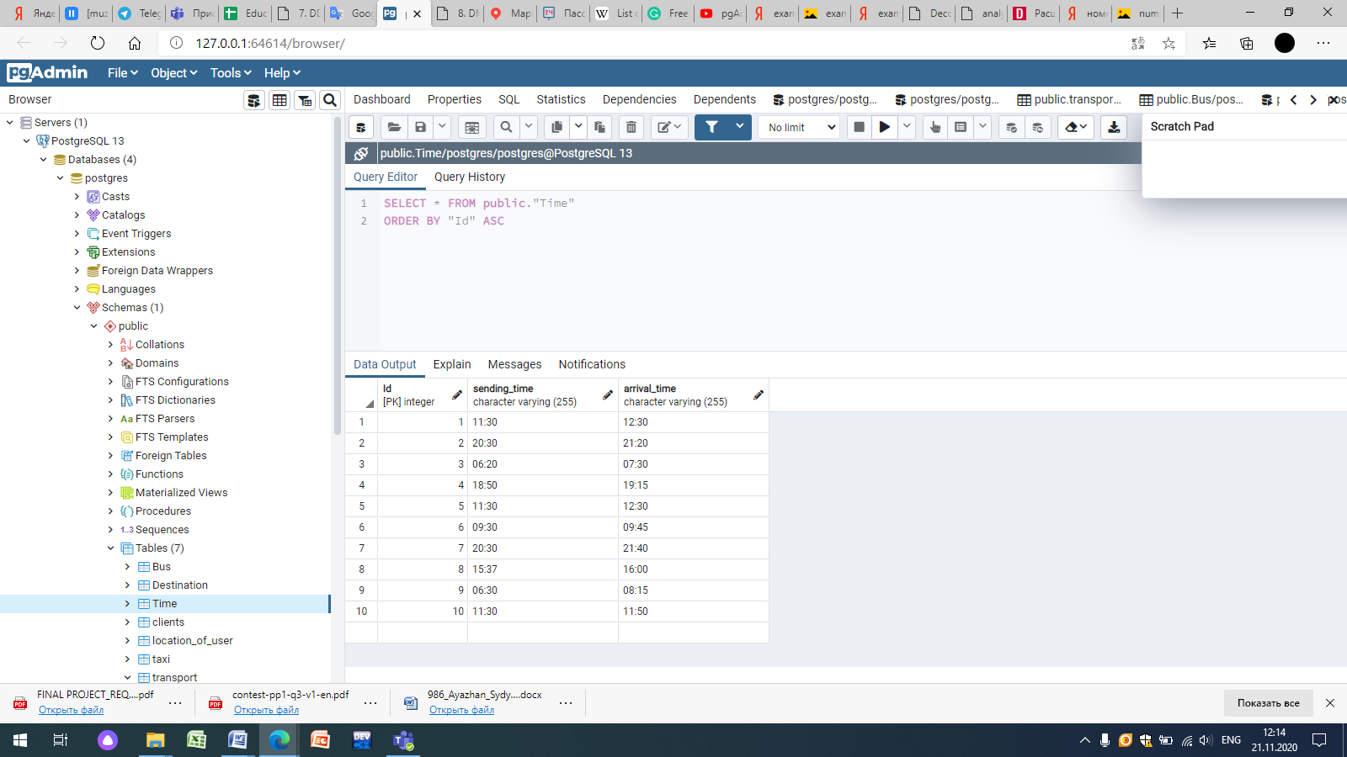
Creating Database
CREATE TABLE public."Time"
(
"Id" integer NOT NULL DEFAULT nextval('"Time_Id_seq"'::regclass),
sending_time character varying(255) COLLATE pg_catalog."default" NOT NULL,
arrival_time character varying(255) COLLATE pg_catalog."default" NOT NULL,
CONSTRAINT "Time_pkey" PRIMARY KEY ("Id")
)

Slide 12
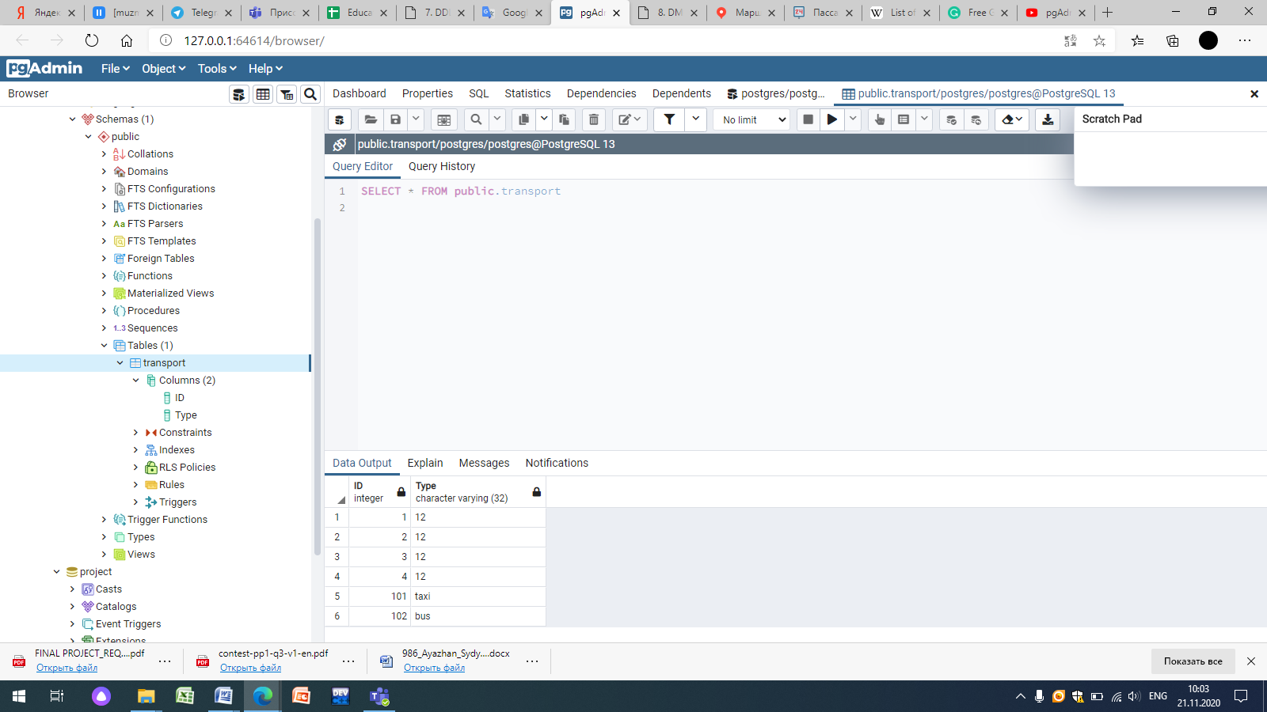
DDL: Alter table
ALTER TABLE public.transport
ADD COLUMN "ID" integer NOT NULL DEFAULT nextval('"transport_ID_seq"'::regclass);
ALTER TABLE public.transport
ADD COLUMN "Type" character varying(32) COLLATE pg_catalog."default" NOT NULL DEFAULT 12;

Slide 13
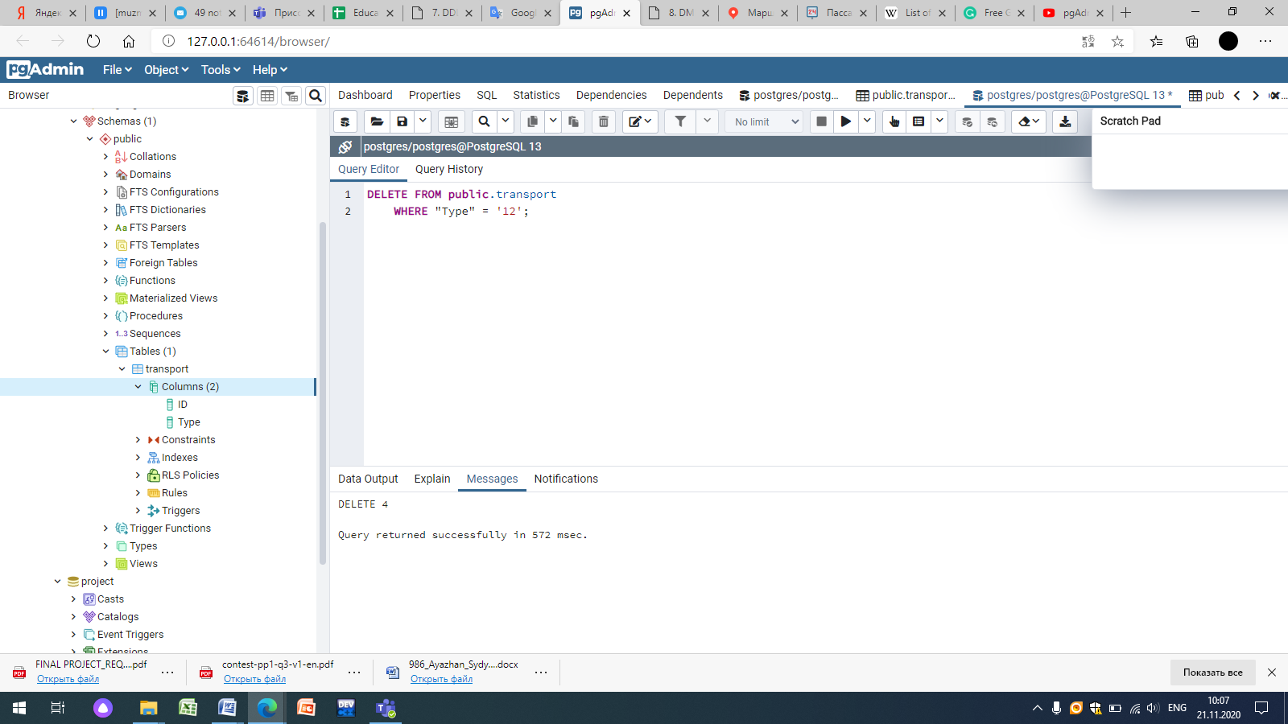
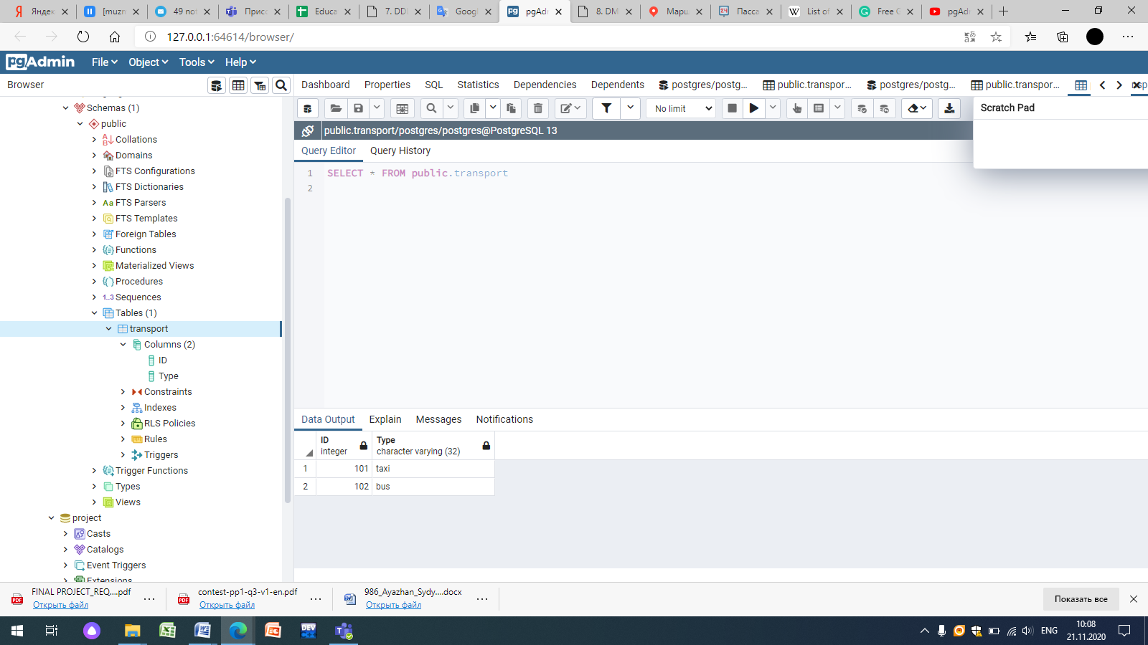
Delete: with WHERE clause

Slide 14
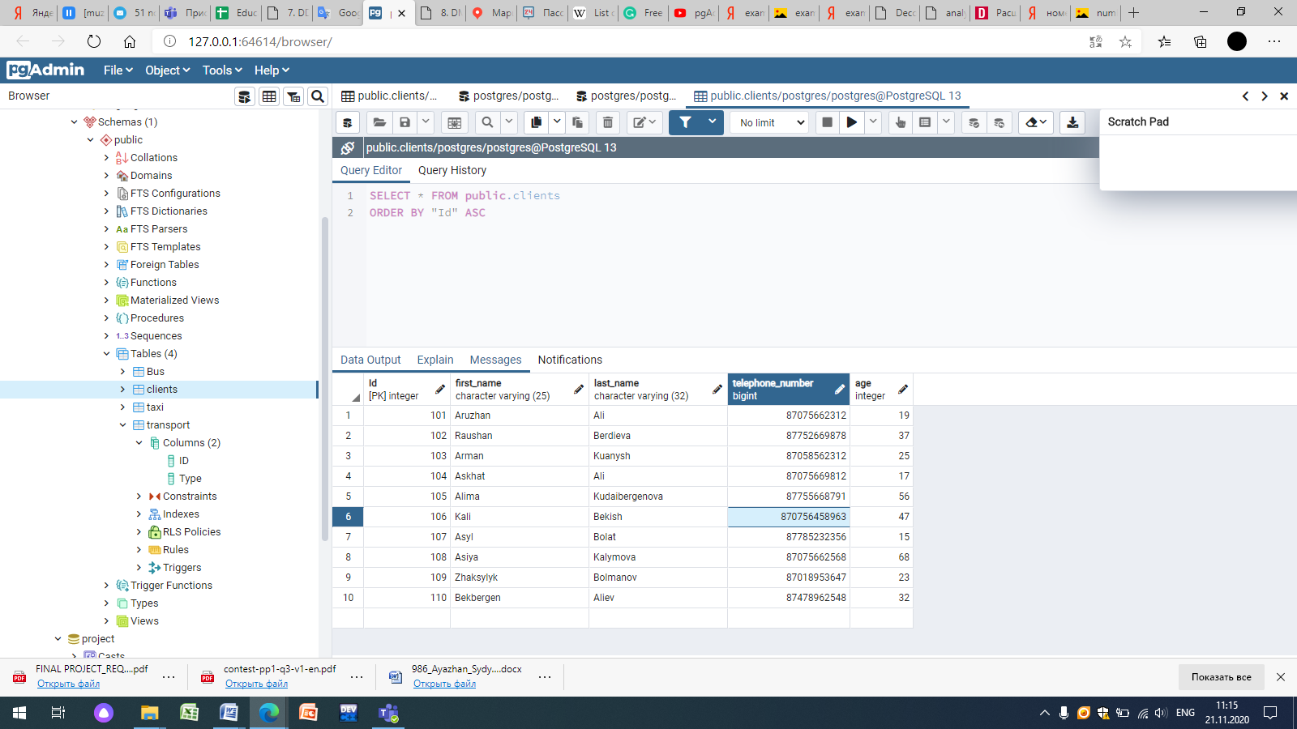
Update: with WHERE clause
UPDATE public.clients
SET telephone_number=87075645893
WHERE "Id" = 106;

Slide 15
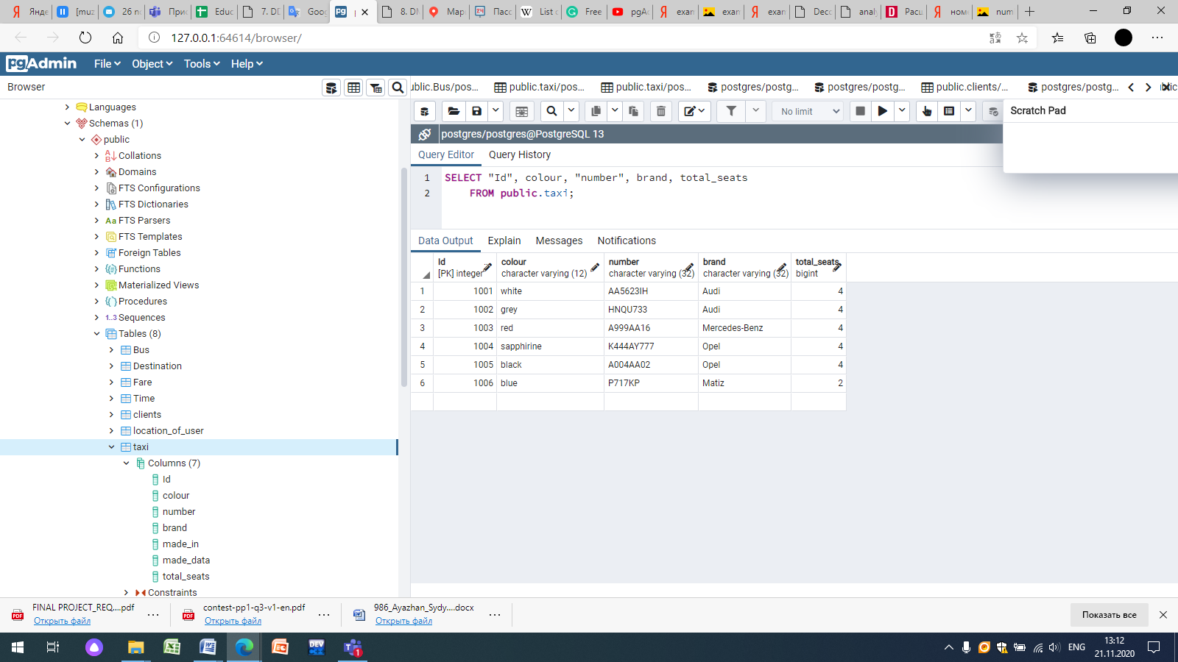
Select : without WHERE clause

Slide 16
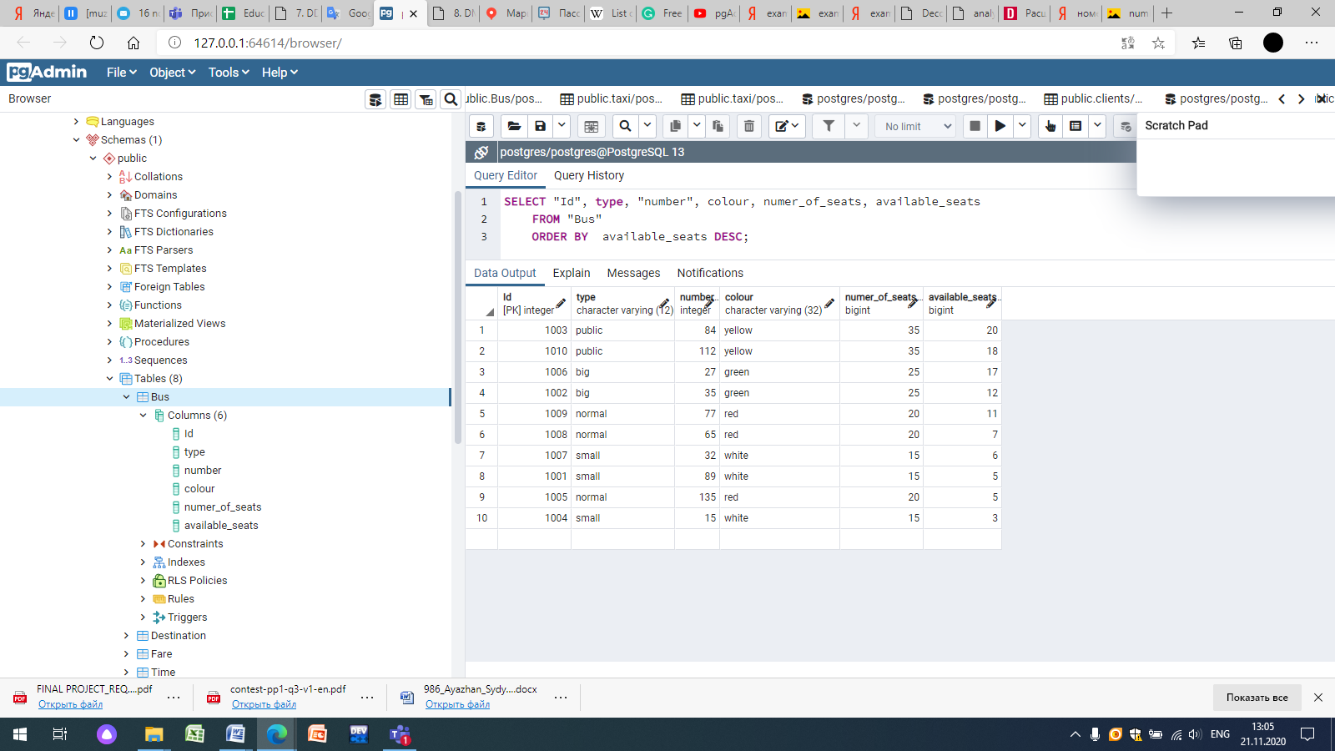
Select: with the syntax “Order By”

Slide 17
Creating database (Foreign key)
CREATE TABLE public."Fare"
(
"Id" integer NOT NULL DEFAULT nextval('"Fare_Id_seq"'::regclass),
by_taxi character varying(55) COLLATE pg_catalog."default" NOT NULL,
by_bus character varying(55) COLLATE pg_catalog."default" NOT NULL,
on_foot character varying(12) COLLATE pg_catalog."default" NOT NULL,
"time_Id" integer NOT NULL DEFAULT nextval('"Fare_time_Id_seq"'::regclass),
CONSTRAINT "Fare_pkey" PRIMARY KEY ("Id"),
CONSTRAINT "time_Id" FOREIGN KEY ("time_Id")
REFERENCES public."Time" ("Id") MATCH SIMPLE
ON UPDATE NO ACTION
ON DELETE NO ACTION
NOT VALID
)

Slide 18
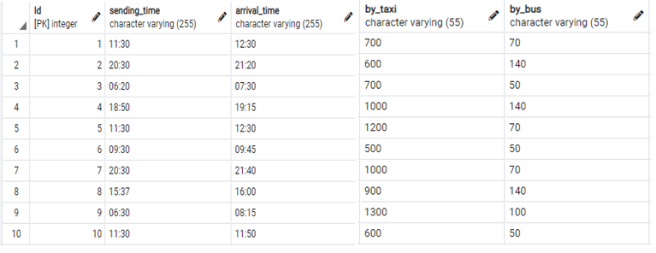
Inner Join
SELECT Fare.Id, Fare.by_taxi, Fare.by_bus, Time.sending_time, Time.arrival_time
FROM Fare
Inner Join Time
ON Fare.time_id = Time.Id;

Slide 19
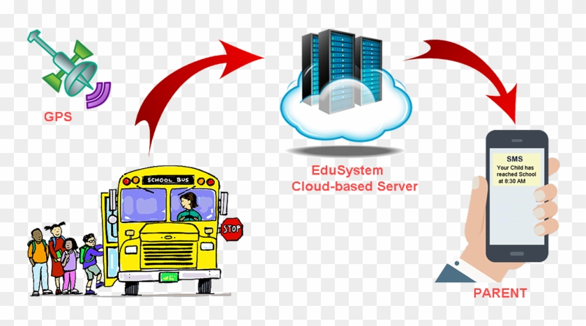
Conclusion
The main aim of mini-project was done
A bit part of social problem was solved
Availability of creating the application, which encourages the voice based transport enquiry system

Slide 20


