Slide 1

Particle Swarm Optimization (PSO)
Group Members:
Syeda Areesha Najam
Shalin Amir Ali
Sana Fatima
https://www.pinterest.com/pin/651825746046910978/

Slide 2
Project Outline
This project will look in to following:
What is PSO?
Important concepts and functions of PSO.
How PSO works?
Theoretical Analysis of PSO
Implementation of PSO
Experimental Analysis of PSO

Slide 3
What is PSO?
A population based stochastic algorithm based on metaheuristic approach.
Basic algorithm as proposed by Kennedy and Eberhart (1995)
Used in numerical optimization problems.
An inspiration from social foraging behaviors of animals.
Also classified as swarm intelligence algorithm like,
bacterial foraging algorithm
ant colony algorithm etc.
Example: predicting score of a football team using a math equation.

Slide 4
Important concepts and functions in PSO. (1/4)
Concepts:
As it is a population based method, it works iteratively until the terminal point is reached
Uses many particles (referred to as swarm) which are moving in search for best solution
Each particle has its fitness value which is evaluated by the fitness function
All the particle has certain velocities which directs the flying of the particles
Particles fly through the space by following the current optimum particles

Slide 5
Important concepts and functions in PSO. (2/4)
How does it work or functions?
It starts with a group of random particles.
Searches for the optimal value by updating generations.
Particles move in the solution space and are evaluated according to a fitness criteria.
After every iteration, the "best" values of each particle is updated i.e.
Pbest (personal best)
Gbest (global best)

Slide 6
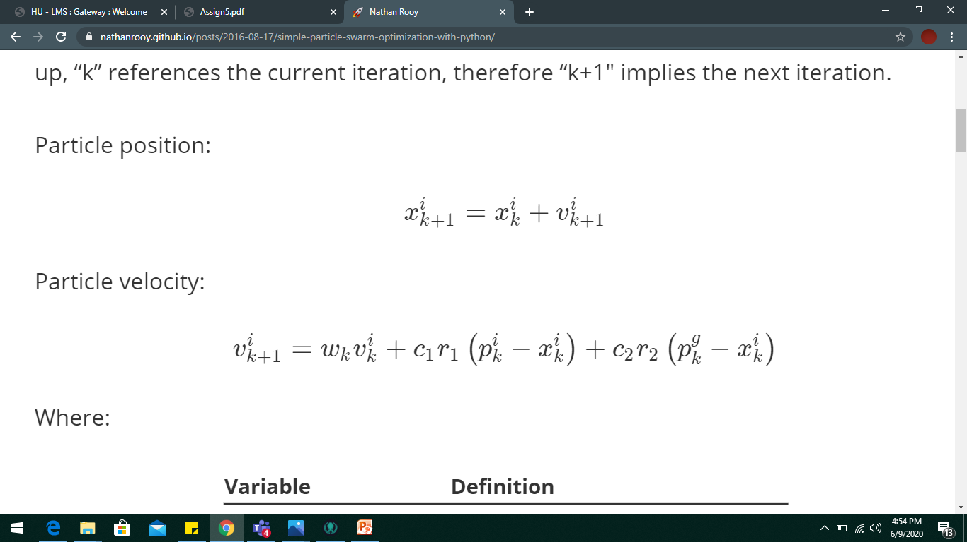
Important concepts and functions in PSO. (3/4)
Mathematical Model of PSO:
Some basic equations:
Position of individual particles updated as follows:
With the velocity calculated as follows:
Distance to the Personal Best.
Distance to the Global Best.
Inertia
Current velocity

Slide 7
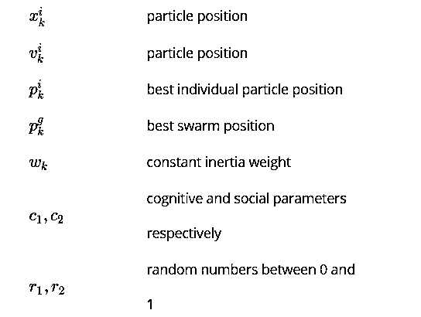
Important concepts and functions in PSO. (4/4)
Where, k is current iteration number and,
And,
Cognitive Component
Social Component

Slide 8
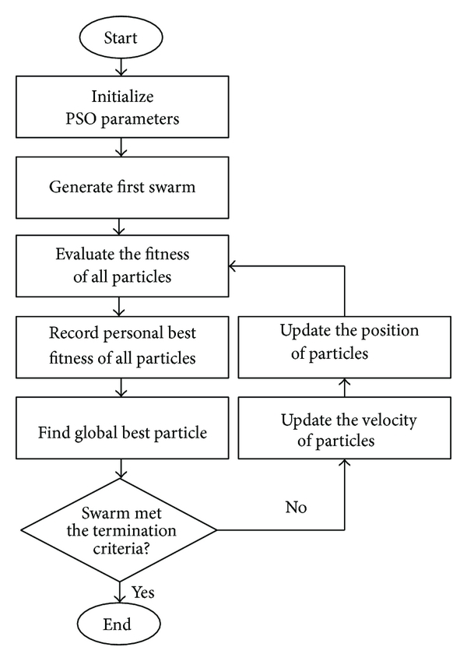
PSO Flowchart: An approach towards PSO problem

Slide 9
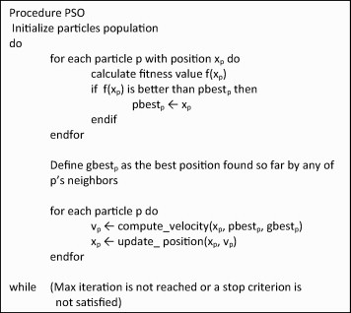
PSO Algorithm:
Update:
Fitness value
Personal best value of each particle
Global best value
Calculate new velocity and position of each particle to achieve the global best function value in every iteration.

Slide 10
Theoretical Analysis (time complexity)
Worst Case : O(n²)
O(n)
O(1)
O(1)
O(1)
O(1)
O(n)
O(1)
O(1)
O(n)

Slide 11
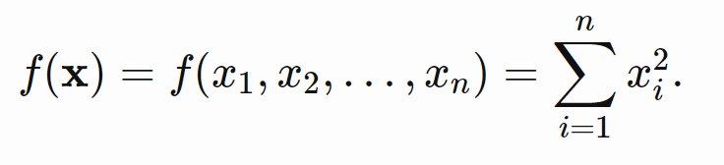
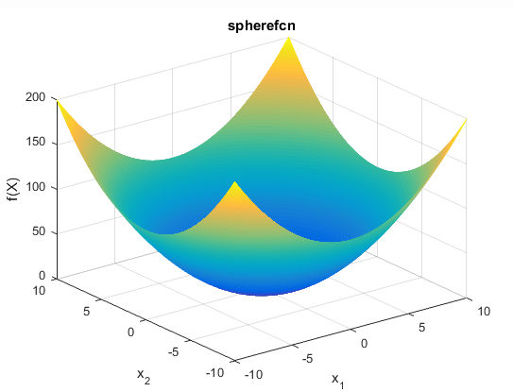

Implementation of PSO (1/2)
Our first test function for which we would find the global minimum is (Function of Sphere):
Where sample bounds of our function are :
$x_{min}$= -5.12
$x_{max}$= 5.12

Slide 12
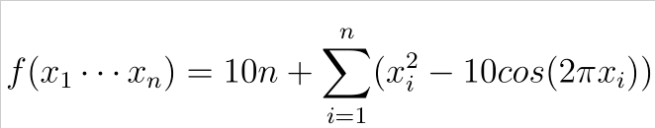
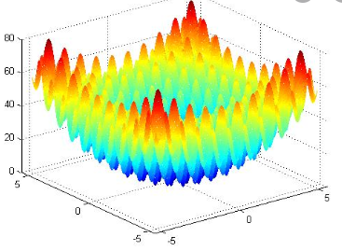

Implementation of PSO (1/2)
Our second test function for which we would find the global minimum is (Rastrigin Function):
Where sample bounds of our function are :
$x_{min}$= -5.12
$x_{max}$= 5.12

Slide 13
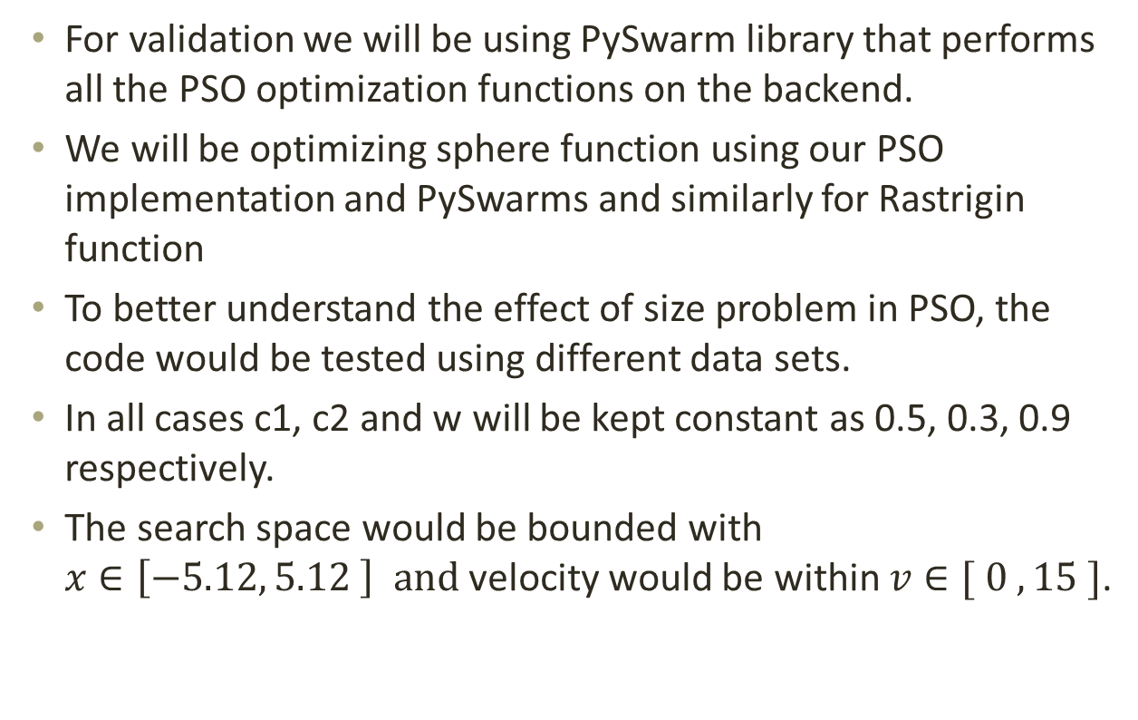
Experimental Analysis:
For validation we will be using PySwarm library that performs all the PSO optimization functions on the backend.
We will be optimizing sphere function using our PSO implementation and PySwarms and similarly for Rastrigin function
To better understand the effect of size problem in PSO, the code would be tested using different data sets.
In all cases c1, c2 and w will be kept constant as 0.5, 0.3, 0.9 respectively.
The search space would be bounded with $x∈\left[−5.12, 5.12 \right] and$velocity would be within $v∈[ 0 , 15 ]$.

Slide 14
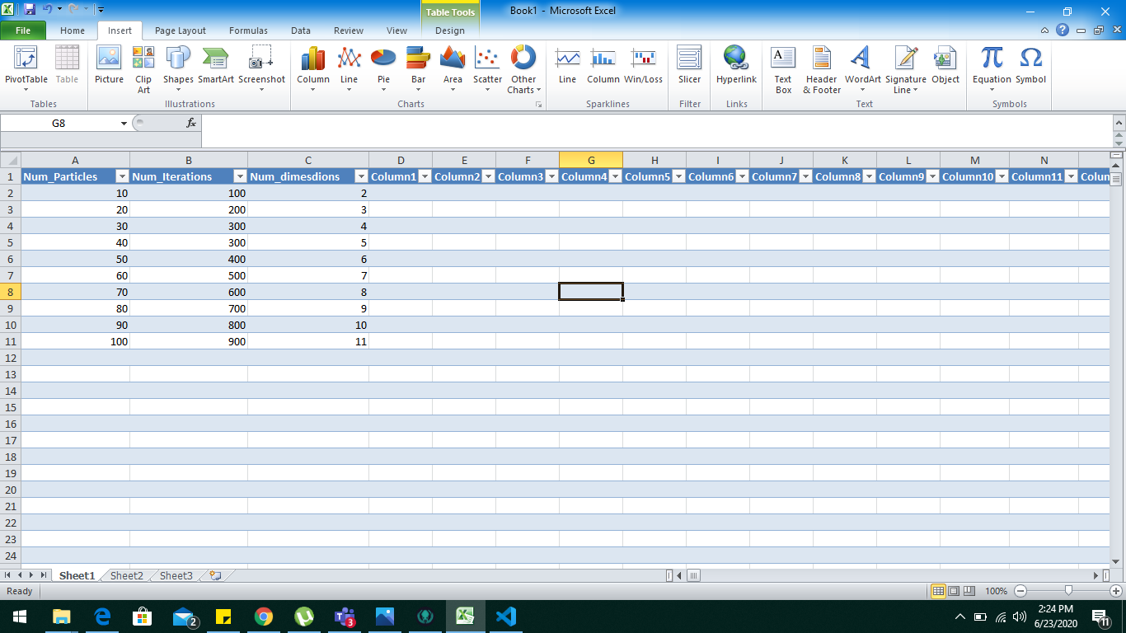
Experimental Analysis:
We’ll test Sphere and Rastrigin function on following test cases,
Num_Particles = 20
Num_Dimensions =2
Num_Iterations = 50
Num_Dimensions =2
Num_Particles = 20
Num_Iterations =50

Slide 15
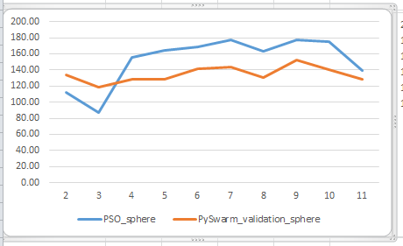
Graphs (1/2): Case 1:
y-axis = time(s)
x-axis = Num_dimensions

Slide 16
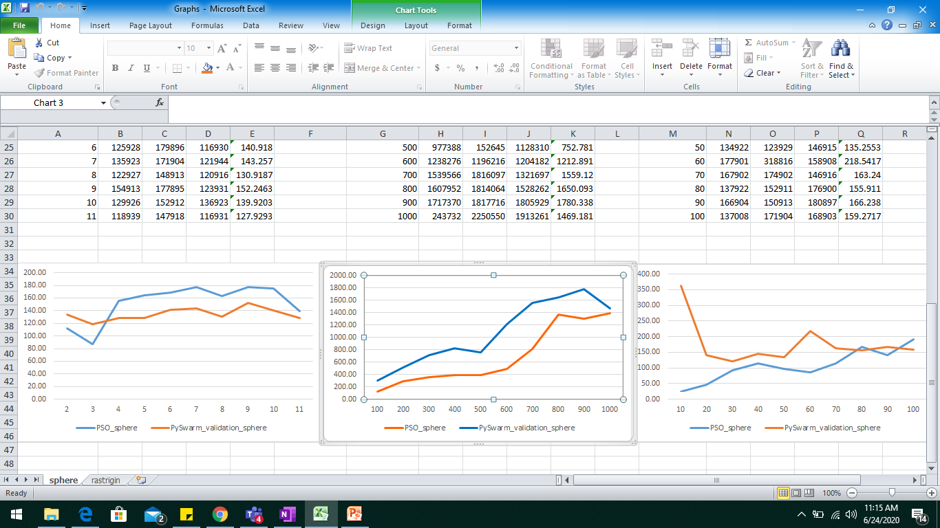
Graphs (2/2): Case 2:
y-axis = time (s)
x-axis = Num_iterations

Slide 17
Applications of PSO
The Analysis of Basketball Free Throw Trajectory using PSO Algorithm
Heating system planning problem (HSP)

Slide 18
Project Outcomes:
Outcomes Completed:
Concepts and mathematical model behind PSO
Python implementation of Algorithm
Theoretical complexity Analysis
Experimental Analysis and Validation

Slide 19
References:
https://www.researchgate.net/figure/The-pseudocode-of-the-PSO-algorithm_fig8_274460300
https://www.hindawi.com/journals/tswj/2014/973093/fig1/
https://pt.slideshare.net/MohamedTalaat9/digital-image-forgery?next_slideshow=1
https://slideplayer.com/slide/12229714/
https://nathanrooy.github.io/posts/2016-08-17/simple-particle-swarm-optimization-with-python/
http://benchmarkfcns.xyz/benchmarkfcns/spherefcn.html

