Slide 1
RTCUDA (A Software Tool for CUDA Code Restructuring)
By
Dr. Ayaz ul Hassan Khan
Email: ayazhk@gmail.com

Slide 2
Features
Simplify writing high performing CUDA program
Modular Approach: based on ANTLR framework
Tested on Fermi and Kepler Architectures
Easy to extend for supporting various architectures
Provides:
GPU Memory Optimizations, Kernel Configurations, Synchronization, and Data Transfer Mechanisms
GPU Resource Optimization:
Auto-tuning to find optimal set of CUDA kernel parameters
Generate Optimized CUDA parallel program from a given sequential C program
API functions to call highly optimized library routines for dense and sparse matrices
Synchronization primitives for inter-block synchronization
Supports multi-kernel conversions

Slide 3
Optimization Specifications

Slide 4
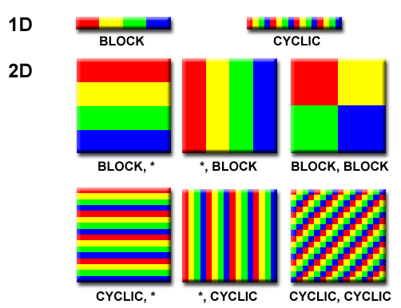
Optimizations Specifications
Input/Output GPU Memory Allocation
Allocating memory for GPU input and output
Explicit transfer of data between host (CPU) and device (GPU)
Computation Partitioning and Decomposition
Problem iteration space partitioning
Block – level and Thread – level Parallelism
Appropriate block/tile size to fit in the cache/shared memory
Perform related transformations

Slide 5
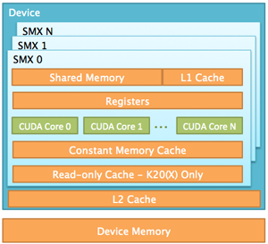
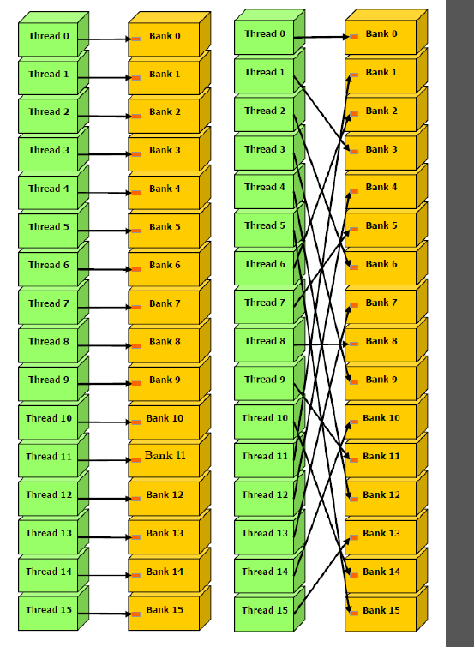
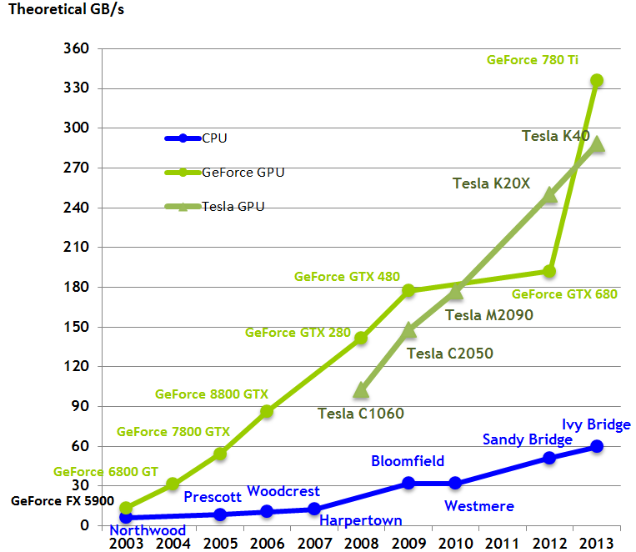
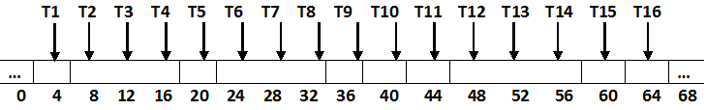
Optimizations Specifications
Locality optimizations and Datacopy Transformations
Explicit copy of data into lower level portions
Utilize special memories such as constant and texture caches
Efficient shared memory and register file usages per thread block
Parallel Memory Bandwidth
Increased memory bandwidth by
Coalesced global memory access
Bank conflict free shared memory access

Slide 6
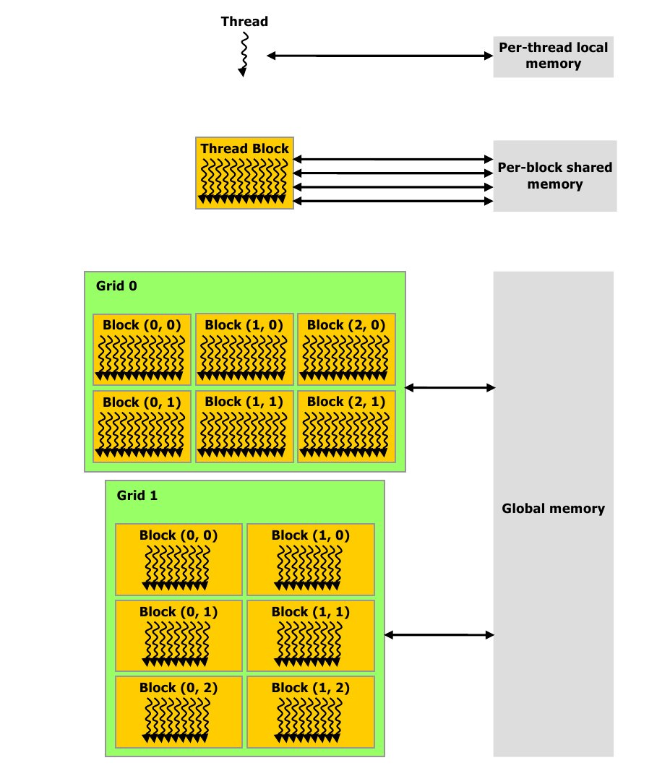
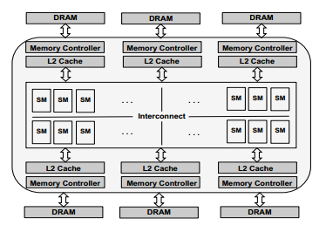
Optimizations Specifications
Optimization of Architectural Parameters
To set optimal thread granularity, block size, grid size
Better resource management and machine occupancy
Required auto-tuning mechanism
Use of automatic compiler optimization and/or programmer-guided optimization
User choices for compiler optimizations
Synchronization across SMs
Avoiding expensive inter-block synchronization
No global synchronization mechanisms except the kernel exit/re-entry

Slide 7
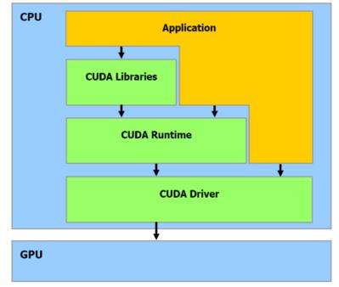
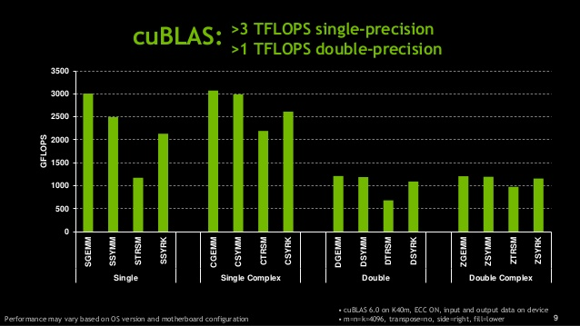
Optimizations Specifications
Invocation of Optimized external Libraries
optimized at lower level programming
Examples:
cuBLAS for dense linear algebra
cuSparse for sparse arrays
Library details are hidden from the user
But requires full understanding of parameters and related implementation logic

Slide 8
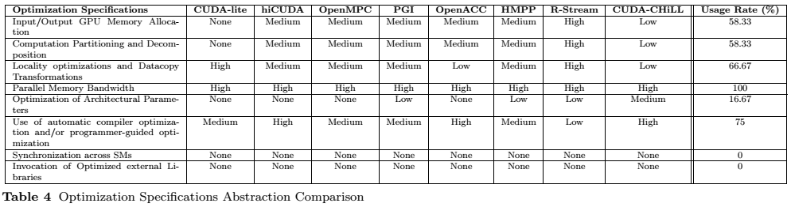
Optimization Specifications Comparison among Different Tools

Slide 9
RT-CUDA Code Transformation Strategy

Slide 10
Restructuring Algorithm

Slide 11
CUDA Kernel Optimizations in RTA-CUDA

Slide 12
RT-CUDA Design

Slide 13
RT-CUDA Implementation

Slide 14
RT-CUDA Examples

Slide 15
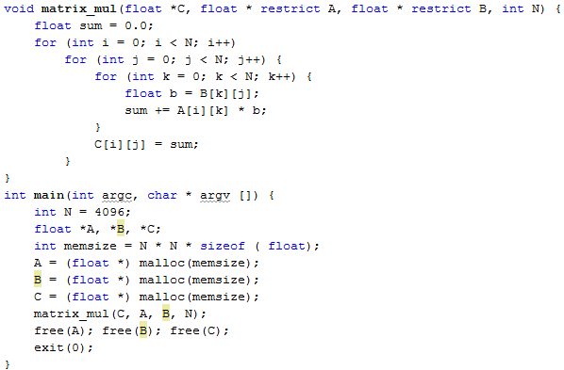
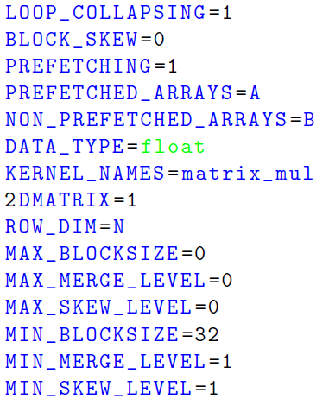
RT-CUDA Example: Matrix-Matrix Multiplication (Input)

Slide 16
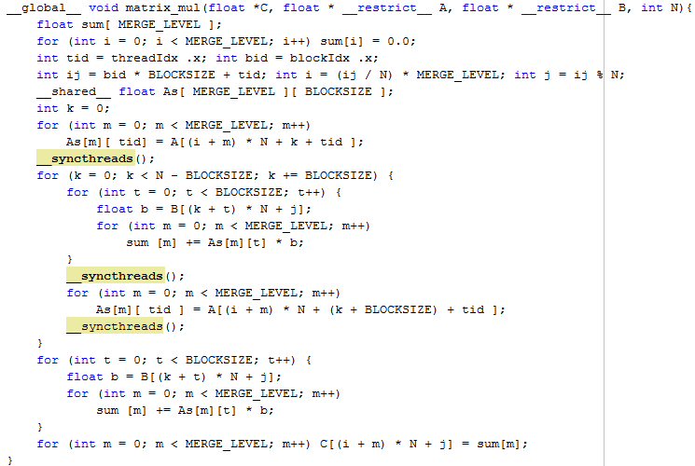
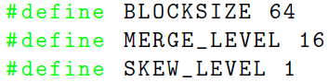
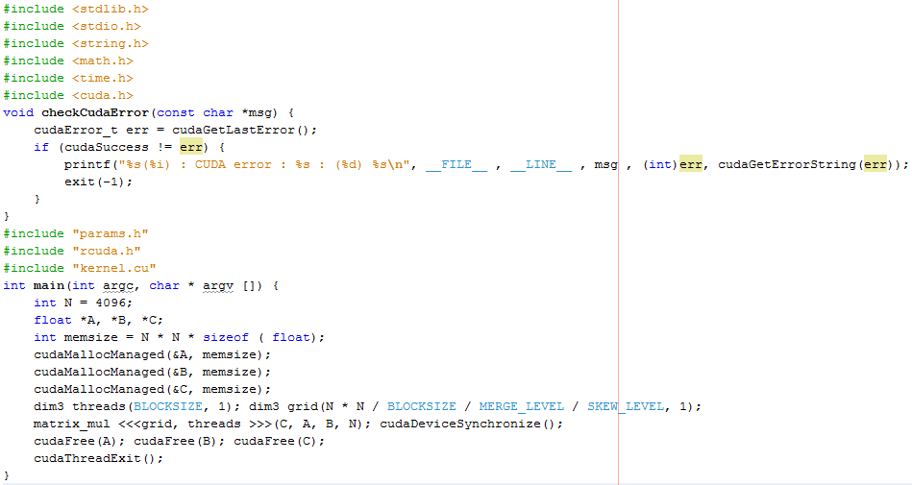
RT-CUDA Example: Matrix-Matrix Multiplication (Output)

Slide 17
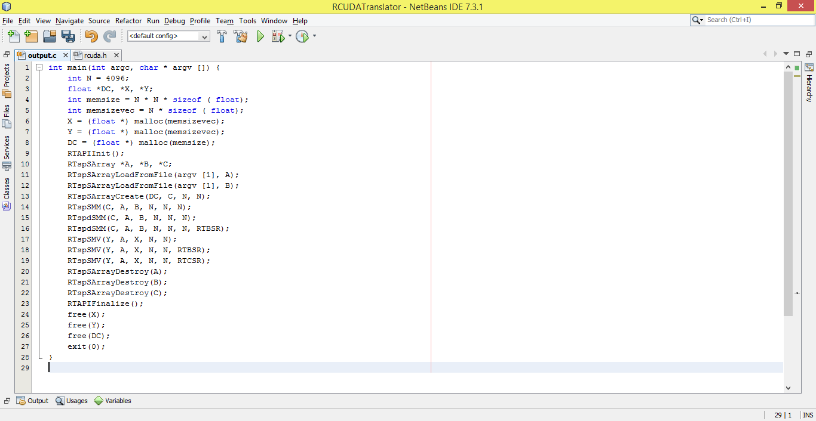
RT-CUDA Example: Sparse Matrix Operators using RT-CUDA API (Input)

Slide 18
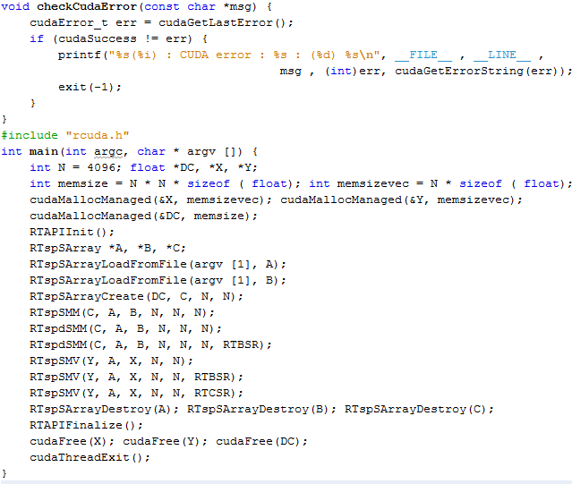
RT-CUDA Example: Sparse Matrix Operators using RT-CUDA API (Output)

Slide 19
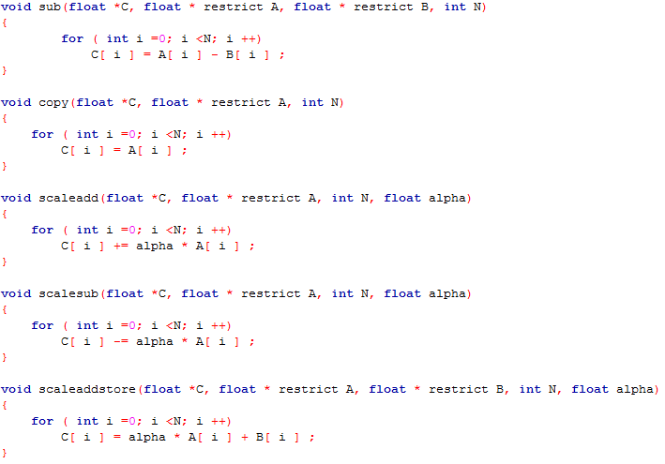
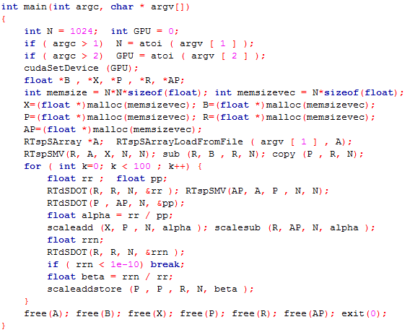
RT-CUDA: Conjugate Gradient using RT-CUDA aPI and Custom Merge operations – (Input) (Multi-Kernel Conversions)

Slide 20
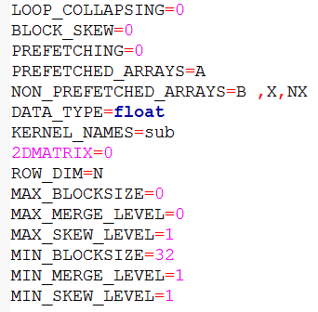
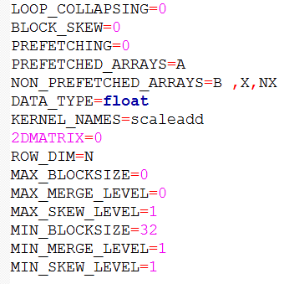
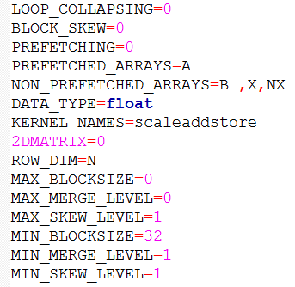
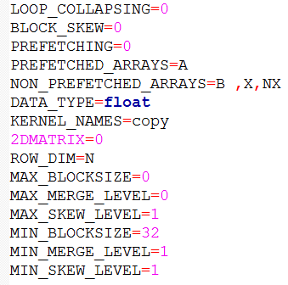
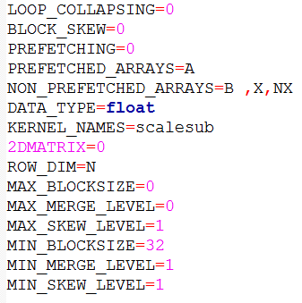
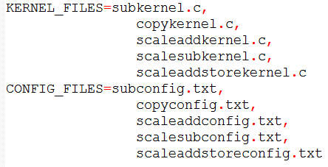
RT-CUDA: Conjugate Gradient using RT-CUDA aPI and Custom Merge operations – (Configurations) (Multi-Kernel Conversions)

Slide 21
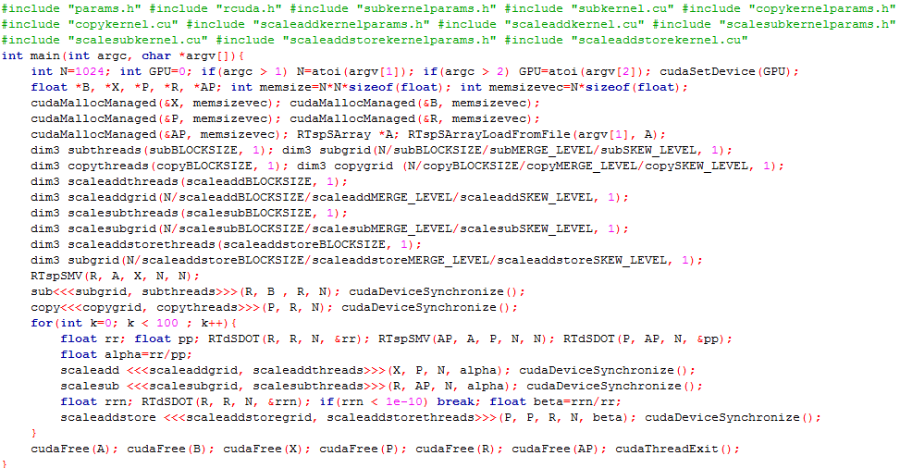
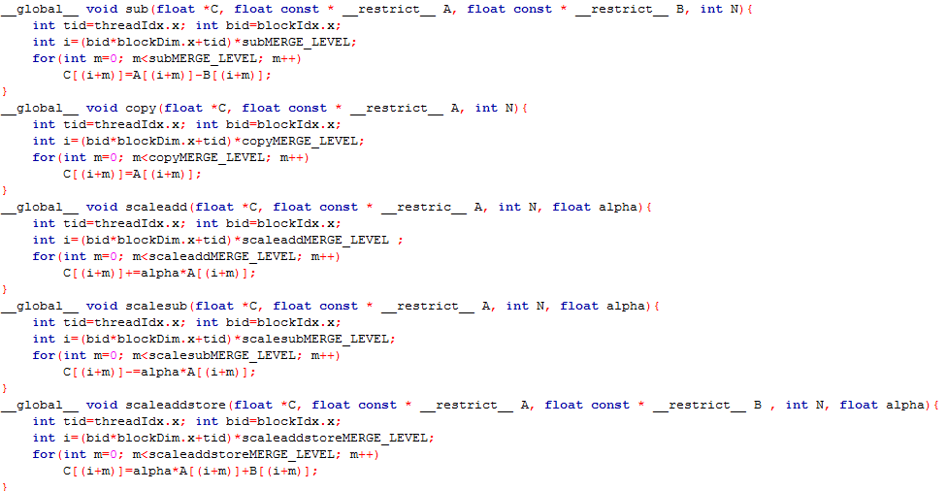
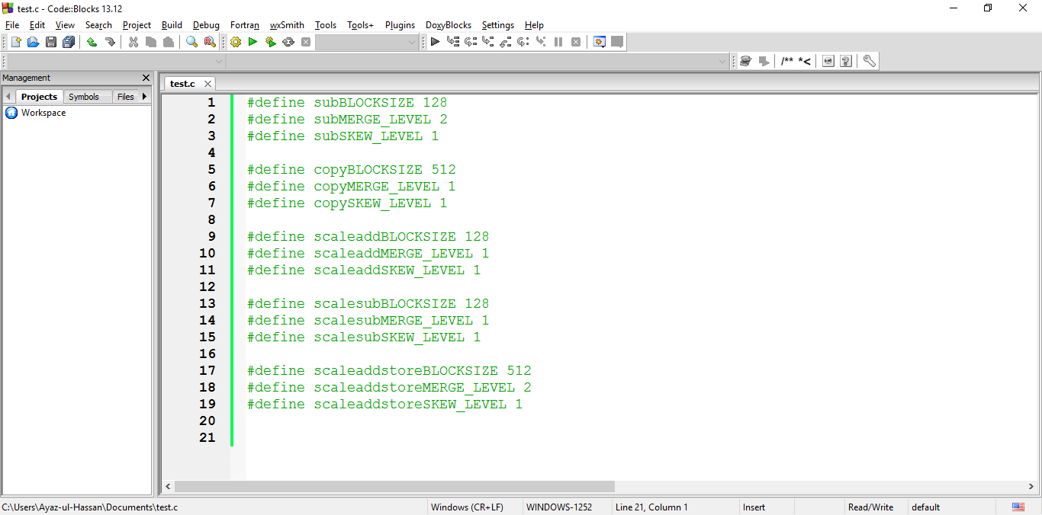
RT-CUDA: Conjugate Gradient using RT-CUDA aPI and Custom Merge operations – (Output) (Multi-Kernel Conversions)

Slide 22
Performance Evaluation

Slide 23
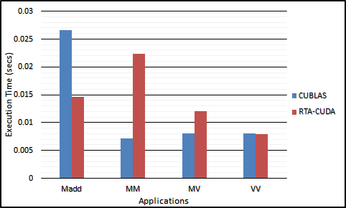
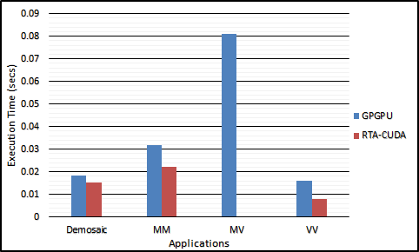
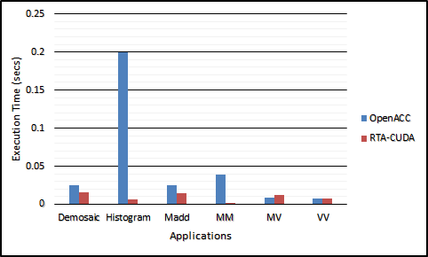
Evaluation of Basic Linear Algebra Operations

Slide 24
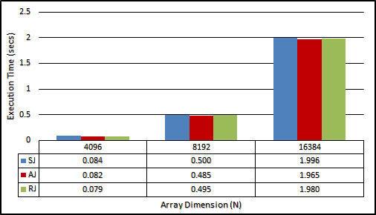
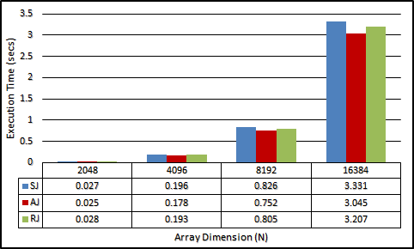
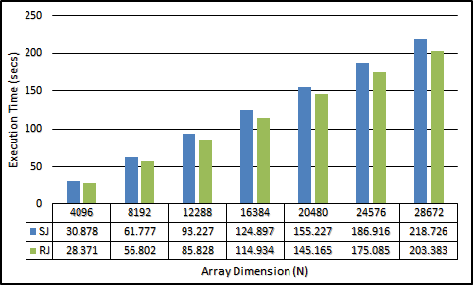
Evaluation of Inter-Block Synchronization Primitives
Single Precision
Double Precision

Slide 25
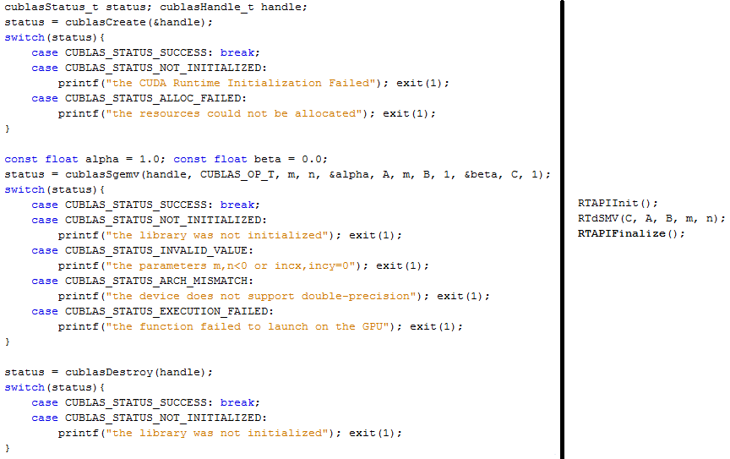
Effects of Calling External CUBLAS Functions

Slide 26
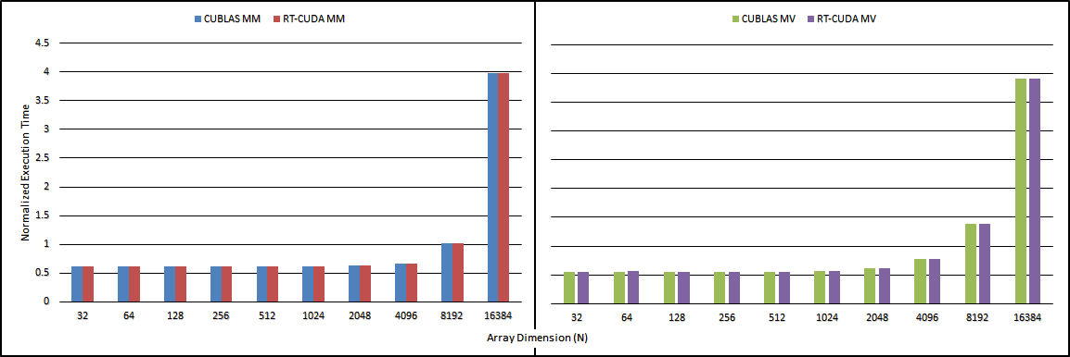
Effects of Calling External CUBLAS Functions

Slide 27
Effects of Calling External CUBLAS Functions

Slide 28
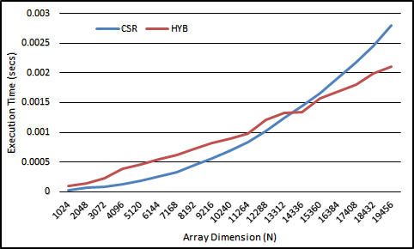
Effects of Sparse Matrix Operations using CUDA Sparse Library Routines

Slide 29
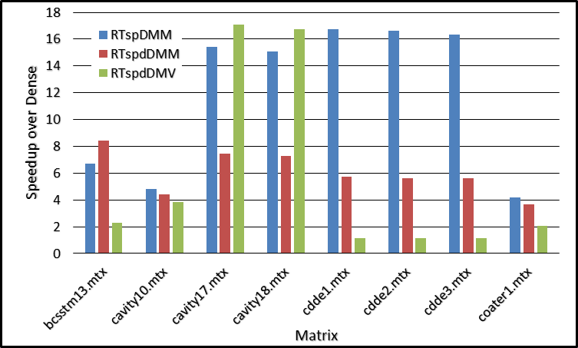
Effects of Sparse Matrix Operations using CUDA Sparse Library Routines

Slide 30
Conclusion and Future Work
Performance evaluation of the tool has been performed using basic linear algebra operations including Lapack BLAS benchmark, Jacobi iterative solver with different inter-block synchronization primitives, dense and sparse matrix operations
Testing of the tool has been performed by some graduate students based on a set of 10 testing cases with progressive difficulties ranging from simple vector matrix operations to full solver of linear system of equations
RT-CUDA Possible Enhancements:
Add more optimizations suitable for emerging GPU architectures such as Maxwell
More API functions can be added from cuBLAS and cuSparse libraries with different sparse matrix formats

