Slide 1
FITTLYF ASSIGNMENT SUBMITTED BY : AYAZ KHAN

Slide 2
DATA PREPROCESSING
For the Actual Productivity column, which contains missing values, we impute these missing values by replacing them with the mean of the column. This method assumes that the missing data generally follows the trend of the column's distribution, allowing us to retain the integrity of the dataset without losing valuable information.
For columns such as Targeted Productivity, Overtime, and No. of Workers, which contain non-numeric values, we convert any invalid entries to NaN and subsequently replace these non-numeric values with the mean of the respective column. This ensures that these columns are kept numeric and consistent for analysis. If the non-numeric values are scattered randomly and do not align with the general data trend, we consider dropping the affected rows.
Additionally, any duplicate rows in the dataset are identified and removed, keeping only the first occurrence, to avoid repetition of information and ensure that the data remains clean and reliable for further analysis.

Slide 3
PCA ANALYSIS
Explained Variance Ratios: - PC1: 45.01% - PC2: 33.46% - PC3: 14.88% - PC4: 6.65% -
Number of Principal Components Explaining 90% Variance: 3 –
Feature Contributions: -
PC1: Targeted Productivity: -0.2860, Overtime: 0.6561, No. of Workers: 0.6539, Actual Productivity: -0.2453 –
PC2: Targeted Productivity: -0.6419, Overtime: -0.2619, No. of Workers: -0.2688, Actual Productivity: -0.6686 –
PC3: Targeted Productivity: -0.7112, Overtime: -0.0110, No. of Workers: -0.0367, Actual Productivity: 0.7019

Slide 4
Predictive Modeling and Time Series Analysis
- ARIMA Model Performance:
RMSE: 0.0325197
MSE: 0.00105
MAPE: 0.03293

Slide 5
Predictive Modeling and Time Series Analysis
Dickey-Fuller Test for Stationarity:
Initial Test: Conducted the Augmented Dickey-Fuller (ADF) test to check for stationarity in the data.
Result: The initial p-value was greater than 0.05, indicating that the data was non-stationary.
Conversion to Stationary Data:
Method Used: Applied differencing techniques to convert the data to a stationary form.
Result: After differencing, the data became stationary and was ready for modeling.
Identification of ARIMA Parameters (p, d, q):
Approach: Determined the appropriate values for ARIMA model parameters (p, d, q) using the first-difference method.
Model Setup: The values of p, d, and q were selected based on the ACF and PACF plots.(2,0,2)
Productivity Forecasting:
Model Used: Built and trained the ARIMA model with the selected (p, d, q) values.
Prediction: Used the model to forecast productivity for the next four quarters.

Slide 6
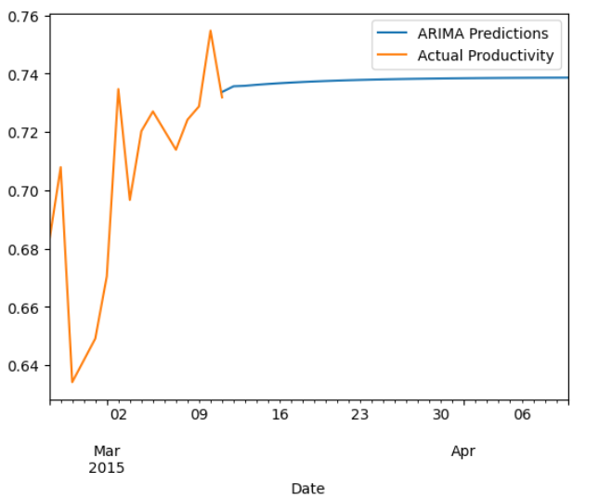
FORECASATING FOR NEXT FOUR QUARTERS
.

Slide 7
Department Value Analysis
Department Value Calculation: - Both departments have an equal and very low Department Value of 0.000002. –
Implications: - Indicates inefficiency or a misalignment between spending and productivity. - Suggests that the current budget allocation does not significantly impact productivity. –
Insights: - Need to address inefficiencies and explore alternative strategies to improve productivity.

Slide 8
Thank you
Khan.15@iitj.ac.in
8707084683

