Slide 1

Project Title – Seasonal Agriculture Performance Analysis
MOHAMMAD AYAZ QURESHI
JAMIA MILLIA ISLAMIA
AICTE STU ID : STU6a663c5ae7ee41785085018

Slide 2

PROBLEM STATEMENT
Agricultural activities are influenced by seasonal variations in environmental conditions, farming practices, resource availability and market conditions. As a result, agricultural performance may differ from one season to another. However, raw agricultural data does not clearly explain how agricultural performance changes across seasons or what patterns can be observed in different seasonal conditions. The problem is to analyze the given agricultural dataset and investigate seasonal differences in agricultural performance by identifying meaningful patterns, trends, relationships and variations within the available data.

Slide 3
Project Description This project analyzes agricultural performance across Kharif, Rabi and Zaid seasons using data on crop yield, production, environmental conditions, resource usage and financial outcomes. The analysis uses Python, Pandas and Matplotlib to clean and explore the dataset, compare seasonal and crop-wise performance, study relationships between agricultural factors and yield, and identify differences in profitability and resource efficiency. The findings are used to identify high-performing crops, seasonal patterns, resource-use trends and areas for improving agricultural productivity and profitability.

Slide 4

WHO ARE THE END USERS?
Farmers – To understand seasonal crop performance, resource use and profitability.
Agricultural Planners – To support seasonal planning and resource allocation.
Government & Policymakers – To identify agricultural trends and improve decision-making.
Agribusinesses – To evaluate crop profitability, production and market-related performance.
Researchers & Students – To study seasonal agricultural patterns and relationships.
Farmers – To understand seasonal crop performance, resource use and profitability.
Agricultural Planners – To support seasonal planning and resource allocation.
Government & Policymakers – To identify agricultural trends and improve decision-making.
Agribusinesses – To evaluate crop profitability, production and market-related performance.
Researchers & Students – To study seasonal agricultural patterns and relationships.

Slide 5

Technology Used
Python – Main programming language for data analysis
Jupyter Notebook – Development environment
Pandas – Data cleaning, manipulation and analysis
Matplotlib – Data visualization and charts
SciPy – Statistical analysis and ANOVA testing

Slide 6
RESULTS
Key Results from the Analysis
* Kharif recorded the highest average crop yield at 5.64 tonnes/ha.
* Kharif also achieved the highest average profit of approximately ₹1.79 lakh.
* Zaid had the lowest average yield (4.67 tonnes/ha) and an average loss of ₹26,592.
* Sugarcane was the strongest-performing crop, with an average profit of approximately ₹8.17 lakh.
* Drip irrigation showed the highest average yield (6.62 tonnes/ha) and profit (₹2.20 lakh).
* Water used and crop yield showed a positive correlation of 0.389.

Slide 7
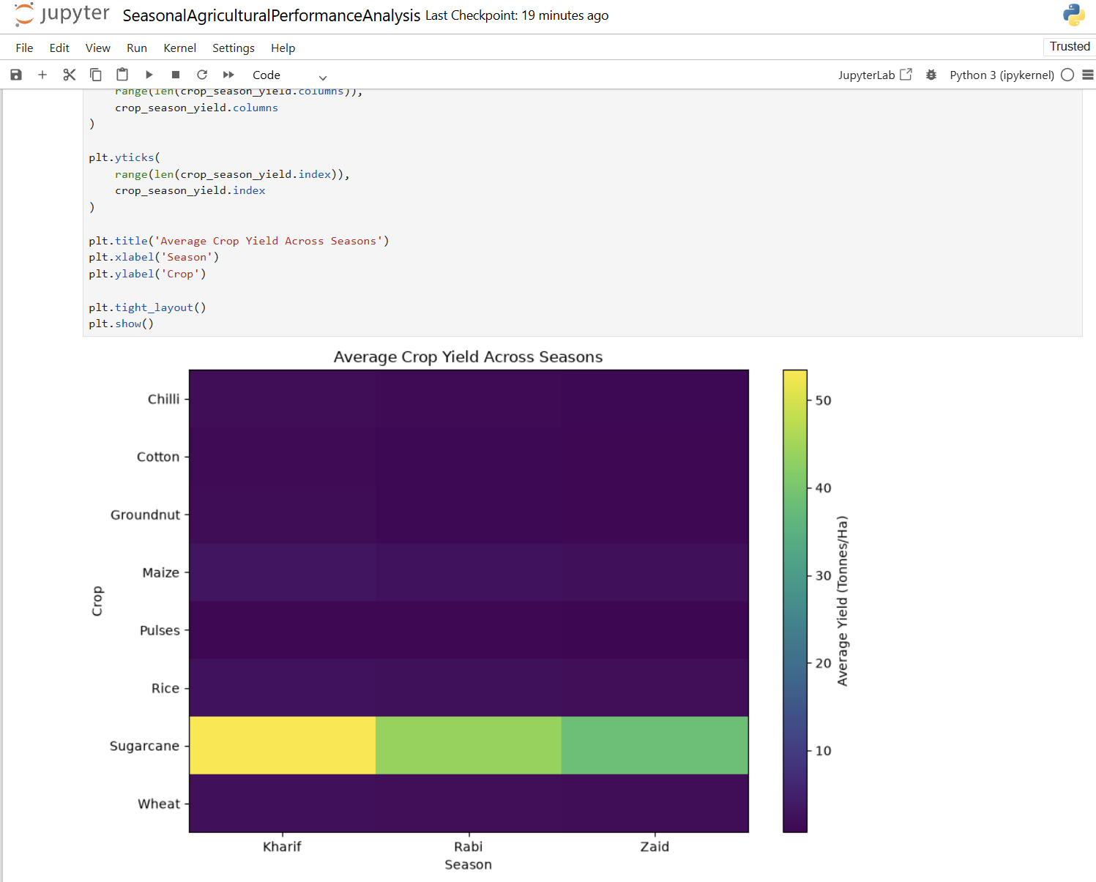
RESULTS
* Kharif recorded the highest average yield at 5.64 tonnes/ha.
* Yield decreased to 5.08 tonnes/ha in Rabi and 4.67 tonnes/ha in Zaid.
* Overall, crop yield was highest in Kharif.

Slide 8
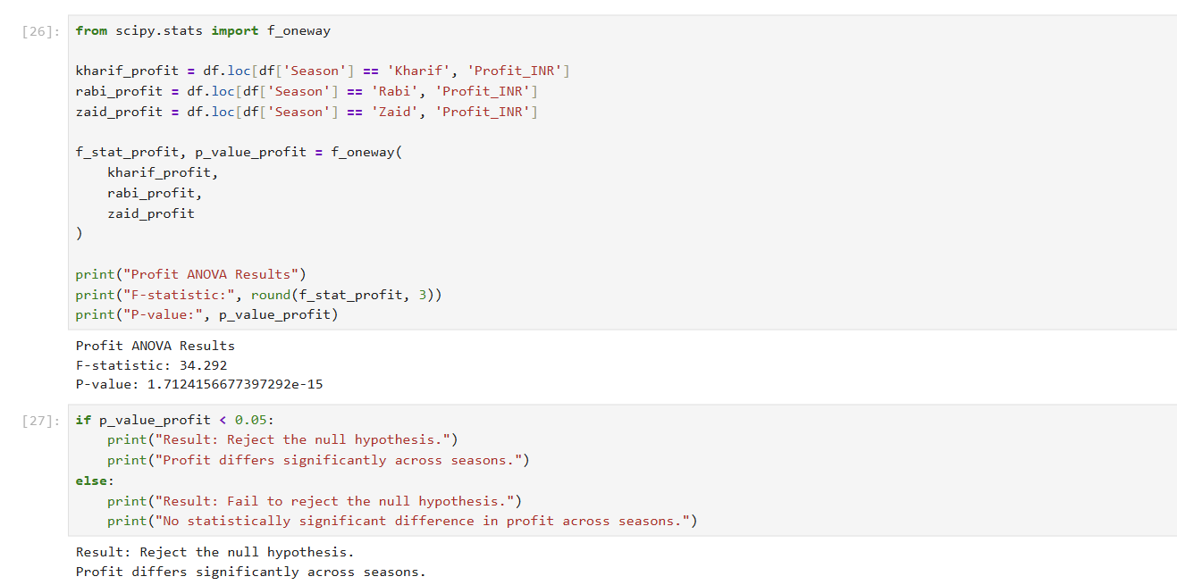
RESULTS
* F-statistic: 34.292
* P-value: 1.71 × 10⁻¹⁵
* Profit differs significantly across seasons.
* This indicates that season has a significant impact on agricultural profitability.

Slide 9
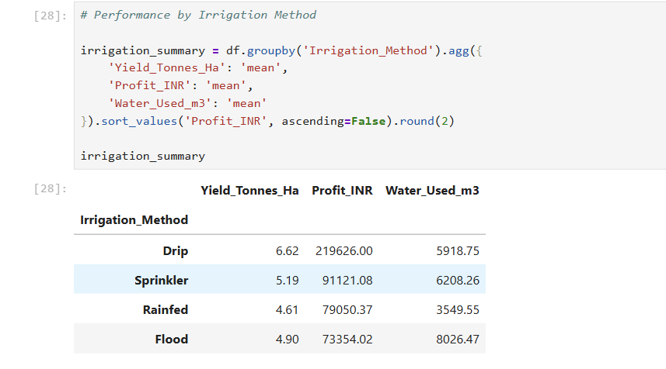
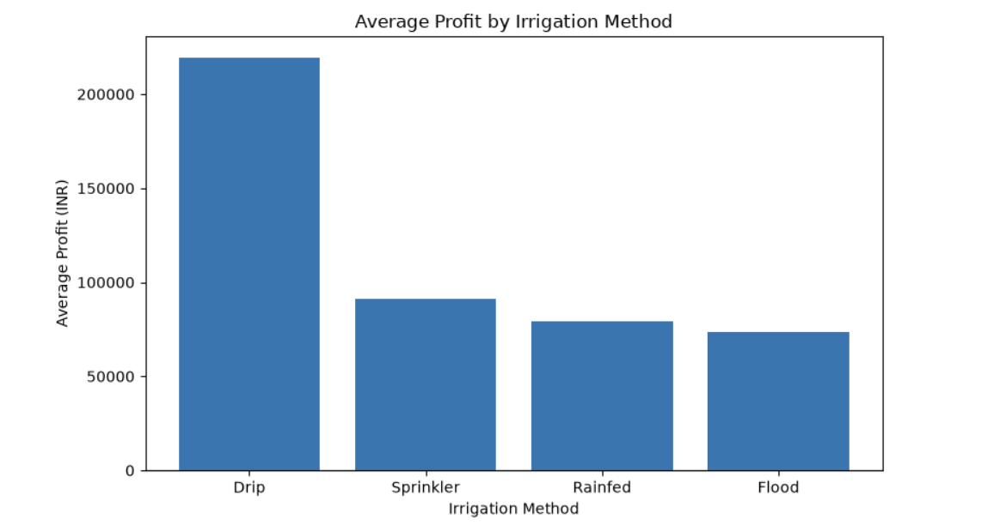
RESULTS
* Drip irrigation achieved the highest yield and profit.
* Flood irrigation used the most water while giving lower returns.
* Overall, drip irrigation showed the strongest agricultural performance.

Slide 10
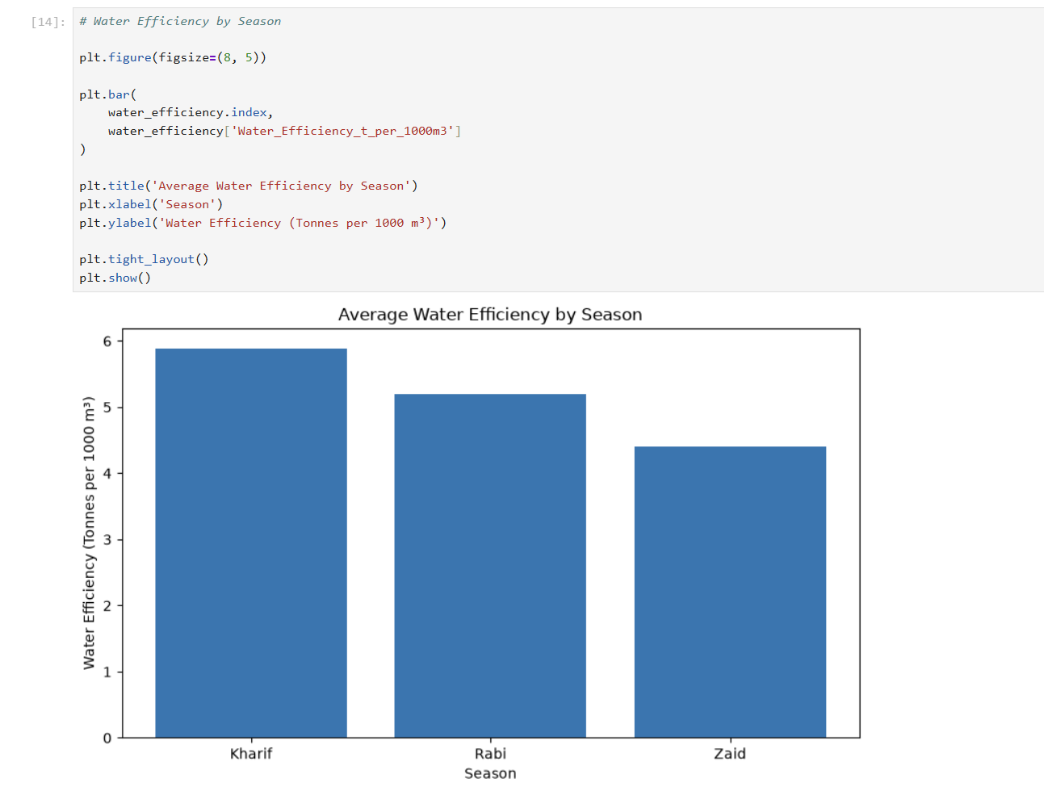
RESULTS
* Kharif has the highest water efficiency: 5.89 tonnes/1000 m³.
* Rabi: 5.19 tonnes/1000 m³.
* Zaid: lowest at 4.41 tonnes/1000 m³.
* Water efficiency declines from Kharif to Zaid.

Slide 11
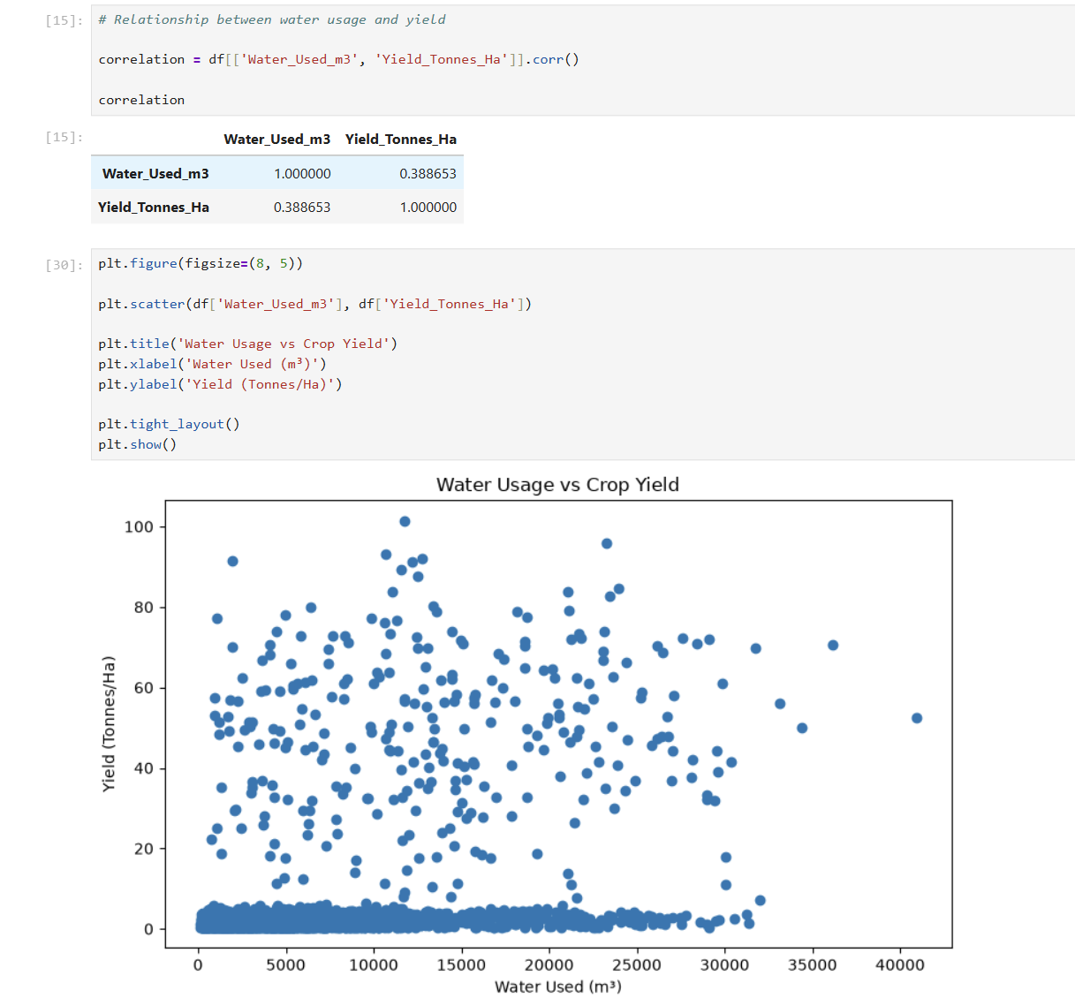
RESULTS
* Correlation coefficient (r) = 0.389
* Water usage shows a moderate positive relationship with crop yield.
* Higher water usage is generally associated with higher yield, but water usage alone does not explain yield differences.

Slide 12
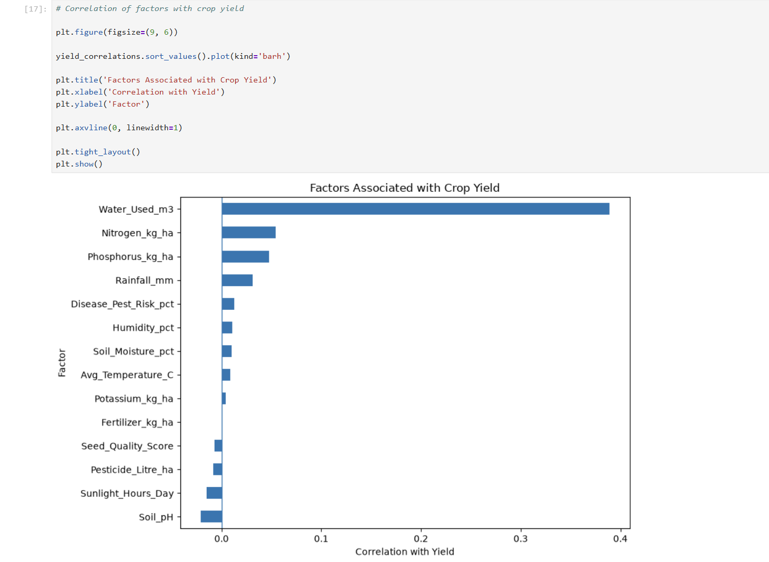
RESULTS
* Water usage showed the strongest positive correlation with yield (r = 0.389).
* Most other factors showed very weak linear relationships with yield.
* Fertilizer usage showed almost no linear association with yield (r = 0.001).
* Correlation indicates association, not causation.

Slide 13
Future scope
* Develop predictive models to forecast crop yield and profitability.
* Use machine learning to identify the key factors affecting agricultural performance.
* Build a Power BI dashboard for interactive seasonal and crop-level monitoring.
* Incorporate real-time weather and soil data for better decision-making.
* Extend the analysis to provide crop and irrigation recommendations.

Slide 14
GitHub Link
https://github.com/ayazqureshi14/Seasonal-Agricultural-Performance-Analysis

Slide 15
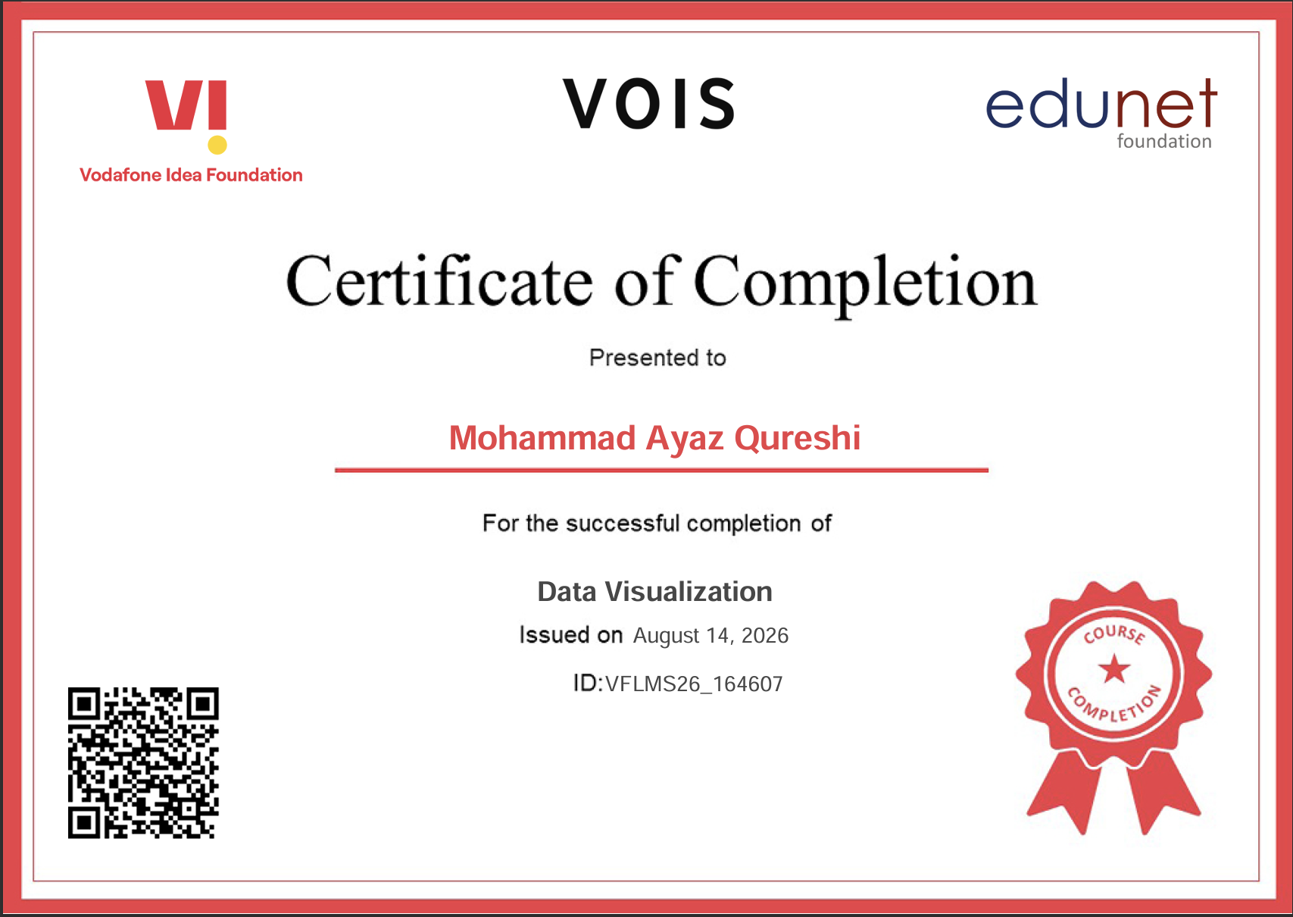
VOIS Course completion certificate - Course name- Data Visualization

Slide 16
Thank you Mohammad Ayaz Qureshi Jamia Millia Islamia
Conclusion
This project analysed seasonal agricultural performance using data covering crops, environmental conditions, resource usage, production and economic outcomes.
The analysis found that Kharif had the highest average yield and profitability, while Zaid showed lower yield, negative average profit and lower water-use efficiency. However, the difference in yield across seasons was not statistically significant, whereas the difference in profit was statistically significant.
Water usage showed the strongest linear association with yield among the numerical factors analysed. The comparison of irrigation methods also showed that Drip irrigation had the highest average yield and profit in the dataset.
Overall, the findings highlight the importance of efficient water management, appropriate irrigation practices and season-specific agricultural planning. These insights can support more evidence-based decisions regarding resource allocation, crop selection and agricultural profitability.
.
.

