Slide 1
Request
Client
Lucy
Latency
Response

Slide 2
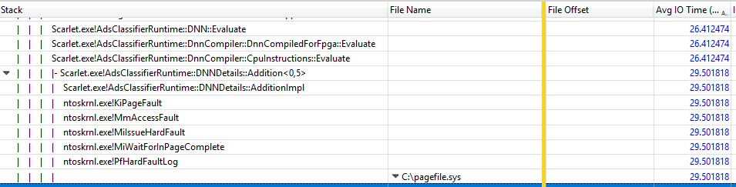
Lucy’s hot path callstack

Slide 3
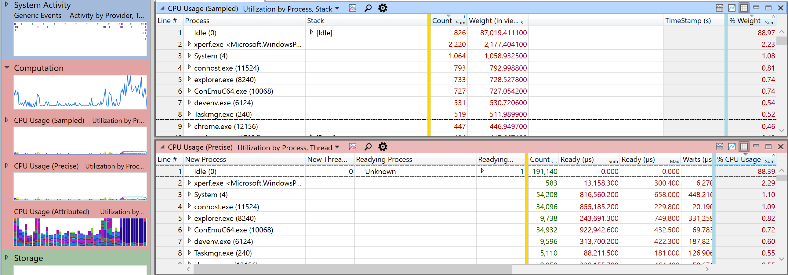
Precise CPU includes detailed thread switching info

Slide 4
Before Leak
During Leak
After Leak Fix
Lucy’s memory
Lucy’s memory
Lucy’s memory
Working Set
Paged File
Paged File
Non-Frequently Accessed memory
Working Set

