Slide 1
Human Freedom Index
Arpi Beshlikyan & Jazmine Toledo

Slide 2
The Human Freedom Index
“The Human Freedom Index presents the state of human freedom in the world based on a broad measure that encompasses personal, civil, and economic freedom.”
The report is co-published by the Cato Institute, the Fraser Institute, and the Liberales Institut at the Friedrich Naumann Foundation for Freedom. For more details on the Human Freedom Index Project, see https://www.cato.org/human-freedom-index-new.

Slide 3
Project Topic
We will investigate the correlations between personal and economic freedom to see if one can be a predictor for the other, and specifically examine the subcategories of the two indeces to see which is the most related to the other main index. The indeces and their sub-categories are listed in the following slides.

Slide 4
Personal Freedom
Rule of Law (rol)
Security and Safety (safety)
Movement (movement)
Religion (religion)
Association, Assembly, and Civil Society (assembly)
Expression and Information (expression)
Identity and Relationships (relationships)

Slide 5
Economic Freedom
Size of Government (govsize)
Legal System and Property Rights (legalsystems)
Access to Sound Money (money)
Freedom to Trade Internationally (trade)
Regulation of Credit, Labor, and Business (regulation)

Slide 6
Summary of Personal Freedom Index
The personal freedom sub-index is comprised of 34 numerical variables divided into six categories. The indicators are rated on a sale of 1 to 10, with 10 representing the most freedom.
## Min. 1st Qu. Median Mean 3rd Qu. Max. ## 2.167 6.025 6.932 6.985 8.142 9.399

Slide 7
Summary of Economic Freedom Index
The economic freedom sub-index is comprised of 42 numerical variables divided into five categories. The indicators are rated on a sale of 1 to 10, with 10 representing the most freedom.
## Min. 1st Qu. Median Mean 3rd Qu. Max. ## 2.880 6.260 6.905 6.795 7.468 8.970

Slide 8
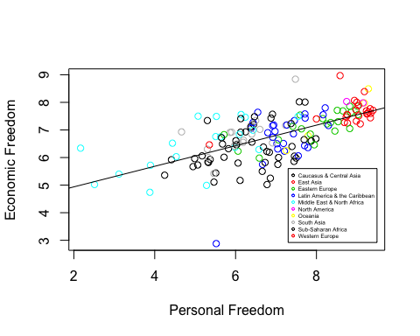
Economic Freedom vs. Personal Freedom

Slide 9
There is a clear positive correlation between personal and economic freedom, with a correlation of 0.6271777.

Slide 10
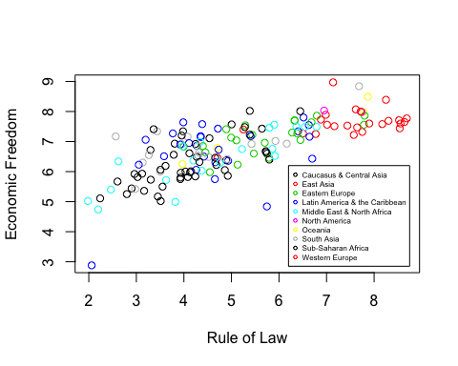
Economic Freedom vs. Rule of Law

Slide 11
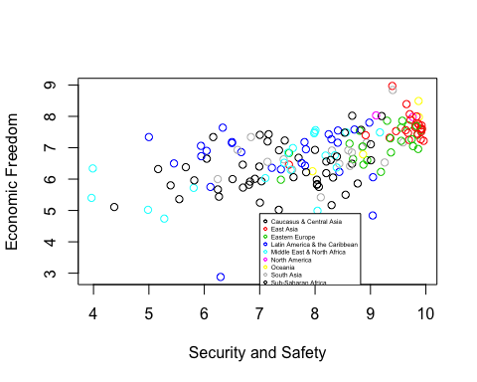
Economic Freedom vs. Security and Safety

Slide 12
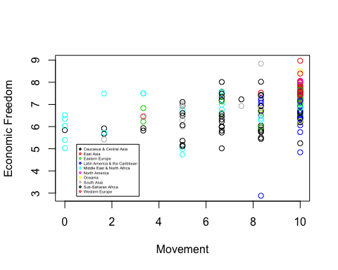
Economic Freedom vs. Movement

Slide 13
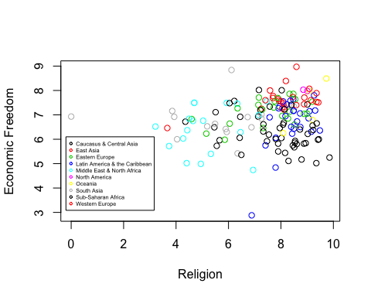
Economic Freedom vs. Religion

Slide 14
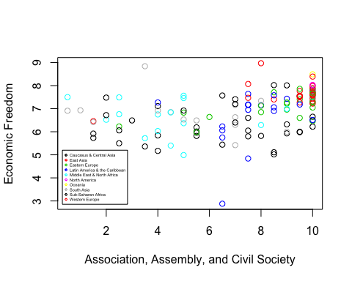
Economic Freedom vs. Association, Assembly, and Civil Society

Slide 15
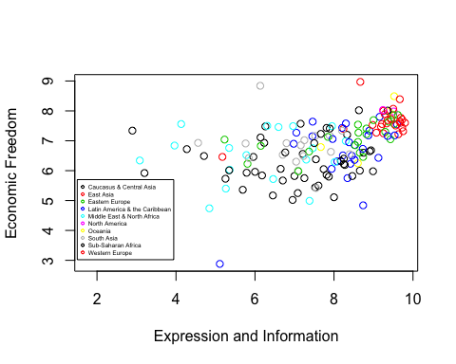
Economic Freedom vs. Expression and Information

Slide 16
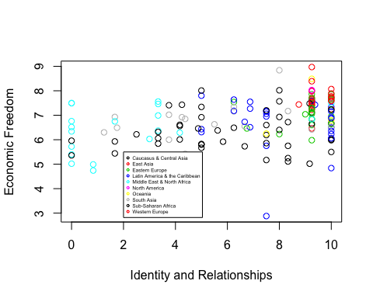
Economic Freedom vs. Identity and Relationships

Slide 17
Multiple Regression of Economic Freedom and Sub-Categories of Personal Freedom
## ## Call: ## lm(formula = data$economicfreedom ~ data$rol + data$religion + ## data$expression + data$safety + data$relationships + data$movement + ## data$assembly) ## ## Residuals: ## Min 1Q Median 3Q Max ## -2.82288 -0.34787 -0.01219 0.37809 1.32904 ## ## Coefficients: ## Estimate Std. Error t value Pr(>|t|) ## (Intercept) 4.039267 0.450908 8.958 3.32e-15 *** ## data$rol 0.301251 0.051946 5.799 4.92e-08 *** ## data$religion -0.005481 0.046958 -0.117 0.9073 ## data$expression -0.008769 0.079106 -0.111 0.9119 ## data$safety 0.121946 0.062657 1.946 0.0538 . ## data$relationships -0.006516 0.023991 -0.272 0.7864 ## data$movement 0.044263 0.029082 1.522 0.1305 ## data$assembly 0.005833 0.039250 0.149 0.8821 ## --- ## Signif. codes: 0 '***' 0.001 '**' 0.01 '*' 0.05 '.' 0.1 ' ' 1 ## ## Residual standard error: 0.6266 on 128 degrees of freedom ## (26 observations deleted due to missingness) ## Multiple R-squared: 0.5607, Adjusted R-squared: 0.5367 ## F-statistic: 23.34 on 7 and 128 DF, p-value: < 2.2e-16

Slide 18
Correlation Between Rule of Law and Sub-Categories of Personal Freedom
## [,1] ## [1,] -0.3282557 ## [2,] 0.9044933 ## [3,] 0.5227554 ## [4,] 0.6780413 ## [5,] 0.6852750

Slide 19
Conclusion
There is a significant relation between economic and personal freedom; one can be predicted using the other. From the summary of the regression, we were able to conclude that Rule of Law is the most signifant in the prediction of economic freedom. Therefore, we examined the correlation between the rule of law index and the subcategories of economic freedom.

