Slide 1
Human Freedom Index
Arpi Beshlikyan & Jazmine Toledo

Slide 2
The Human Freedom Index
“The Human Freedom Index presents the state of human freedom in the world based on a broad measure that encompasses personal, civil, and economic freedom.”
The report is co-published by the Cato Institute, the Fraser Institute, and the Liberales Institut at the Friedrich Naumann Foundation for Freedom. For more details on the Human Freedom Index Project, see https://www.cato.org/human-freedom-index-new.

Slide 3
Slide with Bullets
Bullet 1
Bullet 2
Bullet 3

Slide 4
Slide with R Output
summary(cars)
## speed dist ## Min. : 4.0 Min. : 2.00 ## 1st Qu.:12.0 1st Qu.: 26.00 ## Median :15.0 Median : 36.00 ## Mean :15.4 Mean : 42.98 ## 3rd Qu.:19.0 3rd Qu.: 56.00 ## Max. :25.0 Max. :120.00

Slide 5
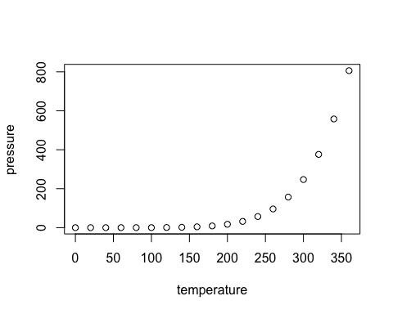
Slide with Plot

