Slide 1
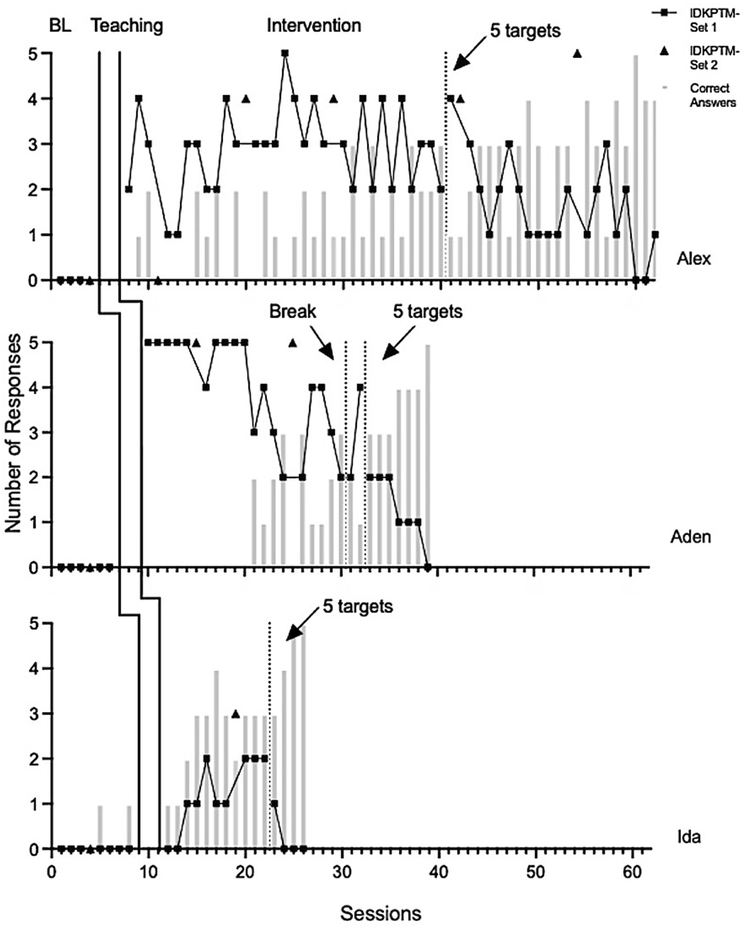
Teaching children with autism spectrum disorder to mand for answers to questions via telehealth: A caregiver implementation
Behavioral Interventions, Volume: 39, Issue: 3, First published: 04 April 2024, DOI: (10.1002/bin.2015)
Notes:
Alex, Aden, and Ida's multiple baseline graph of IDKPTM responses, correct answers and generalization probes. IDKPTM Set 1 are questions selected for intervention and IDKPTM Set 2 are questions used in generalization probes. The phase change lines between baseline and intervention are sessions implemented with a 0 s time delay. The asterisk marks the session where Aden resumed sessions following a break. The data paths reflect an inverse relationship of the IDKPTM response and the acquisition of correct answers to questions. IDKPTM, "I don't know, please tell me".
IF THIS IMAGE HAS BEEN PROVIDED BY OR IS OWNED BY A THIRD PARTY, AS INDICATED IN THE CAPTION LINE, THEN FURTHER PERMISSION MAY BE NEEDED BEFORE ANY FURTHER USE. PLEASE CONTACT WILEY'S PERMISSIONS DEPARTMENT ON PERMISSIONS@WILEY.COM OR USE THE RIGHTSLINK SERVICE BY CLICKING ON THE 'REQUEST PERMISSIONS' LINK ACCOMPANYING THIS ARTICLE. WILEY OR AUTHOR OWNED IMAGES MAY BE USED FOR NON-COMMERCIAL PURPOSES, SUBJECT TO PROPER CITATION OF THE ARTICLE, AUTHOR, AND PUBLISHER.

