Slide 1
Prediction Of House Rent Prices in Sariyer
🐈Aybüke Meydan 🐈
İstanbul Data Science Academy

Slide 2
🏡 INTRODUCTİON 🏡
Problem : We will rent a house from Sariyer and we want to estimate the rent of a house with the appropriate criteria we think in our minds. 🐈
Solution : Collecting and analyzing data from real estate sites. 🐈

Slide 3
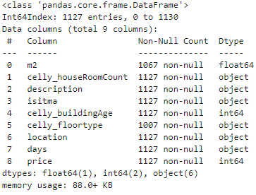
🏡 DATA & METHODOLOGY 🏡
1. DATA COLLECTİNG
2. DATA PREPROCESSİNG
3. FEATURE ENGINEERING
4. STATISTICAL MODELLİNG WITH OLS & REGRESSİON MODELS
5. CONCLUSION & FUTURE WORKS

Slide 4
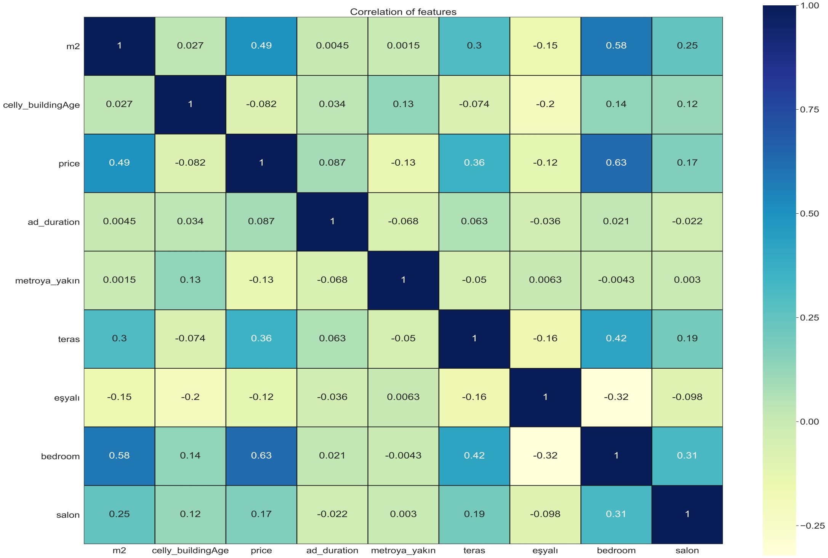
🏡 Correlation Matrix 🏡

Slide 5
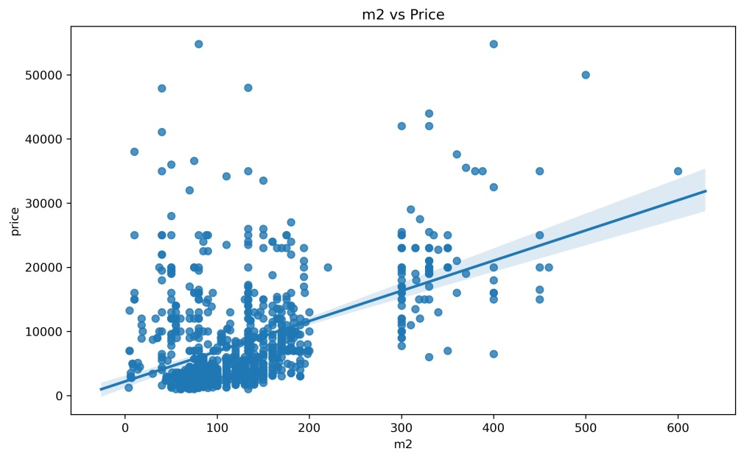
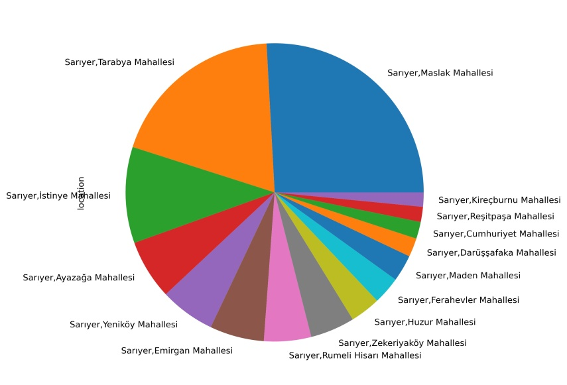
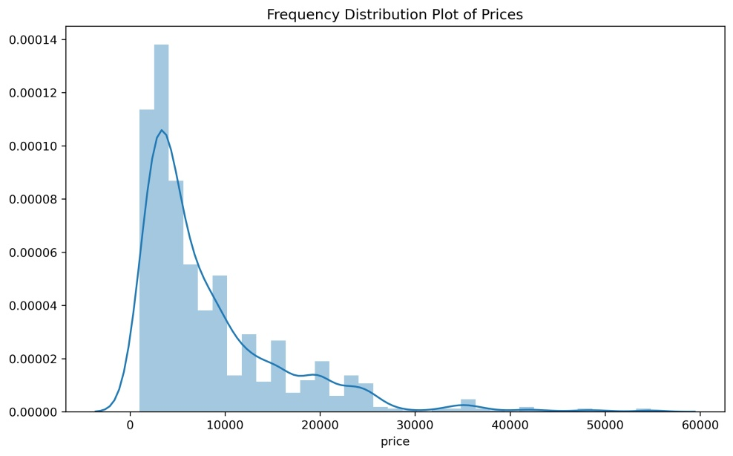
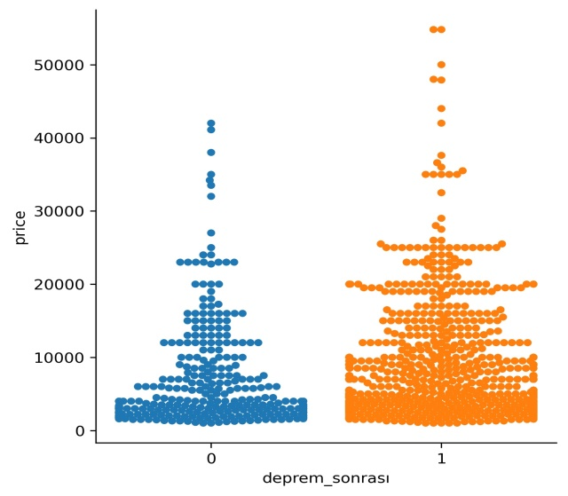
🏡 EDA 🏡

Slide 6
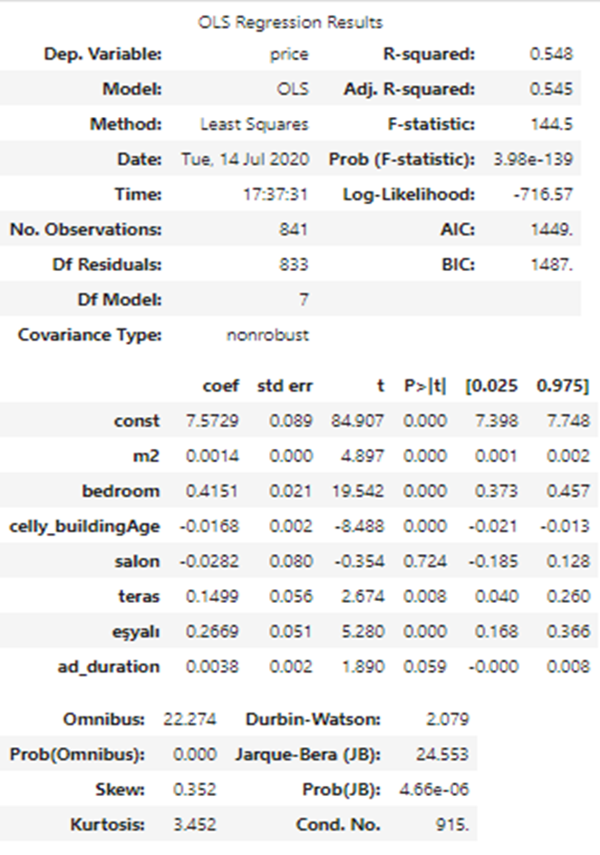
🏡 RESULTS 🏡
OLS Results After Adding Cat. Features :
R^2=0.606 Adj.R^2=0.601
Regression Model Scores :
R^2 score of Simp.Linear regression : 0.58
R^2 score of Lasso regression : 0.44
R^2 score of Ridge regression : 0.58
R^2 score of Poly. regression : 0.65
Test R^2 Score for Best Model: 0.67

Slide 7
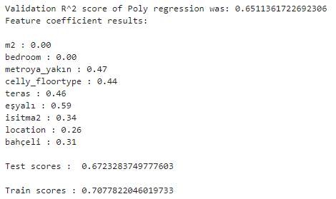
🏡 FUTURE WORK
& CONCLUSİON 🏡
In statsmodel,First R^2 that i got 0.548,after added categ.features it become 0.606. 🐈
Ridge is bigger score than Lasso in cross validation. 🐈
Polynomial Regression has max score. 🐈
In my future work,I will collect more data in website. 🐈

