Slide 1
Prediction Of House Rent Prices in Sariyer
Aybüke Meydan
İstanbul Data Science Academy

Slide 2
🏡 INTRODUCTİON 🏡
Problem : We will rent a house from Sariyer and we want to estimate the rent of a house with the appropriate criteria we think in our minds.
Solution : Collecting and analyzing data from real estate sites.

Slide 3
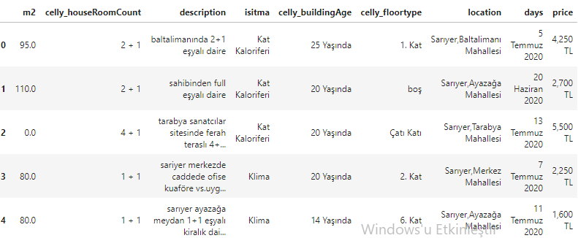
🏡 DATA 🏡
TARGET

Slide 4
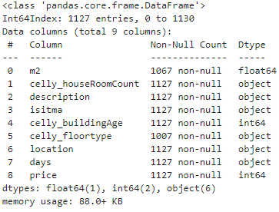
🏡 DATA & METHODOLOGY 🏡
1. DATA COLLECTİNG
2. DATA PREPROCESSİNG
3. FEATURE ENGINEERING
4. STATISTICAL MODELLİNG WITH OLS & REGRESSİON MODELS
5. CONCLUSION & FUTURE WORKS

Slide 5
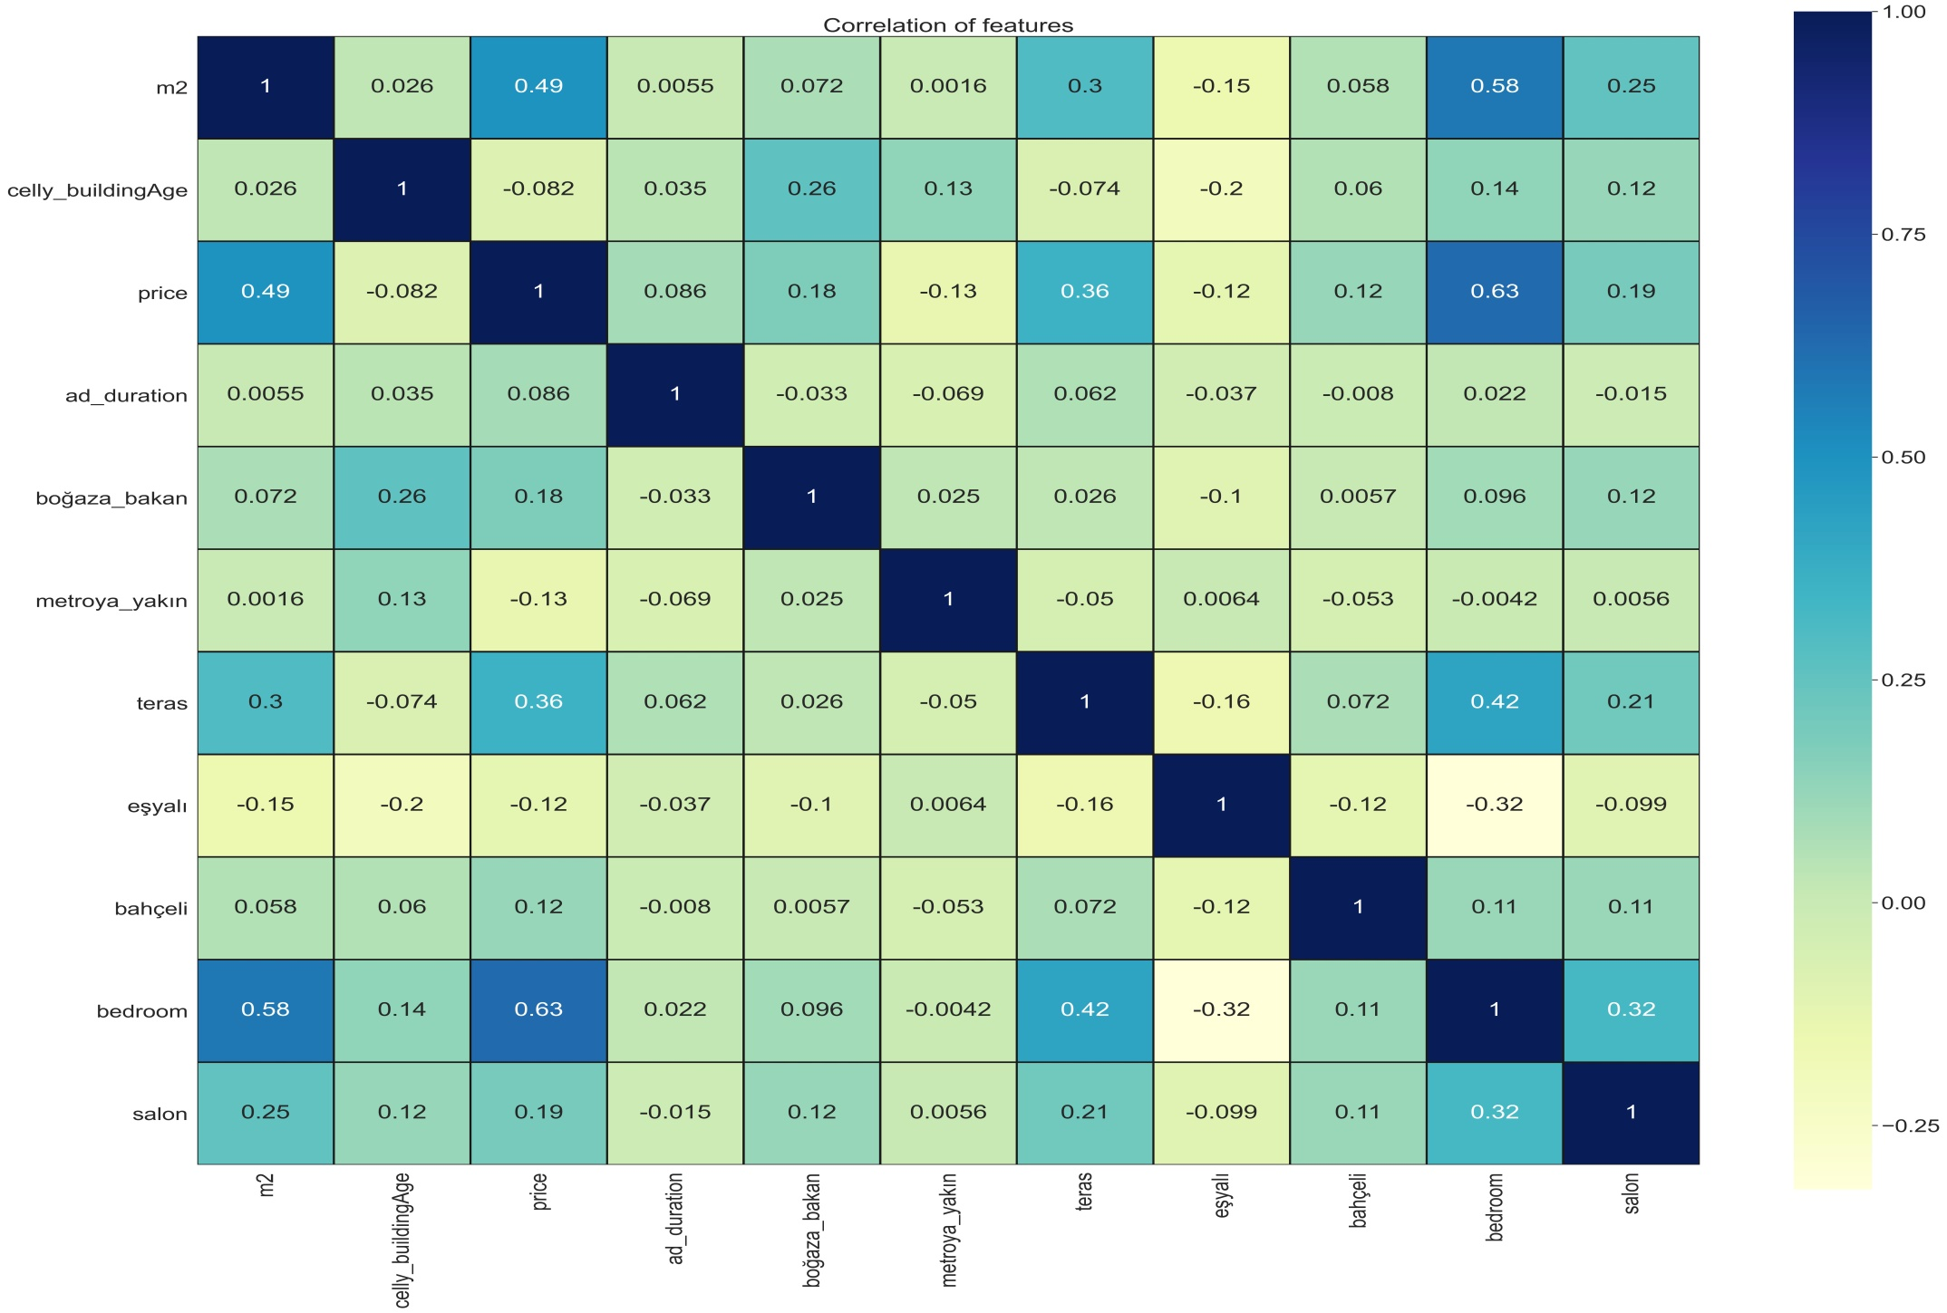
🏡 Correlation Matrix 🏡

Slide 6
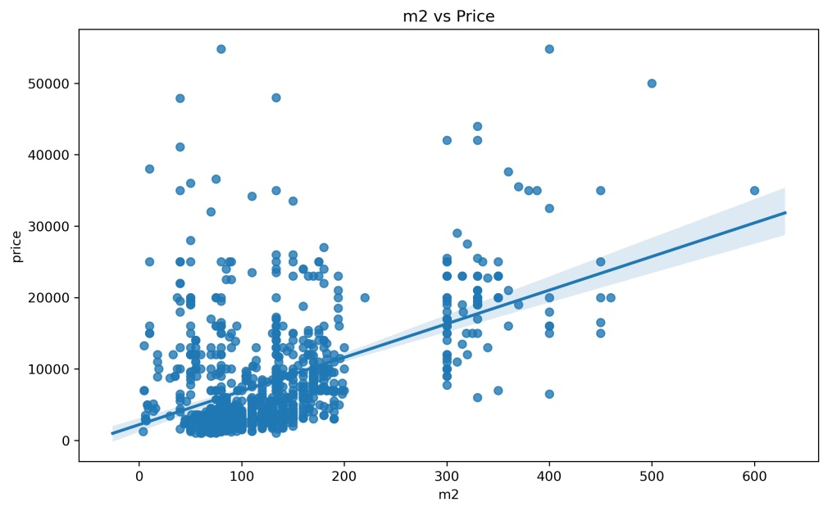
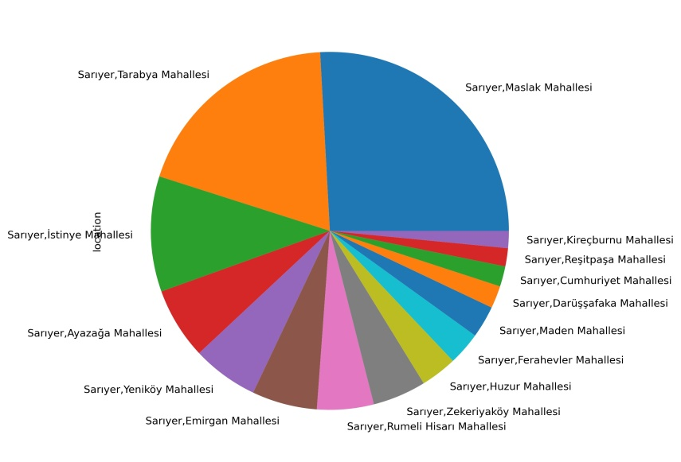
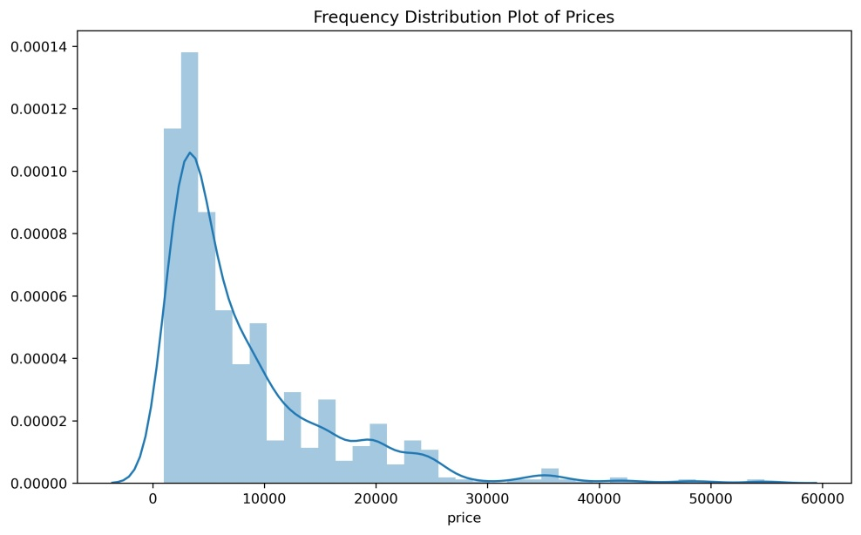
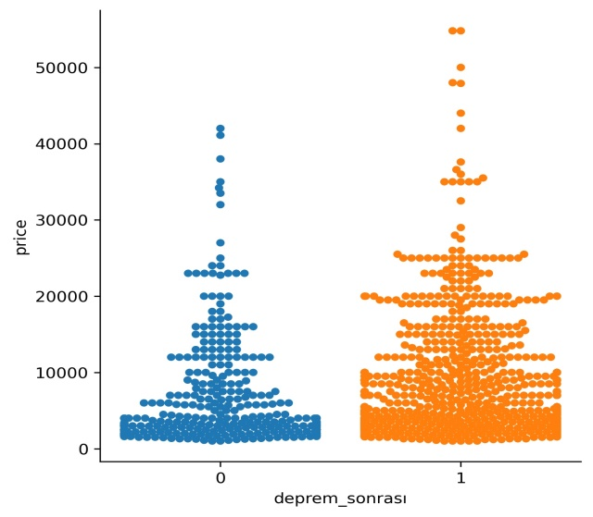
🏡 EDA 🏡

Slide 7
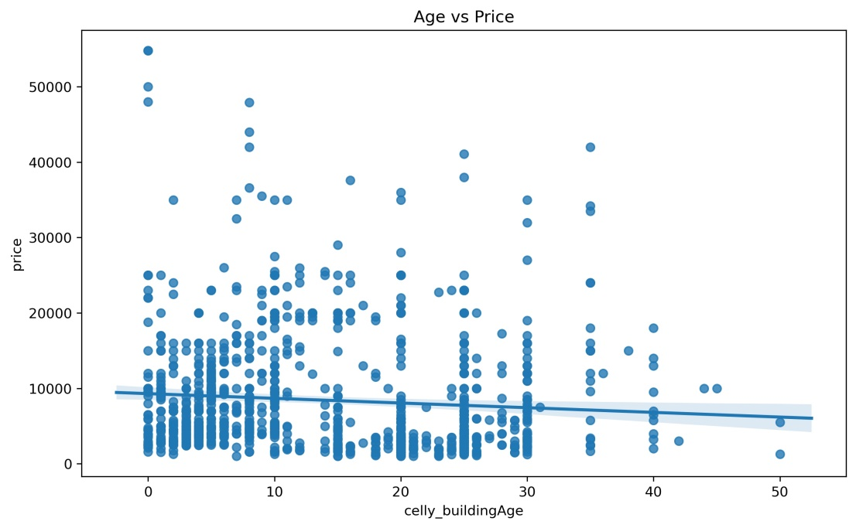
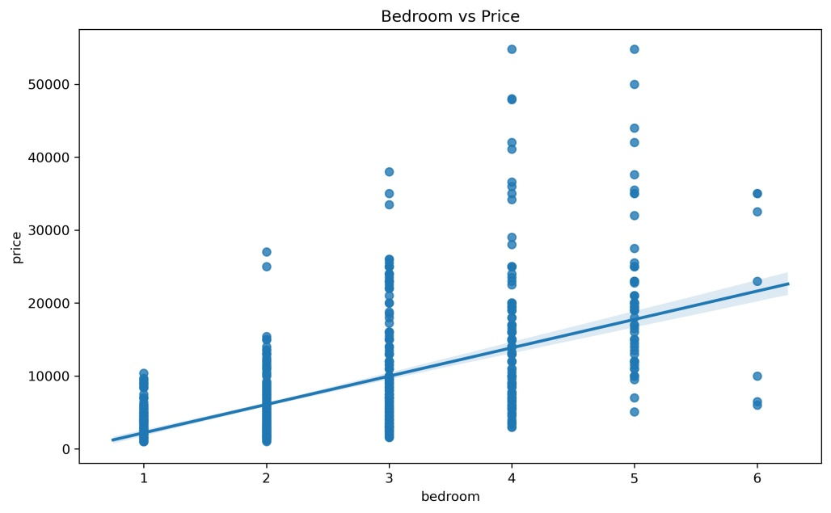
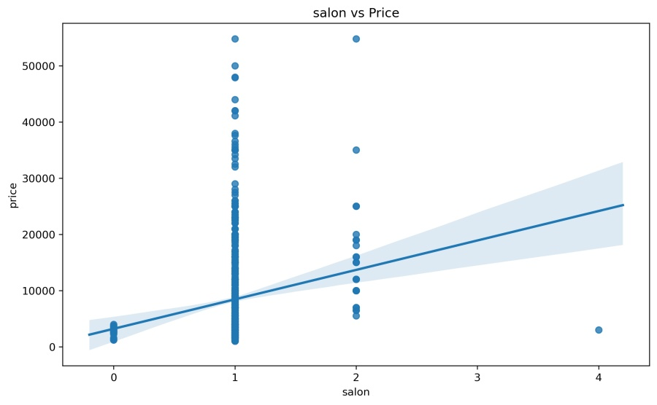
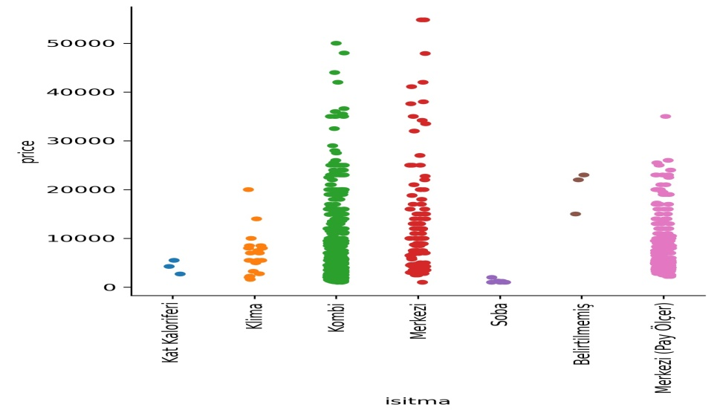
🏡 EDA 🏡

Slide 8
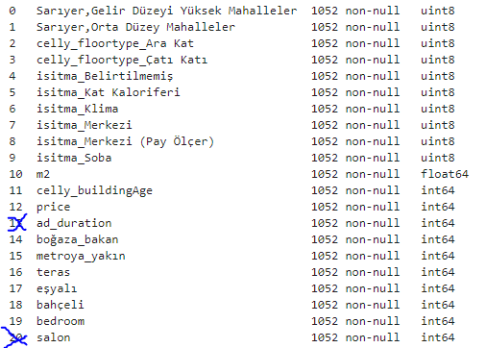
🏡 FEATURE ENGINEERING 🏡
Using the Definition feature, I have produced new features called "proximity to the subway", "Bosphorus view", "furnished", "terrace" from the articles written by people on house advertisements.
With the Dummy variable, I assigned celly_floortype, the warm-up type of the house, the location properties to numerical values and I divided them all into smaller categories in order to avoid too many features.
In total, I had 20 features, and I used 18 of this.

Slide 9
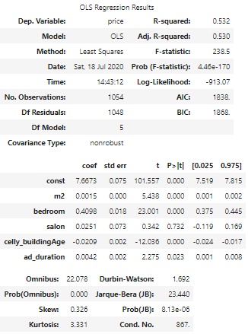
🏡 RESULTS 🏡
OLS Results After Adding Features :
R^2=0.696 Adj.R^2=0.691
Regression Model Scores :
R^2 score of Simp.Linear regression : 0.6836 (Cond No. is too high!)
R^2 score of Lasso regression : 0.44
R^2 score of Ridge regression : 0.6833
R^2 score of Poly. regression : -410
Test R^2 Score for Best Model: 0.6949

Slide 10
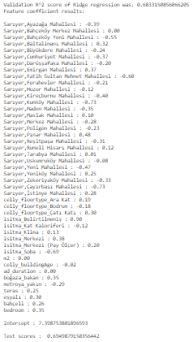
🏡 FUTURE WORK
& CONCLUSİON 🏡
In statsmodel,First R^2 that i got 0.548,after added my other features it become 0.718.However,Cond No. is too high.
Val. R^2 of Ridge > Val. R^2 of Lasso
Ridge Regression has max r score.
MSE 0,22
In my future work,I will collect more data in website.

