Slide 1

Prediction Hotel Booking Cancellation
AYBÜKE MEYDAN

Slide 2
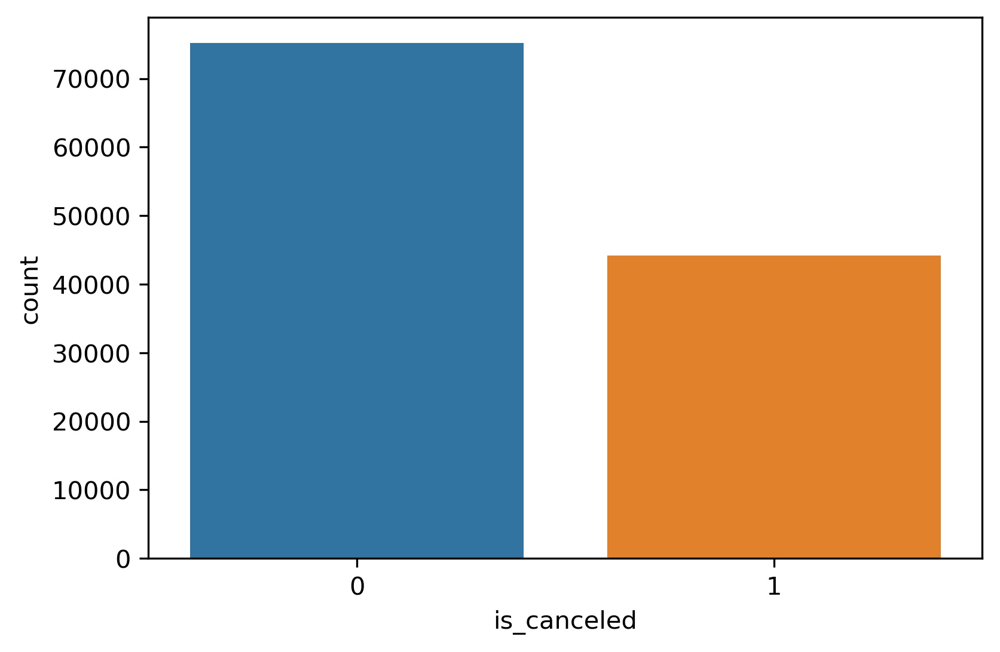
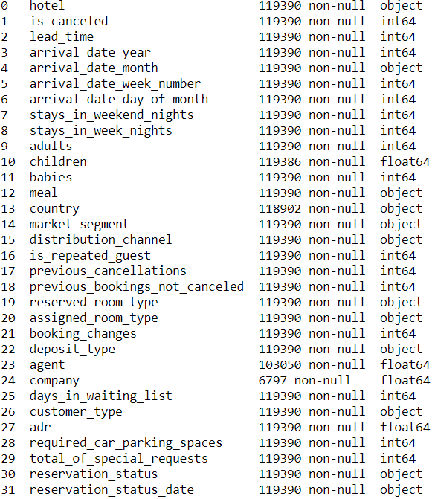
INTRODUCTION & DATA
Problem : Knowing whether the guest will cancel their reservation helps hotels take action. Hotels adjust their spending accordingly.
Not Canceled : % 73
Canceled : % 27

Slide 3
METHADOLOGY
DATA CLEANING
2. DATA PRE-PROCESSİNG
3. FEATURE ENGINEERING
4. MODELS & OVERSAMPLING(SMOTE)
5. CONCLUSION

Slide 4
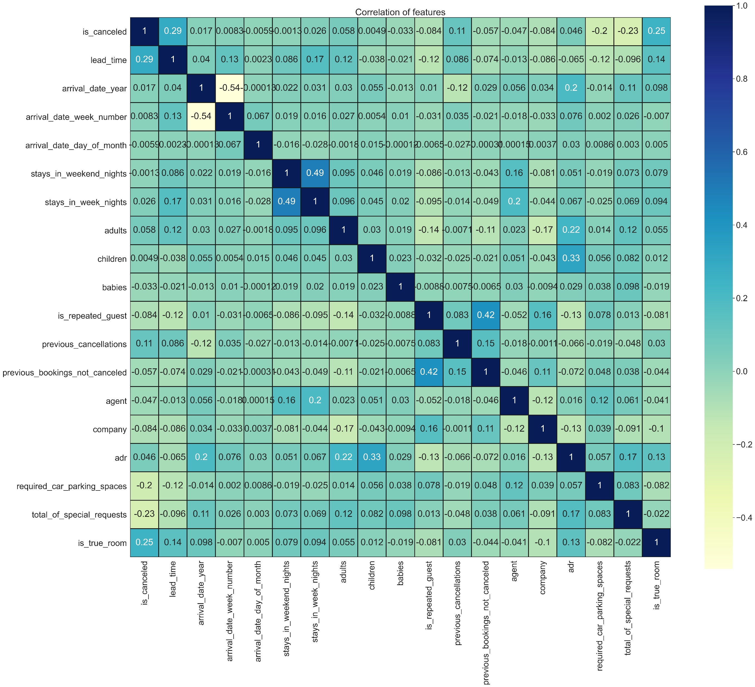
CORRELATION HEATMAP

Slide 5
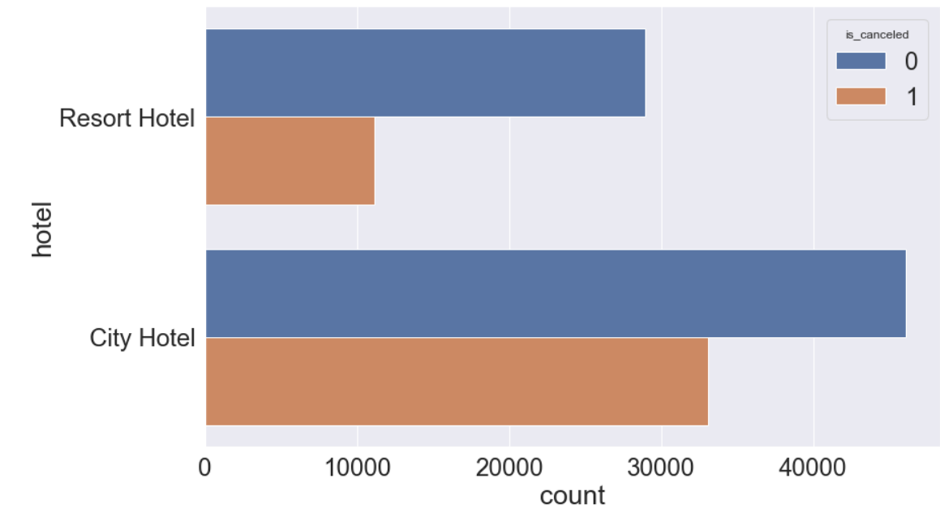
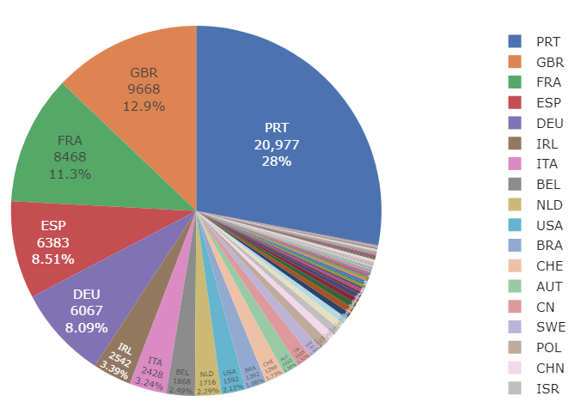
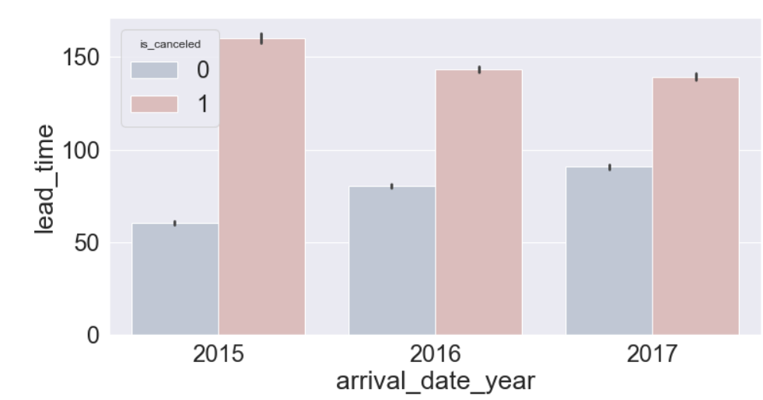
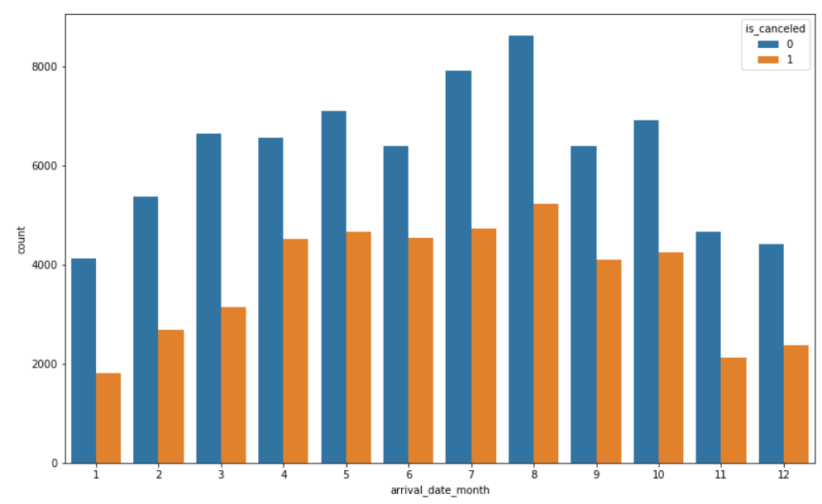
EDA

Slide 6
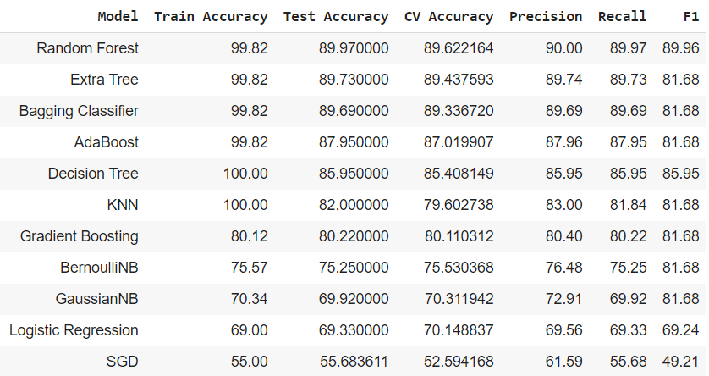
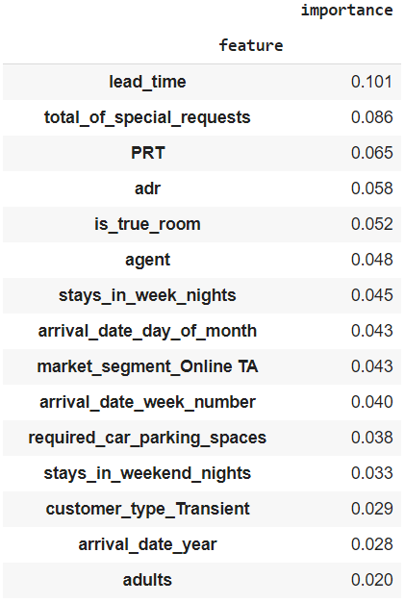
MODEL RESULTS & FEATURE IMPORTANCE

Slide 7
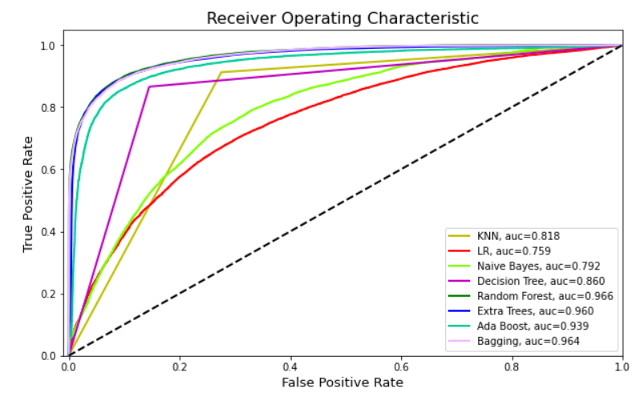
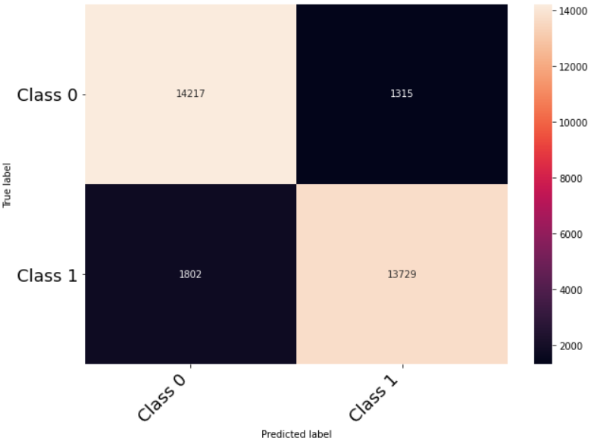
MODEL SELECTION
RANDOM FOREST CM

Slide 8
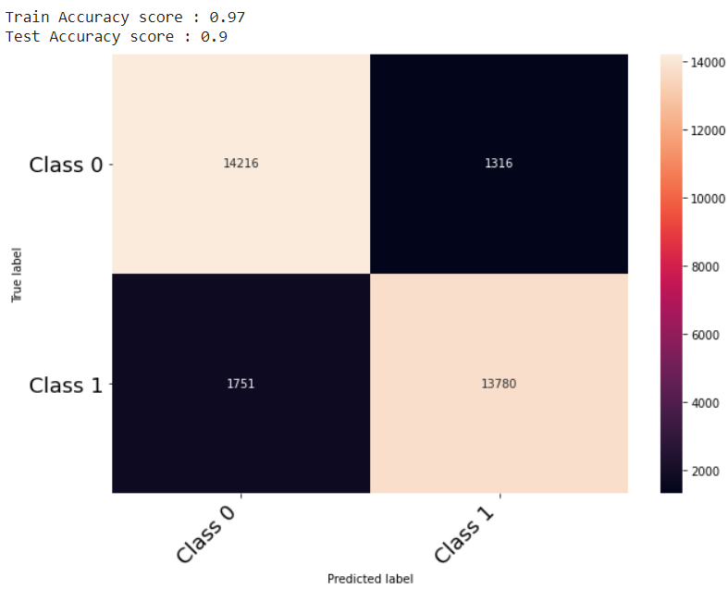
OPTIMIZATION
As you can see, the most successful model is Random Forest.
But It can only be an overfitting problem and the best way to avoid overfitting is to optimize tuning hyperparameters. We can tune your parameters using RandomizeSearchCV.
Random Forest :
Train Accuracy score : 0.9739
Test Accuracy score : 0.9012

Slide 9
CONCLUSION
- I got the best results from tree-based algorithms. The accuracy I got after model evalution : 0,9012
- As can be seen in the feature importance tables, redshift and color indexes are the most valuable features.
- I will try to deploy it with Flask and try new models like XGBoost and apply PCA to the features.

