Slide 1
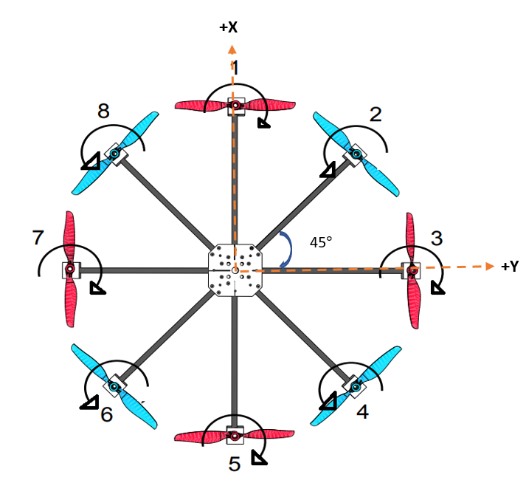
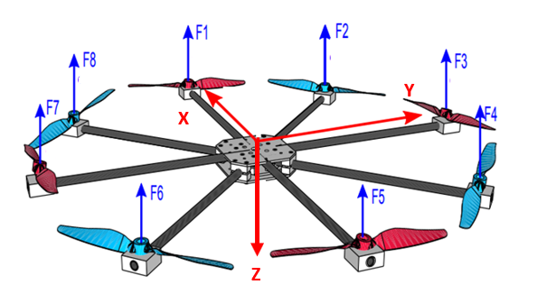

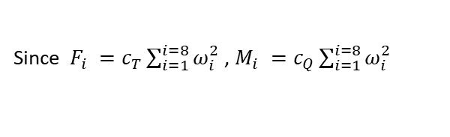
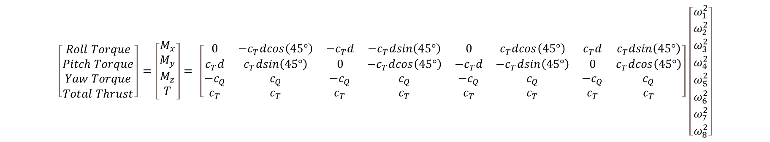
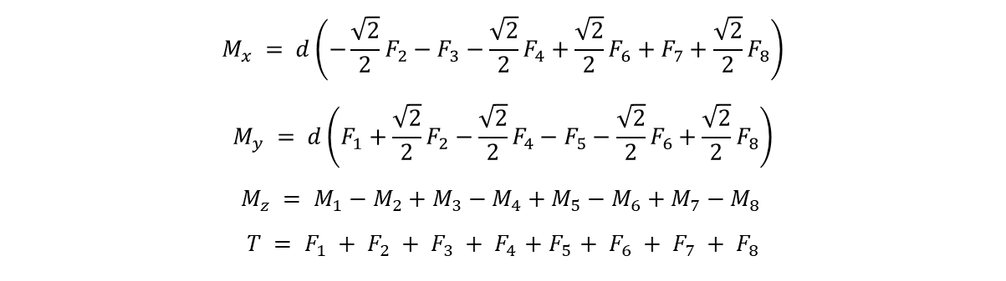
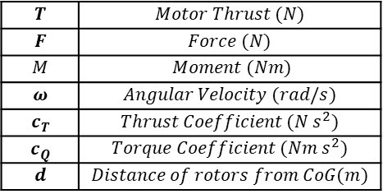
Task#1: Deriving Control Efficiency Matrix
$$M_{x} = d\left(−{\frac{\sqrt{2}}{2}F}_{2}−F_{3}−{\frac{\sqrt{2}}{2}F}_{4}+{\frac{\sqrt{2}}{2}F}_{6}+F_{7}+{\frac{\sqrt{2}}{2}F}_{8}\right)$$
$$M_{y} = d\left(F_{1}+{\frac{\sqrt{2}}{2}F}_{2}−{\frac{\sqrt{2}}{2}F}_{4}−F_{5}−{\frac{\sqrt{2}}{2}F}_{6}+{\frac{\sqrt{2}}{2}F}_{8}\right)$$
$$M_{z} = M_{1}−M_{2}+M_{3}−M_{4}+M_{5}−M_{6}+M_{7}−M_{8 }$$
$$T = F_{1} + F_{2} + F_{3} + F_{4}{ + F}_{5} + F_{6} + F_{7} + F_{8}$$
$$T$$ | $$Motor Thrust (N)$$
$$F$$ | $$Force (N)$$
$$M$$ | $$Moment (Nm)$$
$$ω$$ | $$Angular Velocity (rad/s)$$
$$c_{T}$$ | $$Thrust Coefficient (N s^{2})$$
$$c_{Q}$$ | $$Torque Coefficient (Nm s^{2})$$
$$d$$ | $$Distance of rotors from CoG(m)$$
Since $F_{i} =c_{T}\sum_{i=1}^{i=8}{ω_{i}^{2}}$ , $M_{i} =c_{Q}\sum_{i=1}^{i=8}{ω_{i}^{2}}$
Control Efficiency Matrix (M)
$$\left[\begin{matrix}Roll Torque \\ Pitch Torque \\ Yaw Torque \\ Total Thrust\end{matrix}\right]=\left[\begin{matrix}M_{x} \\ M_{y} \\ \begin{aligned}M_{z} \\ T\end{aligned} \\ \end{matrix}\right]= \left[\begin{matrix}0 & −c_{T}dcos\left(45°\right) & −c_{T}d & −c_{T}dsin\left(45°\right) & 0 & c_{T}dcos\left(45°\right) & c_{T}d & c_{T}dsin\left(45°\right) \\ c_{T}d & c_{T}dsin\left(45°\right) & 0 & {−c}_{T}dcos\left(45°\right) & {−c}_{T}d & −c_{T}dsin\left(45°\right) & 0 & c_{T}dcos\left(45°\right) \\ {−c}_{Q} & c_{Q} & −c_{Q} & c_{Q} & −c_{Q} & c_{Q} & −c_{Q} & c_{Q} \\ c_{T} & c_{T} & c_{T} & c_{T} & c_{T} & c_{T} & c_{T} & c_{T}\end{matrix}\right]\left[\begin{matrix}ω_{1}^{2} \\ ω_{2}^{2} \\ ω_{3}^{2} \\ ω_{4}^{2} \\ ω_{5}^{2} \\ ω_{6}^{2} \\ ω_{7}^{2} \\ ω_{8}^{2}\end{matrix}\right]$$
$$u_{ref}$$

Slide 2
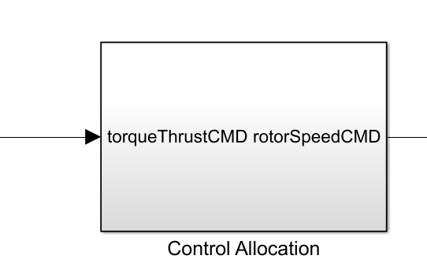

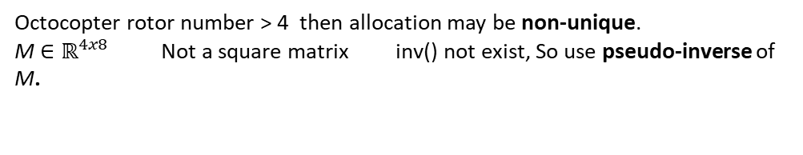

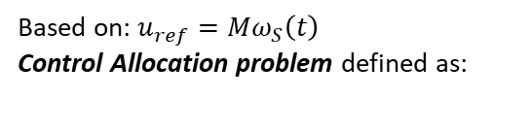
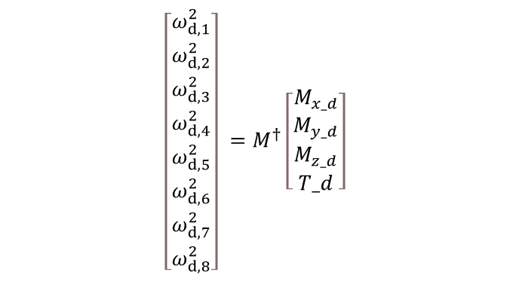




Task#2: Control Allocation Method
Based on: $u_{ref}=Mω_{S}\left(t\right)$
Control Allocation problem defined as:
$$u_{ref}$$
$$ω_{S}$$
Given $\text{u}(t)$, we seek $ω_{S}\left(t\right)$
$\text{u}(t)=g\left(ω_{S}\left(t\right)\right)$, where g: $ℝ^{4}→ℝ^{8}$ mapping
Octocopter rotor number > 4 then allocation may be non-unique.
M$∈ℝ^{4x8}$ Not a square matrix inv() not exist, So use pseudo-inverse of M.
$$ω_{S}=M^{†}{ u}_{ref}$$
$$\left[\begin{matrix}ω_{d,1}^{2} \\ ω_{d,2}^{2} \\ ω_{d,3}^{2} \\ ω_{d,4}^{2} \\ ω_{d,5}^{2} \\ ω_{d,6}^{2} \\ ω_{d,7}^{2} \\ ω_{d,8}^{2}\end{matrix}\right] =M^{†}\left[\begin{matrix}M_{x_d} \\ M_{y_d} \\ M_{z_d} \\ T_d\end{matrix}\right]$$
Found from MATLAB pinv() command
Which uses singular value decomposition to form pseudoinverse

Slide 3
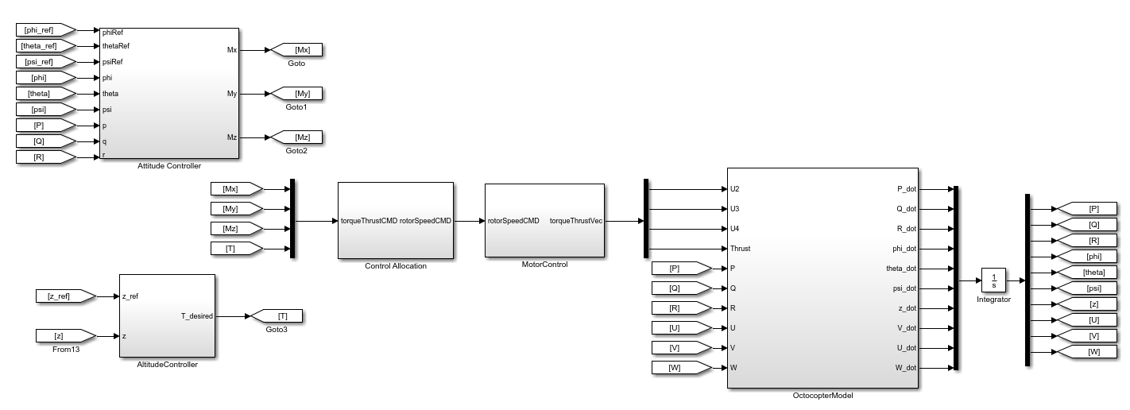
Task#2: Flight control law design & handle limitations of actuators
There is a maximum and minimum rotational speed of the rotor: $ω_{i, ul} ≤ω_{i}(t)≤ω_{i, ll}$
Motors cannot turn backwards, negative thrust cannot be generated so, $ω_{i}≥0$

Slide 4
References
A. Marks, J. F. Whidborne and I. Yamamoto, "Control allocation for fault tolerant control of a VTOL octorotor," Proceedings of 2012 UKACC International Conference on Control, Cardiff, UK, 2012, pp. 357-362, doi: 10.1109/CONTROL.2012.6334656.
Osmic, Nedim & Tahirovic, Adnan & Lacevic, Bakir. (2022). Octocopter Design: Modelling, Control and Motion Planning.
Quan, Quan & Dai, Xunhua & Wang, Shuai. (2020). Multicopter Design and Control Practice: A Series Experiments based on MATLAB and Pixhawk. 10.1007/978-981-15-3138-5.

