Slide 1
analysis
File created on: 18.12.2024 09:06:22

Slide 2
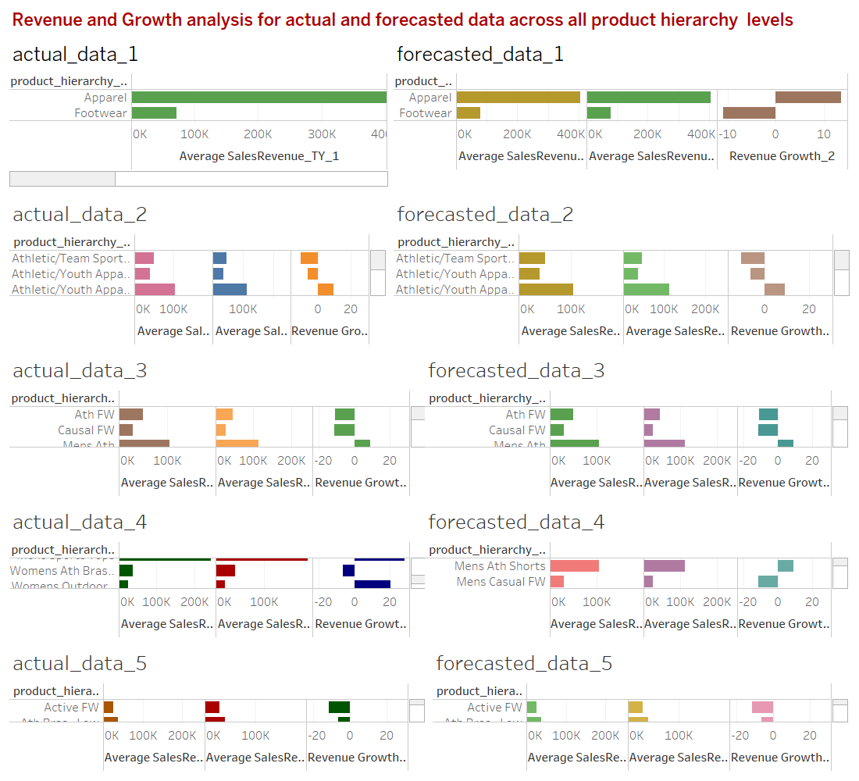

Slide 3
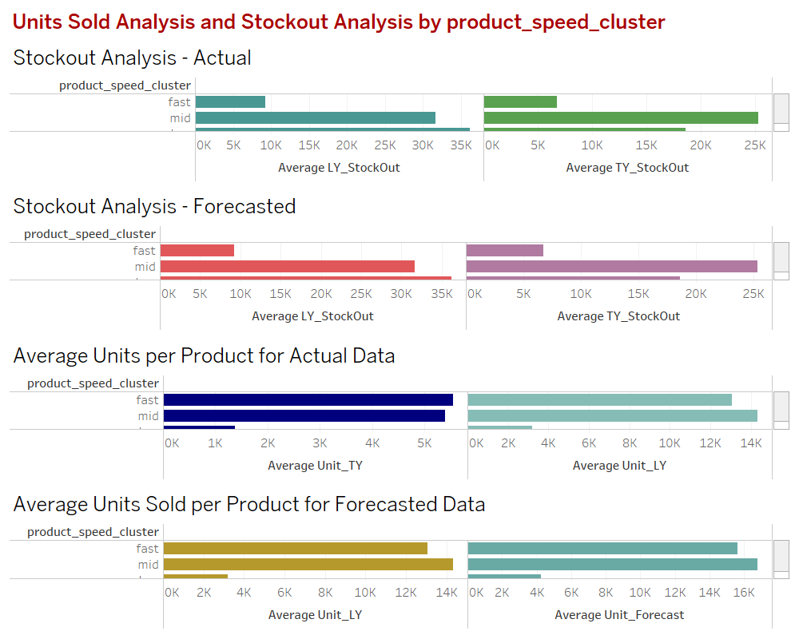

Slide 4
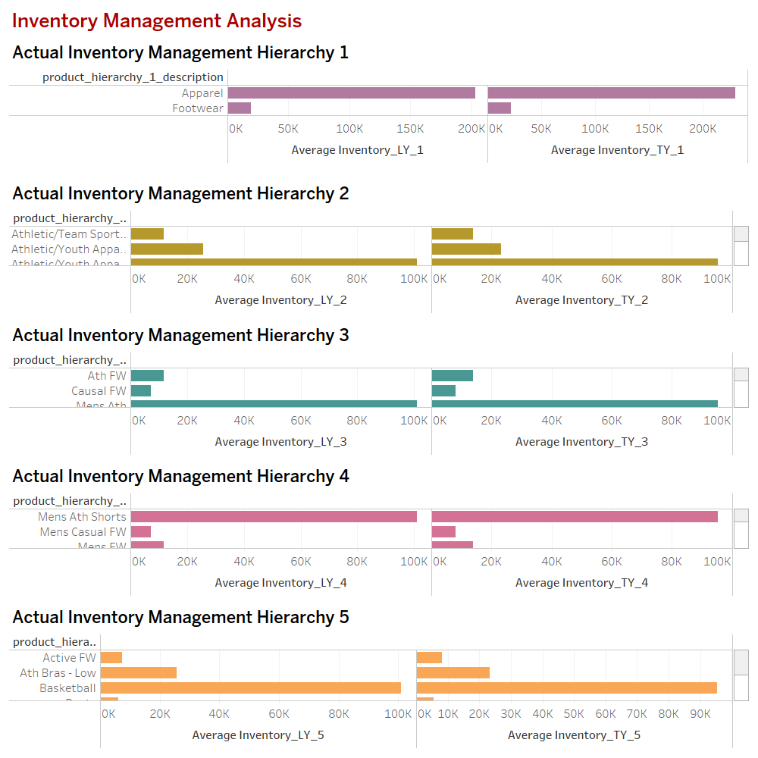

Slide 5
