Slide 1

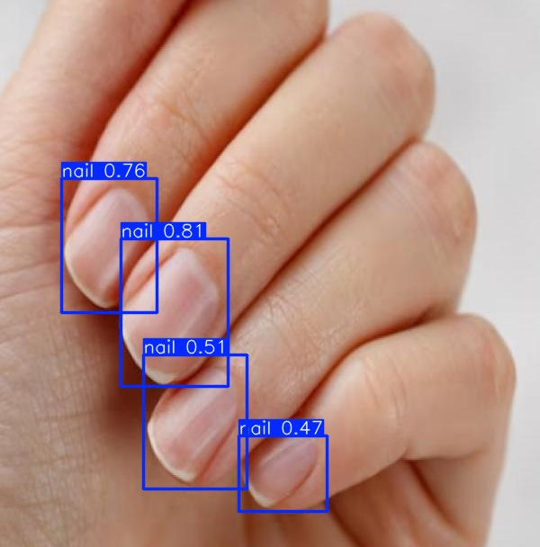
Nail Melanoma Project
Statistical Analysis and Detection Performance from different CNN Models
Supervisor: Juan Prada
Second Examiner: Thomas Dandekar
Ayca Öztürk, 2777497

Slide 2
Results of the Bounding Box Algorithm: Precision, Recall and F1-Scores from the Confusion Matrices
  dataset: 831 images (70% train, 20% val, 10% test)
  optimizer: auto conf: 0,3 lr0=0,01
 | epochs | batch | precision | recall | F1-Score
1 | 20 | 8 | 0,91 | 0,99 | 0,951
2 | 20 | 16 | 0,90 | 0,99 | 0,949
3 | 20 | 32 | 0,95 | 1 | 0,975
4 | 50 | 8 | 0,92 | 0,99 | 0,957
5 | 50 | 16 | 0,91 | 1 | 0,953
6 | 50 | 32 | 0,89 | 0,99 | 0,942
7 | 100 | 8 | 0,95 | 0,98 | 0,967
8 | 100 | 16 | 0,92 | 0,99 | 0,954
9 | 100 | 32 | 0,93 | 0,99 | 0,958
Epoch: One full pass of the entire training dataset.
Batch: A small subset of dataset processed together before updating the model.

Slide 3
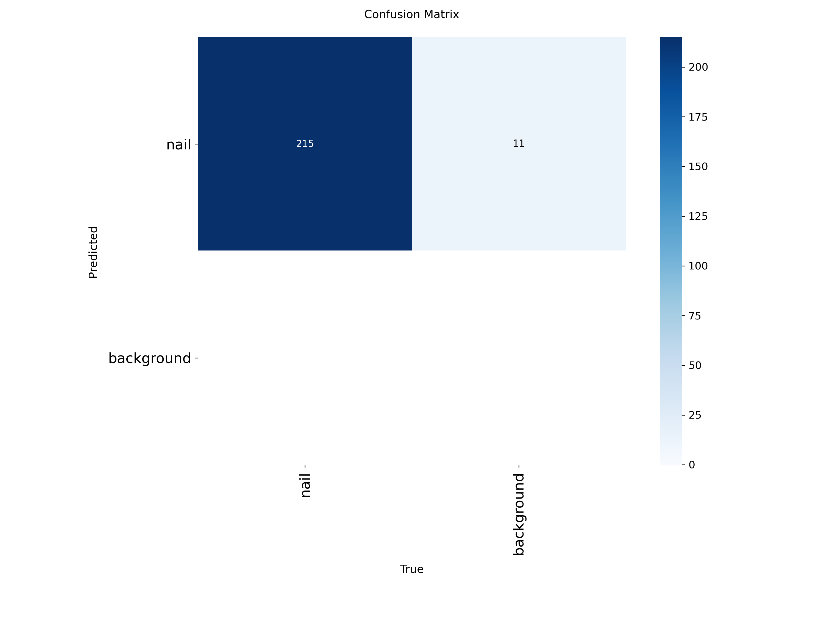
Confusion Matrix of the model for bounding box algorithm (epoch=20, batch=32, conf=0,3)

Slide 4
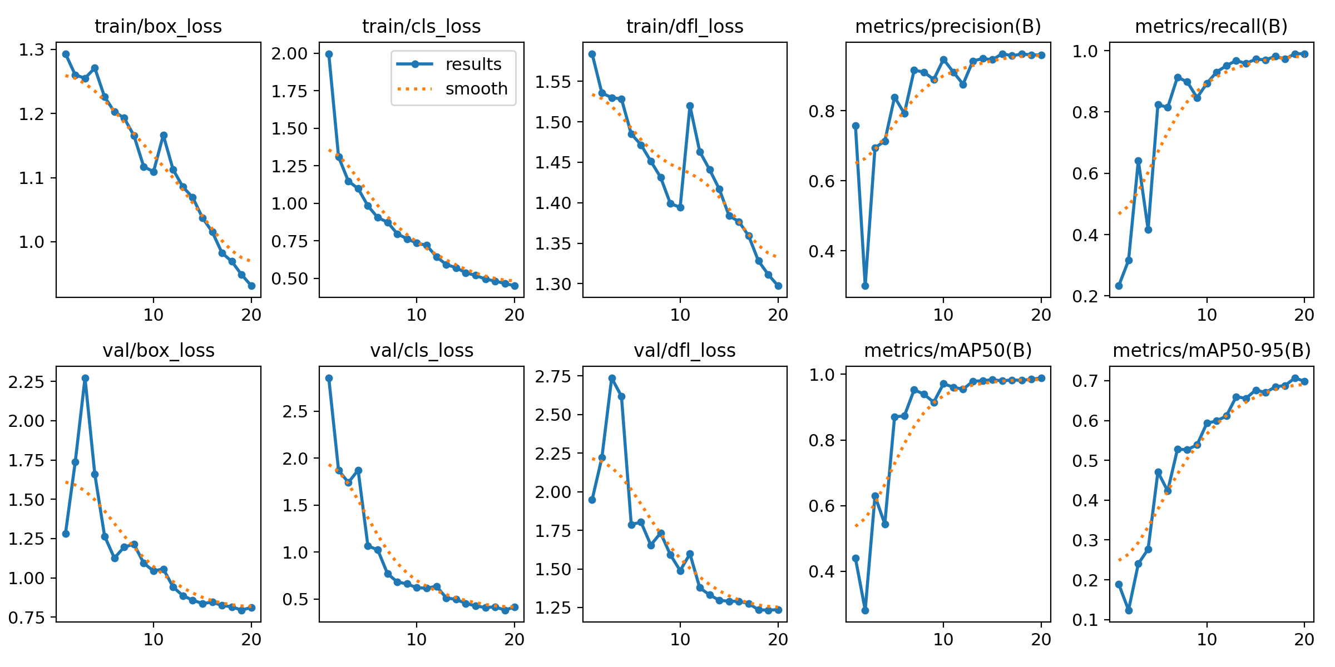
Results of the model for bounding box algorithm (epoch=20, batch=32, conf=0,3)

Slide 5
Current Dataset with Numbers
831 images → 491 images from healthy people (59%)
→ 340 images from people with nail melanoma (41%)
→ 1381 nails in total (847 healthy nails, 534 melanoma nails)
Bounding Box Algorithm could detect 1462 nails → 883 healthy
→ 579 melanoma
According to the results from bounding box: 7 false negative
17 false positive
Reason why 883 detected healthy nails > 847 labeled healthy nails: While creating the dataset, thumbs and some of the fingers were not labeled due to their positions, in case they could confuse the training of the model. However, on some images, those unlabeled nails were successfully detected by the model
from the excel file (folder names of the images were tracked for the statistical result)

Slide 6
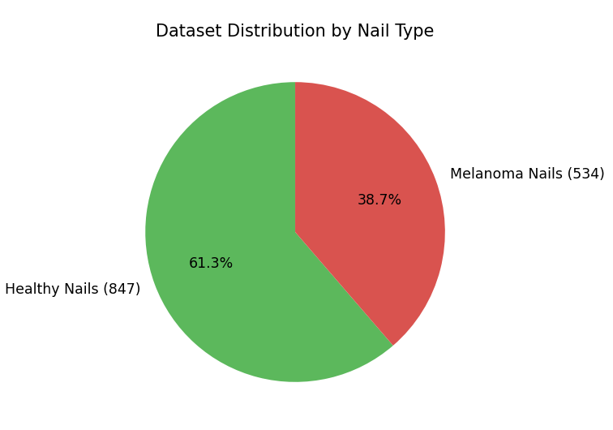

Slide 7


 | Labeled | Detected | Difference | FN | FP | TP
Healthy | 847 | 883 | +36 | 7 | - | 883
Melanoma | 534 | 579 | +45 | - | 17 | 562
Total | 1381 | 1462 | +81 | 7 | 17 | 1445
Precision = $\frac{TP}{TP+FP} = 0,988$​
Recall = $\frac{TP}{TP+FN} = 0,995$
F1-Score= 2 $×\frac{Precision × Recall}{Precision + Recall} =0,991$
The overall F1-score of 0.991 indicates a good balance between precision and recall.

Slide 8
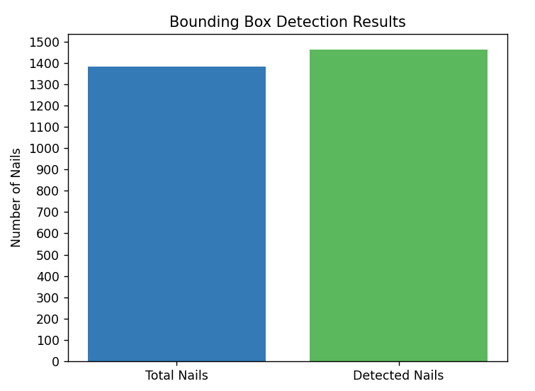
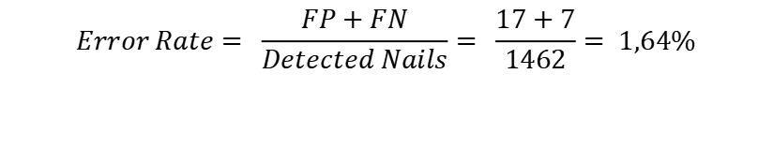
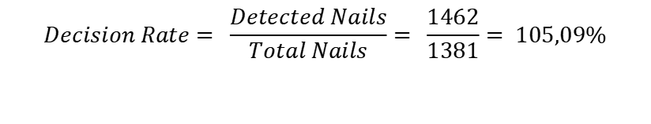
$$Decision Rate= \frac{Detected Nails}{Total Nails}= \frac{1462}{1381}= 105,09\%$$
$$Error Rate= \frac{FP+FN}{Detected Nails}= \frac{17+7}{1462}= 1,64\%$$
The model achieved a detection rate of 105.9% and even detected some unlabeled nails (possibly thumbs or tilted nails), suggesting generalization beyond the training labels, with an overall error rate below 2%.

Slide 9
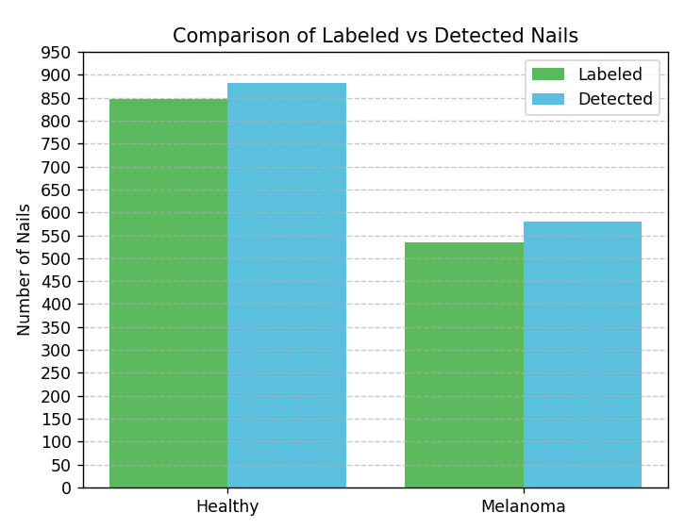

Slide 10
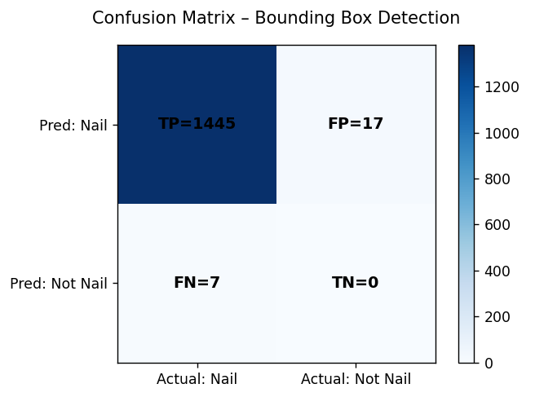

Slide 11
The model performs slightly better for healthy nails, likely due to higher visual consistency, while melanoma nails show more variability in shape and color
Class | Precision | Recall | F1-Score
Healthy | 1,000 | 0,992 | 0,996
Melanoma | 0,971 | 1,000 | 0,985

Slide 12
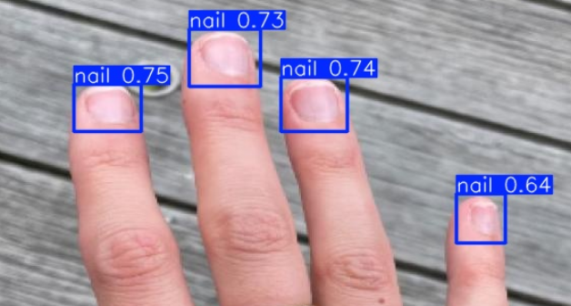
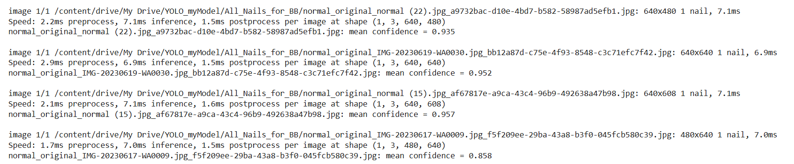
Confidence Score Analysis
An extra feature was added to the bounding box algorithm: For each image, the mean confidence value (mean value of each detected nail box) gets calculated.
Distribution of these values are used for the analysis.
An example output from the program

Slide 13
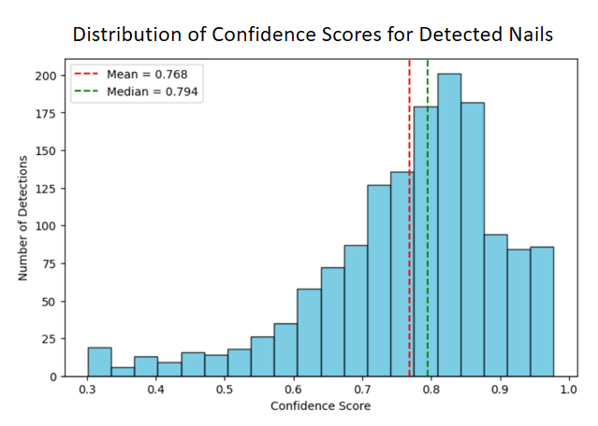

Confidence Score Analysis
Overall mean confidence: 0.7680 $≈ 77\%$
Median confidence: 0.7945
Standard deviation: 0.1337 →suggests moderate
variation across detections
Most detections have confidence scores between 0.7 and 0.9
The model is generally confident and consistent in detecting nails
A few lower confidence score detections likely correspond to difficult lighting or angles.

Slide 14
Error Types & Reasons why actual and result numbers do not align
overly zoomed nail pictures → led to FP
colorful background → led to FN
hand in bad position → led to FN
color/contrast of the nail → led to FP and FN
unlabeled nails in the preprocessing →
led to a nigher number of detected nails (good sign that model is learning)
→ Data augmentation can be improved for more accurate results

Slide 15
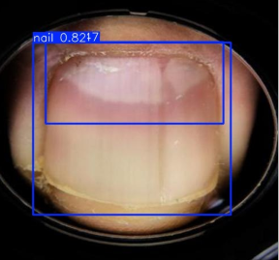
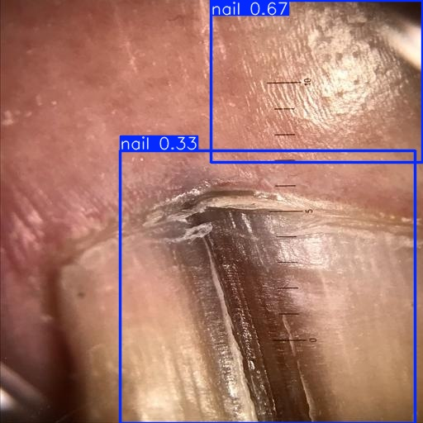
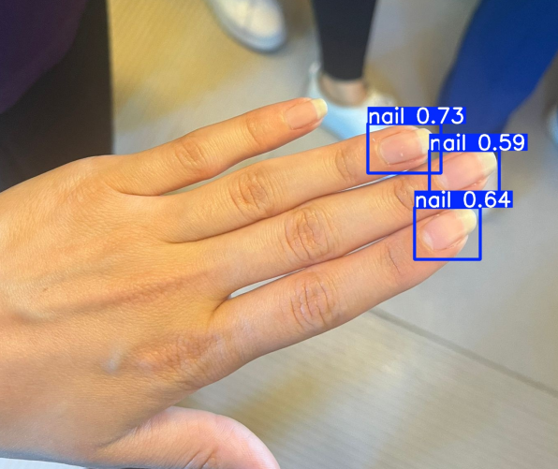
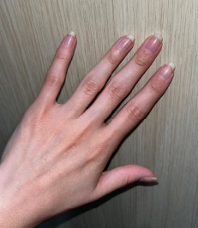
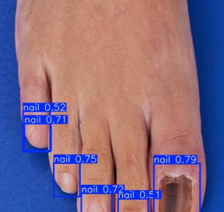
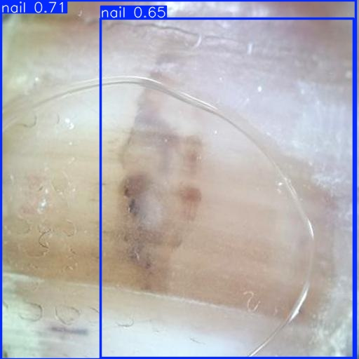
Error Examples

Slide 16
Benchmark Comparison of CNN Models (from Github) for Image Classification
Classes: healthy vs melanoma
EfficientNetB0 (high accuracy with low comp cost, lightweight, good for transfer learning)
Vision Transformer ViT-B/16 (requires a large dataset, global understanding of the image, uses self attention, offers explainability → important for medical uses)
ResNet18 (stable learning, high accuracy, good for transfer learning)
SwinTransformer (computationally efficient, strong generalization and transfer learning)
Vgg19 (simple architecure, high accuracy, well-studied, good for explainability)
YOLO (new versions can be used for image classification as well)

Slide 17
Dataset Structure
│── train/
│ │── healthy/
│ └── melanoma/
│── test/
│ │── healthy/
│ └── melanoma/
│── val/
│ │── healthy/
│ └── melanoma/

Slide 18
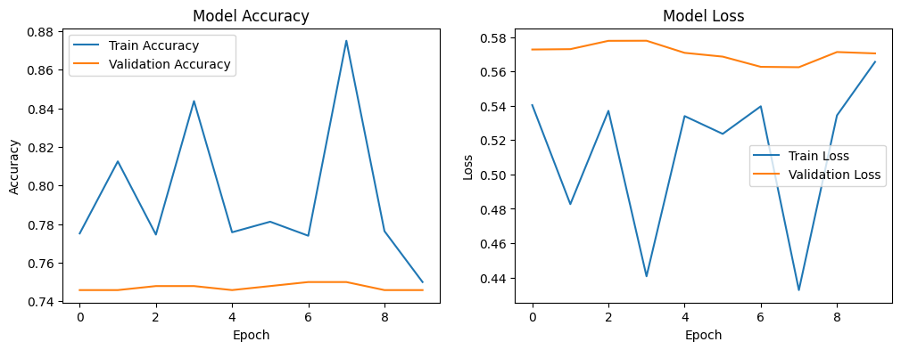
EfficientNetB0
sign of overfitting: learns the training data inconsistently and fails to classify the unseen data
train accuracy: its variability shows that the model is unstable during training
validation accuracy: remains flat around 0.745-0.75, showing no real improvement
train loss: varies irregularly, not stable
validation loss: starts high, varies a lot and stays high in the end
Validation loss not decreasing means the model isn’t improving its generalization

Slide 19
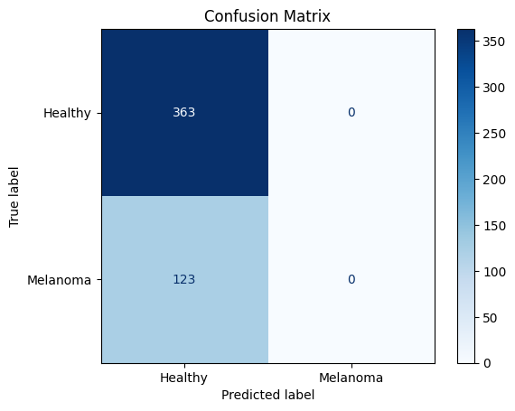
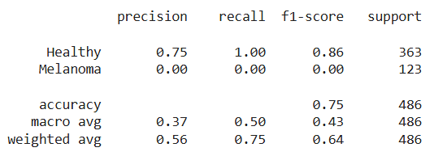
Confusion Matrix and other Metrics
The model classifies every image as “Healthy”, no matter what the true label is.
  All Healthy images are predicted correctly (TP).
  All Melanoma images are incorrectly classified as Healthy (FN).
The model fails to detect Melanoma cases.
Healthy class:
  F1 = 0.86 : good because this class dominates.
Melanoma class:
  Precision = 0.00, Recall = 0.00 → the model never predicts this class.
  F1 = 0.00 → total failure to recognize Melanoma.
Conclusion:
  The model learned only the majority class (Healthy)
  Severe bias likely caused by class imbalance (too few Melanoma nails)

Slide 20
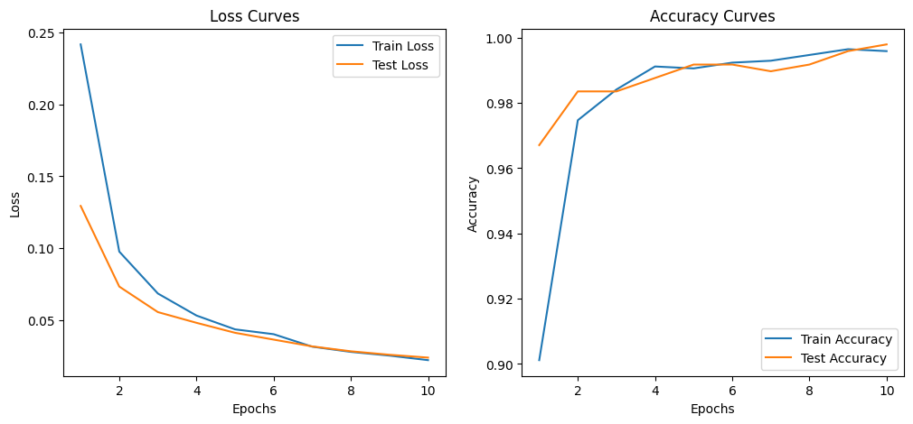
Vision Transformer ViT-B/16
Loss curves :
  Both training loss and test loss steadily decrease with epochs
  The model is learning effectively and generalizing well
  No major overfitting
Accuracy Curves:
  Training accuracy increases quickly to almost 1.0.
  Test accuracy increases similarly, also approaching 1.0
  The model is achieving a good performance on both sets.
  stable learning

Slide 21
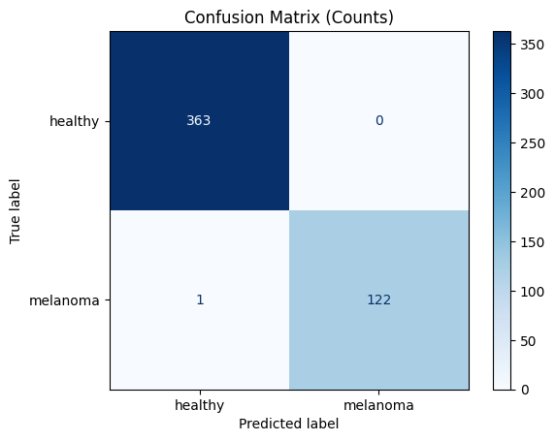
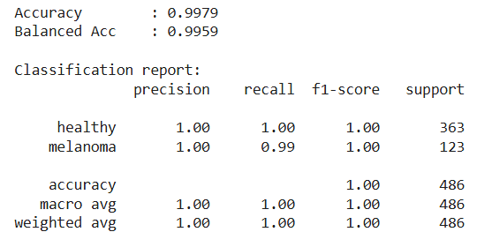
363 healthy images correctly classified as healthy.
122 melanoma images correctly classified as melanoma.
Only 1 melanoma image was misclassified as healthy.
Model detects almost all melanomas.
It does not confuse healthy nails as melanoma.
Training appears stable and well-generalized.
Precision, Recall and F1-Score are high
almost perfect classification
Conclusion: model is learning
performs well
makes accurate decisions

Slide 22
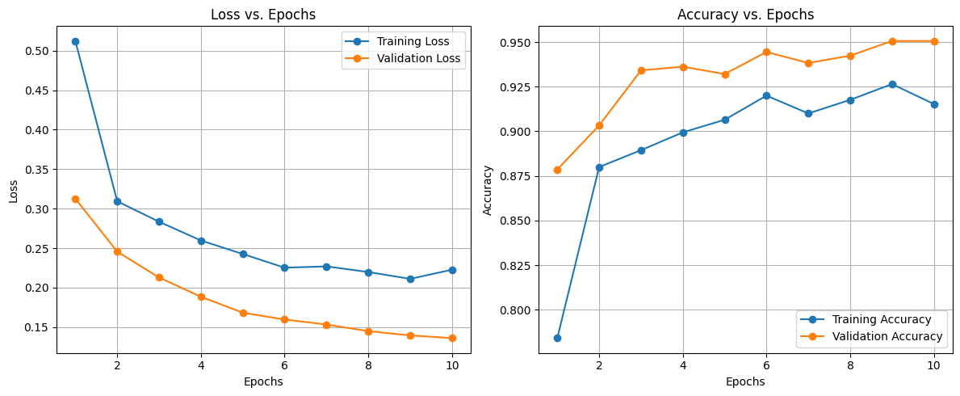
ResNet18
Loss Curves:
  Training loss starts high and decreases steadily to 0.2.
  Validation loss starts lower and drops continuously to 0.13
  These show that model is learning
  No major overfitting, model is stable
Accuracy Curves:
Both training and validation accuracy are increasing
Model performs well

Slide 23
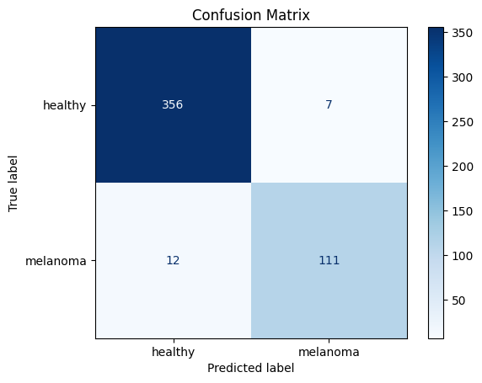
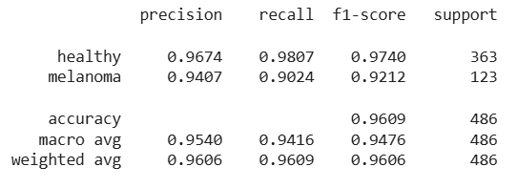
Out of 363 healthy images, the model correctly classified 356 and mislabeled 7 as melanoma (FP).
Out of 123 melanoma images, the model correctly detected 111 and missed 12 (FN).
The model performs well on both classes and shows no severe bias
Precision (Melanoma = 0.94): When the model predicts melanoma, it’s almost always correct, leading to few false alarms.
Recall (Melanoma = 0.90): It catches 90% of actual melanomas.
F1 (Melanoma = 0.92): Overall performance on melanoma detection is good and balanced.
Conclusion: The model generalizes well and rarely misclassifies

Slide 24
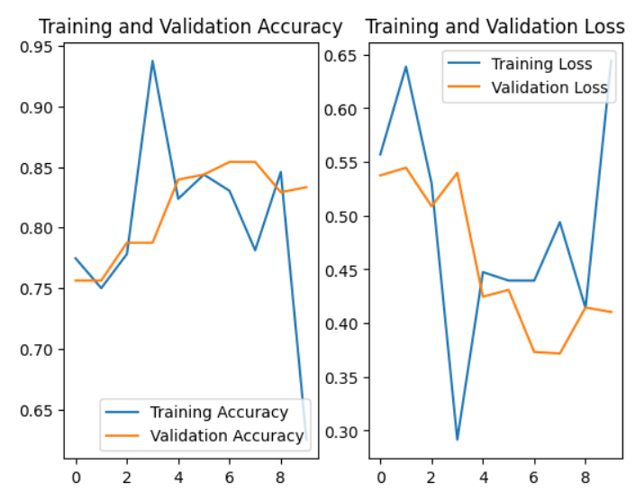
Swin Transformer
Accuracy Curves:
  Training accuracy fluctuates heavily and then drops, means optimization isn’t smooth
  Validation accuracy being smoother and consistently high shows that the model generalizes well, despite unstable training.
Loss Curves:
  Training loss drops strongly, then increases again later
  Validation loss decreases but then fluctuates in the middle
  → unstable optimization

Slide 25
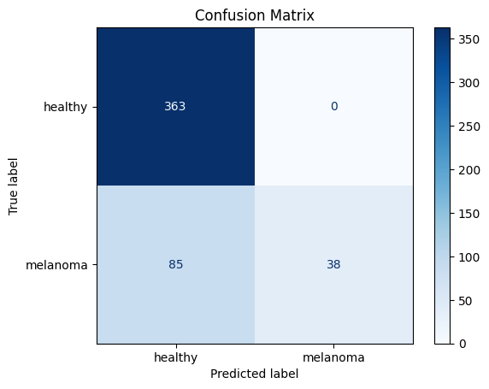
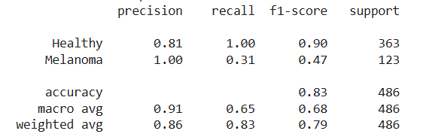
The model correctly identifies all Healthy cases.
But for Melanoma:
  Only 38 out of 123 are correctly detected
  85 melanomas were misclassified as healthy → FN
Conclusion: The model is partially successful but unbalanced:
  It has learned to detect Healthy nails, but it still misses most Melanoma cases, which are clinically critical.

Slide 26
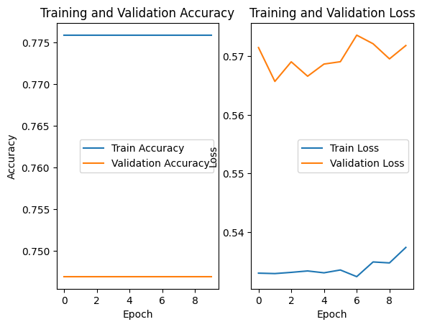
Vgg19
Accuracy Curves:
  training accuracy is completely flat around 0.78, it is not learning through the epochs.
  validation accuracy is also flat, showing zero improvement.
Loss Curves:
  training loss shows small fluctuations, it is almost constant → no real improvement
  validation loss stays high

Slide 27
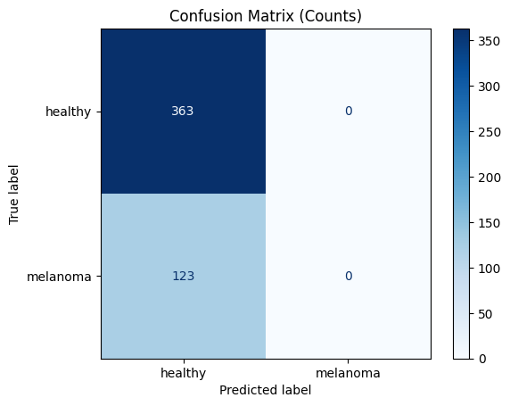
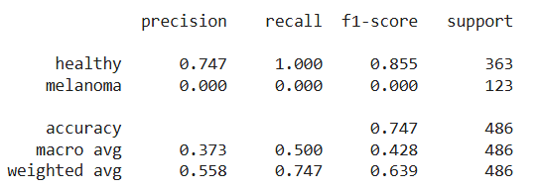
All images, regardless of whether they were healthy or melanoma, were predicted as healthy.
  So the model completely failed to detect the Melanoma class.
The model memorized the majority class.
Conclusion: the model doesn‘t make meaningful decisions for melanoma detection

Slide 28
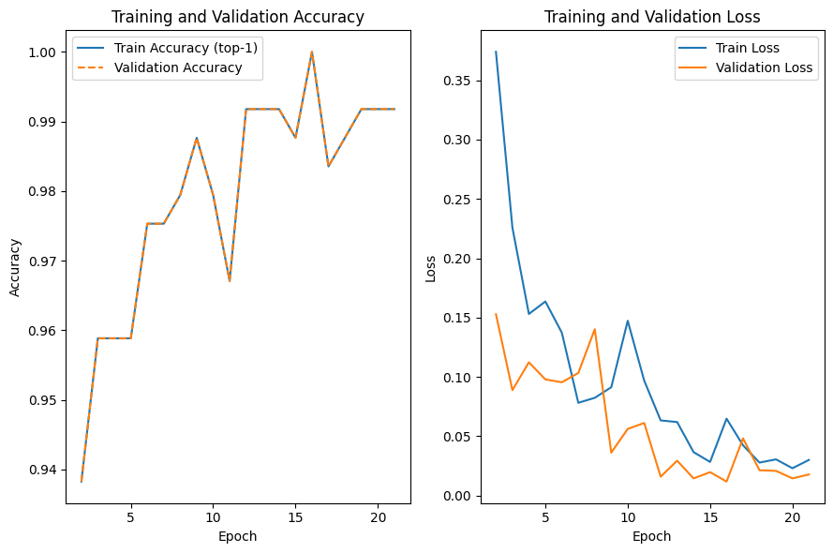
YOLO
Accuracy Curves:
  Both training and validation accuracy are increasing → the model is learning
  The curves overlap → no sign of overfitting
Loss Curves:
Both training and validation losses drop sharply in the first few epochs, then continue to decrease gradually.
The model is confident and consistent in its predictions

Slide 29

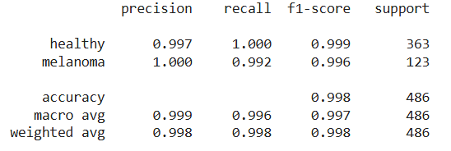
Out of 363 healthy images, the model predicted all 363 correctly, zero FP.
Out of 123 melanoma images, 122 were correctly identified and 1 was missed (FN).
Model detects almost all melanomas.
It does not confuse healthy nails as melanoma.
Training is stable and well-generalized.
Precision, Recall and F1-Score are high.
Conclusion: In total, 485 out of 486 test samples are correct → very good accuracy and balance
The ideal scenario for a binary medical classification model

Slide 30
Best Model(s)
With an accuracy of 99% in melanoma detection, ViT-B/16 and YOLO show strong potential.
Confusion Matrix of ViT-B/16 and YOLO (they have the same conf matrix)

Slide 31
What to do next to improve the model(s)?
class imbalance can be fixed (more melanoma images are needed)
experimenting with different hyperparameters (e.g. different epochs, batch sizes, optimizers, lr, etc.)

