Slide 1
Project3: Space Allocation Methods
13/05/2020

Slide 2
Notes
Please watch the related lectures or read the related sections from the book carefully before starting.
Please comment your code well:
On top of each functionality, I am expecting some lines explaining what you are trying to do.
If your comments show your understanding and you have some bug or missing a minor detail, you will not lose much points.
Please read the whole assignment including the analysis questions before starting, do not read a part and directly start implementing.

Slide 3
Goals
Understanding and implementing:
Contiguous allocation.
Linked allocation (using file-allocation table FAT).
Evaluate both methods on different inputs:
Each strategy has its strengths and weaknesses.
Understand the effect of the system operations pattern on the two alternatives strategies performance.
Decide when to use which.

Slide 4
Our directory Structure
Single level directory
No sub directories.
Directory components:
Directory content
Fix-sized list. Each entry corresponds to a block.
Directory table (DT)
Key-value map,
they key is file identifier
The value consists of the index of its first block in the file, its size.

Slide 5
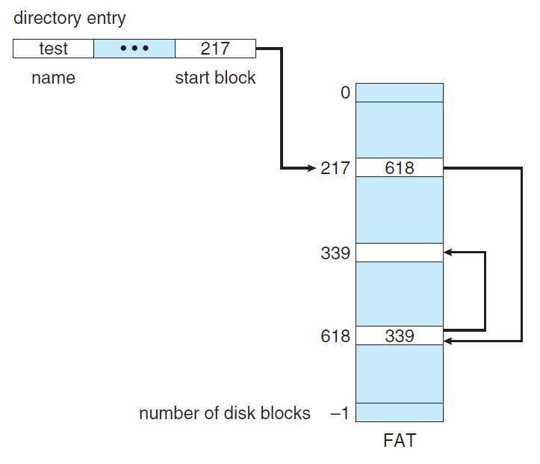
Directory structure-FAT
File allocation table.
We have no space available apart from:
The space to allocate the DT
Fully occupied with the DT.
The space for the directory contents.
You need to reserve some for the FAT.

Slide 6
Important Assumptions
Other than DT and FAT, you are not supposed to define any additional data structures
We assume you have additional fixed memory, e.g. a set of registers, sufficient to store fixed number of variables.
You have a space enough to hold one file-block, not more
E.g. if you want to move a file from location to another, you are not allowed to store the file blocks on a temporary data structure, you need to do it block by block.
We are not asking to do any write operations on a certain index within a block.
You can actually map a block to one integer.
Let us use zero to represent an empty block and a positive integer to indicate the block contents.
The block size will be used just to do some calculations.
Like returning the offset of a certain locations or calculating the number of blocks from the number of bytes upon file creation.
Assume each fat entry needs 4 bytes.
Other assumptions should be straight forward, However
Please read all of them from the assignment document and let me know in case of any ambiguities ASAP.

Slide 7
Code performance
Please pay some attention to your design performance.
For certain input/s linked allocation should be considerably faster, while for other/s it is considerably slower.
A poor implementation of one strategy may affect your conclusions about the strategy's efficiency – running time – compared to the other and your ability to analyze and interpret the results.
Your implementation does not have to be perfect or even excellent, just reasonable
E.g. do not use nested loops do something that can be done in one loop.

Slide 8
Create Operation
Allocate and fill a space in the directory contents equal to the number of blocks of the file
Note that the numbers in the input files for the creation operation in byes, you need to obtain the number of blocks.
When trying to allocate space for the file:
There is space
Linked
Allocate.
Contiguous
The space is contiguous (implement first fit algorithm to find a contiguous space, best fit is much slower)
Allocate
Else
Defragment then allocate.
There is no
Reject.

Slide 9
Allocation Effect
Upon allocation you need to modify
Directory content.
Directory table (DT).
Add a new file entry, its starting position and size.
The file identifier maybe obtained using its appearance order in the creation sequence.
E.g. the file created by the first create operation has in the input file a file_id of 0, the second has a file_id of 1,….
If linked allocation:
Update the FAT.

Slide 10
Defragmentation
For simplicity and to have consistent results:
Let‘s do defragmentation in one direction.
From high to low.
Having adaptive defragmentation implementation may affect (enhance) some results given that no additional data structures are allowed.
No need to spend time on this.
indx | 0 | 1 | 2 | 3 | 4 | 5 | 6 | 7 | 8
content | 3 | 3 | 1 | 0 | 0 | 5 | 7 | 0 | 9

Slide 11
Access operation
Given the offset from the beginning of a file:
Return the offset from the beginning of the directory.
If the location beyond the file limit,
Return -1.

Slide 12
Extension operation
Extend the file by the given number of blocks
There is a space:
Linked:
Extend
Contiguous:
The space is contiguous
Extend
Else
Try to defragment and handle, if not doable reject.
There is no space:
Reject.
Upon extension, you need to update content, DT, FAT.

Slide 13
Extension rejection consequences
The input files are generated so that if all the operations until K are done, K is a valid operation
If K is an access operation:
K should access a byte within the file.
If K is shrinking operation:
K should shrink the file by at most file_size - 1.
Since some extension operations may be rejected due to the lack of space
You need to reject any shrinking operation that results in having a file of size <= 0. A file must have at least one block.

Slide 14
Shrinking Operation
Shrinks a given file by the given number of blocks.
The shrinking will always be from the rear of the file.
The shrunk blocks may be filled up with zero to indicate they are free.
Any valid shrinking should leave at least one block in the file.
Note:
When we say that shrinking or extension target the rear e.g.
“For simplicity, the extension will always add blocks after the last block of the file”. This does not have to be absolute location in the directory contents; it is rather the relative order of the block in the file..

Slide 15
Results
The number of files that their creation is rejected.
The number of files that their extension is rejected.
The average running time of an operation. For this you should run with each input file 5 times and take the average over averages.
We are not expecting exact numbers for any of the results
Some implementation decisions may affect the number of rejections. We tried to give assumptions to narrow down this.
Your results should make sense.

Slide 16
Good Luck!

