Slide 1
Naive Bayes Classifier

Slide 2
Bayesian Methods
Our focus this lecture
Learning and classification methods based on probability theory.
Bayes theorem plays a critical role in probabilistic learning and classification.
Uses prior probability of each category given no information about an item.
Categorization produces a posterior probability distribution over the possible categories given a description of an item.

Slide 3
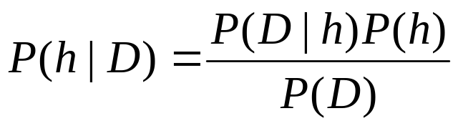
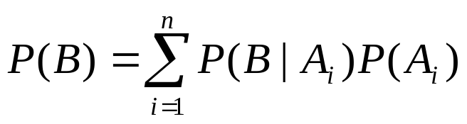
Basic Probability Formulas
Product rule
Sum rule
Bayes theorem
Theorem of total probability, if event Ai is mutually exclusive and probability sum to 1

Slide 4
Bayes Theorem
Given a hypothesis h and data D which bears on the hypothesis:
P(h): independent probability of h: prior probability
P(D): independent probability of D
P(D|h): conditional probability of D given h: likelihood
P(h|D): conditional probability of h given D: posterior probability

Slide 5
Does patient have cancer or not?
A patient takes a lab test and the result comes back positive. It is known that the test returns a correct positive result in only 98% of the cases and a correct negative result in only 97% of the cases. Furthermore, only 0.008 of the entire population has this disease.
  1. What is the probability that this patient has cancer?
  2. What is the probability that he does not have cancer?
  3. What is the diagnosis?

Slide 6
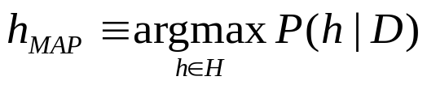
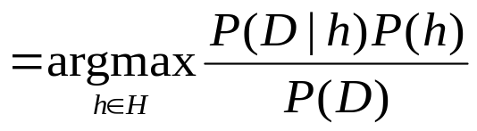
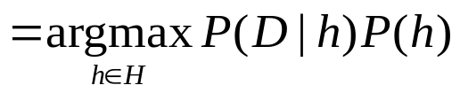
Maximum A Posterior
Based on Bayes Theorem, we can compute the Maximum A Posterior (MAP) hypothesis for the data
We are interested in the best hypothesis for some space H given observed training data D.
H: set of all hypothesis.
Note that we can drop P(D) as the probability of the data is constant (and independent of the hypothesis).

Slide 7
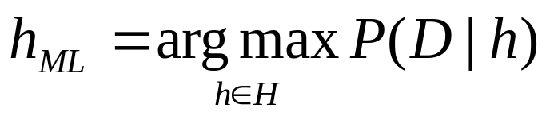
Maximum Likelihood
Now assume that all hypotheses are equally probable a priori, i.e., P(hi ) = P(hj ) for all hi, hj belong to H.
This is called assuming a uniform prior. It simplifies computing the posterior:
This hypothesis is called the maximum likelihood hypothesis.

Slide 8
Desirable Properties of Bayes Classifier
Incrementality: with each training example, the prior and the likelihood can be updated dynamically: flexible and robust to errors.
Combines prior knowledge and observed data: prior probability of a hypothesis multiplied with probability of the hypothesis given the training data
Probabilistic hypothesis: outputs not only a classification, but a probability distribution over all classes

Slide 9

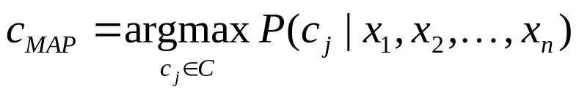
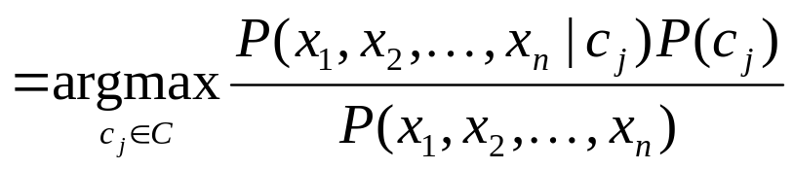
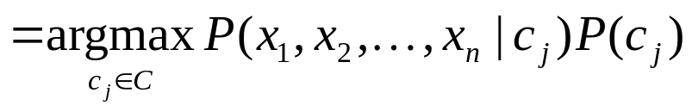
Bayes Classifiers
Assumption: training set consists of instances of different classes described cj as conjunctions of attributes values
Task: Classify a new instance d based on a tuple of attribute values into one of the classes cj ∈ C
Key idea: assign the most probable class using Bayes Theorem.

Slide 10
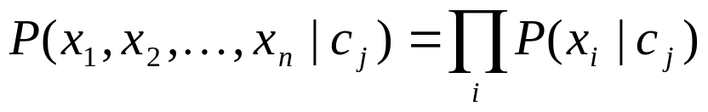
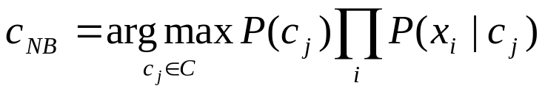
Parameters estimation
P(c_{j})
  Can be estimated from the frequency of classes in the training examples.
P(x₁,x₂,…,x_{n}|c_{j})
  O(|X|^{n}•|C|) parameters
  Could only be estimated if a very, very large number of training examples was available.
Independence Assumption: attribute values are conditionally independent given the target value: naïve Bayes.

Slide 11


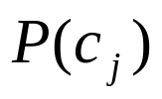
Properties
Estimating instead of greatly reduces the number of parameters (and the data sparseness).
The learning step in Naïve Bayes consists of estimating and based on the frequencies in the training data
An unseen instance is classified by computing the class that maximizes the posterior
When conditioned independence is satisfied, Naïve Bayes corresponds to MAP classification.

Slide 12
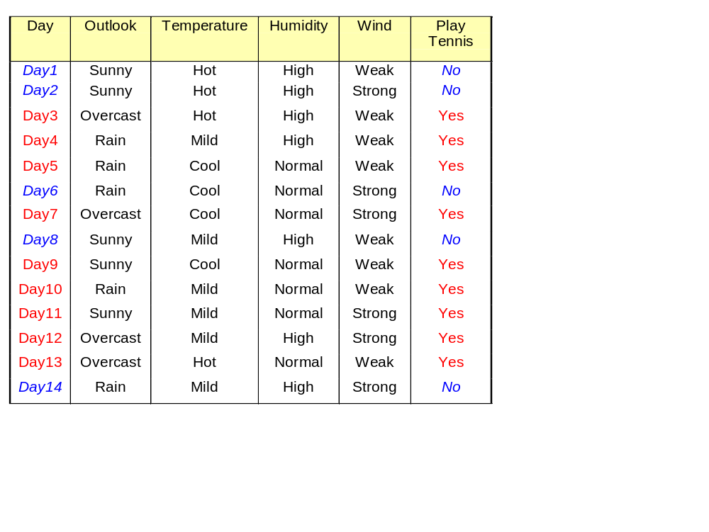
Example. ‘Play Tennis’ data
Question: For the day <sunny, cool, high, strong>, what’s the play prediction?

Slide 13


Naive Bayes solution
Classify any new datum instance x=(a₁,…a_{T}) as:
To do this based on training examples, we need to estimate the parameters from the training examples:
  For each target value (hypothesis) h
  For each attribute value a_{t} of each datum instance

Slide 14
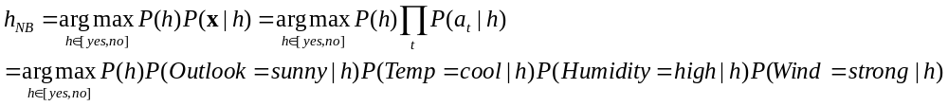
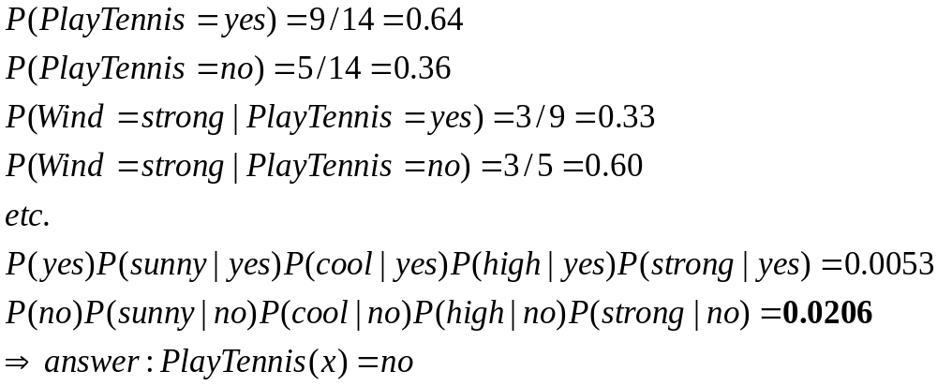
Based on the examples in the table, classify the following datum x:
x=(Outl=Sunny, Temp=Cool, Hum=High, Wind=strong)
That means: Play tennis or not?
Working:

Slide 15
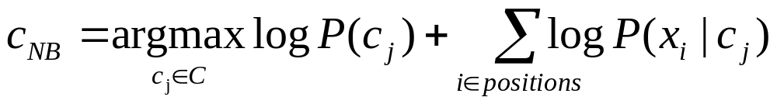
Underflow Prevention
Multiplying lots of probabilities, which are between 0 and 1 by definition, can result in floating-point underflow.
Since log(xy) = log(x) + log(y), it is better to perform all computations by summing logs of probabilities rather than multiplying probabilities.
Class with highest final un-normalized log probability score is still the most probable.

