Slide 1

British Airways Data Science Virtual Internship
Task 2:
Implementing Random Forest Algorithm
Written By Aydan Gadirzada

Slide 2
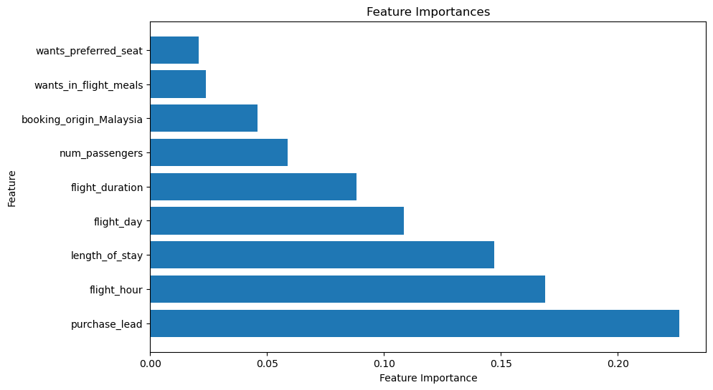
Predicting customer buying behavior
The Accuracy of the model: 85.22%
The Features most affecting the outcome:
purchase_lead
flight_hour
length_of_stay
flight_day
flight_duration

