Slide 1
Recognition of emotions in speech: overview and implementation
Aydar Musin

Slide 2
Emotions are important and recognizable:
People express emotion not only by facial expressions and gestures
We change acoustic characteristics of voice to express some emotion
There is many researches which associate this characteristics with emotions

Slide 3
Goals
consider research and take the best techniques
implement own solution for recognition of emotions

Slide 4
Where this technology can be used?
Robots
decision-making on interacting with people
generating emotional speech
analysis of quality in the services sector
Call-center

Slide 5
There are many research…
Their main differences on:
Features used for acoustic characteristics
Classification methods
Selected emotions

Slide 6
Acoustic characteristics of speech
Pitch (or fundamental frequency)
Loudness(or Energy, Intensity)
Formants (term from phonetics)
MFCC (Mel-frequency cepstrum, representation of the short-term power spectrum of a sound)
Notes:
In my thesis I distinguish two types of features

Slide 7
Features
Speaker dependent
Mean pitch
Mean intensity
Speaker independent
Pitch range, intensity range
Pitch DDS(Difference-Distance-Slope), Intensity DDS, Formants DDS, Center of gravity of spectrum, mean phrase duration, mean silence duration

Slide 8
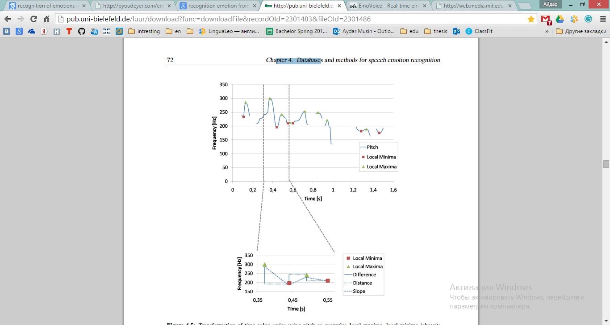
DDS (Difference – Distance- Slope)
[1]

Slide 9
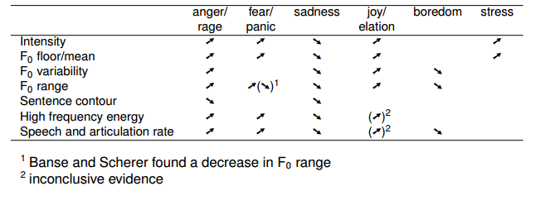
Selected emotions
some emotions have very similar acoustic characteristics
trade-off between accuracy and number of recognizing emotions
Stefan Steidl; October 26, 2010;” Vocal Emotion Recognition”; ICSI

Slide 10
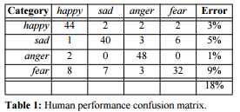
How well a human does in classifying?
Frank Dellaert, Thomas Polzin and Alex Waibel. Carnegie Mellon University. “RECOGNIZING EMOTION IN SPEECH”

Slide 11

Implementation

Slide 12
Recognizing emotions
Extraction of acoustic characteristics from sound file or microphone
Splitting speech to phrases or words
Features extraction from acoustic characteristics
Classification

Slide 13
Extraction of acoustic characteristics
The main problem is noises. To solve it we can use:
Pass-band filter
standard deviation to exclude some random artefacts

Slide 14
Extraction of acoustic characteristics
PRAAT- phonetics software package (www.praat.org)
Has scripting language
Provides extraction for all needed characteristics and filtering

Slide 15
Extraction of acoustic characteristics
Filtering
Pass band filtering by human speech frequency range
Noise removing
Acoustic characteristic which we will use:
Pitch (or F0)
Energy (or Intensity, loudness)
Formants: 1, 2, 3. Or F1, F2, F3
Center of gravity of spectrum

Slide 16
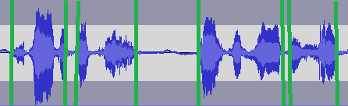
Splitting speech to phrases or words

Slide 17
Features extraction
These features can be calculated from acoustic characteristics and which we will use:
Pitch: range, variance, DDS.
Intensity: range, variance, DDS
F1, F2, F3,F4: DDS.
Mean phrase duration, mean silence duration
Centroid – center of gravity of spectrum

Slide 18
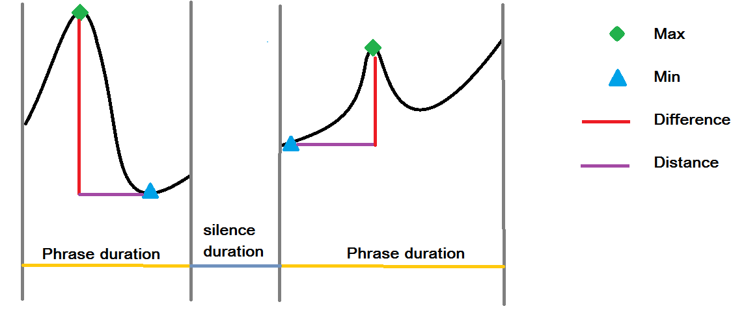
Pitch DDS

Slide 19
Features extraction
Compute all these features for three basic emotions: angry, happiness, sadness from training set
As a training set: EmoDB- records with different emotions

Slide 20
Features
 | PitchDIf | PitchDis | IntDif | IntDis | F1Dif | ddsF1Dis | F2dif | F2Dis | F3Dif | F3Dis | Pitch Range | Int Range | Pitch Variance | Int Variance | Phrase Duration | Silence Duration | Centroid
anger | 137,08 | -6 | 22,22 | 6,44 | 239,44 | -1,71 | 349,82 | -1,42 | 355,51 | -0,4 | 465,16 | 31,36 | 7253,96 | 46,19 | 28,9 | 5,2 | 580,3
happy | 211,55 | -10,125 | 22,92 | -5,83 | 228,16 | -5,87 | 318,56 | -3,15 | 359,38 | -2,28 | 406,37 | 28,95 | 10823,92 | 41,20 | 38,16 | 4,45 | 519,54
sadness | 67,32 | -19,33 | 19,633 | -7,41 | 210,52 | -9 | 340,58 | -2,32 | 449,35 | -0,33 | 150,06 | 28,865 | 1737,46 | 35,10 | 39,58 | 5,37 | 359,085
neutral | 64,65 | -8 | 18,76 | -3,2 | 193,49 | -1,66 | 299,02 | 0,66 | 425,46 | 2,6 | 457,2 | 27,61 | 6720,77 | 36,24 | 24,66 | 5,4 | 350,02

