Slide 1
Recognition of emotions in speech: overview and implementation
Aydar Musin
Supervisor: Max Talanov

Slide 2
Outline
Introduction
Overview
Implementation
Results
Conclusions and further work

Slide 3
Emotions are important and recognizable:
People express emotions not only by facial expressions and gestures
We change acoustic characteristics of voice to express some emotion
There are many studies which associate these characteristics with emotions

Slide 4
Where this technology can be used?
robots
decision-making on interacting with people
generating emotional speech
estimation of customer service
Call-center

Slide 5
Goals
distinguish differences between recognition techniques
implement prototype
compare recognition accuracy with different parameters

Slide 6
Overview

Slide 7
There are many studies…
Their main differences on:
Acoustic characteristics
Features
Classification methods
Selected emotions
Training set

Slide 8
Acoustic characteristics of speech
Pitch (or fundamental frequency)
Loudness(or Energy, Intensity)
Formants (term from phonetics)
MFCC (Mel-frequency cepstrum, representation of the short-term power spectrum of a sound)
Notes:
In my thesis I distinguish two types of features

Slide 9
Features
Speaker dependent – based on average values for speaker
Mean pitch, mean intensity.
Divided training set for every person is required
Speaker independent – based on voice signal dynamics
Pitch, intensity variance;
Pitch DDS(Difference-Distance-Slope), Intensity DDS, Formants DDS, Center of gravity of spectrum, mean phrase duration, mean silence duration

Slide 10
Classification
Binary decision tree
SVM (Support vector machine)
ANN (Artificial Neural Networks)
Naïve Bayes classifier
Fuzzy rules

Slide 11
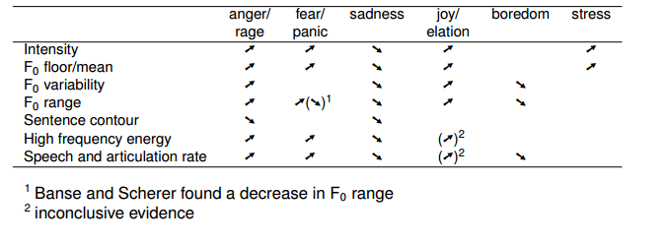
Selected emotions
some emotions have very similar acoustic characteristics
trade-off between accuracy and number of recognizing emotions
Stefan Steidl; October 26, 2010;” Vocal Emotion Recognition”; ICSI

Slide 12
Implementation

Slide 13
Steps
Extraction of acoustic characteristics from sound file
Splitting speech to phrases or words
Features extraction from acoustic characteristics
Classification

Slide 14
Extraction of acoustic characteristics
Filtering
Pass band filtering by human speech frequency range
Noise removing
Acoustic characteristics:
Pitch (or F0)
Energy (or Intensity)
Formants: 1, 2, 3. Or F1, F2, F3
Center of gravity of spectrum

Slide 15
Extraction of acoustic characteristics
PRAAT- phonetics software package (www.praat.org)
Has scripting language
Provides extraction for all needed characteristics and filtering

Slide 16
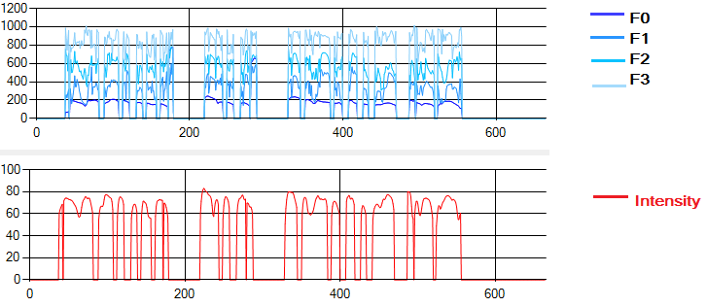
Extraction of acoustic characteristics

Slide 17
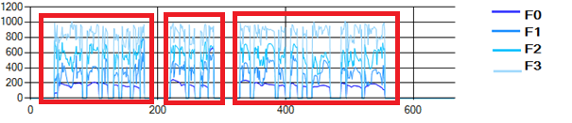
Splitting speech to phrases or words

Slide 18
Features extraction
Pitch: range, variance, DDS.
Intensity: range, variance, DDS
F1, F2, F3: DDS.
Mean phrase duration, mean silence duration
Centroid – center of gravity of spectrum

Slide 19
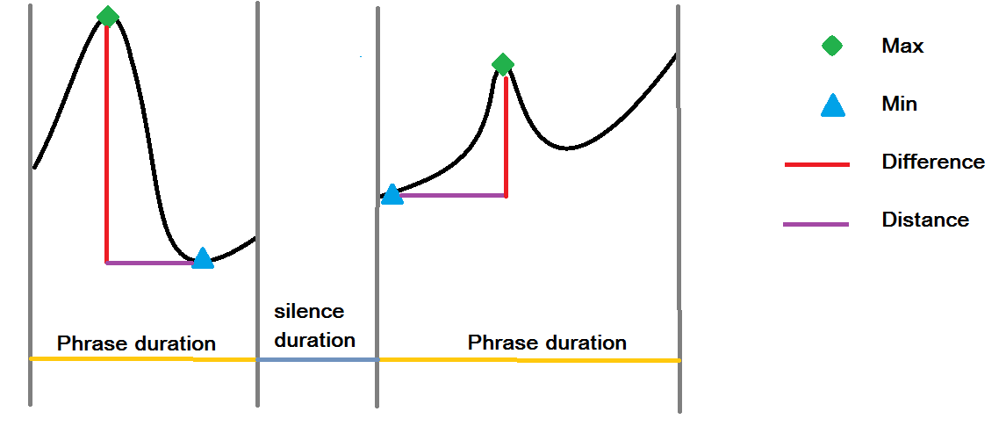
DDS

Slide 20
Training set
EmoDB
10 actors
7 emotions (anger, boredom, disgust, fear, happiness, sadness, neutral)
10 texts
>250 records for our goals (70% as a training set and 30 % for testing)
http://emodb.bilderbar.infoa

Slide 21
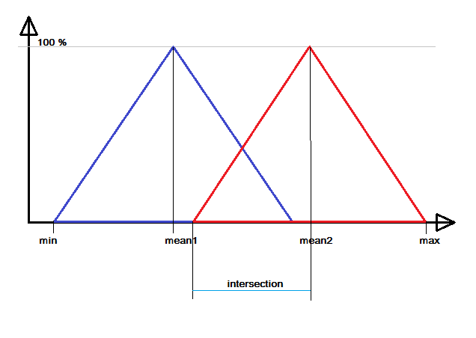
Classification using fuzzy sets

Slide 22
Classification using fuzzy sets
 | Anger | Happiness | Sadness | Neutral
Pitch range | High | High | Low | Low
Phrase duration | Low | High | High | Low
Intensity variance | High | High | Low | Low
…

Slide 23
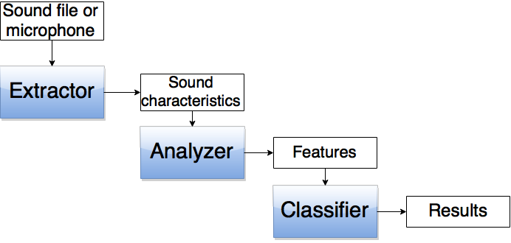
System as a whole

Slide 24
Testing

Slide 25

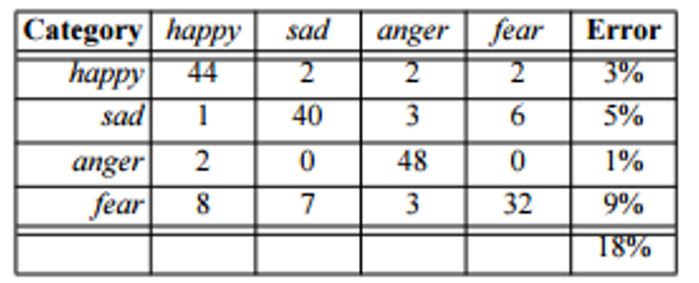
Human performance and ambiguity of emotions
”Recognizing emotion in speech”, Frank Dellaert, Thomas Polzin and Alex Waibel. Carnegie Mellon University.

Slide 26
Results with 4 basic emotions classification
Precision ~60 %
Recall ~65 %

Slide 27
Results with active-passive emotions classification
Precision ~75%
Recall ~83%

Slide 28
Conclusions and further work

Slide 29
Recognizable emotions
Selected emotions for recognition have influence to accuracy
recognizable emotions should be chosen specially for application domain of the system

Slide 30
What we can improve?
Acoustic characteristics
MFCC
Other spectral characteristics
Features
Less dependence with person speciﬁcs
Weights for features
Classification
Can be used other techniques: SVM, k-NN, or ANN.
Another training and test set

Slide 31
Thank you!

