Slide 1
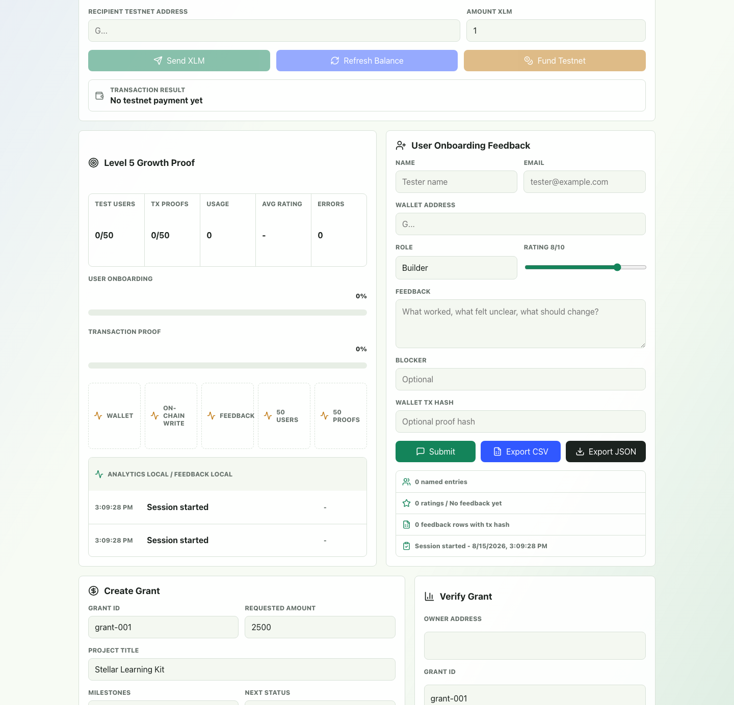
GrantPulse
On-chain mini-grant progress that builders and reviewers can verify.
Level 5 Blue Belt: user growth, product iteration, pitch and demo readiness
01
Notes:
[Sources]
- README.md: project overview, live demo URL, deployed Stellar Testnet contract ID.
- docs/screenshots/level5-growth-proof.png: Level 5 product screenshot used as visual evidence.

Slide 2
Small grant programs still lose trust in handoffs.
Hackathon, bootcamp, and microgrant teams often rely on private forms, screenshots, and manual reviewer notes. That makes progress hard to verify and harder to reuse.
Progress is scattered
Review is repetitive
Trust is fragile
Milestone status, reviewer decisions, and payment proof usually live in separate tools.
Reviewers need the same wallet, project, and status context for every update.
A promising project still needs public proof that activity happened on Testnet.
02
Notes:
[Sources]
- README.md: GrantPulse vision and target use cases for bootcamps, hackathons, and demo days.

Slide 3
GrantPulse turns grant progress into a verifiable workflow.
The app combines Freighter onboarding, Stellar Testnet transactions, and Soroban grant records so a project can show both product progress and wallet-backed evidence.
01
02
03
Wallet connection, Friendbot funding, balance and XLM transfer
Grant creation, milestone updates, reviewer approvals and archive
Telemetry, feedback, CSV and JSON exports for Level 5 proof
03
Notes:
[Sources]
- frontend/src/App.tsx: Freighter, Friendbot, XLM payment, grant workflow, feedback, and export UI.
- contracts/grantpulse/src/lib.rs: grant creation, milestone, review, archive, and read contract functions.

Slide 4
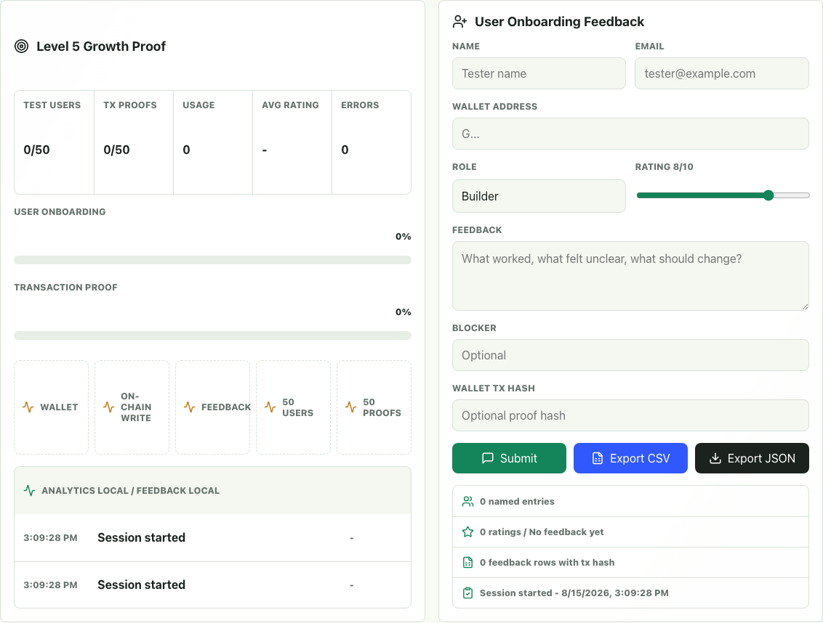
The demo flow mirrors real testnet usage.
1. Connect Freighter on Stellar Testnet
2. Fund the wallet if needed
3. Send a real XLM transaction
4. Create and update a grant
5. Submit named feedback with proof
6. Export CSV and JSON evidence
04
Notes:
[Sources]
- docs/demo/level5-demo-script.md: recommended Level 5 recording sequence.
- docs/screenshots/level5-growth-panel.png: Level 5 growth proof and feedback panel screenshot.

Slide 5
Architecture keeps proof close to the user action.
React + TypeScript UI
Stellar SDK + Horizon
Soroban contract
Evidence exports
Freighter wallet session, forms, evidence dashboard
XLM balance, Friendbot, payment and account funding
Grant storage, milestones, review state, archive flag
Local telemetry, feedback rows, CSV and JSON bundle
Every Level 5 proof item can be traced back to a wallet interaction, contract call, feedback row, or exported evidence file.
05
Notes:
[Sources]
- frontend/src/lib/grantpulse.ts: generated client connection to Stellar Testnet Soroban RPC.
- frontend/src/lib/telemetry.ts: local telemetry, feedback storage, Level 5 summary, CSV and JSON exports.
- contracts/grantpulse/src/lib.rs: on-chain grant lifecycle data model.

Slide 6
Level 5 proof targets 50 real users.
What will complete this slide
- 50+ Google Form rows
- 50+ wallet addresses
- Real transaction hashes or Stellar Expert URLs
- Analytics screenshots from the live app
- Feedback summary tied to commit links
06
Notes:
[Sources]
- docs/submission/level5-checklist.md: Level 5 user growth, proof, presentation, and technical standards.
- docs/submission/level5-user-feedback-export.xlsx: response workbook structure and target KPIs.

Slide 7
Growth strategy focuses on activation, evidence, and retention.
Acquire
Activate
Retain
Recruit Stellar bootcamp peers, hackathon builders, grant reviewers, and early community testers.
Guide each tester through wallet connect, funding, one transaction, and a grant action.
Use feedback themes to improve onboarding, then invite testers back for reviewer flows and project updates.
07
Notes:
[Sources]
- docs/submission/level5-feedback-iteration-summary.md: feedback themes and next phase decisions.

Slide 8
The next roadmap turns validation into ecosystem readiness.
Now
Next
After
Finish Level 5 proof
Reduce onboarding friction
Scale reviewer workflows
Collect 50+ tester rows, transaction hashes, screenshots, final demo, and README links.
Use feedback to simplify wallet setup, proof submission, and grant discovery.
Add project share links, reviewer queue, public campaign pages, and retention analytics.
08
Notes:
[Sources]
- docs/submission/level5-feedback-iteration-summary.md: next phase decisions and feedback-driven iteration placeholders.
- README.md: Level 5 documentation and submission requirements.

Slide 9
GrantPulse is ready for Level 5 field validation.
The product now has the user onboarding loop, evidence exports, documentation, pitch material, and demo script needed to complete the Blue Belt submission once real tester data is collected.
Final submission package: GitHub repository, live app, pitch deck, demo video, Excel export, feedback iteration summary, and 50+ real transaction proofs.
09
Notes:
[Sources]
- docs/submission/level5-checklist.md: final submission package requirements and status.
- docs/screenshots/level5-mobile-growth-proof.png: mobile responsive Level 5 product screenshot.

