Slide 1
Child Mode

Slide 2
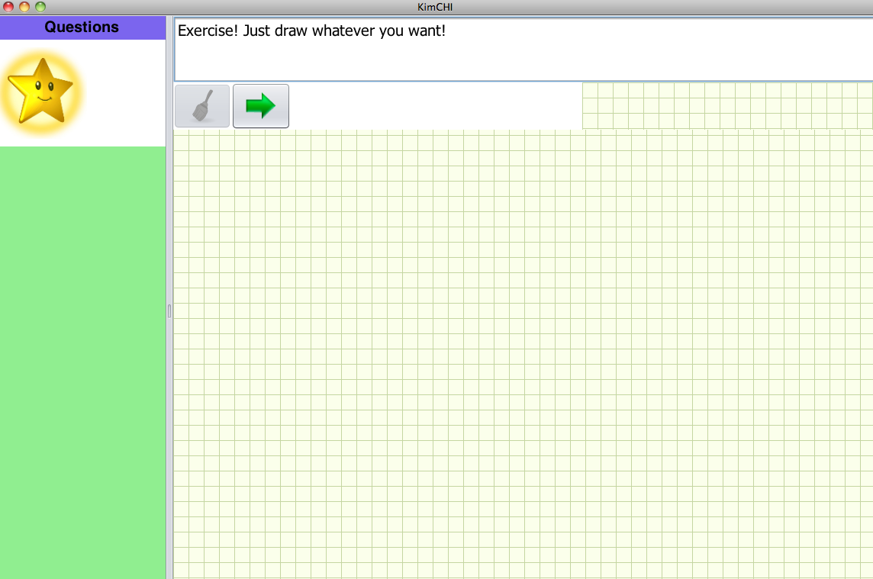
Gender: Boy or Girl
Age:

Slide 3


Slide 4


Slide 5

Draw a star as fast as possible

Slide 6
Draw a star as carefully as possible

Slide 7
Thank you!!!

Slide 8
Review Mode

Slide 9
Name | Age | Gender | Time | Error | Replay | Replay | Replay
user1 | 8 | Girl | #3-#1 | Rate? | Button | Button | Button
user2 | 9 | Boy |  |  | Button | Button | Button
user3 | 10 | Girl |  |  | Button | Button | Button
user4 | 11 | Boy |  |  | Button | Button | Button

