Slide 1
Solar Panel EDA
Aydin Hasanli

Slide 2
Data
Data is taken from Berkeley Lab Tracking the Sun Report
1.5 millions row collected by state agencies
1998-2018 installation data including cost, rebate, location technology
Null values were give as -9999, those points were cleaned up and
Two most important calculated columns are:
cost_per_KW = total installation cost over system size
cost_per_KW_with_rebate = (total installation cost - rebate) over system size

Slide 3
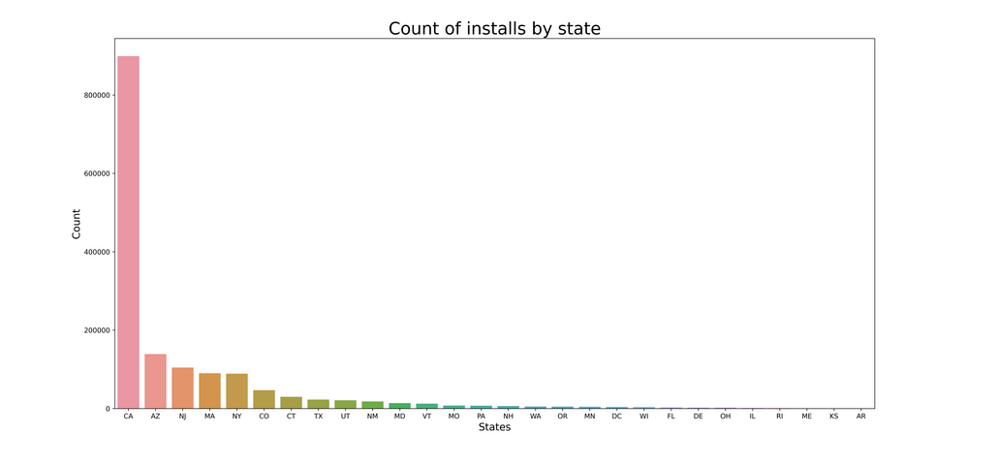
EDA State

Slide 4
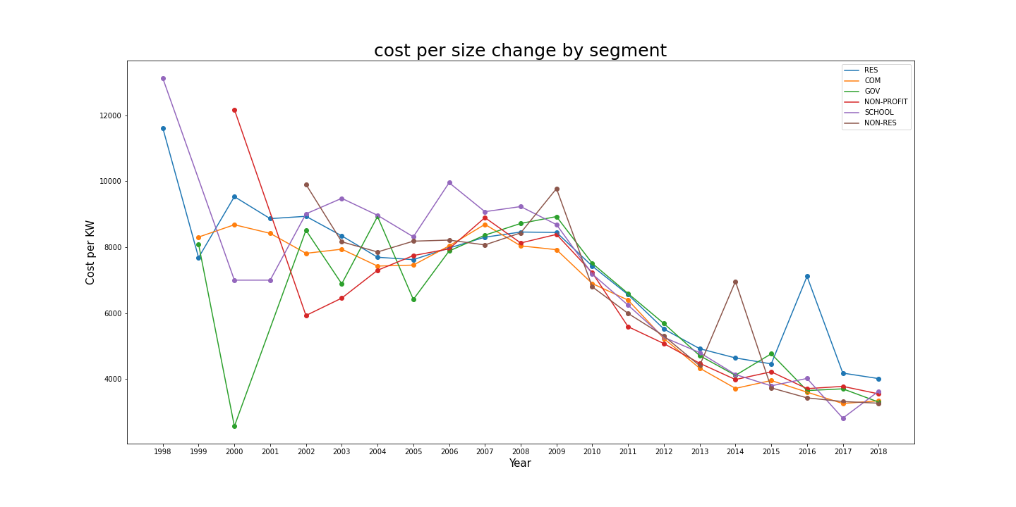
EDA Segments
94.4% are residential
Converge during recent years

Slide 5
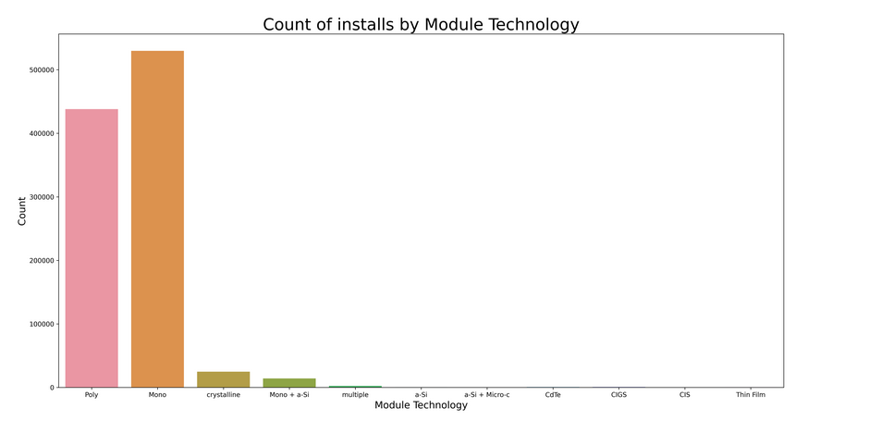
EDA Module Technologies
abbreviation | Full name
Mono | Monocrystalline Silicon Solar PV
Poly | Polycrystalline Silicon Solar PV
Thin Film | Thin Film Solar PV
CdTe | Thin Film Solar Cadmium telluride photovoltaics
CIGS | copper indium gallium diselenide
a-Si | amorphous thin-film silicon
CIS | Copper, Indium and Selenium
Mono and poly and the most common

Slide 6
Hypotethis testing Kruskal–Wallis test
Null hypothesys: Cost per KW is same the for all module technology types.
Alternative hypothesys: Cost per KW is same the for all module technology types.
Signnificance level threshold is 5%.
Kruskal–Wallis non-parametric method for two or more independent samples
Was used to perform Hypotethis testing of between several types of module technology.
Result of the test P-value is 0. We can reject Null Hypothesis

Slide 7
Statistically all groups are different. How about practically?
Module Technology | Mean | Median | P25 | P75 | Count
Mono | 4151.99815 | 4055.22 | 3298.25 | 4931.435 | 529920
Mono + a-Si | 4559.878288 | 4021.065 | 3250.06 | 5767.32 | 14122
Poly | 6154.772923 | 4522.5 | 3538 | 5120 | 438113
Thin Film | 4913.078374 | 4993.58 | 3456.48 | 6639.1325 | 406
Mono and Poly are different by looking at the common statistics
Mono is cheaper

Slide 8
EDA Efficiencies
Module Technology | mean | median | count
CIS | 0.150983 | 0.152381 | 81
CdTe | 0.104439 | 0.104167 | 627
Mono | 0.181952 | 0.181847 | 496038
Mono + a-Si | 0.186594 | 0.194611 | 14029
Poly | 0.156783 | 0.158683 | 398734
Thin Film | 0.15352 | 0.13986 | 406
a-Si | 0.061981 | 0.062 | 312
a-Si + Micro-c | 0.092638 | 0.094156 | 35
CIGS | 0.117233 | 0.12844 | 862
We can observe that Monocrystaline PVs are the most efficent.

