Slide 1


Movie Ratings
Aydin Hasanli,Zi Yang, Evgeny Grobov, OPA Towobola
11 Dec 2020

Slide 2

Overview
Exploration
Analysis
Results

Slide 3

Goals
Given a dataset
Determine a good recommender model
Make recommendations
Using a web-app inteface

Slide 4

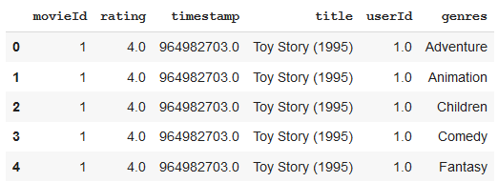
Data Set
20 genres
using ml small 2018 data set
~100000 movies
Exploded into multiple genres fore each movie

Slide 5
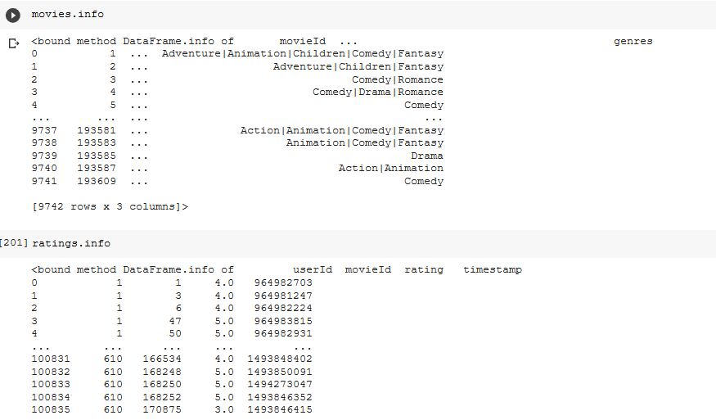

Slide 6
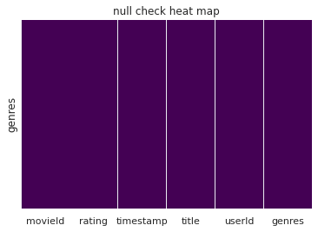
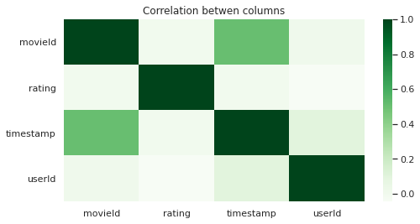

Slide 7
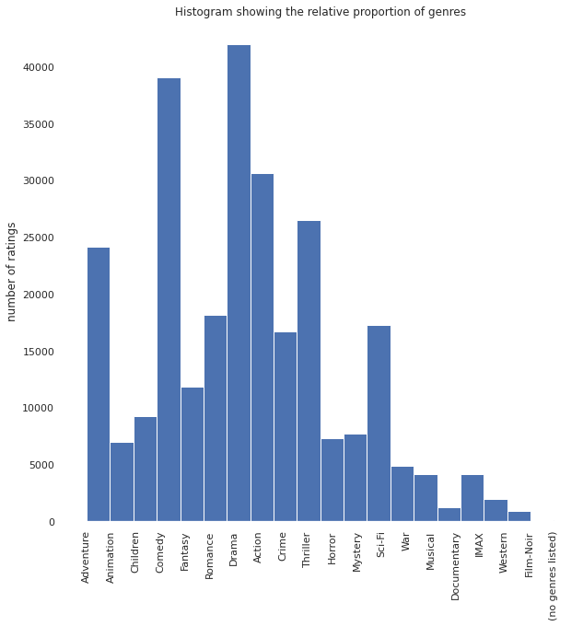
Exploration

Slide 8
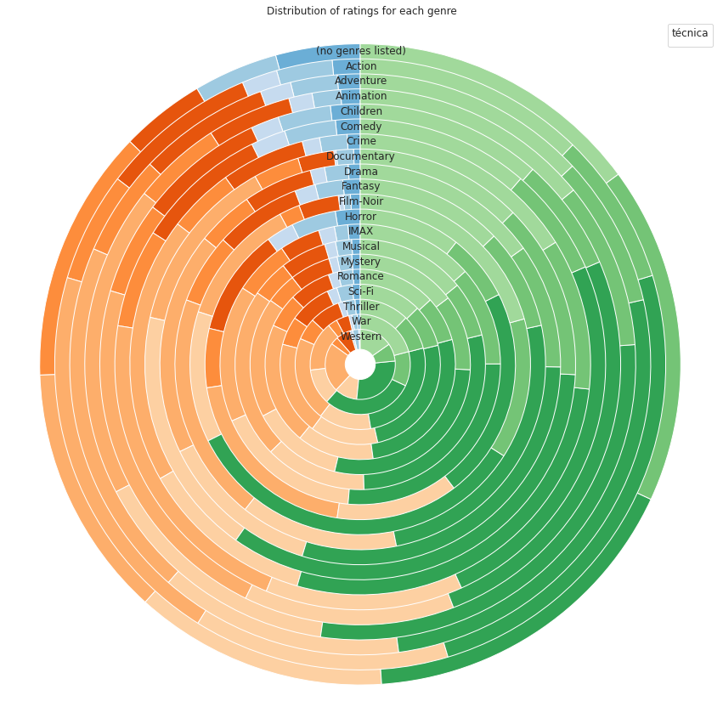
Stationarity

Slide 9
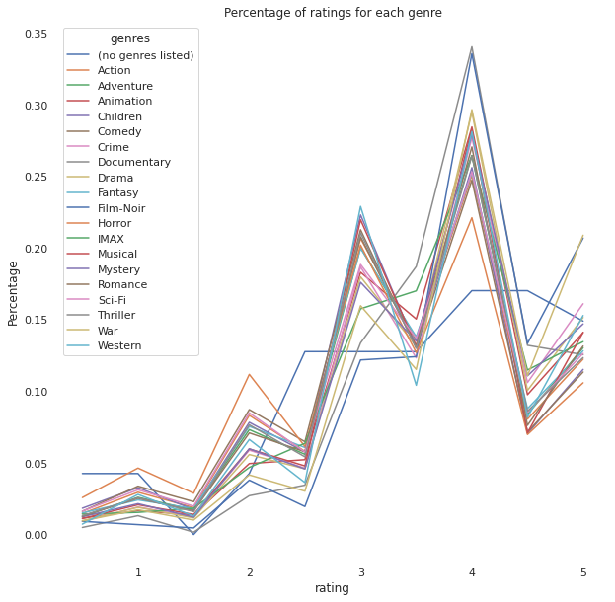

Slide 10
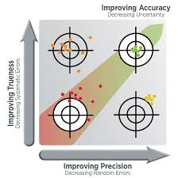
Summary
Conclusion
Means of the ratings is a simple and quick method
A more sophisticated method gives more accurate results

Slide 11

Thank you
Questions?

