Slide 1

Movie Ratings
Aydin Hasanli,Zi Yang, Evgeny Grobov, OPA Towobola
11 Dec 2020

Slide 2
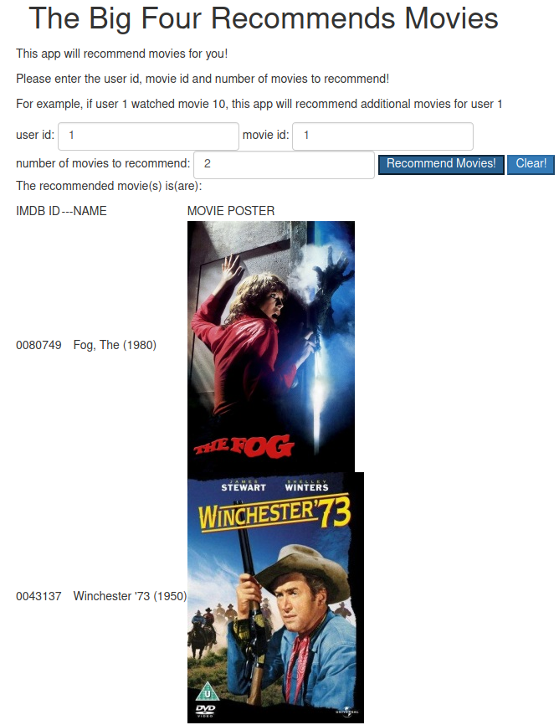

Slide 3

Overview
Exploration
Analysis
Results

Slide 4

Goals
Given a dataset
Determine a good recommender model
Make recommendations
Using a web-app inteface

Slide 5

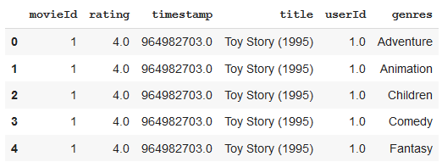
Data Set
20 genres
using ml small 2018 data set
~9742 movies
Exploded into multiple genres for each movie

Slide 6
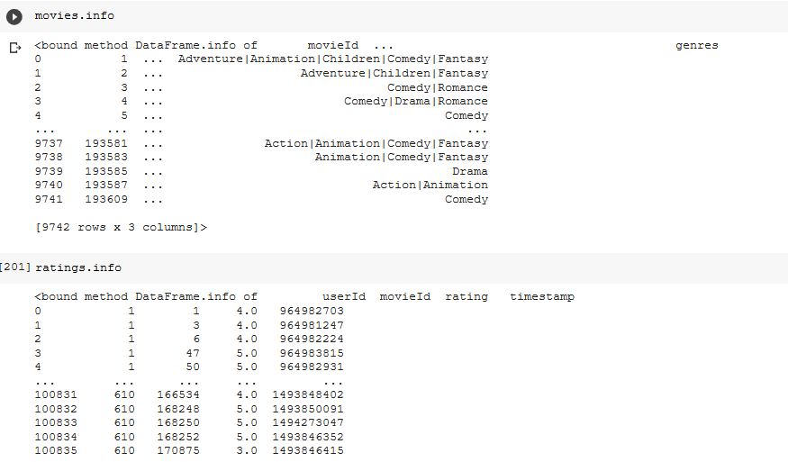

Slide 7
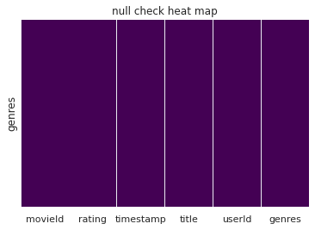
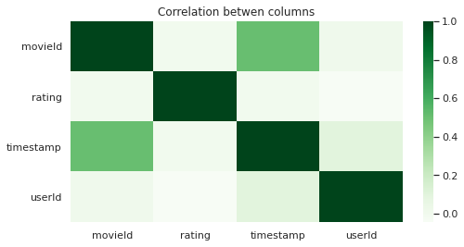
Search for nulls and correlation

Slide 8
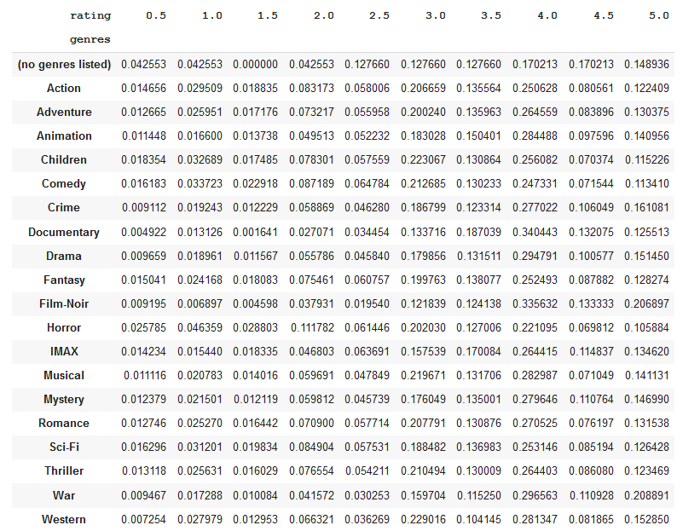

Slide 9
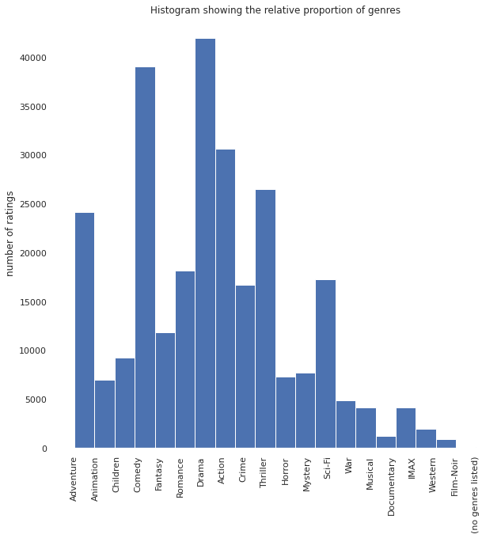

Exploration
Relative proportions

Slide 10
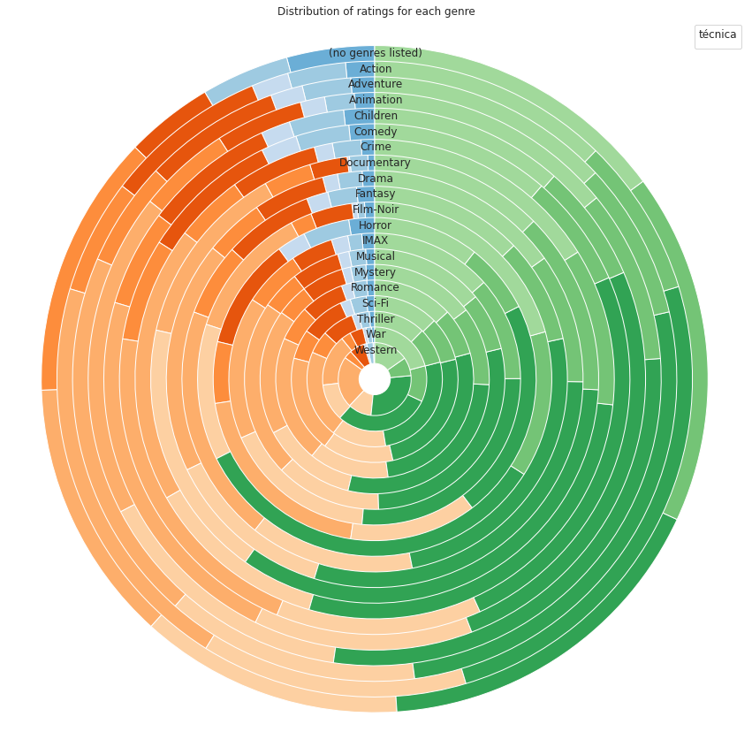
Stationarity

Slide 11
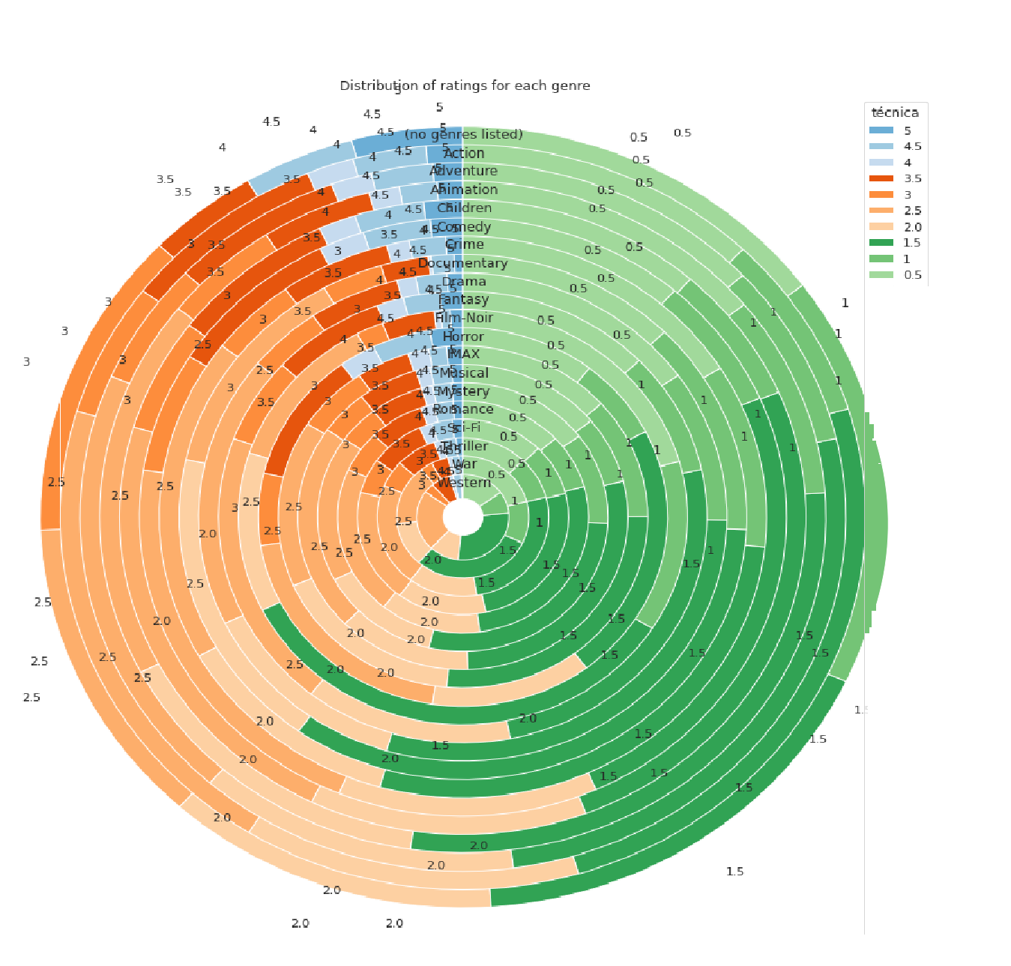

Slide 12
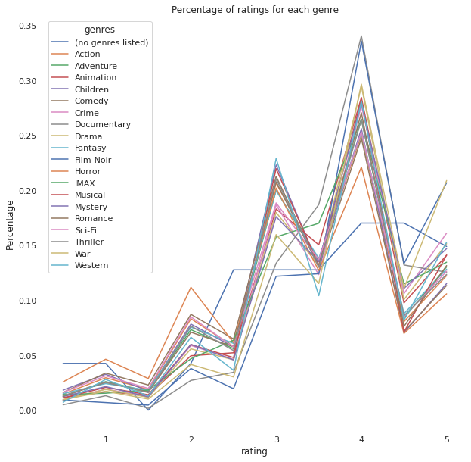

Slide 13
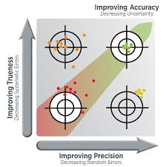
Summary
Conclusion
Means of the ratings is a simple and quick method
A more sophisticated method gives more accurate results

Slide 14

Thank you
Questions?

