Slide 1
Dynamic .NET Demystified
Keith Dahlby
@dahlbyk

Slide 2
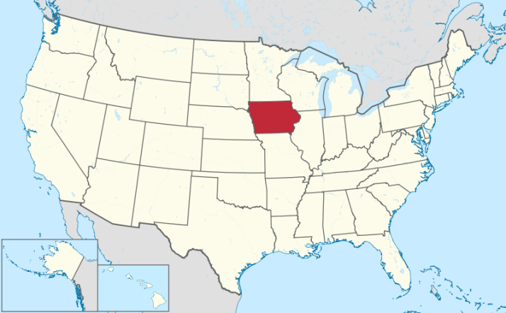




Who am I?

Slide 3
Dynamic .NET Demystified
This talk is not about:
This talk is about:
Static vs Dynamic
Iron* Languages
Using them
Building them
What the DLR is
How C# dynamic works
Interesting use cases

Slide 4
Controversy!
“Dynamic is the last nail in the coffin. C# is no longer a serious statically typed language…”
“Compile-time type checking is one of the hallmarks of a great statically-typed language.”
“C# is becoming less and less robust because of all of these shortcuts, the disaster started with var.”
“C# is strongly typed, let's stop pretending it isn't.”
“The purpose of strong type checking is not to save you from yourself, but to save you from incompetent coworkers.”
http://bit.ly/CSDynamicControversy

Slide 5
Static C#
int id = record.GetInt32( record.GetOrdinal("Id"));
new Discount( (int)xml.Attribute("Id"), (decimal)xml.Element("Amount"))
(int)ViewData["UserId"]

Slide 6
Better?
int id = record.Id;
new Discount( xml.Id, xml.Amount)
ViewBag.UserId

Slide 7
Dynamic .NET
Languages
Iron*
Runtime
Call Site Caching
Expression Trees
Objects
CLR
COM
C#
Dynamic Dispatch
Dynamic
VB.NET

Slide 8
Languages
Iron*
Visual Basic .NET since 7.0
Option Strict Off
Uses DLR since 10.0
C# since 4
dynamic

Slide 9

C# dynamic
Implicit: CLR → dynamic
dynamic foo = "bar";
Implicit: dynamic → CLR
string baz = foo;
Expression with dynamic is dynamic
var qux = foo + baz;

Slide 10

Dynamic Consuming Static
public static class Math {
public static decimal Abs(decimal value);
public static double Abs(double value);
public static float Abs(float value);
public static int Abs(int value);
public static long Abs(long value);
public static sbyte Abs(sbyte value);
public static short Abs(short value);
…
}
dynamic x = 2;
dynamic y = Math.Abs(x);
dynamic x = 1.75;
dynamic y = Math.Abs(x);
dynamic x = "2";
dynamic y = Math.Abs(x);

Slide 11

Static Consuming Dynamic
public static class DMath {
public static dynamic Abs(dynamic value) { if (value >= 0) return value; return -value; }
}
int x = 2;
int y = DMath.Abs(x);
double x = 1.75;
double y = DMath.Abs(x);
string x = "1.75";
string y = DMath.Abs(x);

Slide 12
dynamic Caveats
Limited dynamic conversion/coersion
No extension methods
Thus, using LINQ is tricky

Slide 13
You Write
static int Increment(dynamic x)
{
return x + 1;
}

Slide 14
Compiler Generates
static CallSite<Func<CallSite, object, int>> site1;
static CallSite<Func<CallSite, object, int, object>> site2;
[return: Dynamic]
static int Increment([Dynamic] object x) {
if (site1 == null)
site1 = CallSite<Func<CallSite, object, int>>.Create( Binder.Convert(…, typeof(int), …));
if (site2 == null)
site2 = CallSite<Func<CallSite, object, int, object>>.Create( Binder.BinaryOperation(…, ExpressionType.Add, …));
return site1.Target(site1, site2.Target(site2, x, 1));
}

Slide 15
System.Linq.Expressions v2
.NET 3.5 Expression Trees
Extra Expressions
++, --, ArrayAccess, Default, RefEqual, Unbox, etc
Assignment
=, +=, -=, *=, /=, %=, &=, |=, ^=, <<=, >>=, etc
Control flow
if, switch, for, break, return, throw, try…catch..finally, goto, label, etc
Dynamic dispatch
Full method bodies
Lambda Expressions

Slide 16
Factorial In C#
static dynamic fact(dynamic n) {
if (n == 0) {
return 1;
} else {
return n * fact(n - 1);
}
}
Parameter
n
Dynamic
CSharpOp[==]
Constant
0
If
Return
Constant
1
Parameter
n
Return
Dynamic
CSharpOp[*]
Parameter
n
MethodCall
Program.fact
Dynamic
CSharpOp[-]
Constant
1

Slide 17
Factorial In Python
def fact(n):
if n == 0:
return 1
else:
return n * fact(n - 1)
Parameter
n
Dynamic
PythonOp[==]
Constant
0
If
Return
Constant
1
Parameter
n
Property
Value
Field
$global.fact
Return
Dynamic
PythonOp[*]
Dynamic
PythonInvoke
Parameter
n
Dynamic
PythonOp[-]
Constant
1

Slide 18
Factorial In Ruby
def fact(n)
if n == 0
1
else
n * fact(n - 1)
end
end
Parameter
n
MethodCall
Ruby.IsTrue
Dynamic
RubyOp[==]
Constant
0
If
Constant
1
Parameter
n
Parameter
self
Dynamic
RubyOp[*]
Dynamic
RubyCall[fact]
Parameter
n
Dynamic
RubyOp[-]
Constant
1

Slide 19
Dynamic on CLR
ExpandoObject
Key-Value Pairs
Accessed as properties
DynamicObject
Abstract Base Class
IDynamicMetaObjectProvider
DynamicMetaObject GetMetaObject( Expression parameter)

Slide 20
Dynamic .NET In Action
http://bit.ly/dJ2BHa
http://ironpython.net/
http://ironruby.net/
http://ironjs.net/
http://code.google.com/p/impromptu-interface/
http://clay.codeplex.com/
https://github.com/dahlbyk/DNXml
http://www.microsoft.com/web/webmatrix/
https://github.com/robconery/massive
http://code.google.com/p/dapper-dot-net/
https://github.com/markrendle/Simple.Data

Slide 21
Resources
Dynamic .NET Projects: http://bit.ly/dJ2BHa
Most available on http://nuget.org/
http://github.com/dahlbyk/Presentations
@dahlbyk
http://keith.lostechies.com/

