Slide 1
Year in Preview: Advice From the 2013 Software Craftsmanship Calendar
Keith Dahlby
@dahlbyk

Slide 2



Who am I?
Iowa Native
Iowa State University
Cedar Rapids
ASP.NET MVC
Language Geek
Developer of posh-git (Git with PowerShell)

Slide 3
Who are you?

Slide 4


Slide 5


Slide 6


Slide 7


Slide 8


Slide 9


Slide 10


Slide 11


Slide 12


Slide 13


Slide 14


Slide 15
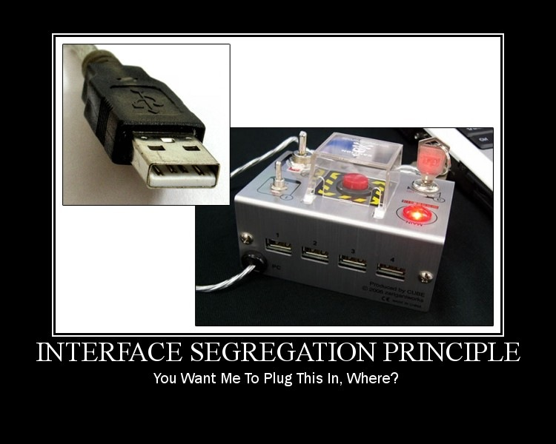

Slide 16


Slide 17


Slide 18
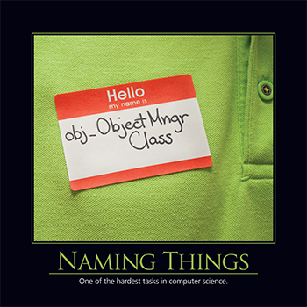

Slide 19


Slide 20


Slide 21


Slide 22
Credits
2013 Software Craftsmanship Calendar
http://gear.telerik.com/
Images from http://deviq.com/
Derick Bailey’s SOLID Motivational Posters
http://bit.ly/solid-posters

