Slide 1
Distributed Version Control: Attack of the Clones
Keith Dahlby
@dahlbyk

Slide 2




Who am I?
Iowa Native
Iowa State University
Cedar Rapids
ASP.NET MVC
jpcycles.com – we’re hiring!
Language Geek
Developer of posh-git (Git with PowerShell)

Slide 3
Who are you?

Slide 4
Centralized Version Control

Slide 5
Centralized Version Control

Slide 6
Centralized Version Control

Slide 7
Centralized Version Control
branches

Slide 8
Centralized Version Control

Slide 9
Distributed Version Control

Slide 10
Distributed Version Control

Slide 11
Distributed Version Control

Slide 12
Distributed Version Control

Slide 13
Distributed Version Control
branches

Slide 14
DVCS Operations

Slide 15
clone

Slide 16
push

Slide 17
pull (hg: fetch)

Slide 18
branch
HEAD
master
feature-a

Slide 19
commit
master
HEAD
feature-a
feature-b

Slide 20
checkout (hg: update)
master
HEAD
feature-a
feature-b

Slide 21
merge
HEAD
master
feature-a
feature-b

Slide 22
Demo
Git Started

Slide 23
Why Git is Better Than X
Bridges to SVN, TFS, VSS, Hg
Staging Area
Cheap Local Branches
Stashes
Rewriting History
Reflog
Bisect
http://whygitisbetterthanx.com/

Slide 24
Git to *
!Git

Slide 25
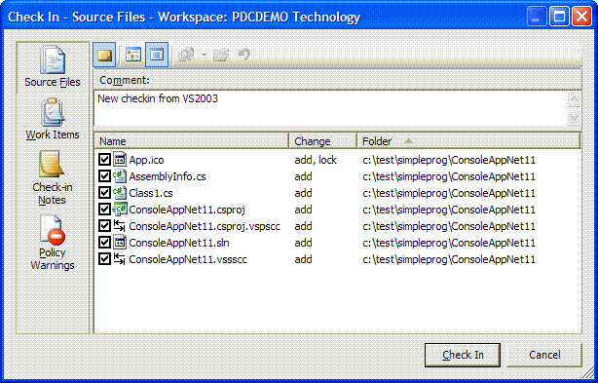
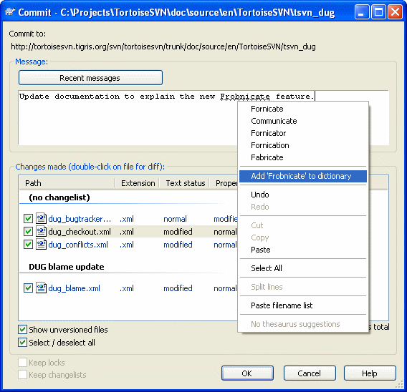
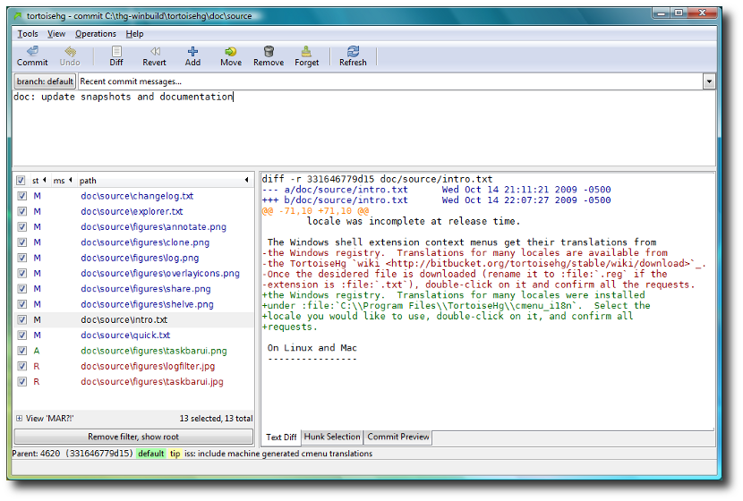
Staging Area

Slide 26
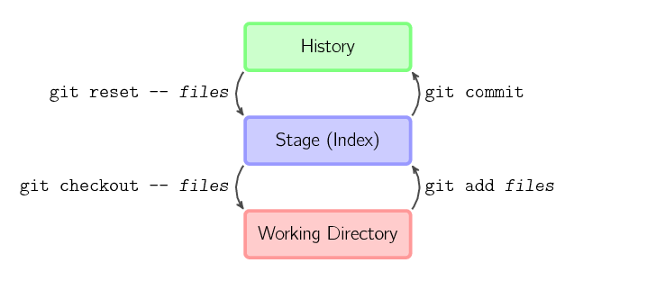
Staging Area

Slide 27
git add --patch
Overlapping logical changes to one file?
Reformatting
Refactoring
Changing functionality
Pick “hunks” (sections of diff) to stage
Key operations: y/n, a/d, s (split), e (edit)
Also:
git reset -p commit -- files
git checkout -p commit -- files

Slide 28
Demo
Patchwise Add

Slide 29
Branching
Keep master clean!
Create branch but stay where you are
git branch <name> <commit>
Switch to new branch
git checkout <commit> -b <name>
Branches to clean up
git branch --merged

Slide 30
git stash
Stash away work in progress
Preserves working directory & index
Typical workflow
Working on topic branch
git stash
Switch to other branch, hack away, switch back
git stash pop

Slide 31
Temporary Commits
Stays with branch
Works well with rebase
Typical workflow
Working on topic branch
git commit -m "WIP: Need impl"
Switch to other branch, hack away, switch back
git reset HEAD^

Slide 32
Rewriting History
Permanent when pushed
Until then, pretend you were perfect
Simple case: messed up last commit
git add -A
git commit --amend
alias.cia = commit --amend -C HEAD
git cia -a --reset-author

Slide 33
git cherry-pick
Applies changeset(s) elsewhere
Commit to wrong branch?
… working on wrong-branch…
git checkout correct-branch
git cherry-pick wrong-branch
git checkout wrong-branch
git reset --hard HEAD^

Slide 34
git rebase
Replay commits
A---B---C topic
/
D---E---F---B' master, HEAD
git rebase master topic
A'--C' topic, HEAD
/
D---E---F---B' master

Slide 35
git rebase --interactive
Replay history with modifications
A---B---C topic, HEAD
/
D---E master
git rebase -i master
C'---(A+B)' topic, HEAD
/
D---E master

Slide 36
Demo
Interactive Rebase

Slide 37
git rebase -i --autosquash
git commit -m "Do something"
… work, another commit …
… stage work to fix "Do something" …
git commit -m "fixup! Do something"
git rebase -i --autosquash HEAD~3
Updates todo list for us
Moves fixup! after first commit; marks as fixup
rebase.autosquash = true

Slide 38
Fixing “Oops”

Slide 39
git reflog
Uh oh…where’d my commit go?
ls -r .git/logs
HEAD, heads, remotes
> git reflog --all
c66d5f9 refs/heads/dev2@{0}: branch: Created from origin/dev2
1df4b7e refs/heads/master@{0}: push
b6e3739 refs/remotes/origin/dev1@{0}: update by push
2c2c892 refs/remotes/origin/dev1@{1}: fetch origin: forced-update
69dcefd refs/remotes/origin/dev1@{2}: update by push
954fa68 refs/remotes/origin/dev1@{3}: pull : fast-forward
0234a69 refs/remotes/origin/dev1@{4}: pull origin: storing head
8de4df0 refs/heads/master@{1}: pull origin: Fast-forward
66e2e5f refs/heads/tiny74@{0}: commit: WIP

Slide 40
Finding Bugs

Slide 41
git bisect
Binary search through commit space
Good
Good/Bad?
Bad
Good
Good/Bad?
Bad
Good
Good/Bad?
Bad
Good
Oldest Bad!

Slide 42
git bisect
> git bisect start
> git bisect bad new-commit
> git bisect good old-commit
Bisecting: 4 revisions left to test after this
> git bisect bad
Bisecting: 2 revisions left to test after this
> git bisect good
Bisecting: 0 revisions left to test after this
> git bisect bad
5087d6… is the first bad commit
> git bisect reset

Slide 43
Review
Bridge to SVN, TFS, VSS, Hg
Staging Area
Patchwise add/reset/checkout
Stashes and WIP commits
Interactive rebase
Oops? reflog
Bugs? bisect

Slide 44
Resources
http://git-scm.com/
http://gitref.org/
http://gitready.com/
http://progit.org/
http://github.com/dahlbyk/posh-git
http://bit.ly/better-git-svn
Me
http://keith.lostechies.com/
dahlbyk@gmail.com
@dahlbyk

