Slide 1
What’s New in C# 4 & VB 10
Keith Dahlby
http://solutionizing.net/
@dahlbyk

Slide 2


Who am I?
Iowa Native
Iowa State University
Cedar Rapids
SharePoint → ASP.NET MVC
J&P Cycles
Language Geek

Slide 3
Agenda
Embedded Interop Types
Language Parity
Generic Variance
Dynamic Language Runtime

Slide 4
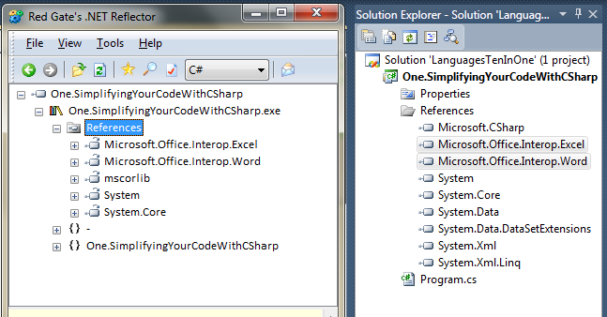
Embedded Interop Types

Slide 5
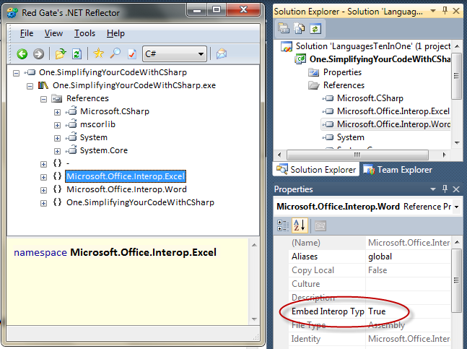
Embedded Interop Types

Slide 6
Language Parity
VB: Lambda Expressions
VB: Auto-implemented Properties
VB: Implicit Line Continuations
VB: Collection Initializers
VB: Array Literals
VB: Nullable Optional Parameters
C#: Named/Optional Parameters

Slide 7
Lambda Expressions Review
Anonymous delegate
Func<int, string> f = i => i.ToString();
var s = f(1); // "1"
Expression tree
Expression<Func<int, string>> e = i => i.ToString()
var t = e.Parameters[0].Type; // Int32

Slide 8
Lambda Expressions – VB 9
Function (x) x + 1

Slide 9
Lambda Expressions – C# 3.0
x => x + 1
x => { return x + 1; }
x => Console.WriteLine(x)
x => { Console.WriteLine(x); }

Slide 10
Lambda Expressions – VB 10
Function (x) x + 1
Function (x) Return x + 1 End Function
Sub (x) Console.WriteLine(x)
Sub (x) Console.WriteLine(x) End Sub

Slide 11
Auto-Implemented Properties
public int Id { get; set; }
Compiles into… private int <Id>k__BackingField; public int Id { get { return <Id>k__BackingField; } set { <Id>k__BackingField = value; } }

Slide 12
Auto-Implemented Properties
Property Id() As Integer = -1
Compiles into… Private _Id As Integer = -1 Property Id() As Integer Get Return _Id End Get Set(ByVal value As Integer) _Id = Value End Set End Property

Slide 13
Auto-Prop Caveats
Cannot be ReadOnly or WriteOnly
Cannot mix access levels
C# can: { get; protected set; }

Slide 14
Implicit Line Continuations
After a comma
After a dot (member access)
After a binary operator (+, =, +=, &, And, etc)
After a LINQ query clause
After a (, {, or <%=
Before a (, }, or %>

Slide 15
Collection Initializers
Dim list = New List(Of String) From { "abc", "def", "ghi" }
Dim dict = New Dictionary( Of Integer, String) From { {1, "abc"}, {2, "def"}, {3, "ghi"} }
Compiled as calls to Add() method or extension

Slide 16
Array Literals
Type is inferred if possible
Dim a = {1, 2, 3}
Dim b = {"1", "2", "3"}
Dim c = {1, "2", 3.0} ' What type?

Slide 17
Nullable Optional Parameters
Sub Add( x As Integer, y As Integer, Optional z As Integer? = 0) …

Slide 18
Visual Basic 10 Review
Property Ids() As List(Of Integer) =
New List(Of Integer) From {
1, 2, 3, 4
}
Public Sub New(Optional ByVal i As Integer? = 0)
If i.HasValue Then
Ids.Add(i)
End If
Dim moreIds = {5, 6, 7}
Ids.AddRange(moreIds)
End Sub
Auto-implemented property
Collection initializer
Implicit line continuations
Nullable optional parameters
Array literal

Slide 19
C# Named/Optional Params
void MyMethod( string myString = "", int myInt = 1, double myDub = 0.1) { … }
MyMethod( myDub: -0.1, myString: "neat" );
Caveat: default value is compiled as attribute
Same implementation as Visual Basic always had

Slide 20
Type Variance
Ordering of types for equivalence
Covariant = using narrower as wider
Contravariant = using wider as narrower
Invariant = no conversion
These work on CLR 2:
object o = "my string";
object[] a = new string[] { "my string" };
These don’t:
IEnumerable<object> s = new List<string> { "" };
Action<XElement> a = (XNode n) => n.Remove();

Slide 21
Generic Variance
Covariance (substitute wider type for narrower)
interface IEnumerable<out T>
IEnumerable<string> ss = new List<string> { "" };
IEnumerable<object> so = ss;
Contravariance (substitute narrower type as wider)
interface IComparer<in T>
IComparer<XObject> co = new XObjectComparer();
IComparer<XElement> ce = co;
Both!! (don’t try this at home)
delegate TResult Func<in TArg, out TResult>(TArg arg)
Func<string, object> f = (object o) => o.ToString();

Slide 22
Generic Variance Caveats
Interfaces and delegates only – no classes or structs
List<object> s = new List<string> { "" }; // Error
Not valid for all interfaces
IList<T> uses T both for input and output – must be invariant
IList<object> s = new List<string> { 1 }; // Error
Variance requires reference conversion
IEnumerable<object> s = new List<int> { 1 }; // Error

Slide 23
Intermission

Slide 24
Dynamic vs. Static
Dynamic Languages
Static Languages
Robust
Simple and succinct
Intelligent tools
Implicitly typed
Meta-programming
No compilation
Performant
Better scaling

Slide 25
Diverse Object Models
C# and Visual Basic were designed to work great with .NET’s strongly-typed libraries.
However, there are many other object models out there that rely on specific features from their original target language!
C#
Visual Basic
HTML DOM
.NET BCL
COM
Python Libs

Slide 26
Static
J(ava)Script
C# 3.0
var loc = new VELatLong(lat, long);
var pin = map.AddPushpin(loc);
pin.SetTitle(title);
pin.SetDescription(description);
map.SetCenterAndZoom(loc, 7);
var loc = win.CreateInstance("VELatLong", lat, long);
var pin = (ScriptObject)map.Invoke("AddPushpin", loc);
pin.Invoke("SetTitle", title);
pin.Invoke("SetDescription", description);
map.Invoke("SetCenterAndZoom", loc, 7);

Slide 27
Dynamic
J(ava)Script
C# 4
var loc = new VELatLong(lat, long);
var pin = map.AddPushpin(loc);
pin.SetTitle(title);
pin.SetDescription(description);
map.SetCenterAndZoom(loc, 7);
var loc = win.CreateInstance("VELatLong", lat, long);
var pin = loc.AddPushpin(loc);
pin.SetTitle(title);
pin.SetDescription(description);
map.SetCenterAndZoom(loc, 7);

Slide 28





.NET Dynamic Programming
IronPython
IronRuby
C#
VB.NET
Others…
Dynamic Language Runtime
Dynamic Dispatch
Expression Trees
Call Site Caching
Object Binder
JavaScript Binder
Python Binder
Ruby Binder
COM Binder

Slide 29
Dynamically Typed Objects
Calculator calc = GetCalculator();
int sum = calc.Add(10, 20);
object calc = GetCalculator();
Type calcType = calc.GetType();
object res = calcType.InvokeMember("Add",
BindingFlags.InvokeMethod, null,
new object[] { 10, 20 });
int sum = Convert.ToInt32(res);
ScriptObject calc = GetCalculator();
object res = calc.Invoke("Add", 10, 20);
int sum = Convert.ToInt32(res);
Statically typed to be dynamic
dynamic calc = GetCalculator();
int sum = calc.Add(10, 20);
Dynamic conversion
Dynamic method invocation

Slide 30
dynamic vs var
var is inferred static type
Known at compile-time
Equivalent to using name of type
dynamic is static late-bound type
Compiled as type Object with dynamic dispatch
void CanButDont(dynamic value) { var inferMePlz = value; }
Statically inferred as dynamic

Slide 31
Static Consuming Dynamic
public static class DMath
{
public static dynamic Abs(dynamic value) { if (value >= 0) return value; return -value; } }
Dynamic invocation
Dynamic invocation
Implicit cast to dynamic
double x = 1.75;
double y = DMath.Abs(x);
Implicit cast from dynamic
int x = 2;
int y = DMath.Abs(x);

Slide 32
Dynamic Consuming Static
public static class Math
{
public static decimal Abs(decimal value);
public static double Abs(double value);
public static float Abs(float value);
public static int Abs(int value);
public static long Abs(long value);
public static sbyte Abs(sbyte value);
public static short Abs(short value);
...
}
Method chosen at compile-time: double Abs(double x)
double x = 1.75;
double y = Math.Abs(x);
Method chosen at run-time: double Abs(double x)
dynamic x = 1.75;
dynamic y = Math.Abs(x);
Method chosen at run-time: int Abs(int x)
dynamic x = 2;
dynamic y = Math.Abs(x);

Slide 33
dynamic in a Nutshell
Implicit: CLR → dynamic
Implicit: dynamic → CLR
Any expression using dynamic is dynamically evaluated
Static type of dynamically-evaluated expression is dynamic

Slide 34
Dynamic in Visual Basic 10
Dynamic dispatch is not new:
Option Strict Off
Pre-.NET: Variant
Single type to allow multiples
In .NET that’s Object
VBx (10) Uses DLR for Late Binding

Slide 35
Introducing dynamic

Slide 36
Creating Dynamic Objects
ExpandoObject
Key-Value Pairs
Accessed as properties
DynamicObject
Abstract Base Class
IDynamicMetaObjectProvider
DynamicMetaObject GetMetaObject( Expression parameter)

Slide 37
Creating Dynamic Objects

Slide 38
.NET Dynamic Programming
IronPython
IronRuby
C#
VB.NET
Others…
Dynamic Language Runtime
Dynamic Dispatch
Expression Trees
Call Site Caching
Object Binder
JavaScript Binder
Python Binder
Ruby Binder
COM Binder

Slide 39
Resources
PDC on Channel 9
http://channel9.msdn.com/tags/Languages/
C# in Depth, 2nd Edition by Jon Skeet (Manning EAP)
Bart De Smet – Microsoft Language Geek
http://community.bartdesmet.net/blogs/bart/
Me
http://solutionizing.net/
keith@ ---^
@dahlbyk

